Slide 1
Silverfish Safe Passage System
Human and AI Intervention
By Carlo Lipizzi, Sanika Mhadgut, Krutin Rathod, Devam Mondal

Slide 2
Introduction
The evaluation of the Silverfish Safe Passage System aimed to determine the necessity of human intervention by examining various factors that affect AI and human accuracy.
Through a series of statistical tests, including paired t-tests and ANOVA, we investigated the differences in performance between AI and human operators.
The findings reveal critical insights into how terrain types and environmental conditions influence detection capabilities, providing a foundation for further improvements and understanding of the system.
Through these findings, we aim to provide users of the systems a way to easily conduct decision-making through an interactive dashboard.

Slide 3
Summary of Past Results
Grassy Terrain
Rocky Terrain
Wooded Terrain
Both AI and humans maintain high accuracy, with minimal performance drops. AI accuracy generally around 0.95 to 0.96, while human accuracy ranges from 0.85 to 0.90.
Significant performance drops for both AI and humans, indicating this terrain poses challenges. AI accuracy varies from 44% to 75%, while human accuracy generally around 70%.
Notable drops in performance for both AI and humans, suggesting dense vegetation impacts detection abilities. AI accuracy is around 0.56 to 0.57, while humans show significant drops to 0.56.

Slide 4
Refined Approach
Statistical metrics calculated provide great basis for decision making but must be delivered in an interactive way to users.
Thus, we consider the solution of providing an interactive dashboard that allows the user to advance the UAV/UGV based on given statistics for the provided condition.
Enables a solution that balances risk-based monitoring and management with autonomy.

Slide 5
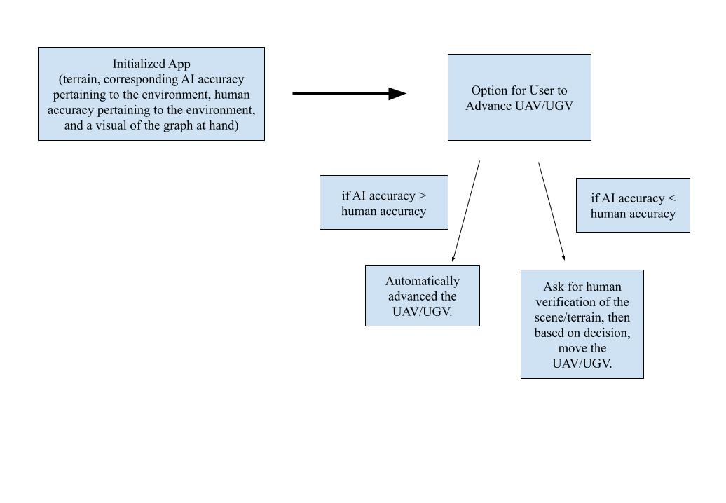
The Workflow

Slide 6
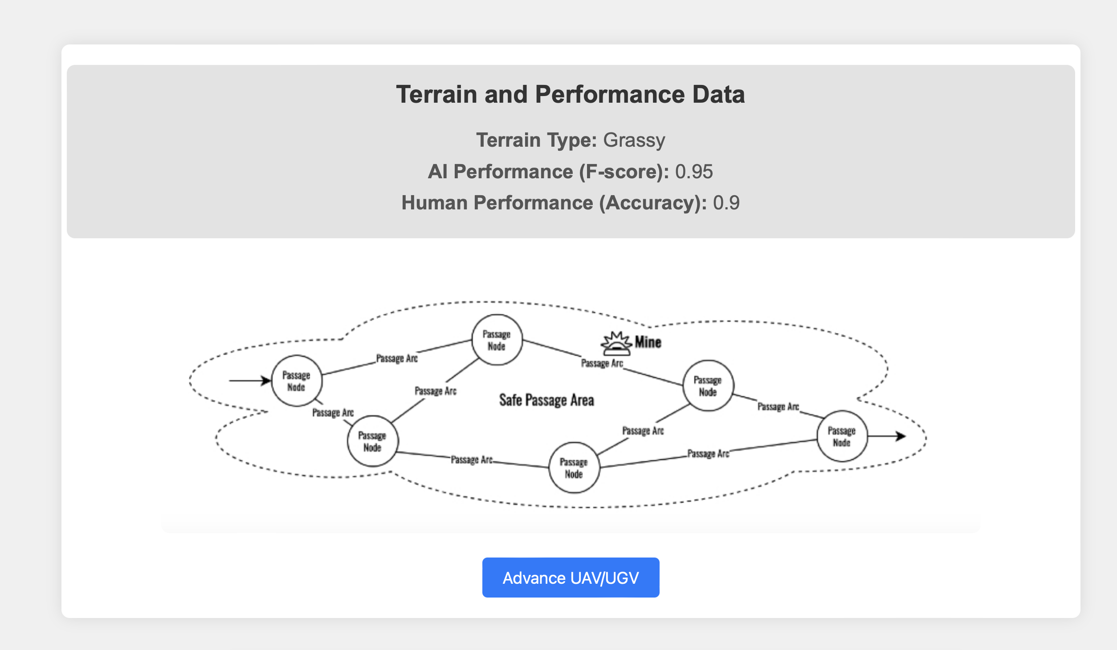
The App

Slide 7
Advantages of this Approach
Simple infrastructure: a dashboard with corresponding statistical tests ran on all permutations on environment/terrains.
Can therefore be readily adopted by others.
Design pattern and risk-based monitoring and management done through a human-in-the-loop system with partial automation backed by statistics.
Quantitative methods for assured performance: comparison of statistics calculated across a variety of environment/terrains.
Best practices: allow human intervention when necessary (when human accuracy is lower than the AI accuracy).
Future plans:
Employ a kill-chain strategy to keep track of all past graph traversals and use that as a way to caution the user (if 85% of past traversals in rainy weather had a mine present at Node A, automatically skip at that location).

