Slide 1
Microsoft Excel and Visualization Training.
11/10/2021
Tshering Tashi,

Slide 2
Data Analysis.
Learn different forms of data analysis.
Learn best practices and approaches to data analysis.
Learn to use excel to perform data analysis.
Create interactive dashboards.

Slide 3
Content:
Key matrics
Comparison analysis
Trend analysis
Rankin analysis
Frequency analysis
Pareto a
Variance a
Correlation analysis

Slide 4
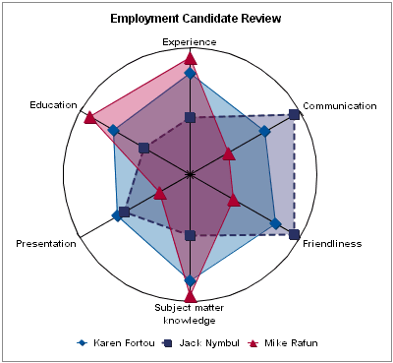

Slide 5
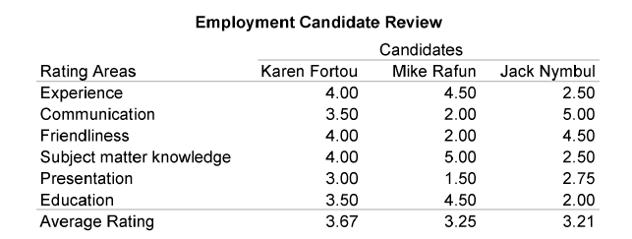

Slide 6
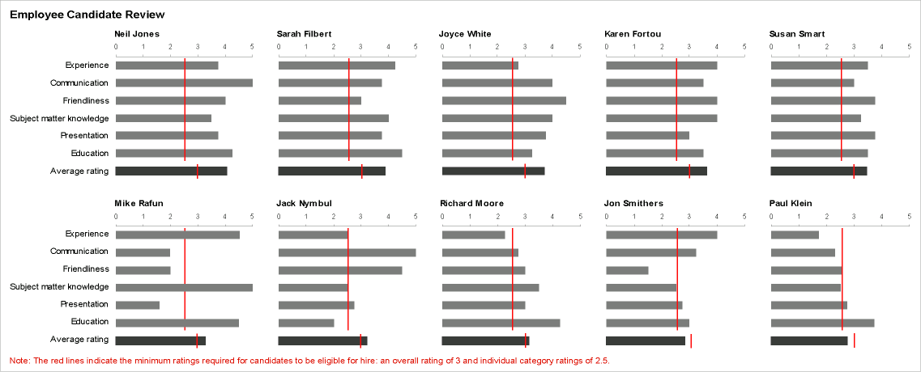

Slide 7
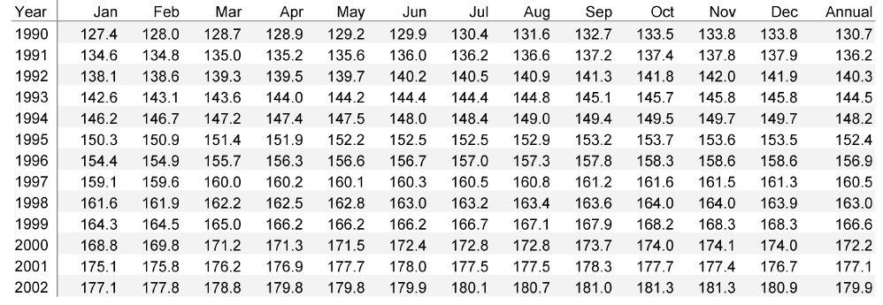

Slide 8
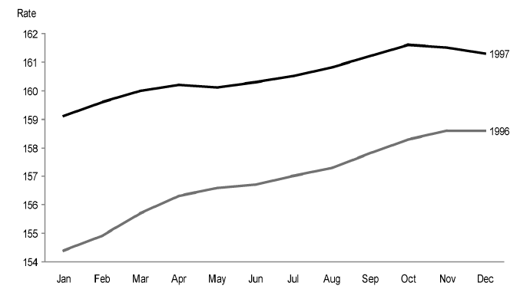

Slide 9
SEVEN QUANTITATIVE GRAPHS
Ranking
Deviation
Correlation
Time-Series
Part-to-Whole
Distribution
Nominal Comparison

Slide 10
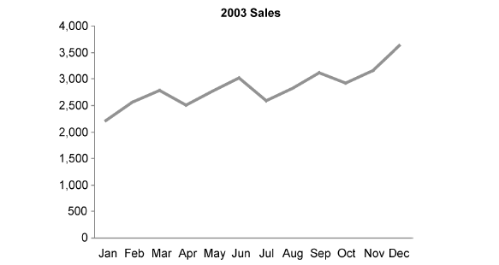
Time-series relationship

Slide 11
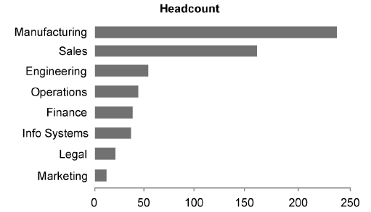
Ranking relationship

Slide 12
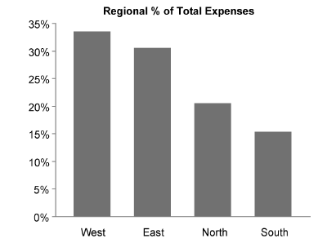
Part to Whole

Slide 13
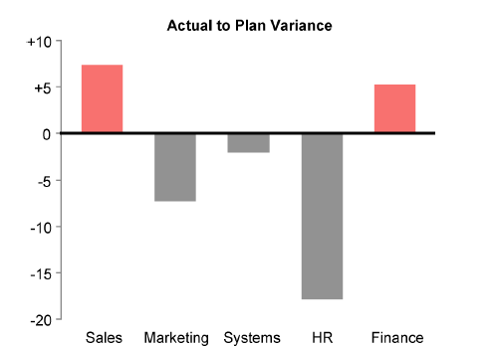
Deviation Relationships

Slide 14
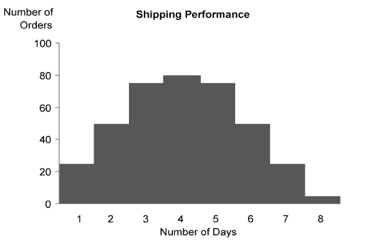
Distribution Relationships

Slide 15
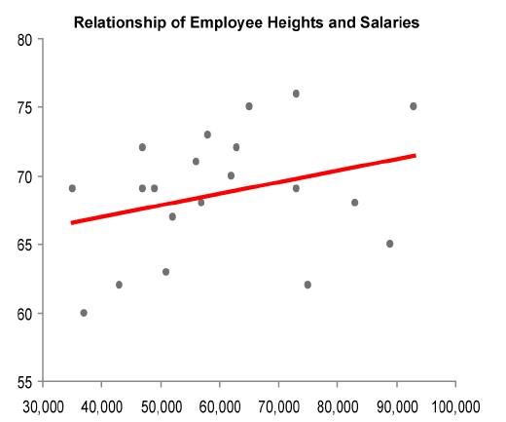
Correlation Relationships

Slide 16
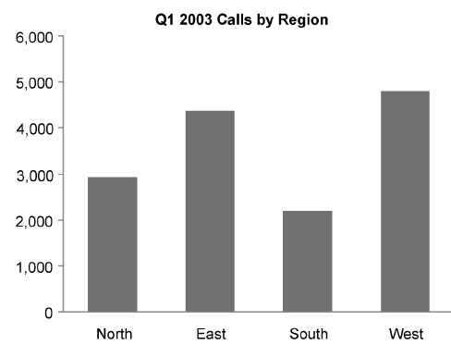
Nominal Comparison Relationships

Slide 17
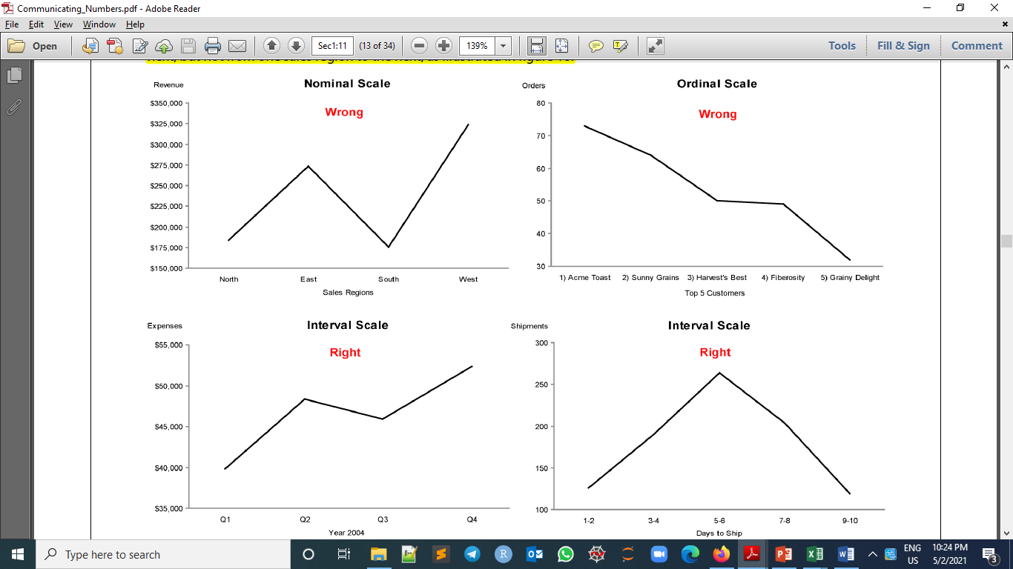

Slide 21
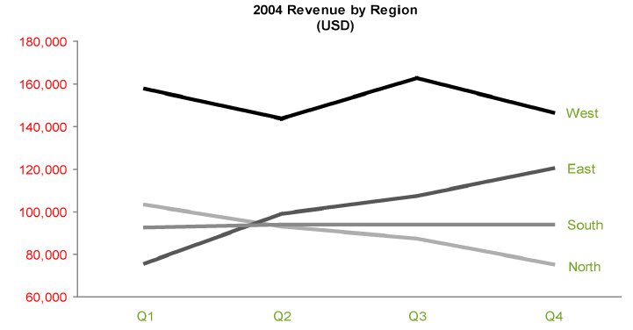

Slide 22
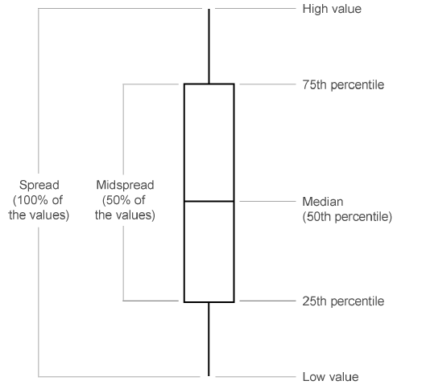
Box plot

