Slide 1
Microsoft Excel and Visualization Training.
5/05/2021
Tshering Tashi,
RPD, BoB

Slide 2
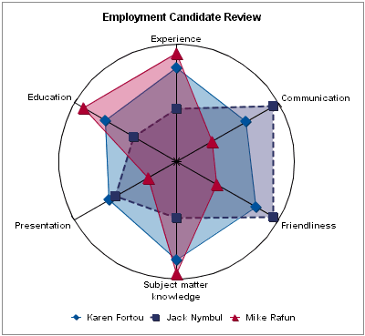

Slide 3
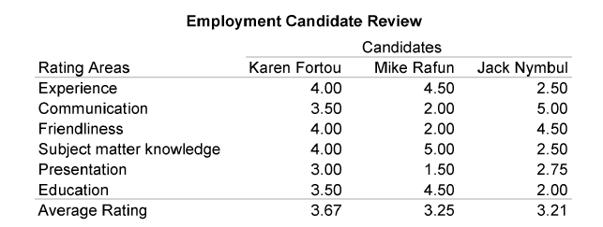

Slide 4
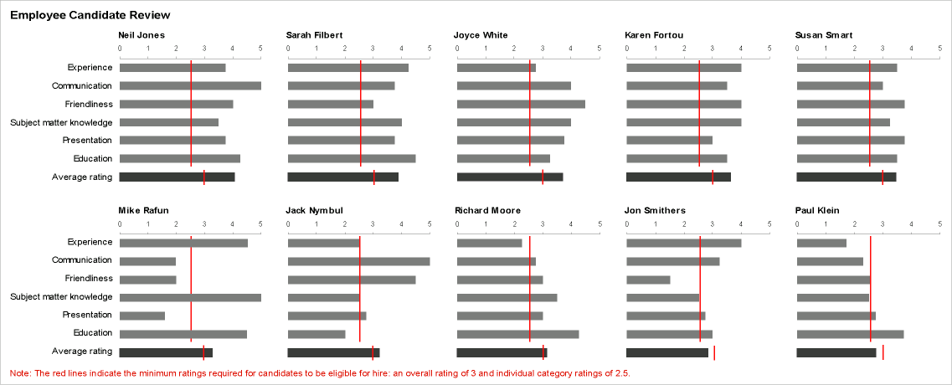

Slide 5
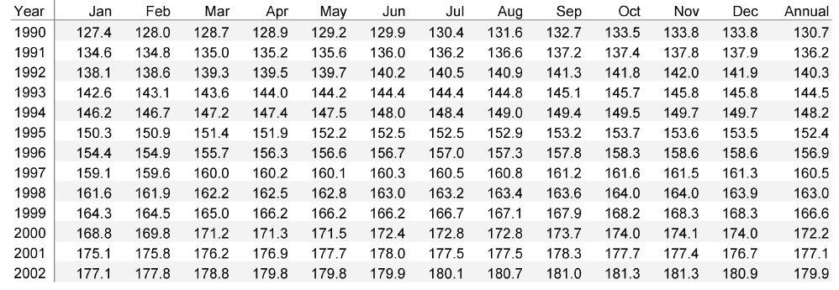

Slide 6
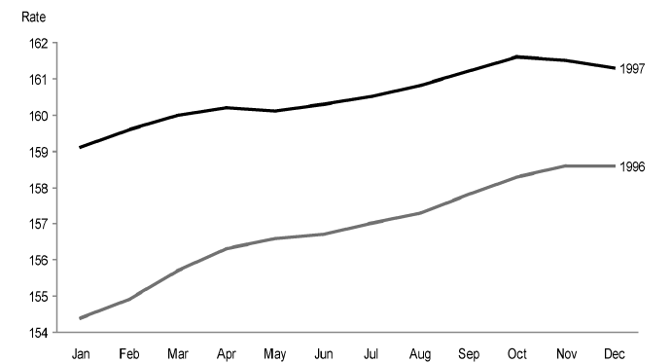

Slide 7
SEVEN QUANTITATIVE GRAPHS
Ranking
Deviation
Correlation
Time-Series
Part-to-Whole
Distribution
Nominal Comparison

Slide 8
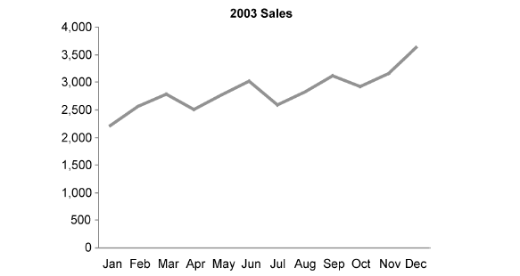
Time-series relationship

Slide 9
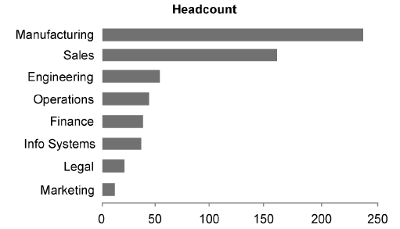
Ranking relationship

Slide 10
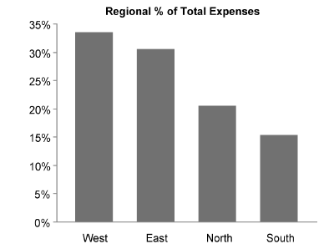
Part to Whole

Slide 11
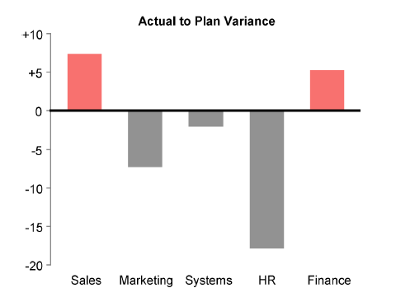
Deviation Relationships

Slide 12
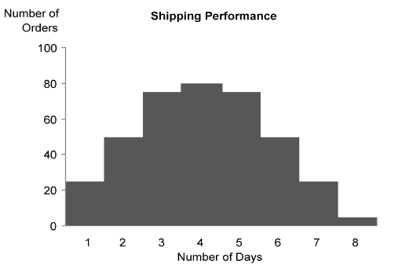
Distribution Relationships

Slide 13
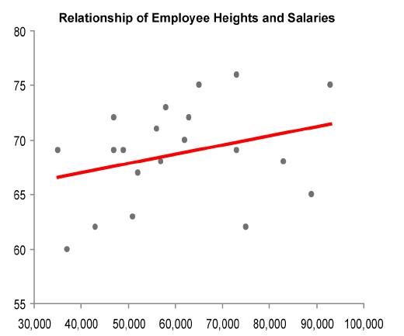
Correlation Relationships

Slide 14
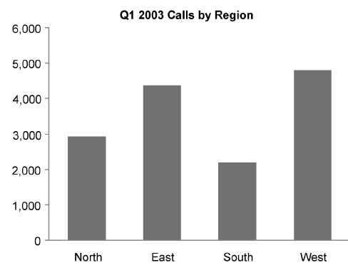
Nominal Comparison Relationships

Slide 15
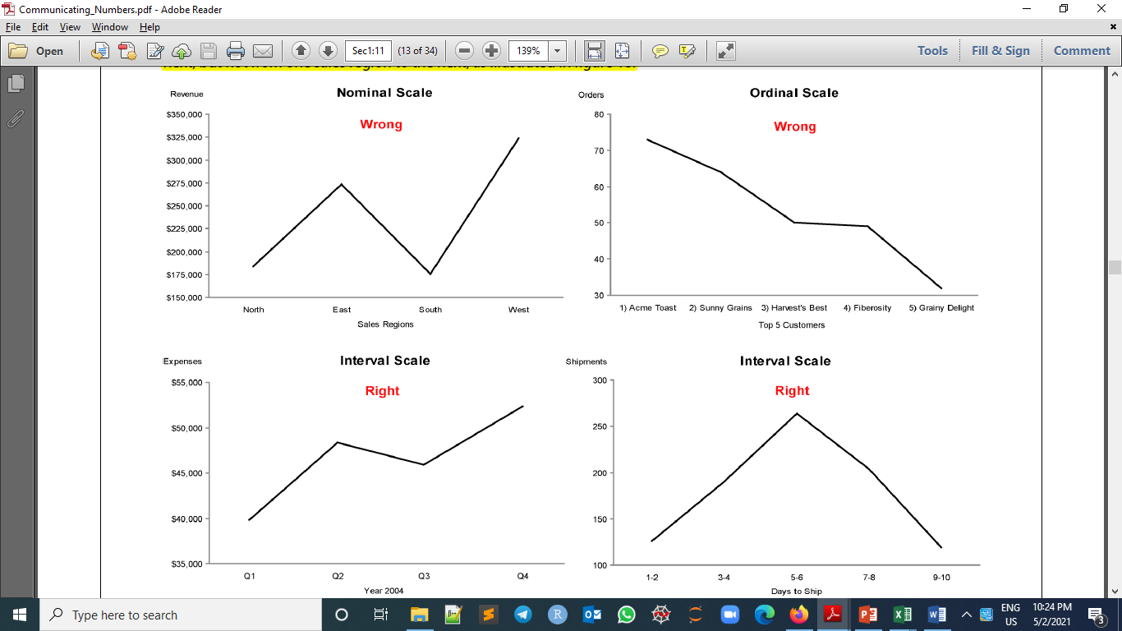

Slide 19
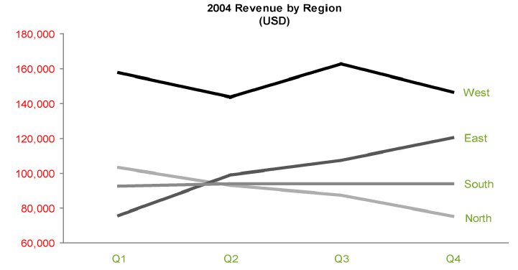

Slide 20
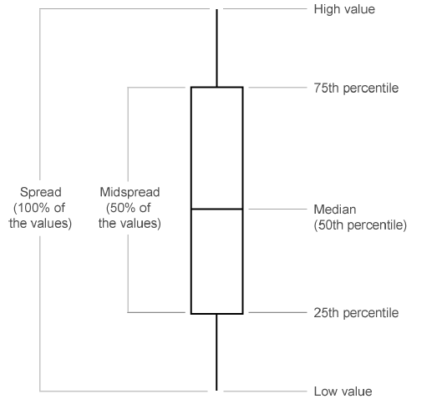
Box plot

