Slide 1

Technology Operations
Computer Hardware
Session 1
Tutor: Tshewang Dhendup

Slide 2
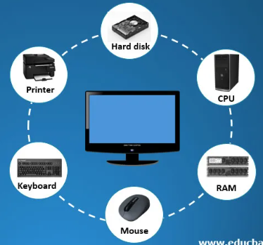

Computer Hardware
Learning Objectives:
At the end of the lesson, you should be able to:
define the term hardware with examples.
classify input, output, and storage devices as external hardware.
differentiate internal and external hardware based on location and function.

Slide 3
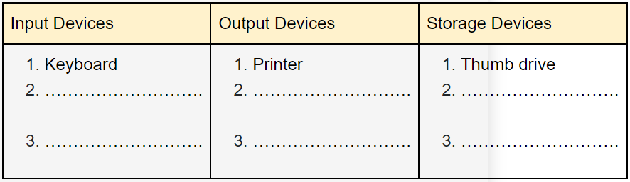
Computer Hardware
Introduction
Move around the computer laboratory and identify the different types of devices you see. Use the table below to list the devices in three categories - input, output, and storage. One example is given in the table.

Slide 4
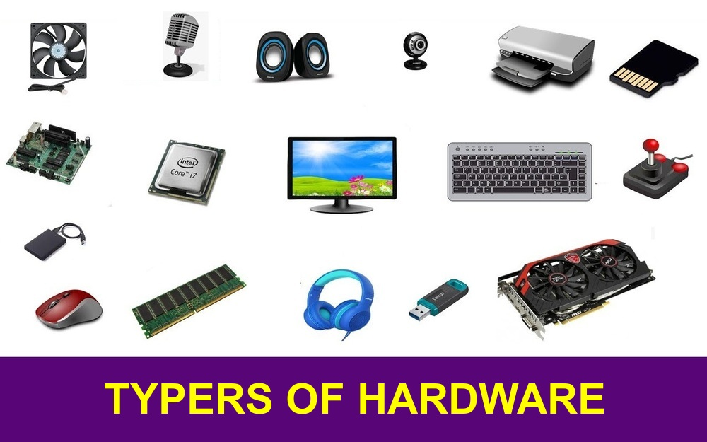
Computer Hardware
What is hardware?
Hardware is a computer device that can be seen and touched.
All input, output and storage devices are computer hardware.
Example, Central Processing Unit (CPU), Random Access Memory (RAM), Hard Disk Drive (HDD)
Two types of hardware:
Internal hardware
External hardware
Watch the video
(https://www.youtube.com/watch?v=SSnNY8GfZig) explaining internal and external hardware with pictures.

Slide 5
Computer Hardware
Internal hardware:
This refers to the hardware components that are installed inside the computer system.
Example: motherboard, CPU, RAM, hard drive, and power supply unit.
These components are essential to the functioning of the computer and cannot be removed without affecting its performance.

Slide 6
Computer Hardware
External hardware:
This refers to the hardware components that are connected to the computer system through ports or cables.
Example: keyboard, mouse, printer, scanner, monitor, and speakers.
These components can be easily removed and replaced without affecting the functioning of the computer, and they are used to input or output data from the computer system.

Slide 7
Home Work
Explore more on the difference between internal and external hardware by going through the following online resources.
https://brainly.in/question/3870790
https://openbookproject.net/courses/intro2ict/hardware/internal.html
https://sites.google.com/site/computertechnologytimeline2/home/external-and-internal-computer-components
List at least two differences between internal and external hardware by using the table given below on the next page.

Slide 8
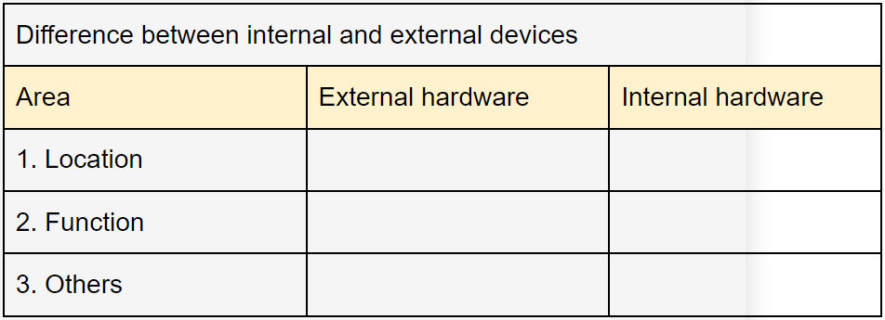
Home Work

Slide 9
Home Work
Do It Yourself:
Follow the link https://wordwall.net/resource/10827661/computing/parts-of-a-computer on the game to identify internal hardware to play individually at home or during free time. Record the score and redo the game until you get a full score of 11 points.
Watch the video titled “Inside the computer” https://www.youtube.com/watch?v=HB4I2CgkcCo to learn more about internal hardware. Take note of at least two key points from the video in your notebook.

