Slide 1

Technology Operation
Using Keyboard
Session 1
Tutor: Tshewang Dhendup

Slide 2
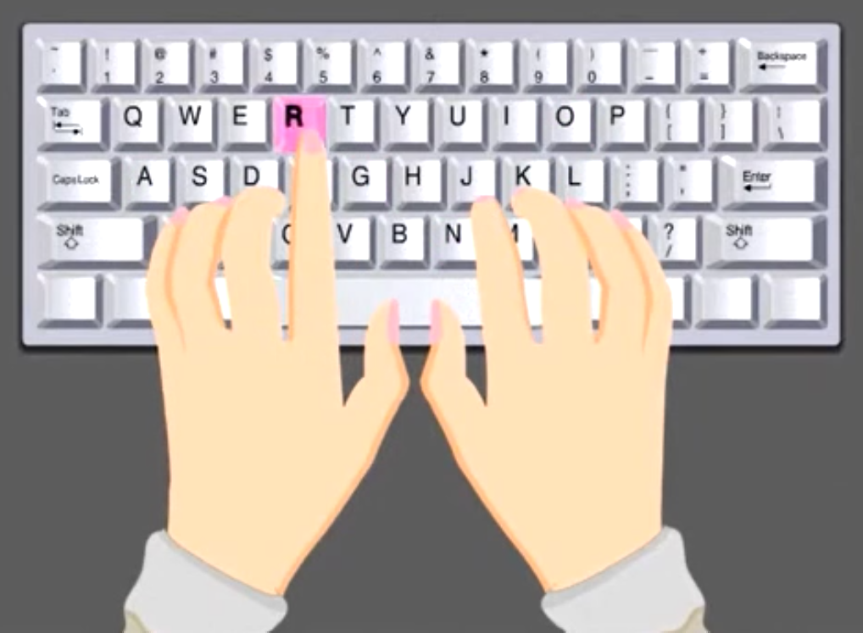

Online Typing Tutor
Learning Objectives:
At the end of the lesson, you should be able to:
use ten-finger positions properly while typing.
position the right hand and left hand correctly while typing.
complete online typing lessons from 89 to 112.

Slide 3
Using Keyboard
Keyboard:
Keyboard is an important part of computer.
It has different types of keys (Key is a button on the keyboard.)
Use of keyboard:
Keyboard are use to type letters, numbers and punctuation marks.
Different types of keys and their usage:
Alphabet keys: are use to type letters.
Number keys: are use to type numbers.
Punction keys: are use to type punctuation marks.
Other types of keys include space bar, enter or return, backspace, delate, shift, caps lock. (for more on this refer text book pg. 26)

Slide 4
Online Typing Tutor
What is a online typing tutor?:
Online Typing tutors are software or online programs that help people improve their typing skills.
TypingClub:
Typing Club is an online typing tutor used to improve their typing skills through a series of lessons.

Slide 5
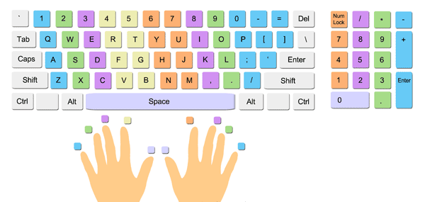
Touch Typing Basics
Three main typing skills:
Proper hand positioning.
Finger placement.
Finger posture.

Slide 6
Touch Typing Basics
Positioning ten fingers:
To understand the proper positioning of the fingers on the keyboard
Touch typing basic link: https://www.youtube.com/watch?v=EebWkecsW38
Activity
Activity 1: Correctly position the fingers on the home row keys
Activity 2: Complete typing lessons from 89 to 112
Follow this link to TypingClub https://www.typingclub.com/sportal/program-3.game

