Slide 1
EXAM PROJECT · DATA ENGINEERING
BrightLearn Data Warehouse Build
A star-schema warehouse built from a single messy flat file, for a 5-store South African retail chain
Tshifhiwa Tshikosi

Slide 2
01 · THE BUSINESS
Five stores, three loyalty tiers, one export problem
STORES
LOYALTY TIERS
Sandton
Gauteng
Bronze
Silver
Gold
Pretoria
Gauteng
Cape Town
Western Cape
Umhlanga
KwaZulu-Natal
The business problem:
each store runs its own POS system, exporting all sales data as a single flat file, transactions, customers, products, and stores mixed together, with no normalisation and known data quality issues.
Gqeberha
Eastern Cape
2

Slide 3
02 · ARCHITECTURE
Bronze, Silver, Gold
A medallion pipeline: raw load, then clean, then warehouse-ready
BRONZE
raw CSV, no transformation
bright_retail_raw_data · dim_store · dim_customer · dim_product · dim_supplier · dim_cashier · dim_payment
SILVER
deduplicated, standardised, blanks resolved
clean_store · clean_customer · clean_product · clean_supplier · clean_cashier · clean_payment · clean_date
GOLD
reporting-ready
dwh_store · dwh_customer · dwh_product · dwh_supplier · dwh_cashier · dwh_payment · dwh_date · dwh_fact_sales
3

Slide 4
03 · DIMENSIONAL MODEL
A star schema
dim_date
dim_payment
dim_cashier
dim_customer
FACT_SALES
dim_supplier
dim_store
dim_product
4

Slide 5
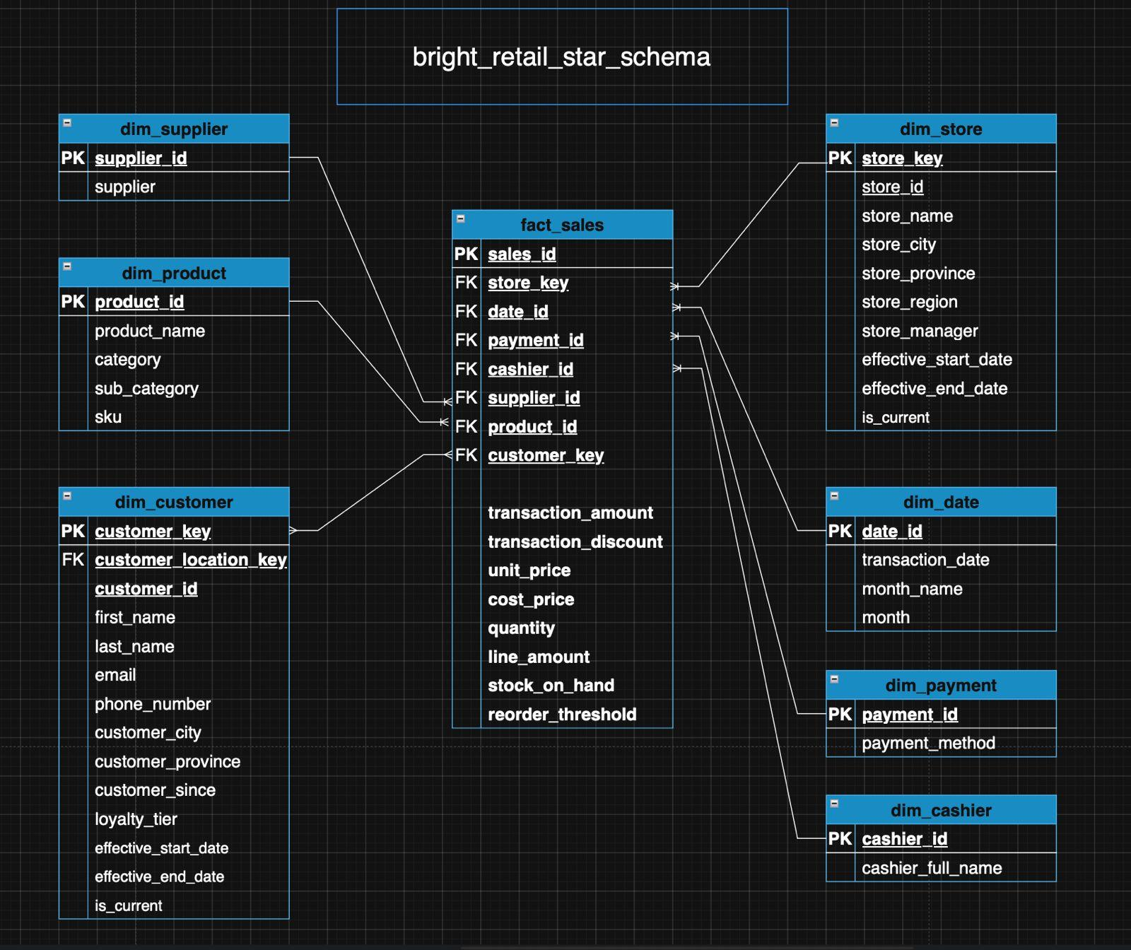
03 · DIMENSIONAL MODEL
The actual entity-relationship diagram
INSIGHT
One inconsistency worth fixing before submission: dim_customer still shows a customer_location_key FK, left over from the earlier snowflaked design. Since dim_customer_location was dropped and location fields were flattened directly into dim_customer, this column should be removed from both the ERD and the live table to match the final design decision.
5

Slide 6
04 · SLOWLY CHANGING DIMENSIONS
One Type 2 dimension where history matters most
Dimension | Attribute Tracked | SCD Type | Reasoning
dim_customer | loyalty_tier | Type 2 | Preserves the tier a customer held at the time of each sale
dim_store | store_manager | Type 2 | Sales stay attributed to the manager active when they happened
All others | — | Type 1 | No business need to track history; overwrite on change
6

Slide 7
05 · DATA QUALITY
What was actually broken in the source file
ISSUE | AFFECTED | RESOLUTION
Blank customer email | 811 rows (16.2%) | Replaced with placeholder
Anonymous walk-in sales | 253 rows (5.1%) | Merged into one walk-in record
Inconsistent date formats | 388 rows (7.8%) | Multi-format TRY_CONVERT chain
Inconsistent payment casing | 4,446 rows (88.9%) | Standardised to fixed values
Blank product category | 132 rows (2.6%) | Backfilled from same SKU
Inconsistent name casing | 2,603 rows (21 emails) | Deduplicated on email key
Discount > 100% | 1,213 rows (24.3%) | Flagged, needs clarification
Negative transaction amount | 435 rows (8.7%) | Flagged, needs clarification
BrightLearn Data Warehouse Build · Tshifhiwa Tshikosi
7

Slide 8
06 · SSIS PIPELINE
Four stages, orchestrated by a master package
01
02
03
04
Load CSV
→
Load Schema
→
Clean
→
Load Warehouse
Raw flat file lands untouched in staging
Staging split into dimensions and fact table
Type fixes, blanks resolved, casing standardised
Stored procedures load dwh_*
8

Slide 9
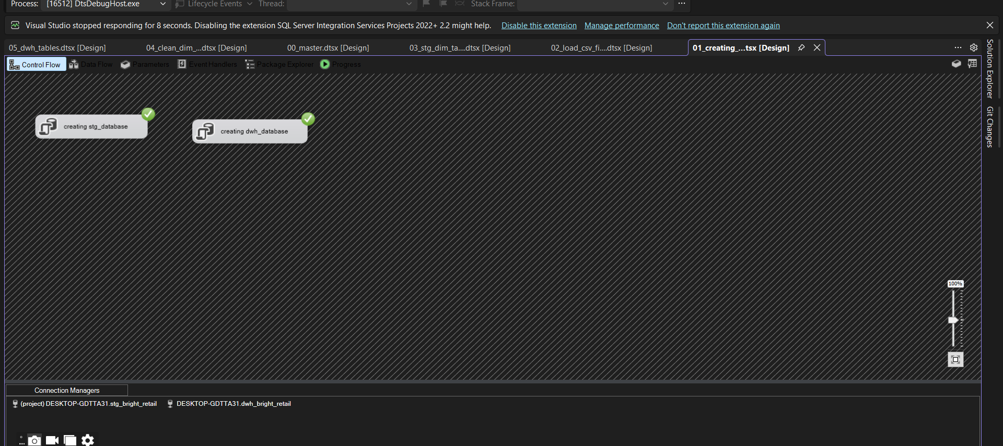
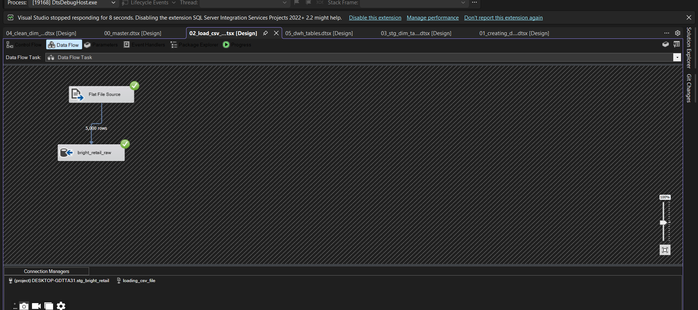
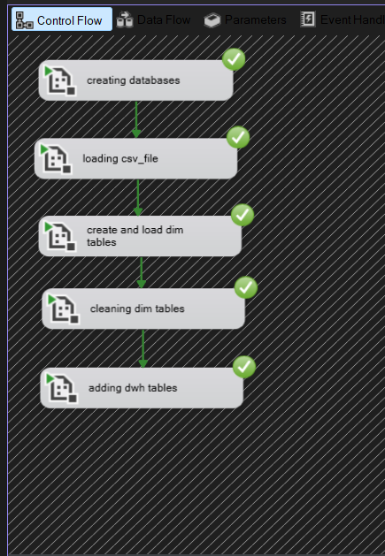
06 · SSIS PIPELINE
Creating both databases
Loading the raw CSV into staging
The master package, end to end
INSIGHT
INSIGHT
INSIGHT
Five sequential stages — create databases, load CSV, build staging dimensions, clean them, then load the warehouse, all complete with a green check.
Two independent Execute SQL Tasks create stg_bright_retail and dwh_bright_retail if they don't already exist. Because neither depends on the other, they're structured as separate tasks rather than one script, making the whole environment reproducible from a blank SQL Server instance.
The Flat File Source moves exactly 5,000 rows into bright_retail_raw on every run, confirming the source extract size before any cleaning or transformation begins, used as a baseline number to compare later row counts against.
9

Slide 10
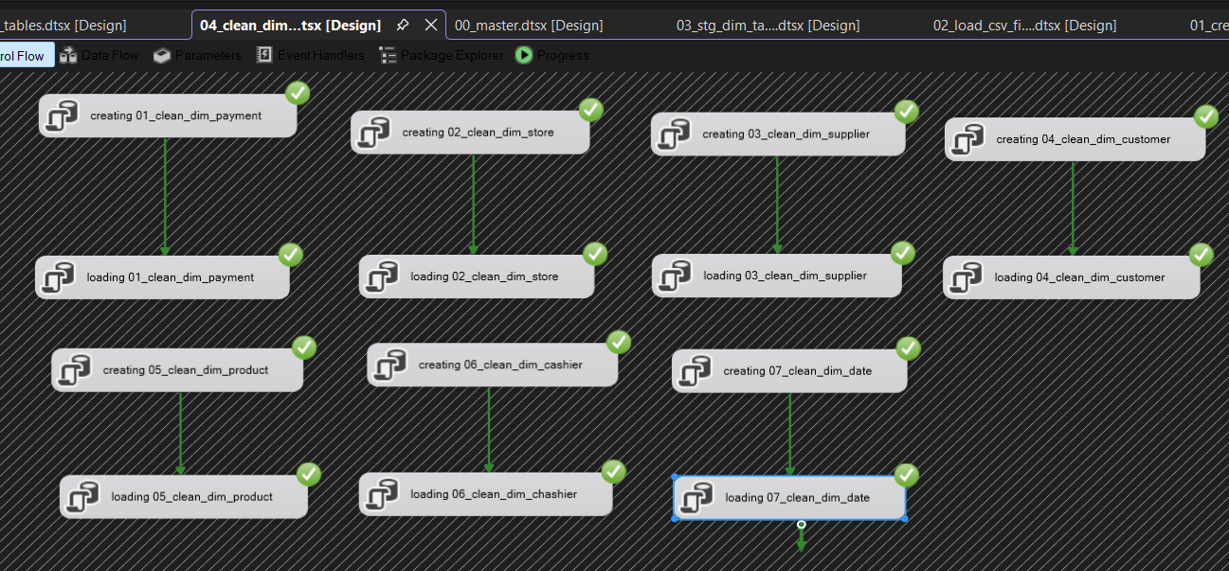
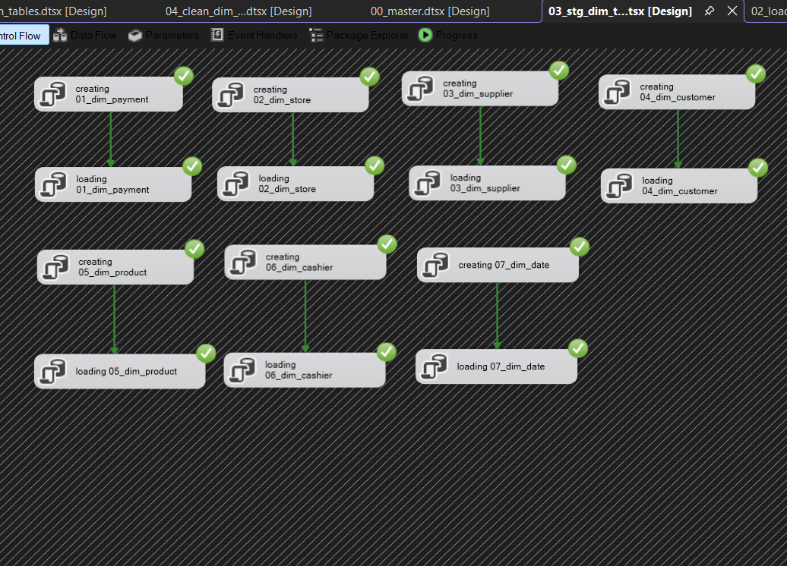
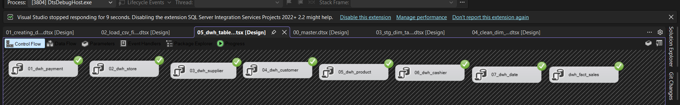
06 · SSIS PIPELINE
Building the staging dimensions
Cleaning the dimensions
Loading the warehouse
12

Slide 11
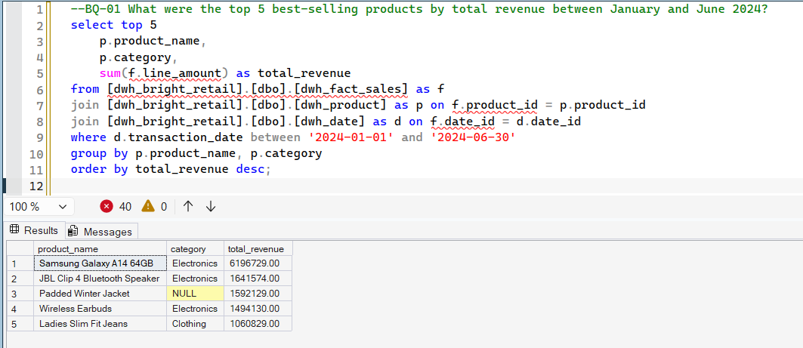
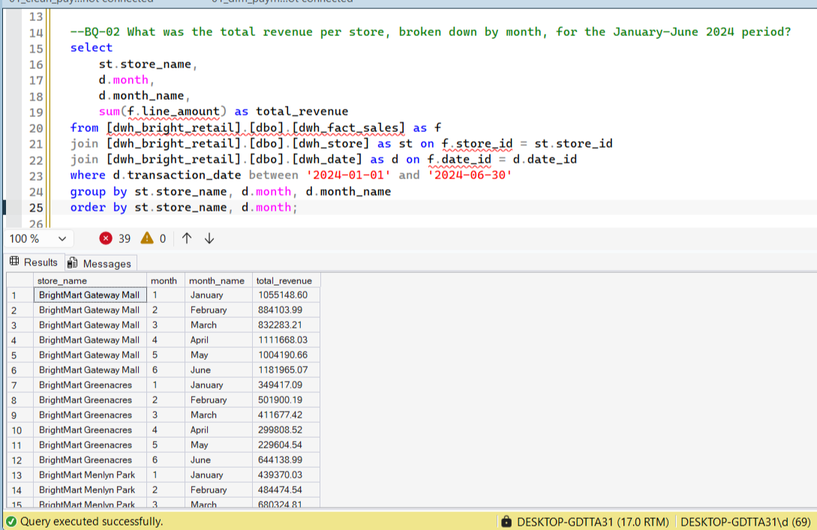
07 · BUSINESS QUESTIONS
BQ-01
BQ-02
Top 5 best-selling products by revenue
Revenue per store, by month
INSIGHT
BQ-01 INSIGHT
BQ-02 INSIGHT
The Samsung Galaxy A14 64GB generated the highest revenue during the reporting period, followed by the JBL Clip 4 Bluetooth Speaker. Electronics dominated the top five products, demonstrating strong customer demand. These products should be prioritised for inventory planning and promotional campaigns.
BrightMart Gateway Mall consistently achieved the highest monthly revenue, with notable increases in April and June. Revenue patterns varied across stores, reflecting differences in customer demand and performance. These insights can help identify best practices and improve lower-performing stores.
17

Slide 12
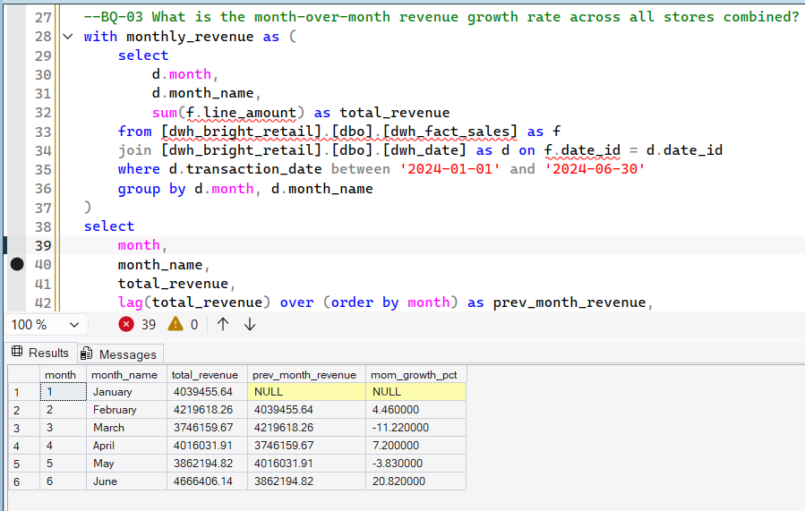
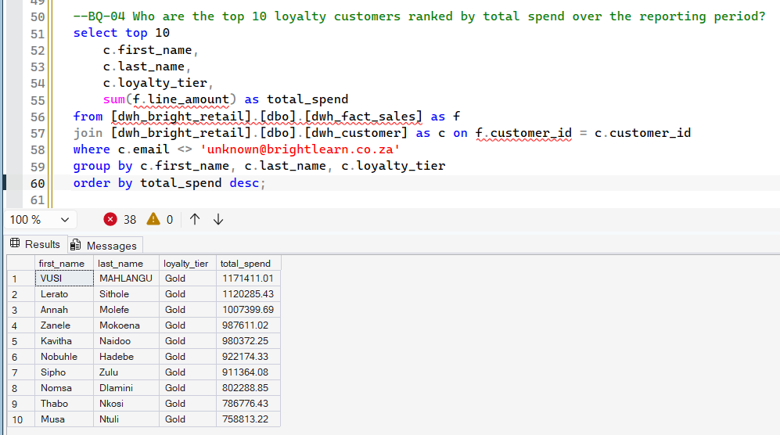
BQ-03
BQ-04
Month-over-month revenue growth
Top 10 loyalty customers by spend
BQ-03 INSIGHT
BQ-04 INSIGHT
Revenue increased by 4.46% in February, declined in March, recovered in April, and experienced the strongest growth of 20.82% in June. This trend highlights seasonal fluctuations in customer spending. Understanding these patterns can support better sales planning and forecasting.
The top ten highest-spending customers all belonged to the Gold loyalty tier, with the highest spender exceeding R1.17 million in purchases. This demonstrates the value of the loyalty programme in retaining high-value customers. Continued investment in loyalty rewards can strengthen customer retention.
19
20

Slide 13
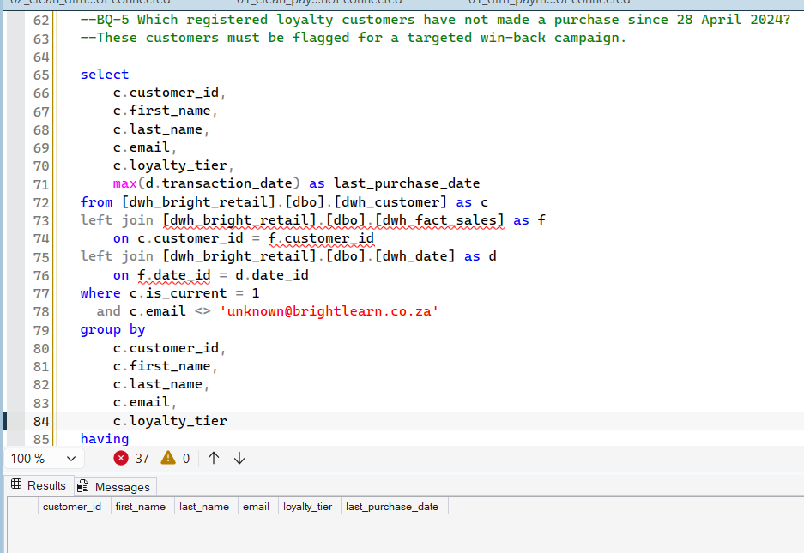
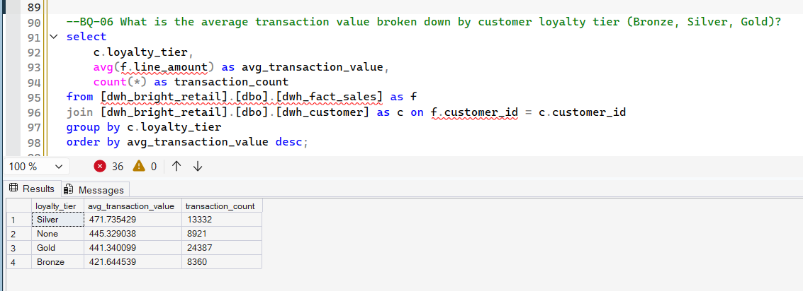
BQ-05
BQ-06
Customers overdue for a win-back campaign
Average transaction value by loyalty tier
BQ-05 INSIGHT
BQ-06 INSIGHT
No registered loyalty customers met the criteria for the win-back campaign, as all active members made purchases after 28 April 2024. This indicates strong customer engagement during the reporting period. Ongoing monitoring will help identify future retention opportunities.
Silver loyalty members recorded the highest average transaction value, while Gold members completed the highest number of transactions. Bronze customers showed the lowest average spend per transaction. Targeted promotions could encourage higher spending among lower-value customer segments.
BrightLearn Data Warehouse Build · Tshifhiwa Tshikosi
21

Slide 14
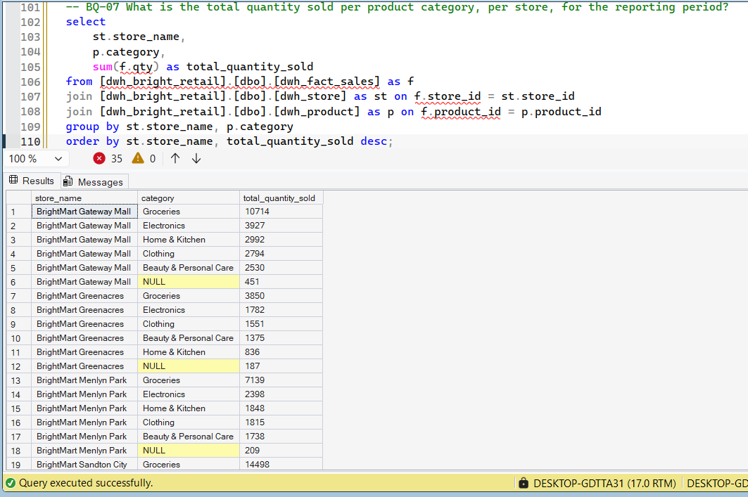
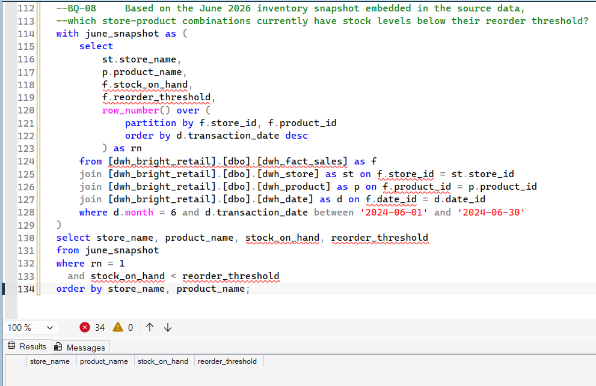
BQ-07
BQ-08
Quantity sold per category, per store
June stock below reorder threshold
BQ-07 INSIGHT
BQ-08 INSIGHT
Groceries were the highest-selling product category across all stores, with BrightMart Sandton City recording the largest sales volume. Electronics also performed consistently well across multiple locations. These results can guide inventory allocation and merchandising strategies.
No products were found below their reorder threshold during the June inventory snapshot. This indicates that stock levels were sufficient to meet customer demand throughout the reporting period. Maintaining proactive inventory monitoring will help sustain product availability.
23

Slide 15
03 · BUSINESS RECOMMENDATION
Prioritise high-performing products by maintaining adequate inventory levels and increasing marketing efforts for top-selling electronics and clothing items.
Replicate successful store strategies by analysing the practices of high-performing stores, such as BrightMart Gateway Mall, and applying them to lower-performing locations.
Leverage seasonal sales trends by planning promotions and inventory around months with historically high growth, particularly June.
Strengthen the loyalty programme by rewarding high-value Gold and Silver members while encouraging Bronze and non-loyalty customers to increase their spending through targeted incentives.
Maintain customer engagement by continuing personalised marketing campaigns, as no active loyalty customers qualified for a win-back campaign during the reporting period.
Improve product master data quality by assigning categories to products with missing classifications to enhance reporting accuracy and business insights.
Optimise inventory management by continuing to monitor stock levels and reorder thresholds to minimise the risk of stock shortages while avoiding overstocking.
Use data-driven decision making by leveraging the data warehouse and business intelligence queries to support strategic planning, sales analysis, and operational performance.

Slide 16
Thank you
BrightLearn Data Warehouse Build , Data Analyst & Junior Data Engineer portfolio project
Tshifhiwa Tshikosi

