Slide 1

Distribution Network Modelling for the Smart Grid
Roger C. Dugan
Sr. Technical Executive, EPRI
ISGT Europe 2011 Tutorial T2
Manchester, UK
December 5, 2011

Slide 2

Instructor
Roger C. Dugan, Fellow, IEEE
Roger is a Sr. Technical Executive with EPRI in Knoxville, Tennessee USA. He has over 40 years of combined experience in distribution engineering with EPRI, Electrotek Concepts, and Cooper Power Systems. He holds the BSEE degree from Ohio University and the Master of Engineering in Electric Power Engineering degree from Rensselaer Polytechnic Institute, Troy, NY. Roger has worked on many diverse aspects of power engineering over his career because of his interests in applying computer methods to power system simulation. Beginning with a student internship with Columbus and Southern Ohio Electric Co, his work has been focused on distribution engineering. He was elected a Fellow of the IEEE for his contributions in harmonics and transients analysis. Recently, he has been very active in distributed generation, particularly as it applies to utility distribution systems and distribution system analysis. He was the 2005 recipient of the IEEE Excellence in Distribution Engineering Award. He is coauthor of Electrical Power Systems Quality published by McGraw-Hill, now in its 2nd edition. He serves on the IEEE PES Distribution System Analysis Subcommittee and is currently Chair of the Distribution Test Feeders WG.

Slide 3
Agenda
8:00 AM | Introduction to Open Distribution System Simulator
 | Uses and Applications
 | Getting Started
 | Open Distribution System Simulator Architecture and Circuit Modeling Basics
 | Scripting Example
10:00 AM- 10:30 AM | Break
 | Advanced Topics
 | Introduction to the COM Interface
 | Example with Excel VBA
12:00 PM | Adjourn

Slide 4
Introduction to
OpenDSS

Slide 5
What is the OpenDSS?
Script-driven, frequency-domain electrical circuit simulation tool
Specific models for:
  Supporting utility distribution system analysis
  Designed for the unbalanced, multi-phase North American power distribution systems
    As well as European-style systems
      These typically have a simpler structure

Slide 6
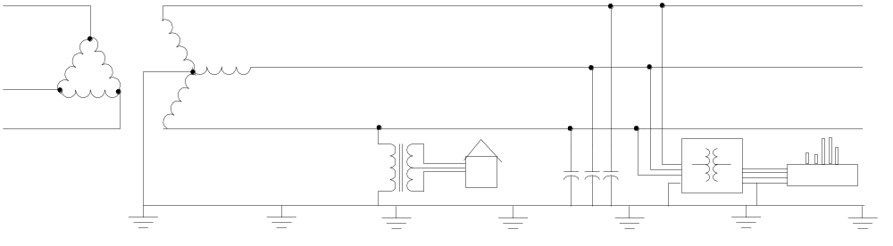
Typical North American Distribution System
Typical 4-wire multi-grounded neutral system
Unigrounded/Delta 3-wire also common on West Coast

Slide 7
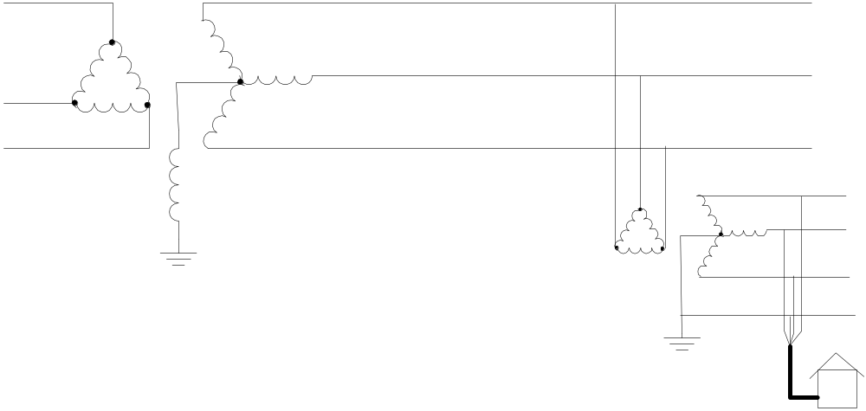
Typical European Style System
  3-wire unigrounded primary
Three-phase throughout,
including secondary (LV)

Slide 8
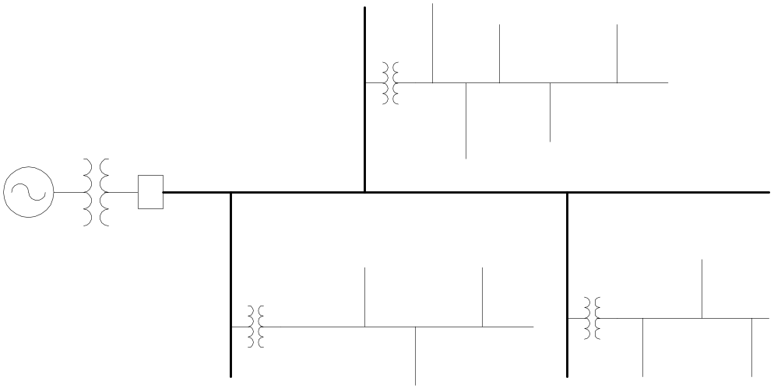
Comparisons of Systems
European-Style System
MV
LV
North American System
MV (ALL)

Slide 9
Comparison of Distribution Systems
North American System
  Primary (MV) system is extensive, complex
  Secondary (LV) is short
  4-5 houses per distribution transformer
    120/240 V single-phase (“split phase”) service
  1 Industrial customer per distribution transformer
    Or multiple transformers per customer
  Extended by adding transformer + wire
European Style System
  MV System has simpler structure
  LV System (400 V) is extensive
  Perhaps 100 residences on MV/LV transformer
    230/400 V 3-phase
  Extended by adding wire
    Fewer transformers

Slide 10
What is the OpenDSS? (cont’d)
Heritage
  Harmonics solvers rather than power flow
    Gives OpenDSS extraordinary distribution system modeling capability
  Simpler to solve power flow problem with a harmonics solver than vice-versa
Supports all rms steady-state (i.e., frequency domain) analyses commonly performed for utility distribution system planning
  And many new types of analyses
  Original purpose: DG interconnection analysis

Slide 11
What is the OpenDSS? (cont’d)
What it Isn’t
  An Electromagnetic transients solver (Time Domain)
    It can solve Electromechanical transients
      Frequency Domain => “Dynamics”
      All solutions are in phasors (complex math)
  Not a Power Flow program
  Not a radial circuit solver
    Does meshed networks just as easily
  Not a distribution data management tool
    It is a simulation engine designed to work with data extracted from one or more utility databases

Slide 12
Time- and Location-Dependent Benefits
The OpenDSS was designed to capture both
  Time-specific benefits and
  Location-specific benefits
Needed for
  DG analysis
  Renewable generation
  Energy efficiency analysis
  PHEV and EV impacts
  Other proposed capacity enhancements that don’t follow typical loadshapes

Slide 13
Time- and Location-Dependent Benefits
Traditional distribution system analysis programs
  Designed to study peak loading conditions
  Capture mostly location-specific benefits
  Ignores time; Assumes resource is available
  This gets the wrong answer for many DG, energy efficiency, and Smart Grid analyses
Must do time sequence analysis to get the right answer
  Over distribution planning area

Slide 14
What are the Key Features?
See Documentation for more details
  http://electricdss.svn.sourceforge.net/viewvc/electricdss/Doc/
  Main page in Wiki:
  sourceforge.net/apps/mediawiki/electricdss/index.php?title=Main_Page
Designed to allow expansion indefinitely
  Impossible to anticipate everything users will want to do
  COM interface allows easier customization

Slide 15
Built-in Solution Modes
Snapshot (static) Power Flow
Direct (non-iterative)
Daily mode (default: 24 1-hr increments)
Yearly mode (default 8760 1-hr increments)
Duty cycle (1 to 5s increments)
Dynamics (electromechanical transients)
Fault study
Monte carlo fault study
Harmonic
Custom user-defined solutions

Slide 16
Controls
A key feature is that controls are modeled separately from the devices being controlled
  Capacitors
  Regulators/tapchangers
Control Modes
  Static
    Power flows with large time steps
  Time
    Control queue employed to delay actions
    Control acts when time is reached
  Event

Slide 17
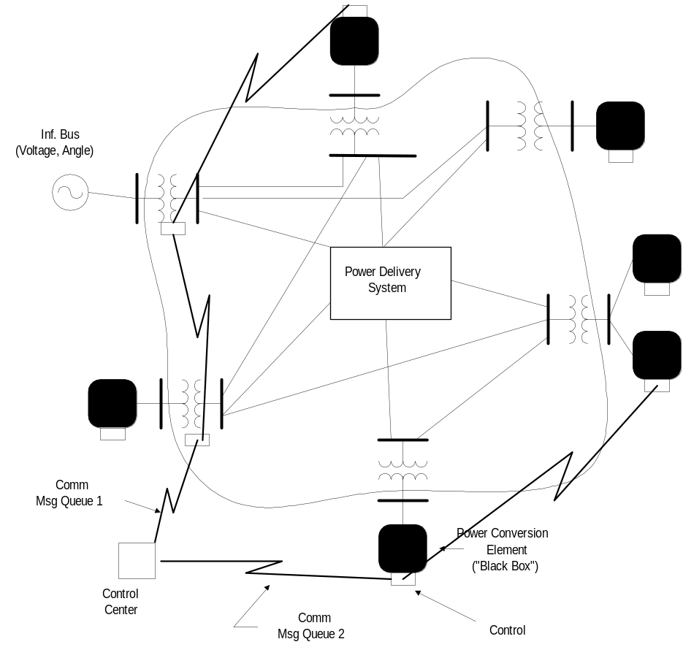
Overall Model Concept

Slide 18
User Interfaces Currently Implemented
A stand-alone executable program that provides a text-based interface (multiple windows)
  Some graphical output is also provided.
  No graphical input is provided.
An in-process COM server (for Windows) that supports driving the simulator from user-written programs.
  (An out-of-process COM server is under development to support execution from 64-bit programs.)
EPRI Program 174 funders have access to DGScreener, an interface to OpenDSS

Slide 19
Validation of OpenDSS
EPRI routinely checks OpenDSS power flow results against CYMDIST, SYNERGEE, and WindMil programs after converting data sets for various projects.
The OpenDSS program has been benchmarked against all the IEEE Test Feeders
  (http://ewh.ieee.org/soc/pes/dsacom/testfeeders/).
  OpenDSS was used to develop the NEV test feeder and the 8500-node test feeder.
  Being used to develop the DG Protection test feeder and the large urban network test feeder.
For the EPRI Green Circuits project, computed load characteristics were calibrated against measured data.
Recently, the new PVSystem model was compared to actual measurements with excellent results.

Slide 20
Plan for Future Work/Enhancements
In 2010-11, much work in solar PV generation modeling.
  The PVSystem model was added recently
  Enhancements are expected to result from the US DOE High-penetration solar PV study and the EPRI Distributed PV study.
Storage models were developed in 2009-2010 for the EPRI Smart Grid demos and will continue through 2012
  Dynamics model development underway
Several projects underway to develop more mature dynamics models.
  (much opportunity for participation from partners)
There has been much interest in a more friendly graphical user interface for users who do not wish to learn either the scripting or programming interface.
  A few users have already developed their own
  Multiple proposals are under consideration.

Slide 21
Plan for Future Work/Enhancements
There is a continuing effort to promote interfacing to the Common Information Model (CIM).
  The CIM is the common data interchange mechanism
We plan to exploit high performance desktop computing to make it feasible to study distribution systems of at least 100,000 nodes and perhaps as many as 1,000,000 nodes.
  This will involve revamping algorithms within the program to enable the application of parallel processing (multiple CPUs) to planning problems.
Improved distribution state estimation functions
Improved Distribution Management Systems (DMS) functions
Reorganization of the source code
  to better support platforms other than Windows and
  to permit operation on 64-bit platforms.

Slide 22
Introduction to
OpenDSS
Uses and Applications
Some examples to inspire you…

Slide 23
What can OpenDSS be used for?
Simple power flow (unbalanced, n-phase)
Daily loading simulations
Yearly loading simulations
Duty cycle simulations
  Impulse loads
    Rock crushers
    Car crushers
  Renewable generation
DG
  Interconnection studies/screening
  Value of service studies (risk based)
  Solar PV voltage rise/fluctuation
  Wind power variations impact
  Hi-penetration solar PV impacts
  Harmonic distortion
  Dynamics/islanding

Slide 24
What can OpenDSS be used for? (cont’d)
Hybrid simulation of communications and power networks
Geomagnetically-Induced Current (GIC) flow (solar storms)
Power delivery loss evaluations (EPRI Green circuits program - > 80 feeders)
Voltage optimization
PEV/PHEV impact simulations
Community energy storage (EPRI Smart Grid Demo)
High-frequency harmonic/interharmonic interference
Various unusual transformer configurations
Transformer frequency response analysis
Distribution automation control algorithm assessment
Impact of tankless electric water heaters
Wind farm collector simulations
Wind farm interaction with transmission
Wind generation impact on capacitor switching and regulator/LTC tapchanger operations
Protection system simulation
Open-conductor fault conditions
Circulating currents on transmission skywires
Ground voltage rise during faults on lines
Stray voltage simulations
Industrial load harmonics studies/filter design
Distribution feeder harmonics analysis, triplen harmonic filter design
And many more ….

Slide 25
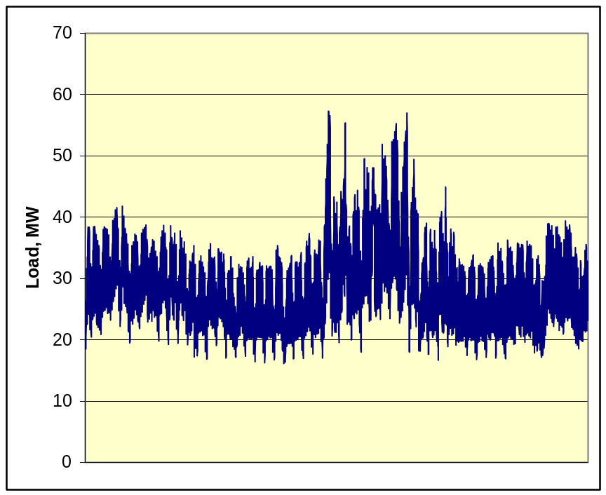
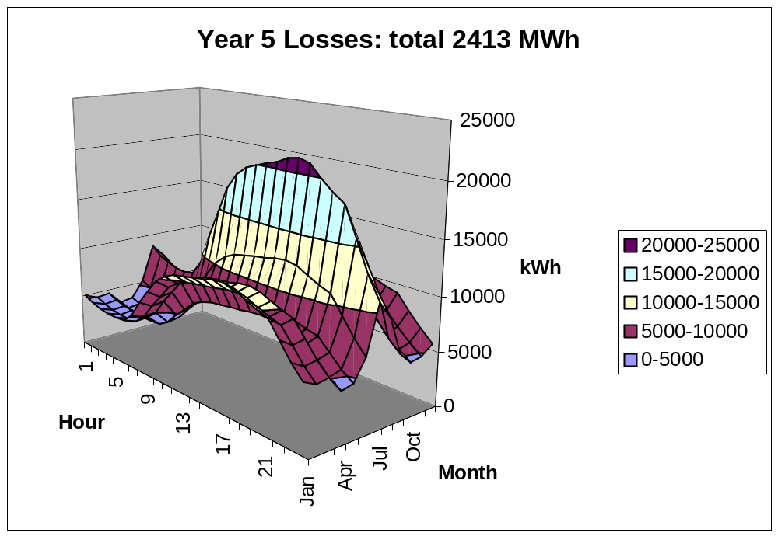
Computing Annual Losses
Peak load losses are not necessarily indicative of annual losses

Slide 26
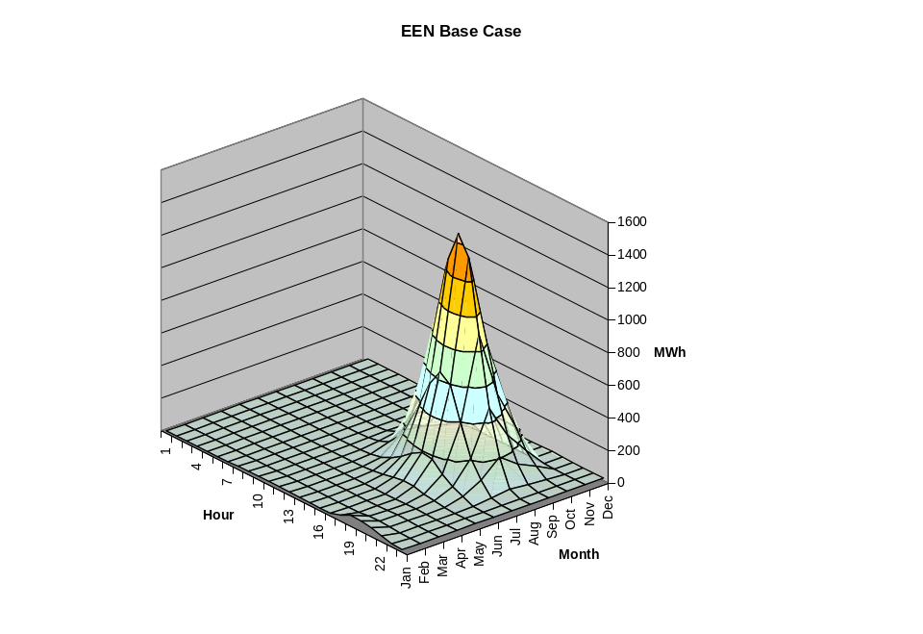
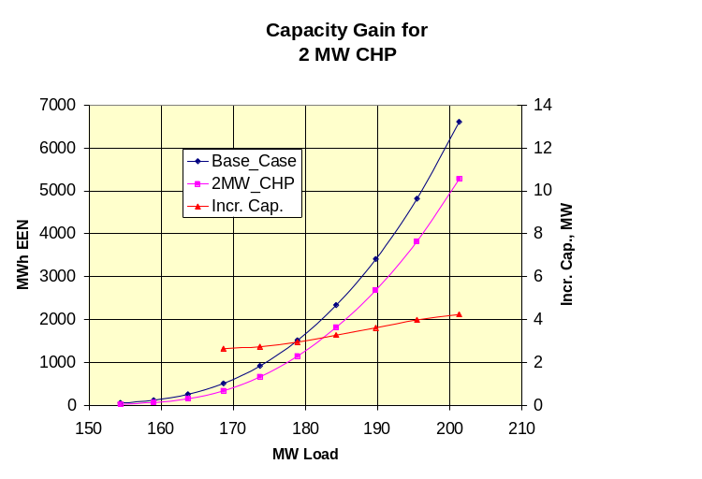
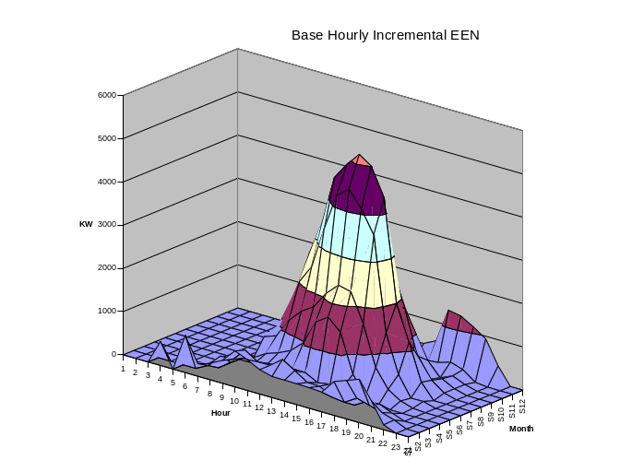
Using DSS to Determine Incremental Capacity of DG
“Needle” Peaking System
“How much more power can be served at the same risk of unserved energy?”
Broad Summer Peaking System

Slide 27
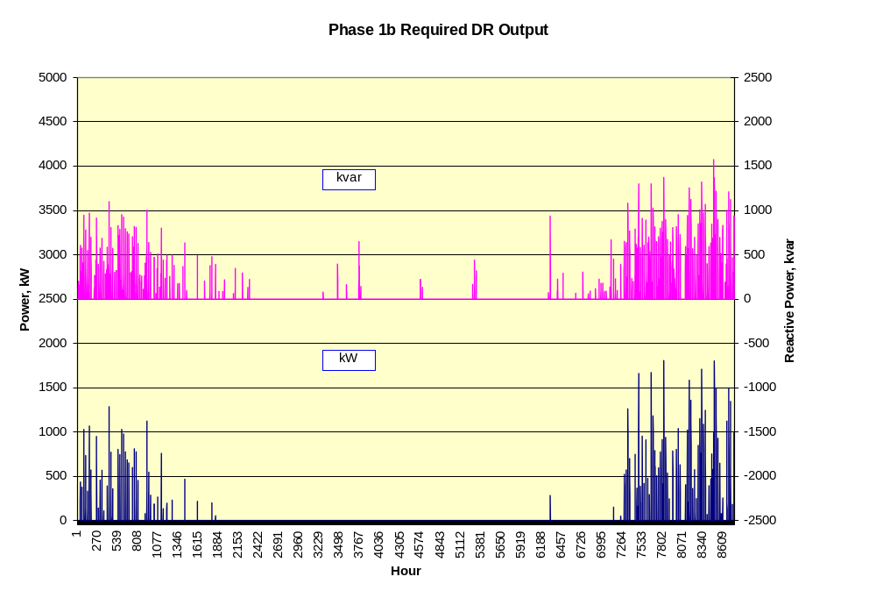
DG Dispatch

Slide 28
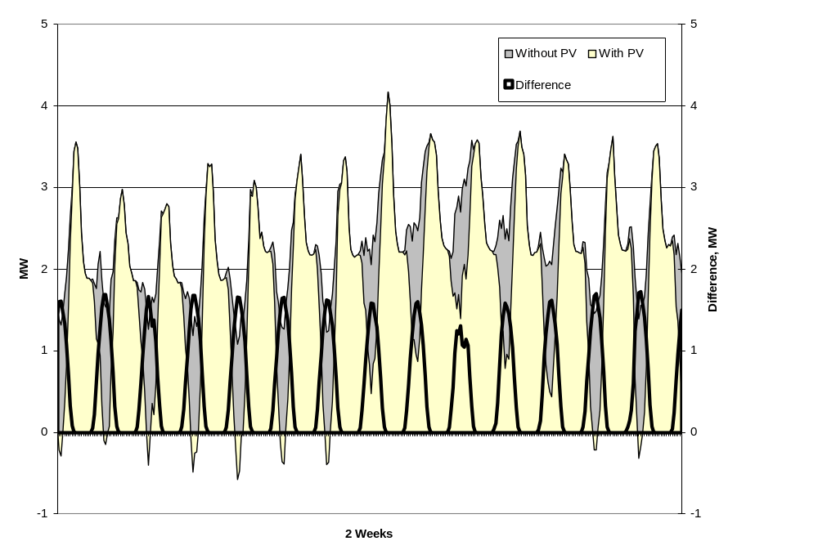
Solar PV Simulation

Slide 29
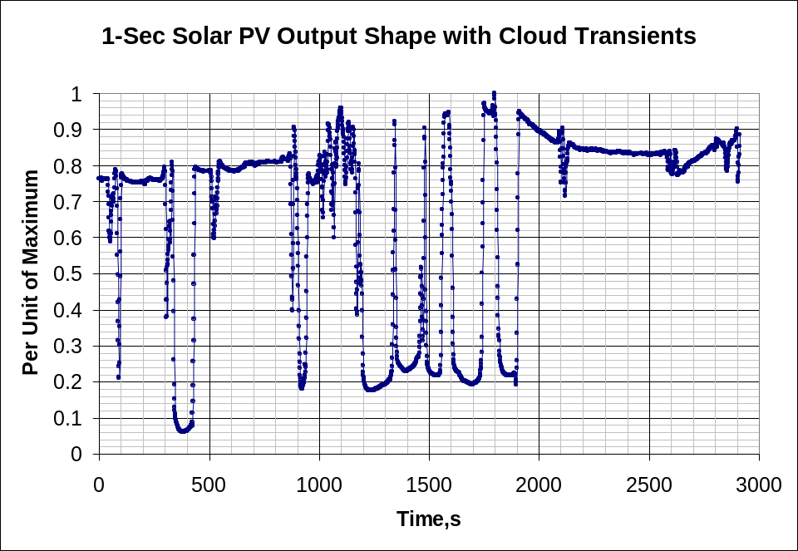
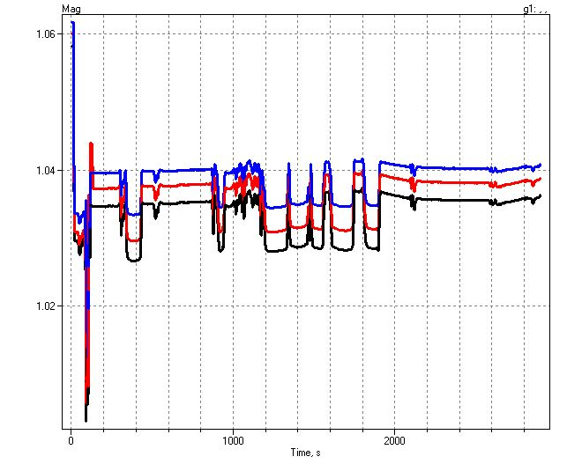
1-sec Solar Data – Cloud Transients
Impact on Feeder Voltage

Slide 30
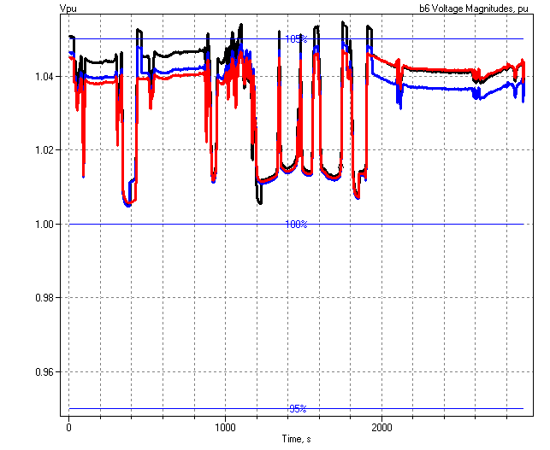
1-sec Solar Data (2010)
Regulator Operations

Slide 31
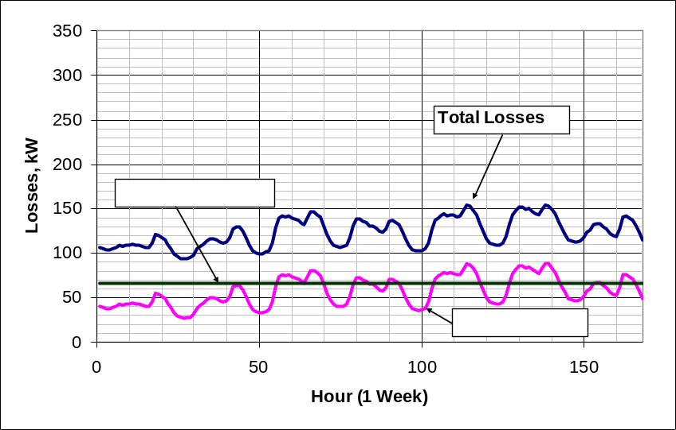
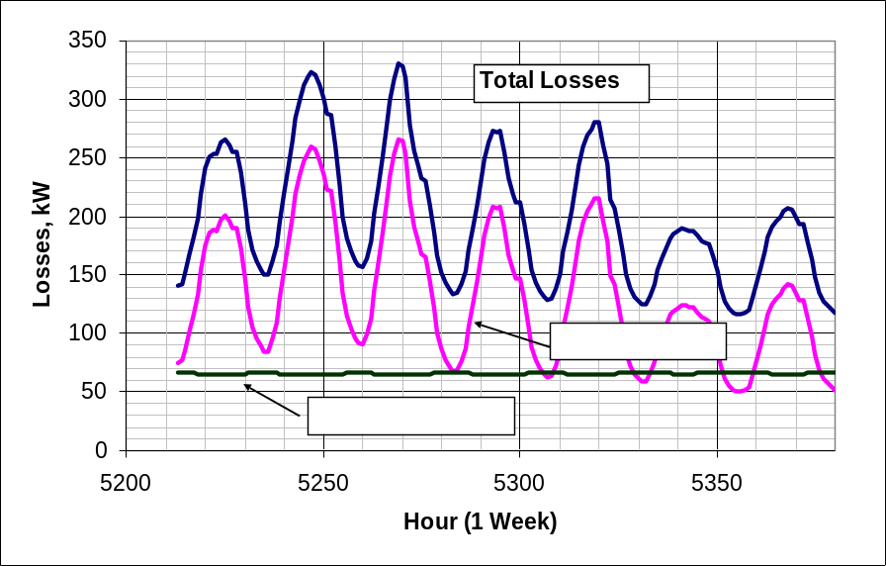
Power Distribution Efficiency
Peak Load Week
Light Load Week

Slide 32
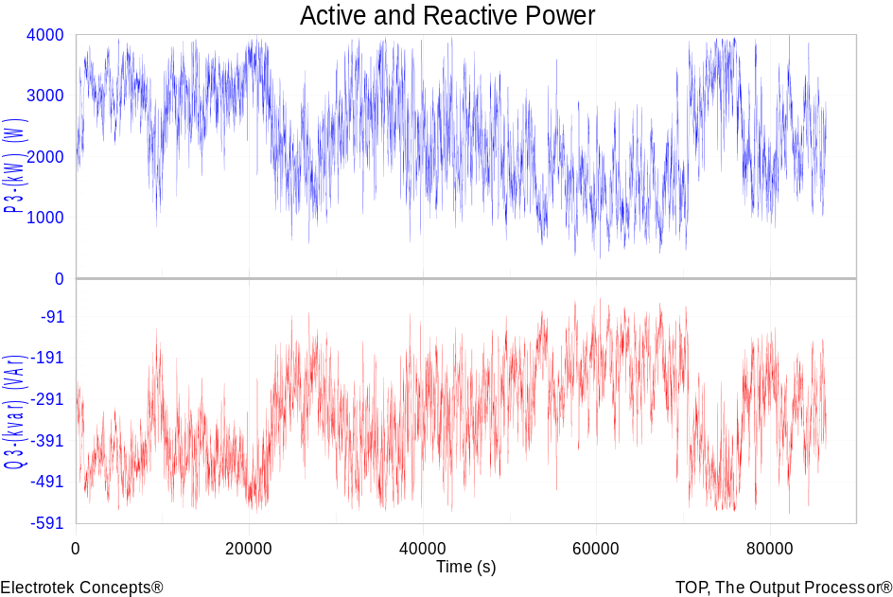
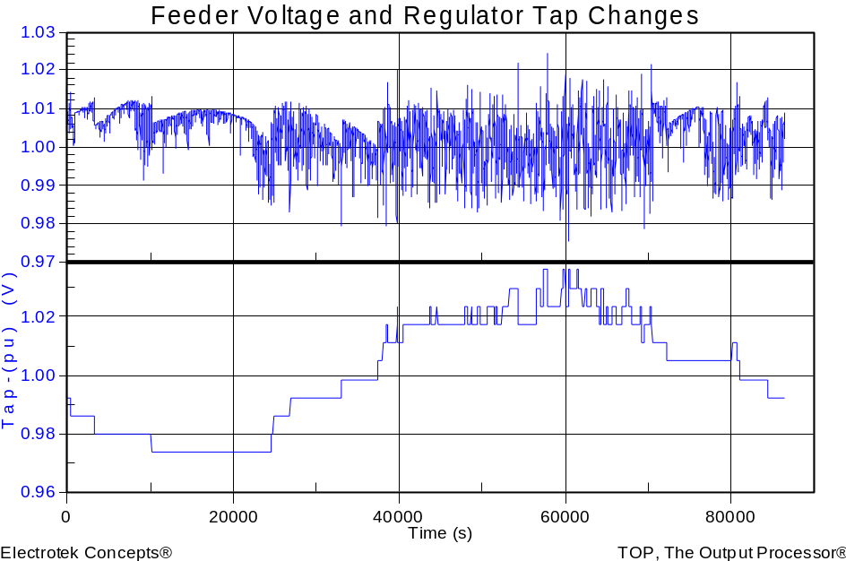
Wind Plant 1-s Simulation
Notes:
The plot you see to the right is a sample case study we did where a developer wanted to install 3 750kW turbines at the end of a 10-mile distribution feeder. Along the feeder was a voltage regulator and large intermittent load. The concern we had was the impact the turbine output fluctuations would have on the flicker, regulator action, as well as the voltage profile along the feeder. Utilizing software that Electrotek had developed, specifically the Distribution System Simulator, or DSS,, minor modifications were made that allowed us to simulate the wind plant fluctuation impact over time, thus giving us the ability to address the concerns at hand.
The plot you see to the right is simulation output from the DSS, over a time horizon of ~ 4 minutes. The three turbines were modeled explicitly, along with the 5-step switched capacitor banks connected to each turbine as well as the voltage regulator upline from the wind plant. This software allows us to make recommendations to the utility and/or wind plant developer regarding modifications necessary, if any, to allow for the wind plant to have minimal impact on the distribution feeder and surrounding customers, or perhaps even improve feeder performance.
We also utilize this software for estimating flicker according the IEC standard 1400-21. The software, along with data specific to the turbine being considered allows one to estimate the flicker impact BEFORE the turbine is installed.

Slide 33
Broadband Driving Point Admittance
0.035
0.03
0.025
0.02
Siemens
|Y|
0.015
0.01
0.005
0
0
100000
200000
300000
400000
500000
Frequency, Hz

Slide 34
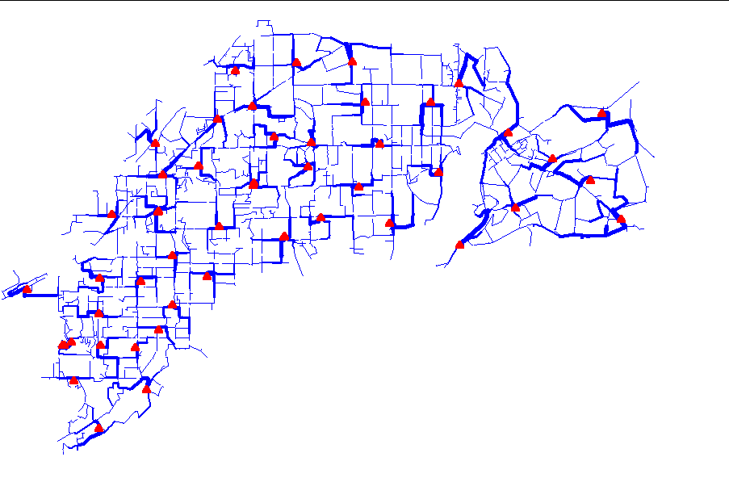
Power Flow Visualization

Slide 35
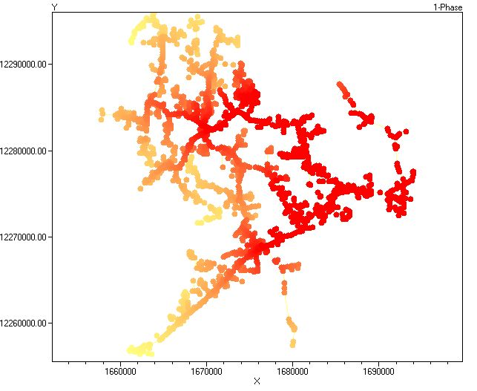
Special Displays
Fault Current Magnitudes

Slide 36
Needs Envisioned by EPRI
Sequential time simulation
Meshed network solution capability
Better modeling of Smart Grid controllers
Advanced load and generation modeling
High phase order modeling ( >3 phases)
  Stray voltage (NEV), crowded ROWs, etc.
Integrated harmonics
  NEV requires 1st and 3rd
User-defined (scriptable) behavior
Dynamics for DG evaluations

Slide 37
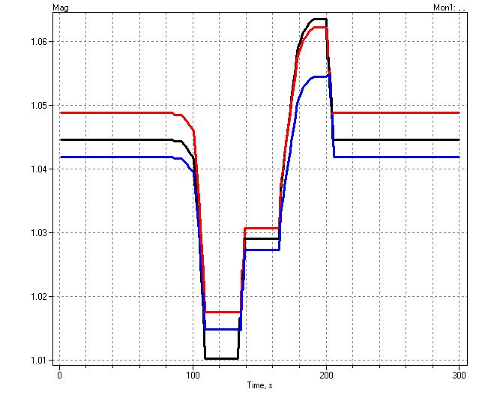
Example of an Expected DG Problem
Voltage overshoots as power output ramps up
Regulator taps up to compensate for voltage drop

Slide 38
Root of Problem
p.u. Voltage
Voltage Profile w/ DG
1.10
Distribution Systems designed for voltage DROP, not voltage RISE.
High Voltages
1.05
1.00
0.95
0.90
0.0
2.0
4.0
6.0
Distance from Substation (km)

Slide 39
Getting Started:
Installation and Basic Usage

Slide 40
SourceForge.Net Links for OpenDSS
OpenDSS Download Files:
  http://sourceforge.net/projects/electricdss/files/
Main Page in Wiki
  http://sourceforge.net/apps/mediawiki/electricdss/index.php?title=Main_Page
Top level of Main Repository
  http://electricdss.svn.sourceforge.net/viewvc/electricdss/
Source Code
  http://electricdss.svn.sourceforge.net/viewvc/electricdss/Source/
Examples
  http://electricdss.svn.sourceforge.net/viewvc/electricdss/Distrib/Examples/
IEEE Test Cases
  http://electricdss.svn.sourceforge.net/viewvc/electricdss/IEEETestCases/

Slide 41
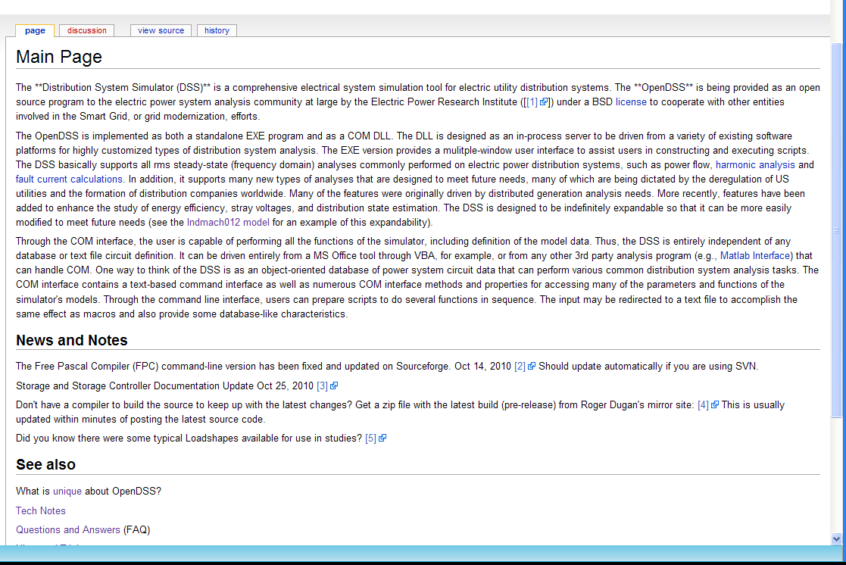
Wiki Home Page

Slide 42
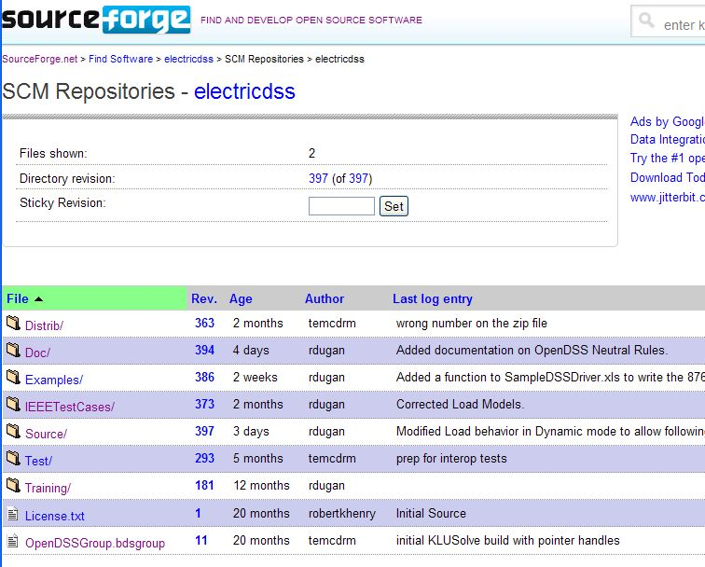
Repository on SourceForge.Net

Slide 43
Accessing the SourceForge.Net Source Code Repository with TortoiseSVN
Install a TortoiseSVN client from Tortoisesvn.net/downloads.
Recommendation:
  From the TortoiseSVN General Settings dialog and click the last check box, to use "_svn" instead of ".svn" for local working directory name.
  Then, to grab the files from SourceForge by:
  1 - create a clean directory such as "c:\opendss"
  2 - right-click on it and choose "SVN Checkout..." from the menu
  3 - the repository URL is
    http://electricdss.svn.sourceforge.net/svnroot/electricdss
    (Change the checkout directory if it points somewhere other than what you want.)

Slide 44
Program Installation

Slide 45
Program Files (as of November 2011)
OpenDSS.EXE Standalone EXE
OpenDSSEngine.DLL In-process COM server
KLUSolve.DLL Sparse matrix solver
DSSgraph.DLL DSS graphics output
Copy these files to the directory (folder) of your choice
  Typically c:\OpenDSS or c:\Program Files\OpenDSS

Slide 46
Registering the COM Server
If you intend to drive OpenDSS from another program, you will need to register the COM server
    Some programs require this !!
    If you are sure you will only use OpenDSS.EXE, you can skip this step
      You can come back and do it at any time
In DOS, or command, window, change to the folder where you installed it and type:
  Regsvr32 OpenDSSEngine.DLL

Slide 47
Registering the COM Server – Windows 7
Special Instructions for Window 7
  (and probably Windows Vista, too)
  See Q&A on the Wiki site
  http://sourceforge.net/apps/mediawiki/electricdss/index.php?title=How_Do_I_Register_the_COM_Server_DLL_on_Windows_7%3F
All Programs > Accessories
right-click on the Command Prompt and select Run as Administrator.
Then change to my OpenDSS folder and type in
  "regsvr32 OpenDSSEngine.DLL" or
  "RegisterDSSEngine", which runs the Bat file.

Slide 48
Registering the COM Server – Windows 7
Another Process for Windows 7
  per Andy Keane- UC Dublin
  1. Right click on the desktop and select new -> shortcut
  2. For location of item just type ‘cmd’
  3. This will create a new shortcut to a command prompt on your desktop
  4. Right click on the new shortcut and select ‘Properties’
  5. On the shortcut tab select ‘Advanced’
  6. Tick the ‘Run as Administrator’ box
  7. Press Apply/OK and that command prompt will always be run as administrator allowing the user to use regsvr32

Slide 49
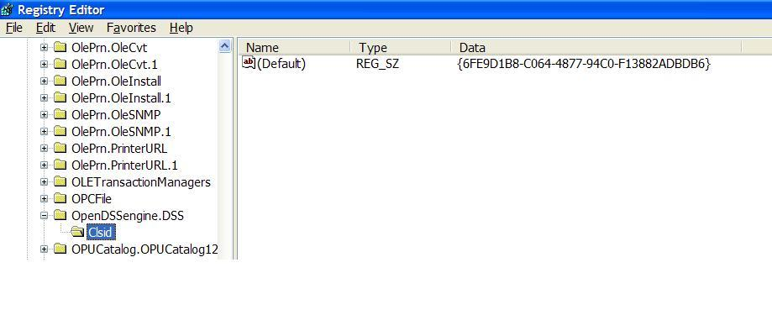
So What Did this Do?
Windows Registry Entry
GUID
The Server shows up as “OpenDSSEngine.DSS” in the Windows Registry
The OpenDSS is now available to any program on the computer

Slide 50
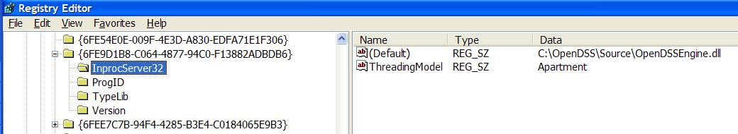
The GUID References the DLL File ….
If you look up the GUID in RegEdit
Points to OpenDSSEngine.DLL
(In-process server, Apartment Threading model)

Slide 51
Questions So Far?

Slide 52
OpenDSS Architecture and
Circuit Modeling Basics
Description of basic circuit elements, bus models, etc.

Slide 53
DSS Structure
Scripts
Main Simulation Engine
COM Interface
User-Written DLLs
Scripts, Results

Slide 54
DSS Object Structure
DSS Executive
Commands
Options
Circuit
Solution
V
[Y]
I
PDElement
PCElement
Controls
Meters
General
Line
Transformer
Capacitor
Reactor
Load
Generator
Vsource
Isource
Storage
RegControl
CapControl
Relay
Reclose
Fuse
Monitor
EnergyMeter
Sensor
LineCode
LineGeometry
WireData
LoadShape
GrowthShape
Spectrum
TCCcurve
XfmrCode

Slide 55
DSS Class Structure
Instances of Objects of this class
Class
Object 1
Property Definitions
Property Values
Methods
Class Property Editor
Yprim
Collection Manager
States
Object n
Property Values
Methods
Yprim
States

Slide 56
Models Currently Implemented (April 2011)
POWER DELIVERY ELEMENTS
  CAPACITOR (Series and shunt capacitors; filter banks)
  LINE (All types of lines, cables)
  REACTOR (Series and shunt reactors)
  TRANSFORMER (multi-phase, multi-winding transformer models)
POWER CONVERSION ELEMENTS
  GENERATOR (General generator models)
  LOAD (General load models)
  PVSYSTEM (Solar PV system with panel and inverter)
  STORAGE (Generic storage element models)
CONTROL ELEMENTS
  CAPCONTROL (Capacitor bank control; various types)
  FUSE (Controls a switch, modeling fuse TCC behavior)
  GENDISPATCHER (A specialized controller for dispatching DG)
  RECLOSER (Controls a switch, modeling recloser behavior)
  REGCONTROL (Standard 32-step regulator/LTC control)
  RELAY (Controls a switch, modeling various relay behaviors)
  STORAGECONTROLLER (Implementation of AEP’s hub controller)
  SWTCONTROL (one way to control switches during simulations)
  VSOURCE (2-terminal multiphase voltage source, thevinen equivalent)

Slide 57
Models Currently Implemented (April 2011)
GENERAL DATA
  CNDATA (Concentric neutral cable data)
  GROWTHSHAPE (Growth vs year)
  LINECODE (Line and cable impedances, matrices or symmetrical components)
  LINEGEOMETRY (Line geometry data)
  LINESPACING (spacing data for LINEGEOMETRY)
  LOADSHAPE (Load shape data)
  PRICESHAPE (Price shape data)
  SPECTRUM (Harmonic spectra)
  TCC_CURVE (TCC curves)
  TSDATA (Tape shield cable data)
  TSHAPE (Temperature shape data)
  WIREDATA (Wire parameters, GMR, etc.)
  XFMRCODE (Transformer type definitions)
  XYCURVE (Generic x-y curves)
METERS
  ENERGYMETER (Captures energy quantities and losses)
  MONITOR (Captures selected quantities at a point in the circuit)
  SENSOR (Simple monitor used for state estimation)
OTHER
  FAULT (1 or more faults can be placed anywhere in the circuit)
  ISOURCE (Multi-phase current source)
  VSOURCE (2-terminal multiphase voltage source, thevinen equivalent)

Slide 58
Input Data Requirements
The OpenDSS was designed for a research or consulting environment where input data might come from a variety of sources.
The program can accept many common forms of data for describing impedances, loading, and topology of distribution systems for planning analysis.
The OpenDSS scripting language is designed to require minimal translation from other formats of distribution data.
The program can accept more detailed data for lines, transformers, etc. than the standard data when they are available.

Slide 59
Advanced Types of Data
Harmonic spectra for harmonic analysis,
Various curves as a function of time for sequential time simulations:
Load shapes (e.g., AMI P, Q data),
Price shapes,
Temperature shapes,
Storage dispatch curves,
Growth curves.
Efficiency curves for PV inverters,
Voltage dependency exponents for loads,
Capacitor control settings,
Regulator control settings,
Machine data.

Slide 60
Circuit Modeling Basics
Some things that might be a bit different than other power system analysis tools you may have used.

Slide 61
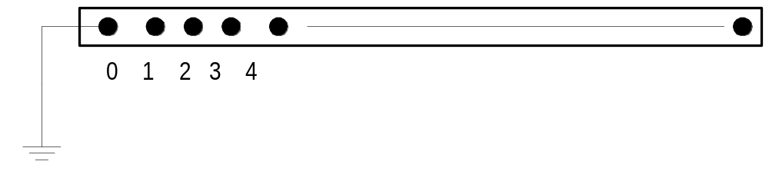
DSS Bus Model (Bus ≠ Node)
Nodes
Bus
Referring to Buses and Nodes (A Bus has 1 or more Nodes)
Bus1=BusName.1.2.3.0
(This is the default for a 3-phase circuit element)
Shorthand notation for taking the default
Bus1=BusName
Note: Sometimes this can bite you (e.g. – Transformers, or capacitors with ungrounded neutrals)

Slide 62
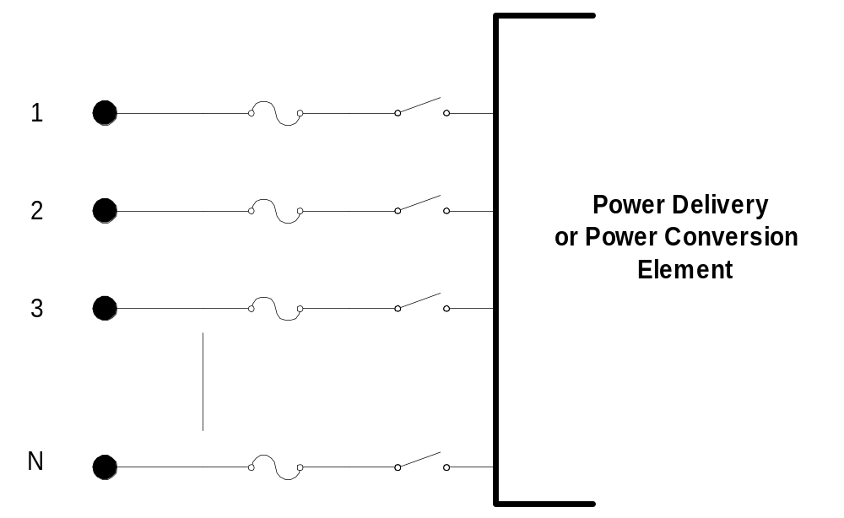
DSS Terminal Definition
Conductors
Circuit Elements have one or more Terminals with 1..N conductors.
Conductors connect to Nodes at a Bus
Each Terminal connects to one and only one Bus

Slide 63
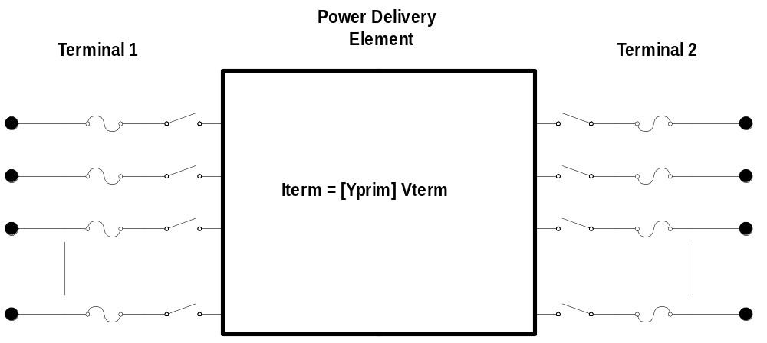
Power Delivery Elements
PD Elements are Generally Completely Described by [Yprim]

Slide 64
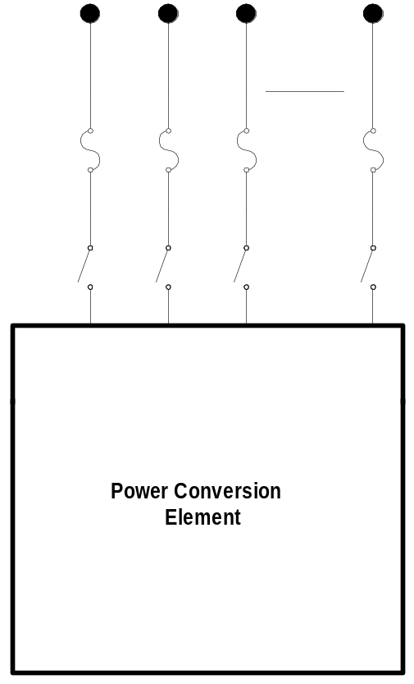

Power Conversion Elements
I_{Term}(t) = F(V_{Term}, [State], t)
Power Conversion (PC) elements are typically connected in “shunt” with the Power Delivery (PD) elements
PC Elements may be nonlinear
Described some function of V
  May be linear
  e.g., Vsource, Isource
May have more than one terminal, but typically one
  Load, generator, storage, etc.

Slide 65
Specifying Bus Connections
Shorthand (implicit)
  New Load.LOAD1 Bus1=LOADBUS
    Assumes standard 3-phase connection by default
LOADBUS
6
5
4
3
LOAD
2
1
0

Slide 66
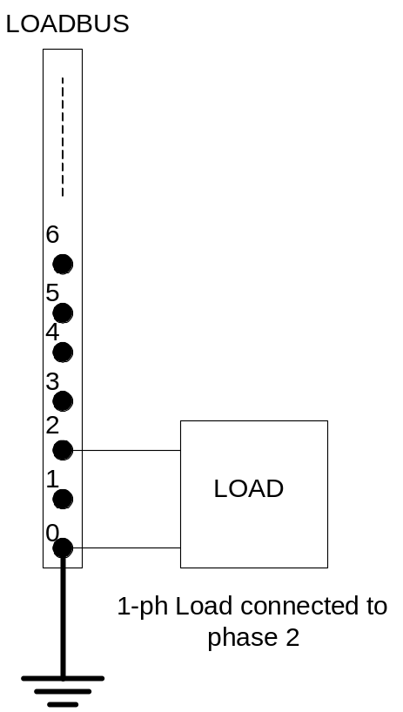
Specifying Bus Connections
Explicit
  New Load.LOAD1 Bus1=LOADBUS.1.2.3.0
      Explicitly defines which node
  New Load.1-PHASELOAD Phases=1 Bus1=LOADBUS.2.0
      Connects 1-phase load to
      Node 2 and ground
1-Phase Load Example

Slide 67
Specifying Bus Connections
Default Bus templates
    Node connections assumed if not explicitly declared
  Element declared Phases=1
    … LOADBUS.1.0.0.0.0.0.0.0.0.0. …
  Element declared Phases=2
    … LOADBUS.1.2.0.0.0.0.0.0.0.0. …
  Element declared Phases=3
    … LOADBUS.1.2.3.0.0.0.0.0.0.0. …

Slide 68
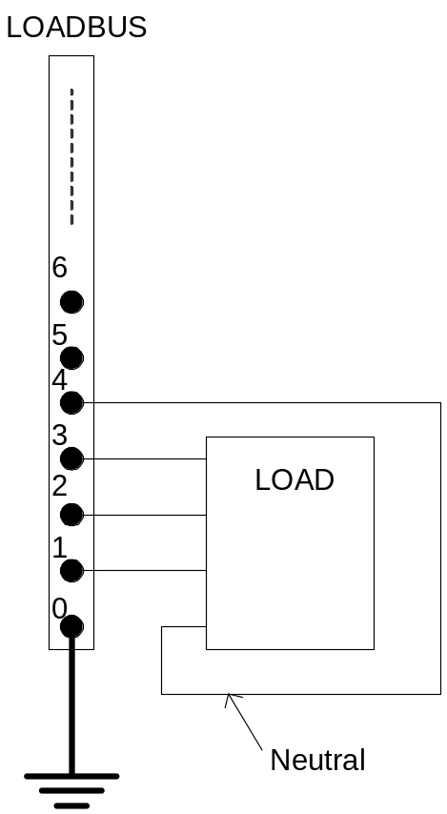
Specifying Bus Connections
  Ungrounded-Wye Specification
  Bus1=LOADBUS.1.2.3.4 (or some other unused Node number)
Voltage at this Node explicitly computed
(just like any other Node)

Slide 69
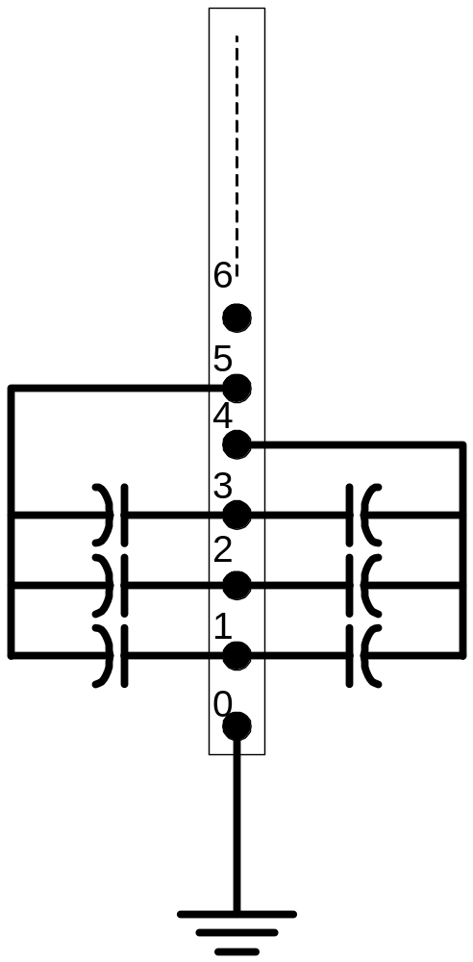
Possible Gotcha: Specifying Two Ungrounded-Wye Capacitors on Same Bus
MyBus
… Bus1=MyBus.1.2.3 Bus2=MyBus.5.5.5
Neutrals are not connected to each other in this specification!
… Bus1=MyBus Bus2=MyBus.4.4.4

Slide 70
Circuit Element Conductors are Connected to the Nodes of Buses
MyBus
3
2
1
0
. . . Bus2 = MyBus.2.1.3.0 . . .
. . . Bus1 = MyBus . . .
(take the default)
(Explicitly define connections)
DSS Convention: A Terminal can be connected to only one Bus.
You can have any number of Nodes at a bus.

Slide 71
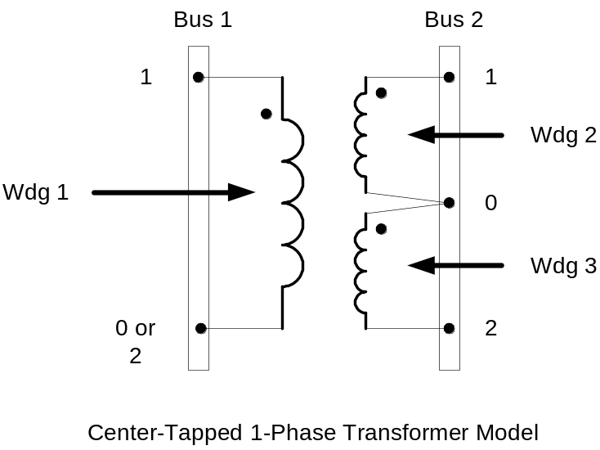
Example: Connections for 1-Phase Residential Transformer Used in North America
! Line-to-Neutral Connected 1-phase Center-tapped transformer
New Transformer.Example_1-ph phases=1 Windings=3
! Typical impedances for small transformer with interlaced secondaries
~ Xhl=2.04 Xht=2.04 Xlt=1.36 %noloadloss=.2
! Winding Definitions
~ wdg=1 Bus=Bus1.1.0 kV=7.2 kVA=25 %R=0.6 Conn=wye
~ wdg=2 Bus=Bus2.1.0 kV=0.12 kVA=25 %R=1.2 Conn=wye
~ Wdg=3 Bus=Bus2.0.2 kV=0.12 kVA=25 %R=1.2 Conn=wye
Note: You may use XfmrCode to define a library of transformer definitions that are used repeatedly (like LineCode for Line elements)

Slide 72
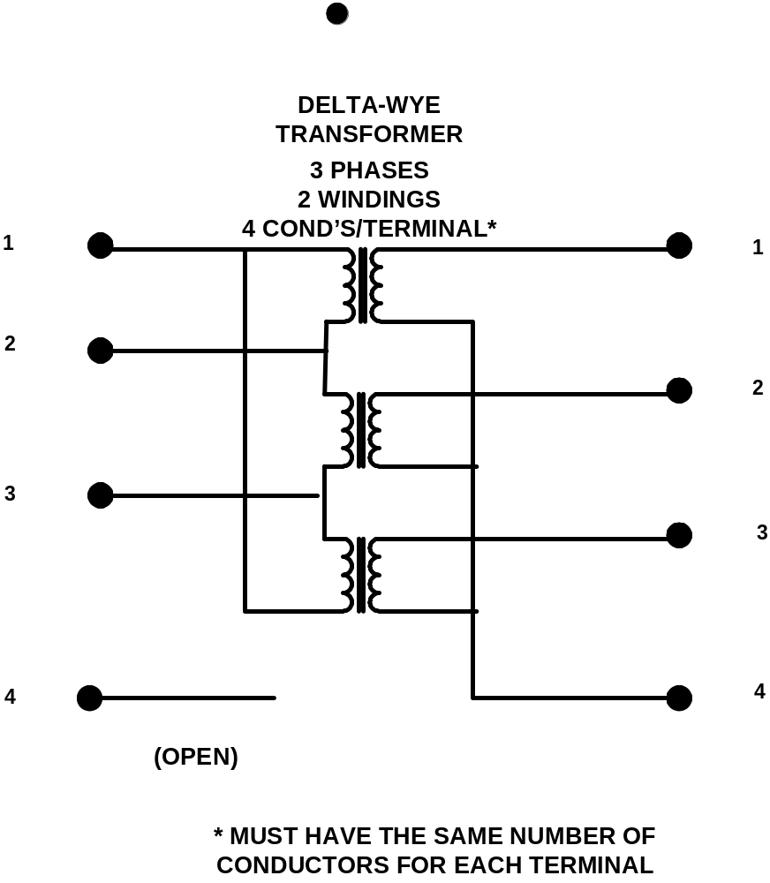
All Terminals of a Circuit Element Have Same Number of Conductors
3-Phase Transformer

Slide 73
Power Flow
Solution Mode
“How to make a harmonics solver
solve the power flow problem”

Slide 74
Solving the Power Flow
Once the circuit model is connected properly the next step is to Solve the base power flow
PC elements (i.e., Loads) are usually nonlinear
Loads are linearized to a Norton equivalent based on nominal 100% rated voltage.
  Current source is “compensation current”
  Compensates for the nonlinear characteristic
A fixed point iterative solution algorithm is employed for most solutions
This method allows for flexible load models and is robust for most distribution systems

Slide 75
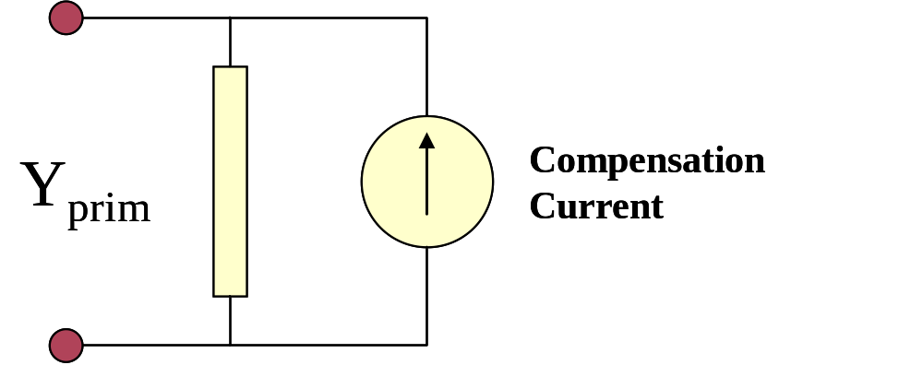
Load (a PC Element)
General Concept
Added into Injection Current Vector
Goes into System Y Matrix
(One-Line Diagram)
Most Power Conversion (PC) Elements are Modeled Like This

Slide 76
Load - 3-phase Y connected
Phase 1
1
2
Phase 2
3
4 Conductors/Terminal
Phase 3
4

Slide 77
Load - 3-phase Delta connected
Phase 1
2
1
Phase 2
3
3 Conductors/Terminal
Phase 3

Slide 78
Load Models (Present version)
1:Standard constant P+jQ load. (Default)
2:Constant impedance load.
3:Const P, Quadratic Q (like a motor).
4:Nominal Linear P, Quadratic Q (feeder mix).
Use this with CVRfactor.
5:Constant Current Magnitude
6:Const P, Fixed Q
7:Const P, Fixed Impedance Q
8: Special ZIP load model (new)

Slide 79
Standard P + jQ (constant power) Load Model
When the voltage goes out of the normal range for a load the model reverts to a linear load model
  This generally guarantees convergence
    Even when a fault is applied
  Script to change break points to +/- 10%:
    Load.Load1.Vmaxpu=1.10
    Load.Load1.Vminpu=0.90
  Note: to solve some of the IEEE Radial Test feeders and match the published results, you have to set Vminpu to less than the lowest voltage published (usually about 0.80 per unit)

Slide 80
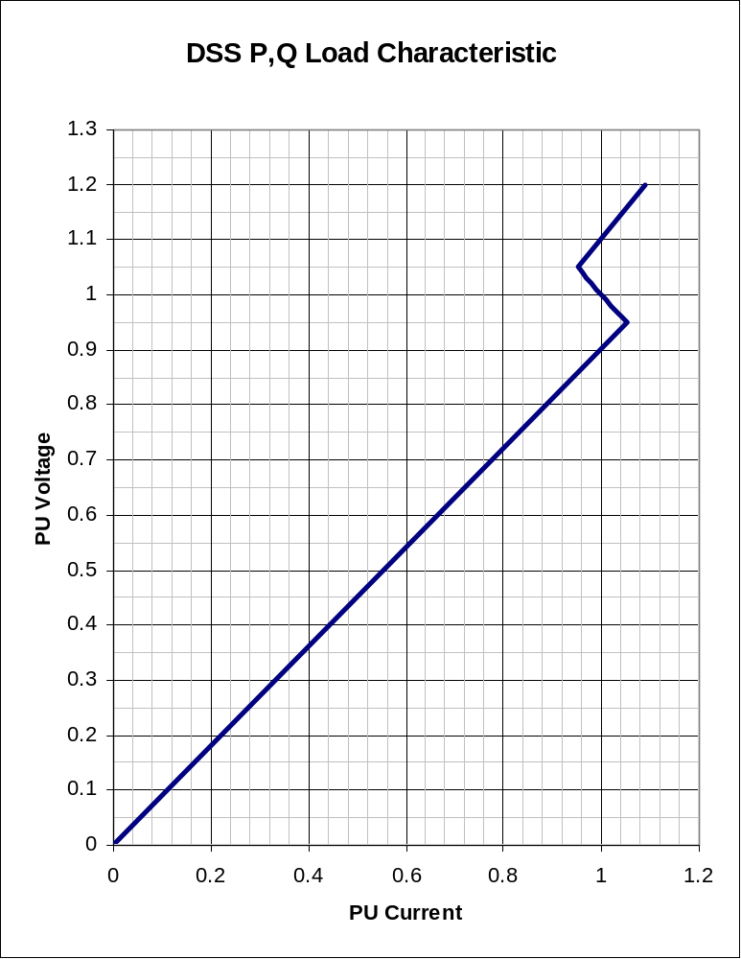
Standard P + jQ Load Model (Model=1)
Const Z
105%
(Defaults*)
95%
|I| = |S/V|
Const Z
* Change by setting Vminpu and Vmaxpu Properties

Slide 81
Putting it All Together
ALL Elements
Yprim 1
Yprim 2
Yprim 3
Yprim n
PC Elements
Comp. Currents
I1
I2
Y
Node
Voltages
I_{inj}
=
V
Im
Iteration Loop

Slide 82
Putting it All Together
Th-Th-That's All Folks !
ALL Elements
Yprim 1
Yprim 2
Yprim 3
Yprim n
PC Elements
Comp. Currents
I1
I2
Y
Node
Voltages
I_{inj}
=
V
Im
Iteration Loop

Slide 83
Solving the Power Flow …
This solution method requires that the first guess at the voltages be close to the final solution
  Not a problem for daily or yearly simulations
    Present solution is a good initial guess at next time step
  First solution is often most difficult
The solution initialization routine in OpenDSS accomplishes this with ease in most cases
Method works well for arbitrary unbalances
  For conditions that are sensitive, a Newton method is provided that is more robust, but slower.
  Not to be confused with “Newton-Raphson Power Flow”

Slide 84
Solution Speed
Distribution systems generally converge very well
  Many transmission systems, also
The OpenDSS program seems to be on par with the speed of faster commercial programs
Solution method is designed to run annual simulations
Our philosophy:
    Err on the side of running more power flow simulations
      Don’t worry about the solution time until it proves to be a problem
      This reveals more information about the problem

Slide 85
Scripting Basics
Syntax and how to build circuit models.
Simple Model

Slide 86
Scripting
OpenDSS is a scriptable solution engine
Scripts
  Series of commands
  From text files
  From edit forms in OpenDSS.EXE
  From another program through COM interface
    e. g., This is how you would do looping
Scripts define circuits
Scripts control solution of circuits
Scripts specify output, etc.

Slide 87
Command Syntax
Command parm1, parm2 parm3 parm 4 ….
Parameters may be positional or named (tagged).
If named, an "=" sign is expected.
  Name=value (this is the named form)
  Value (value alone in positional form)
For example, the following two commands are equivalent:
  New Object="Line.First Line" Bus1=b1240 Bus2=32 LineCode=336ACSR, …
  New “Line.First Line”, b1240 32 336ACSR, …
Comma or white space

Slide 88
Delimiters
Array or string delimiter pairs: [ ] , { },( ),“ “,‘ ‘
Matrix row delimiter: |
Value delimiters: , (comma)
any white space (tab or space)
Class, Object, Bus, or Node delimiter: . (period)
Keyword / value separator: =
Continuation of previous line: ~ (More)
Comment line: //
In-line comment: !
Query a property: ?

Slide 89
Array and Matrix Parameters
Array
  kvs = [115, 6.6, 22]
  kvas=[20000 16000 16000]
Matrix
  (3x3 matrix)
    Xmatrix=[1.2 .3 .3 | .3 1.2 3 | .3 .3 1.2]
  (3x3 matrix – lower triangle)
    Xmatrix=[ 1.2 | .3 1.2 | .3 .3 1.2 ]

Slide 90
An Example

Slide 91
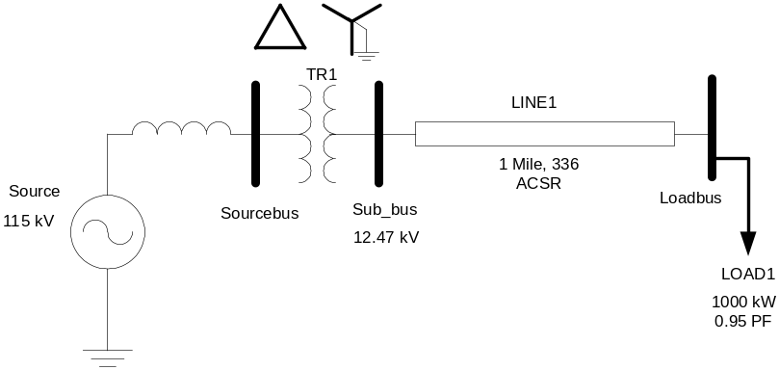
A Basic Script (Class Exercise)
New Circuit.Simple ! Creates voltage source (Vsource.Source)
Edit Vsource.Source BasekV=115 pu=1.05 ISC3=3000 ISC1=2500 !Define source V and Z
New Transformer.TR1 Buses=[SourceBus, Sub_Bus] Conns=[Delta Wye] kVs= [115 12.47]
~ kVAs=[20000 20000] XHL=10
New Linecode.336ACSR R1=0.058 X1=.1206 R0=.1784 X0=.4047 C1=3.4 C0=1.6 Units=kft
New Line.LINE1 Bus1=Sub_Bus Bus2=LoadBus Linecode=336ACSR Length=1 Units=Mi
New Load.LOAD1 Bus1=LoadBus kV=12.47 kW=1000 PF=.95
Solve
Show Voltages
Show Currents
Show Powers kVA elements

Slide 92
Circuit
New Circuit.Simple ! (Vsource.Source is active circuit element)
Edit Vsource.Source BasekV=115 pu=1.05 ISC3=3000 ISC1=2500
Vsource.Source
SourceBus
Source
115
kV
Short Circuit Impedance (a matrix) that yields 3000A 3-ph fault current and 2500A 1-ph fault current.
115 kV, 1.05 pu
One-Line Diagram
(default is 3-phase wye-grd source)

Slide 93
Vsource Element Note
Vsource is actually a Two-terminal Device
  2nd terminal defaults to connected to ground (0V)
  But you can connect it between any two buses
    Comes in handy sometimes
Conceptually a Thevinen equivalent
  Short circuit equivalent
  Actually converted to a Norton equivalent internally

Slide 94
20 MVA Substation Transformer
TR
SourceBus
1
Sub_Bus
Defining Using Arrays
Defining Winding by Winding
New Transformer.TR1 Phases=3 Windings=2
~ Buses=[SourceBus, Sub_Bus]
~ Conns=[Delta Wye]
~ kVs= [115 12.47]
~ kVAs=[20000 20000]
~ XHL=10
New Transformer.TR1 Phases=3 Windings=2 XHL=10
~ wdg=1 bus=SourceBus Conn=Delta kV=115 kVA=20000
~ wdg=2 bus= Sub_Bus Conn=wye kV=12.47 kVA=20000

Slide 95
The Line
Sub_Bus
LoadBus
LINE
1
1
Mile
,
336
New Linecode.336ACSR R1=0.058 X1=.1206 R0=.1784 X0=.4047 C1=3.4 C0=1.6 Units=kft
New Line.LINE1 Bus1=Sub_Bus Bus2=LoadBus Linecode=336ACSR Length=1 Units=Mi
Line objects may also be defined by Geometry or matrix properties.
(Rmatrix=… Xmatrix=… Cmatrix=…)

Slide 96
The Load
Loadbus
LOAD
1
1000
kW
0
.
95
PF
New Load.LOAD1 Bus1=LoadBus kV=12.47 kW=1000 PF=.95
For 3-phase loads, use L-L kV and total kW
For 1-phase loads, typically use L-N kV and total kW
unless L-L-connected; Then use L-L kV.

Slide 97
Solving and Showing Results Reports
  Solve
    Show summary (power flow summary)
  Show Voltages
  Show Currents
  Show Powers kVA elements
Also
  Export … (creates CSV files)
  Plot …

Slide 98
Scripting for Larger Circuits
How to organize scripts for larger problems
Examination of how the IEEE 8500-Node Test Feeder model is organized

Slide 99
Scripting Large Circuits
For small circuits, it is often sufficient to put all the scripts in a single file
  Many of the IEEE test feeder examples are mostly in a single file
When you have large amounts of data, a more disciplined approach is recommended
Redirect Command
  Redirects the input to another file
  Returns to home directory
Compile Command
  Same as Redirect except repositions home directory

Slide 100
Organizing Your Main Screen
OpenDSS.exe saves all windows on the main screen
  They appear where you left them when you shut down
  The next time you start up, you can resume your work
Values are saved in a file (OpenDSS.ini)
  in the OpenDSS.exe folder
    Note: You can update the program simply by copying in new exe and dll files.
  Do not overwrite the “.ini” file if you want to preserve your workspace
    However, if the .ini file gets corrupted, you may simply delete it.

Slide 101
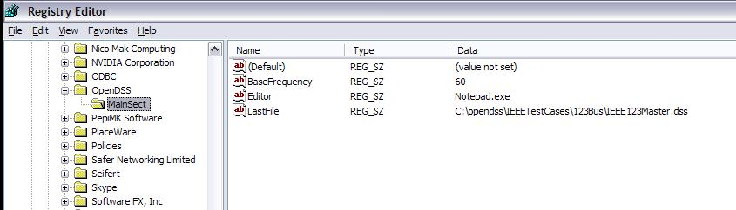
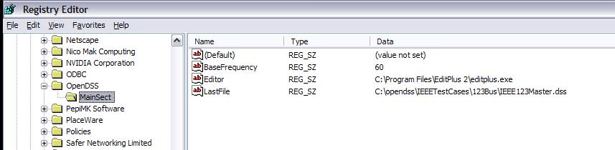
OpenDSS Registry Entries
Certain persistent values are saved to the Windows Registry upon exiting the program
Default Editor Setting
After Redefining

Slide 102
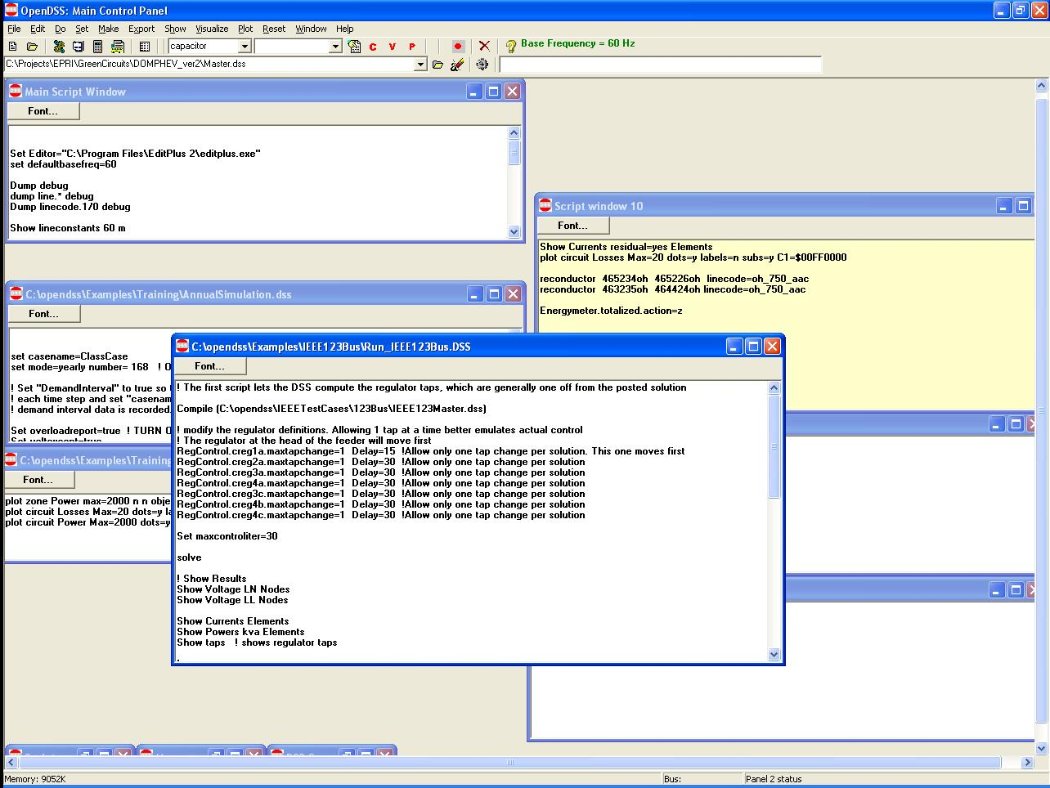
Organizing Your Main Screen
Main Script Window never goes away. Put some frequently-used commands here.
Annual Simulation Script
Misc. Scripts
Plotting Scripts
Project Run window

Slide 103
A Common Sense Structuring of Script Files
Run_The_Master.DSS
“Compile” the Master file from here
Master.DSS
LineCodes.DSS
WireData.DSS
LineGeometry.DSS
Libraries
Put a “Clear” in here
Spectrum.DSS
LoadShape.DSS
Transformers.DSS
Lines.DSS
Circuit
Definition
Make a separate folder for each circuit
Loads.DSS
Etc.

Slide 104
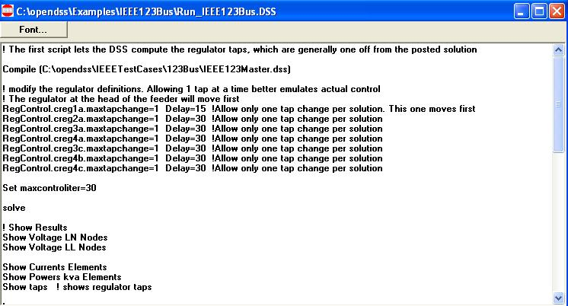
Organizing Run Scripts
Based on 123-bus Test Feeder
Compiles the Circuit Description
Override Some Property Settings
and/or
Define Some Additional Circuit Element
Change an option
Solve Snapshot Power Flow
Selected Results Display

Slide 105
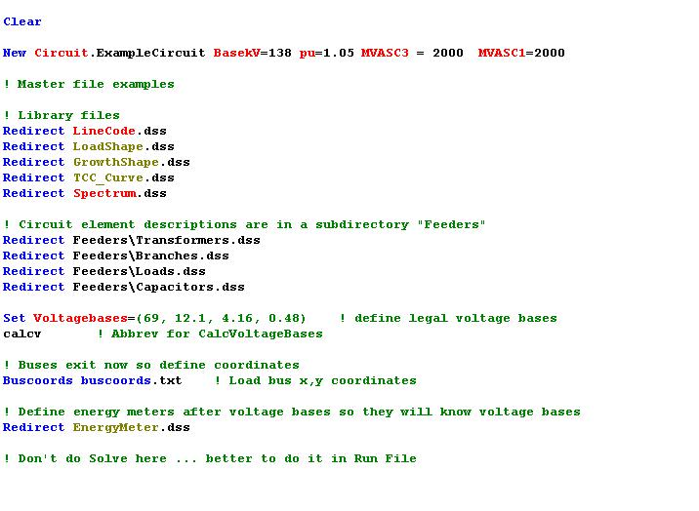
Organizing Your Master File
So Compile Doesn’t Fail
General Library Data
Circuit Elements for this Model
Let OpenDSS Define the Voltage Bases
(You can do this explicitly with SetkVBase command)

Slide 106
Example:
IEEE 8500-Node Test Feeder

Slide 107
Main Part of “Run” File
Compile base circuit description
Add an energymeter not in base description
Change an option
Solve
Compile (C:\DSSdata\IEEETest\8500Node\Master-unbal.dss)
New Energymeter.m1 Line.ln5815900-1 1
! Put an Energymeter at the head of the feeder
Set Maxiterations=20
! Sometimes the solution takes more than the default 15 iterations
Solve

Slide 108
The Master File
Clear
New Circuit.IEEE8500u
! Make the source stiff with small impedance
~ pu=1.05 r1=0 x1=0.001 r0=0 x0=0.001
Redirect LineCodes2.dss
Redirect Triplex_Linecodes.dss
Redirect Lines.dss
Redirect Transformers.dss
Redirect LoadXfmrs.dss ! Load Transformers
Redirect Triplex_Lines.dss
Redirect UnbalancedLoads.dss
Redirect Capacitors.dss
Redirect CapControls.dss
Redirect Regulators.dss
! Let DSS estimate the voltage bases
Set voltagebases=[115, 12.47, 0.48, 0.208]
Calcvoltagebases ! This also establishes the bus list
! Load in bus coordintes now that bus list is established
Buscoords Buscoords.dss

Slide 109
Exercise the 8500-Node Test Feeder …

Slide 110
Loadshapes and Smart Grid Simulation
How to use the OpenDSS Loadshape capability and simulate various time-series phenomena related to Smart Grid simulations.

Slide 111
Loadshapes
Key feature of OpenDSS
Sequential time simulation is required for many Smart Grid analyses
Basic time-varying modes that use Loadshape objects
  Daily (nominally 24 h, 1 h steps)
  Yearly (nominally 8760 h, 1 h steps)
  Dutycycle (nominal step size 1 s .. 5 m)
    (used for wind and solar)

Slide 112
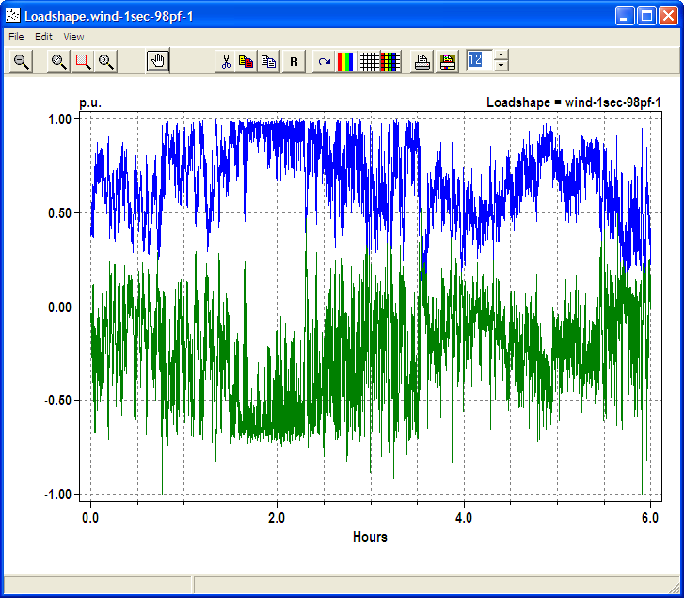
Example Loadshape for Wind Turbine Output
Watts
Vars

Slide 113
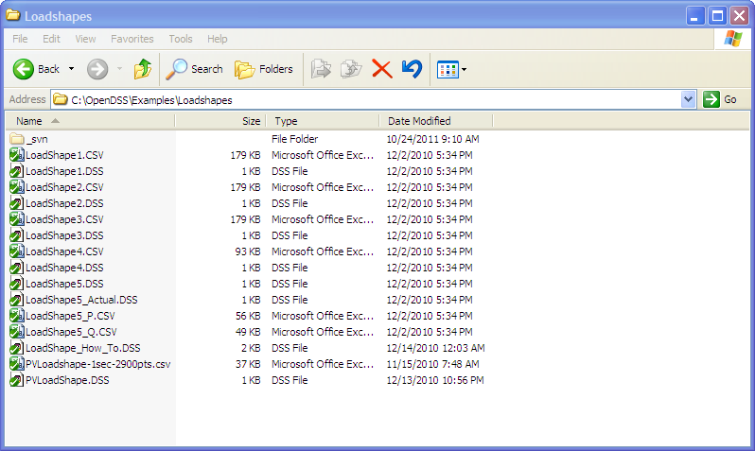
Example Loadshapes Provided in Examples Folder

Slide 114
How to Define
Clear
! Example scripts for loading and plotting loadshapes out of the loadshape library
! You have to have a circuit defined to load in loadshapes.
New Circuit.LoadshapeExamples
! directly ...
New "LoadShape.LoadShape1a" npts=8760 interval=1.0 mult=(File=LoadShape1.csv)
Plot Loadshape Object=Loadshape1a ! execute this to prove you got it
! or using Redirect
Redirect Loadshape1.DSS ! Load in Loadshape 1
Plot Loadshape Object=Loadshape1

Slide 115
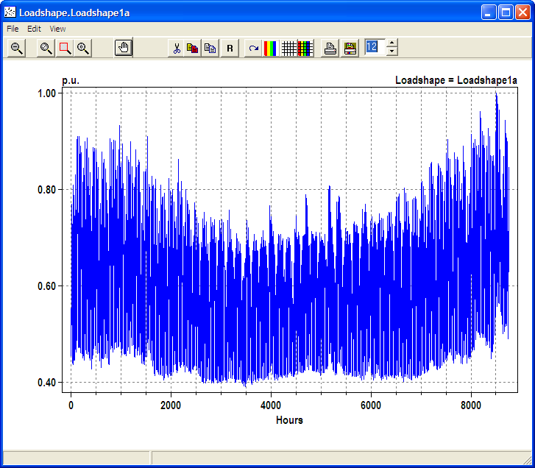
Example Yearly LoadShape

Slide 116
Loadshape Interpolation
The OpenDSS LOADSHAPE class uses two different types of interpolation depending on it is defined
Fixed interval data.
  Default. INTERVAL property defaults to 1 hour.
  You can set it to another value or to 0.
    The SINTERVAL and MINTERVAL properties facilitate defining intervals in second or minutes.
  INTERVAL > 0: fixed interval data
    CSV files --one numeric value per line.
    Interpolation algorithm assumes the value REMAINS CONSTANT over the entire interval
    The HOUR array property is ignored

Slide 117
Loadshape Interpolation, Cont’d
For LINEAR INTERPOLATION between the points, define INTERVAL=0.
  Then both the time and multiplier values for the loadshape using the HOUR, MULT, and QMULT array properties.
Alternatively, you may use the CSVFILE, DBLFILE, or SNGFILE properties.
  Enter both the time in hours and the multiplier values.
    A CSV file would have two values per line separated by a comma or whitespace.
The variable interval interpolation could be a little bit slower than the fixed interval data because there is more work to do to compute the factor.

Slide 118
Importing Packed Binary Files
For simulations, such as AMI, required large volumes of Loadshapes to be imported, using packed binary files can save time
Standard CSV or TXT file
  Mult=[file=myfile.txt]
File of doubles
  Mult=[dblfile=myfile.dbl]
File of singles
  Mult=[sngfile=myfile.sng]

Slide 119
Recent (2011) Enhancements to Defining Array Properties Using CSV files
Syntax:
  mult=[File=myMultiColumnFile.CSV, Column=n, Header=Yes/No]
Allows use of multicolumn CSV files with a single header row.
Example
New Loadshape.Ramp2 npts=4000 sInterval=1 mult=(file=MultiChannelTest.csv, column=3, header=yes)
  Imports the 3rd column from the file, skipping the header row

Slide 120
Advanced
Topics

Slide 121
Intrinsic Simulation Modes
Discussion of the various solution modes built into the OpenDSS

Slide 122
Built-in Solution Modes
Snapshot (static) Power Flow
Direct (non-iterative)
Daily mode (default: 24 1-hr increments)
Yearly mode (default 8760 1-hr increments)
Duty cycle (1 to 5s increments)
Dynamics (electromechanical transients)
Fault study
Monte carlo fault study
Harmonic
Custom user-defined solutions

Slide 123
Snapshot Mode
This is the default solution mode after creating a new circuit model
The basic power flow solution mode for the OpenDSS
Performs a single solution each time Solve is issued
Control mode defaults to “Static”
Defaults to iterative power flow solution
  Load model is “Powerflow”

Slide 124
Direct Mode
Performs a non-iterative solution of the present system admittance equation
Loads and Generators represented by constant impedance
  Value in their Norton equivalents
This is a useful mode when convergence is difficult, but needed to perform Harmonic, Dynamic, or Faultstudy mode solution.
  Will nearly always give a reasonable starting point for these solution modes

Slide 125
Daily Mode
Defaults
  Stepsize = 1.0 h
  Controlmode = static
  Number = 24
Designed for simulations of a load profile for one day for distribution planning studies, losses, other energy studies
Time step of 0.25 .. 1.0 h typically
One or more days (change number)
Set the Daily= property of Load and Generator to follow a loadshape
Similar functionality to Yearly mode

Slide 126
Yearly Mode
Defaults
  Stepsize = 1.0 h
  Controlmode = static
  Number = 8760
Designed for annual simulations for distribution planning studies, losses, other energy studies
Time step of 0.25 .. 1.0 h typically
All or part of year
Set the Yearly= property of Load and Generator to follow a loadshape

Slide 127
DutyCycle Mode
Defaults
  Stepsize = 1.0 s
  Controlmode = time
  Number = 100
Designed for simulations of wind turbine output, solar PV output, stone crushers, and other impulse loads
Time step of 1 – 10 s
Duration of a few minutes up to 1 day
Set the Duty= property of Load and Generator to follow a loadshape

Slide 128
Dynamics Mode
Defaults
  Stepsize = 0.001 s
  Controlmode = time
  Number = 100
Electromagnetic transients simulations
Generator state variables integrated
  Predictor-corrector
Intended for simulations of a few seconds duration

Slide 129
FaultStudy Mode
Defaults to dynamic model so machine contributions to faults are included
Requires a power flow solution to start
Solve causes short circuit equivalents to be computed for each bus
Follow immediately by “Show Faultstudy” report
  Computes fault currents
Typical sequence:
  Solve
  Solve mode=Faultstudy
  Show Faultstudy

Slide 130
Monte Carlo Fault Study Mode
A special kind of fault study useful for some reliability or power quality studies
The circuit model is first populated by a selected number of Fault objects.
  Example: SLG faults at all buses
  User can distribute faults in any manner
This solution mode activates the faults one at a time and computes a Snapshot solution with loads modeled as admittances
Be sure to place Monitors around the circuit where you want to see voltage sag magnitudes, fault currents, etc.
  Answers will come fast!

Slide 131
Harmonic Mode
Defaults
  Controlmode = OFF
  Loadmodel = Admittance
Performs a direct solution at each frequency presently defined in the problem by Spectrum objects.
  See Harmonics option
Requires a power flow solution
Typical sequence
  Solve
  Solve mode=harmonics
Be sure you have Monitor objects defined!

Slide 132
Control Modes
Control models are a key feature of OpenDSS and it is important to understand how they work in different solution modes.
Key Modes
  OFF
    Controls are disabled; controlled parameters stay the same as last value
  TIME
    Controls operate when solution reaches a specified time. For time steps smaller than control delay
  STATIC
    For time steps larger than control delay. Controls operate in sequence of time delay values.
      Shortest delay operates first
      Default for Snapshot, Daily, Yearly modes

Slide 133
Questions?

Slide 134
Using the COM Interface
Discussion of the various solution modes built into the OpenDSS

Slide 135
DSS Structure
Scripts
Main Simulation Engine
COM Interface
User-Written DLLs
Scripts, Results

Slide 136
OpenDSSEngine.DSS is Registered
Windows Registry Entry
GUID
The Server shows up as “OpenDSSEngine.DSS” in the Windows Registry
The OpenDSS is now available to any program on the computer

Slide 137
Accessing the COM Server
Examples of accessing the COM server in various languages
In MATLAB:
  DSSobj = actxserver(‘OpenDSSEngine.DSS’);
In VBA:
  Public DSSobj As OpenDSSEngine.DSS
  Set DSSobj = New OpenDSSEngine.DSS
In Dephi
  {Import Type Library}
  DSSObj := coDSS.Create;
In PYTHON:
  self.engine = win32com.client.Dispatch("OpenDSSEngine.DSS")

Slide 138
Active objects concept
There is one registered In-Process COM interface:
  OpenDSSEngine.DSS
    That is, the DSS interface is the one you instantiate
    The DSS interface creates all the others.
The interfaces generally employ the idea of an
ACTIVE object
  Active circuit,
  Active circuit element,
  Active bus, etc.
  The interfaces generally point to the active object
    To work with another object, change the active object.

Slide 139
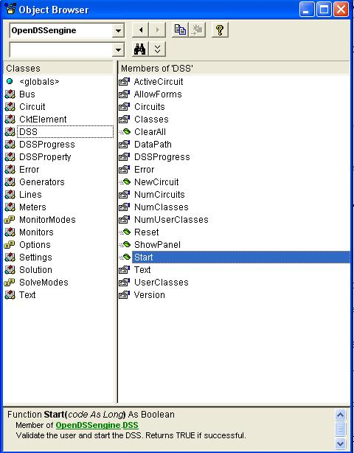
DSS Interface
This interface is instantiated upon loading OpenDSSEngine.DSS and then instantiates all other interfaces
Call the Start(0) method to initialize the DSS
DSS Class Functions (methods) and Properties

Slide 140
A Simple VBA Macro
(Class Exercise)
To run the IEEE 123-bus Test Feeder and plot the voltage profile

Slide 141
Option Explicit
Public MyOpenDSS As OpenDSSengine.DSS
Public MyText As OpenDSSengine.Text
Public MyCircuit As OpenDSSengine.Circuit
Public Sub MyMacro()
Set MyOpenDSS = New OpenDSSengine.DSS
MyOpenDSS.Start (0)
Set MyText = MyOpenDSS.Text
Set MyCircuit = MyOpenDSS.ActiveCircuit
MyText.Command = "Compile (C:\OpenDSS\IEEETestCases\123Bus\IEEE123Master.dss)"
MyText.Command = "New Energymeter.M1 element=Line.L115 terminal=1"
MyText.Command = "Solve"
Dim MyVoltages As Variant
Dim MyNames As Variant
Dim Mydistances As Variant
MyVoltages = MyCircuit.AllBusVmagPu
MyNames = MyCircuit.AllNodeNames
Mydistances = MyCircuit.AllNodeDistances
Dim i As Integer, irow As Integer
irow = 1
For i = LBound(MyVoltages) To UBound(MyVoltages)
ActiveSheet.Cells(irow, 1).Value = MyNames(i)
ActiveSheet.Cells(irow, 2).Value = Mydistances(i)
ActiveSheet.Cells(irow, 3).Value = MyVoltages(i)
irow = irow + 1
Next I
Set MyOpenDSS = Nothing
End Sub

Slide 142
Steps to Do This
Register OpenDSSEngine.DLL (once)
Start Excel
Type alt-F11 to open VBA editor
  Or Tools>Macro …
Select OpenDSS Engine under Tools>References
Insert>Module
Enter code into blank module
  Use correct path name for your computer
Execute the macro “MyMacro”

Slide 143
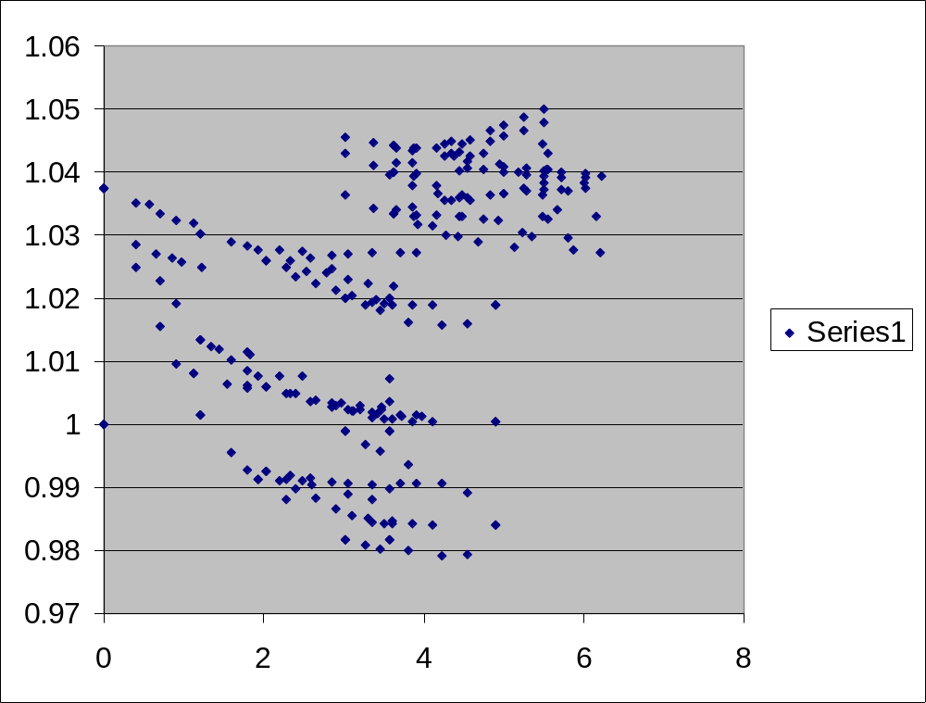
Resulting Chart in Excel

Slide 144
For Your Reference …
More on Accessing COM Interface from VBA
(MS Excel is one of the better tools for exposing the COM interface)

Slide 145
Instantiate the DSS Interface and Attempt Start
Public Sub StartDSS()
' Create a new instance of the DSS
Set DSSobj = New OpenDSSengine.DSS
' Start the DSS
If Not DSSobj.Start(0) Then
MsgBox "DSS Failed to Start"
Else
MsgBox "DSS Started successfully“
' Assign a variable to the Text interface for easier access
Set DSSText = DSSobj.Text
End If
End Sub

Slide 146
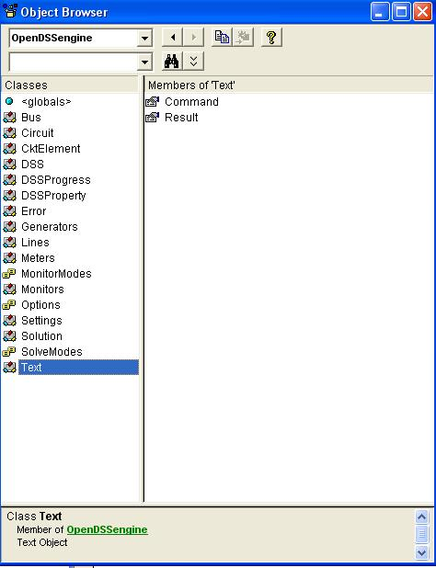
COM Interface
Interfaces as Exposed by VBA Object Browser in MS Excel
Text interface is simplest
Text has two Properties

Slide 147
Assign a Variable to the Text Interface
Public Sub StartDSS()
' Create a new instance of the DSS
Set DSSobj = New OpenDSSengine.DSS
' Start the DSS
If Not DSSobj.Start(0) Then
MsgBox "DSS Failed to Start"
Else
MsgBox "DSS Started successfully“
' Assign a variable to the Text interface for easier access
Set DSSText = DSSobj.Text
End If
End Sub

Slide 148
Now Use the Text Interface …
You can issue any of the DSS script commands from the Text interface
‘ Always a good idea to clear the DSS when loading a new circuit
DSSText.Command = "clear"
' Compile the script in the file listed under "fname" cell on the main form
DSSText.Command = "compile " + fname
‘ Set regulator tap change limits for IEEE 123 bus test case
With DSSText
.Command = "RegControl.creg1a.maxtapchange=1 Delay=15 !Allow only one tap change per solution. This one moves first"
.Command = "RegControl.creg2a.maxtapchange=1 Delay=30 !Allow only one tap change per solution"
.Command = "RegControl.creg3a.maxtapchange=1 Delay=30 !Allow only one tap change per solution"
.Command = "RegControl.creg4a.maxtapchange=1 Delay=30 !Allow only one tap change per solution"
.Command = "RegControl.creg3c.maxtapchange=1 Delay=30 !Allow only one tap change per solution"
.Command = "RegControl.creg4b.maxtapchange=1 Delay=30 !Allow only one tap change per solution"
.Command = "RegControl.creg4c.maxtapchange=1 Delay=30 !Allow only one tap change per solution"
.Command = "Set MaxControlIter=30"
End With

Slide 149
Result Property
The Result property is a Read Only property that contains any result messages the most recent command may have issued.
  Error messages
  Requested values
‘ Example: Query line length
DSSText.Command = “? Line.L1.Length”
S = DSSText.Result ‘ Get the answer
MsgBox S ‘ Display the answer

Slide 150
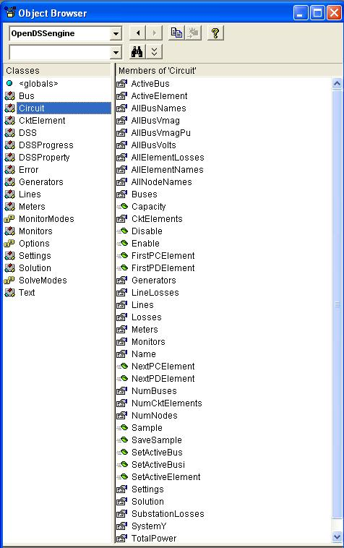
Circuit Interface
This interface is used to
Get many of the results for the most recent solution of the circuit
Select individual circuit elements in a variety of ways
Select the active bus
Enable/Disable circuit elements

Slide 151
Circuit Interface
Since the Circuit interface is used often, it is recommended that a special variable be assigned to it:
Public DSSCircuit As OpenDSSengine.Circuit
…
DSSText.Command = “Compile xxxx.dss”
Set DSSCircuit = DSSobj.ActiveCircuit
DSSCircuit.Solution.Solve
… ‘ Retrieving array quantities into variants
V = DSSCircuit.AllBusVmagPu
VL =DSSCircuit.AllElementLosses

Slide 152
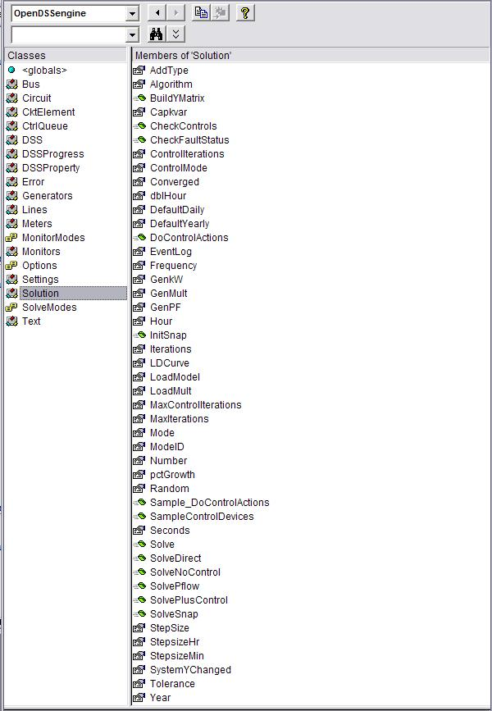
Solution Interface
The Solution Interface is used to
Execute a solution
Set the solution mode
Set solution parameters (iterations,
control iterations, etc.)
Set the time and time step size

Slide 153
Solution Interface
Assuming the existence of a DSSCircuit variable referencing the Circuit interface
Set DSSSolution = DSSCircuit.Solution
With DSSSolution
…
.LoadModel=dssAdmittance
.dblHour = 750.75
.solve
End With
Use the With statement in VBA to simplify coding

Slide 154

CktElement Interface
This interface provides specific values of the Active Circuit Element
Some values are returned as variant arrays
V = DSSCircuit.ActiveElement.Powers
V = DSSCircuit.ActiveElement.seqCurrents
V = DSSCircuit.ActiveElement.Yprim
Other values are scalars
Name = DSSCircuit.ActiveElement.Name
Nph = DSSCircuit.ActiveElement.NumPhases

Slide 155

Properties Interface
This interface gives access to a String value of each public property of the active element
“Val” is a read/write property

Slide 156
Properties Interface
With DSSCircuit.ActiveElement
  ‘ Get all the property names
  VS = .AllPropertyNames
  ‘ Get a property value by numeric index
  V = .Properties(2).Val
  ‘ Get same property value by name (VS is 0 based)
  V = .Properties(VS(1)).Val
  ‘ Set Property Value by Name
  DSSCircuit.SetActiveElement(“Line.L1”)
  .Properties(‘R1’).Val = “.068”
End With
The last two statements are equivalent to:
DSSText.Command = “Line.L1.R1=.068”

Slide 157

Lines Interface
This interface is provided to iterate through all the lines in the circuit and change the most common properties of Lines.

Slide 158
Example: Setting all LineCodes to a Value
Set DSSLines = DSSCircuit.Lines
. . .
iL = DSSLines.First ‘sets active
Do While iL>0
DSSLines.LineCode = MyNewLineCode
iL = DSSLines.Next ‘ get next line
Loop

Slide 159
VBA Example
Option Explicit
Public DSSobj As OpenDSSengine.DSS
Public DSSText As OpenDSSengine.Text
Public DSSCircuit As OpenDSSengine.Circuit
Public Sub StartDSS()
' Create a new instance of the DSS
Set DSSobj = New OpenDSSengine.DSS
' Assign a variable to the Text interface for easier access
Set DSSText = DSSobj.Text
' Start the DSS
If Not DSSobj.Start(0) Then MsgBox "DSS Failed to Start"
End Sub
Define some public variables that are used throughout the project
This routine instantiates the DSS and starts it. It is also a good idea at this time to assign the text interface variable.

Slide 160
VBA Example
Public Sub LoadCircuit(fname As String)
' Always a good idea to clear the DSS when loading a new circuit
DSSText.Command = "clear"
' Compile the script in the file listed under "fname" cell on the main form
DSSText.Command = "compile " + fname
' The Compile command sets the current directory the that of the file
' Thats where all the result files will end up.
' Assign a variable to the Circuit interface for easier access
Set DSSCircuit = DSSobj.ActiveCircuit
End Sub
This subroutine loads the circuit from the base script files using the Compile command through the Text interface. “fname” is a string contains the name of the master file.
There is an active circuit now, so assign the DSSCircuit variable.

Slide 161
VBA Example
Public Sub LoadSeqVoltages()
' This Sub loads the sequence voltages onto Sheet1 starting in Row 2
Dim DSSBus As OpenDSSengine.Bus
Dim iRow As Long, iCol As Long, i As Long, j As Long
Dim V As Variant
Dim WorkingSheet As Worksheet
Set WorkingSheet = Sheet1 'set to Sheet1 (target sheet)
iRow = 2
For i = 1 To DSSCircuit.NumBuses ' Cycle through all buses
Set DSSBus = DSSCircuit.Buses(i) ' Set ith bus active
' Bus name goes into Column 1
WorkingSheet.Cells(iRow, 1).Value = DSSCircuit.ActiveBus.Name
' Load sequence voltage magnitudes of active bus into variant array
V = DSSBus.SeqVoltages
' Put the variant array values into Cells
' Use Lbound and UBound because you don't know the actual range
iCol = 2
For j = LBound(V) To UBound(V)
WorkingSheet.Cells(iRow, iCol).Value = V(j)
iCol = iCol + 1
Next j
iRow = iRow + 1
Next i
End Sub
This Sub puts the sequence voltage onto a spreadsheet
Define a variable for the Bus interface
Define a variant to pick up the arrays
Cycle through all the buses
Get the bus name
Get the voltages into the variant array
Put them on the spreadsheet

Slide 162
Branch Exchange Example
See
OpenDSS Wiki on SourceForge.Net
TechNote_Excel_VBA_Example

Slide 163

Loss Minimization – Branch Exchange
Branch Exchange
Loop Breaking
Branch & Bound
Heuristics
Optimization
  Genetic Alg.
  Simulated Annealing
  Ant Colony
  Et cetera

Slide 164
While Not done
r = iter + 1
ws.Cells(r, 10) = iter
ckt.Solution.Solve ‘ solve the current system
ThisLoss = ckt.Losses(0)
ws.Cells(r, 11) = ThisLoss ‘ write current losses, # loops, # isolated loads to sheet
ws.Cells(r, 12) = CStr(ckt.Topology.NumLoops) & " _ " & _
CStr(ckt.Topology.NumIsolatedLoads)
Vmax = 0# ‘ track the maximum voltage difference across any open switch
ToClose = ""
ToOpen = ""
LowBus = ""
c = 14 ‘ column number for output
i = swt.First ‘ check all SwtControls
While i > 0 ' find the open switch with biggest delta-V
… (Inner loop – next slide)
Wend
ws.Cells(r, 13) = CStr(Vmax)
done = True ' unless we found a switch pair to exchange
If Len(ToOpen) > 0 And Len(ToClose) > 0 Then ‘ found a switch pair to exchange
swt.name = ToClose ‘ do the switch close-open via SwtControl interface
swt.Action = dssActionClose
swt.name = ToOpen
swt.Action = dssActionOpen
done = False ' try again ‘ i.e., run solution again and look for the next exchange
End If
iter = r
' stop if too many iterations, system is non-radial, or losses go up
If iter > 10 Or ckt.Topology.NumIsolatedLoads > 0 Or ThisLoss > LastLoss Then
done = True ‘ met one of the three stopping criteria
End If
LastLoss = ThisLoss ‘ best loss total found so far
Wend

Slide 165
Inner Loop
  While i > 0 ' find the open switch with biggest delta-V
If swt.Action = dssActionOpen Then ‘ check only open switches
ws.Cells(r, c) = swt.name
Set elem = ckt.CktElements(swt.SwitchedObj)
Vdiff = Abs(elem.SeqVoltages(1) - elem.SeqVoltages(4)) ‘ V1 across switch
If Vdiff > Vmax Then ‘ if highest V1 difference so far…
LowBus = FindLowBus ‘ which side of open switch has lowest V?
topo.BusName = LowBus ‘ start from that bus in the topology
Set elem = ckt.ActiveCktElement
k = 1
While (Not elem.HasSwitchControl) And (k > 0) ‘ trace back from low bus to src
k = topo.BackwardBranch ‘ until we find a closed switch
Wend
If elem.HasSwitchControl Then ‘ if we found a switch to close…
Vmax = Vdiff ‘ keep this as the highest voltage difference found
ToClose = swt.name ‘ we will close this currently-open switch
ToOpen = Mid(elem.Controller, 12) ‘ and open the switch from back-trace
End If
End If
c = c + 1
End If
i = swt.Next
Wend

Slide 166
Running from MATLAB

Slide 167
Running OpenDSS From Matlab
Starting the DSS
%Start up the DSS
[DSSStartOK, DSSObj, DSSText] = DSSStartup;
function [Start,Obj,Text] = DSSStartup
% Function for starting up the DSS
%
%instantiate the DSS Object
Obj = actxserver('OpenDSSEngine.DSS');
%
%Start the DSS. Only needs to be executed the first time w/in a
%Matlab session
Start = Obj.Start(0);
% Define the text interface to return
Text = Obj.Text;

Slide 168
Using the DSS through the Text Interface from Matlab (harmonics example)
%Compile the DSS circuit script
DSSText.Command = 'compile master.dss';
% get an interface to the active circuit called "DSSCircuit"
DSSCircuit = DSSObj.ActiveCircuit;
%Determine which connection type for the source and call
%appropriate DSS file
switch XFMRType
case 1
DSSText.Command = 'redirect directconnectsource.DSS';
case 2
DSSText.Command = 'redirect deltadelta.DSS';
case 3
DSSText.Command = 'redirect deltawye.DSS';
otherwise
disp('Unknown source Connection Type')
end
%Set the system frequency and vsource frequency for harmonic requested
DSSText.Command = ['set frequency=(' num2str(Freq) ' 60 *)'];
DSSText.Command = ['vsource.source.frequency=(' num2str(Freq) ' 60 *)'];

Slide 169
Using the DSS through the Text Interface from Matlab (harmonics example) (cont’d)
% Vary the parameters according to a random distribution
% If more parameters need to be varied, just add them to the below
% list. Set ParamNum to total number of parameters varied
ParamNum = 6; %ParamNum used for sorting/plotting
for Case_Count = 1:Max_Cases
%Create index in the OutputData matrix to keep the cases in order
OutputData(Case_Count,1) = Case_Count;
% Generate random new coordinates for each conductor
[x1 y1 x2 y2 x3 y3 geomean] = RandomGeometry(8,0.75,30);
(... etc. etc. )
%define a new line geometry with random spacing
DSSText.Command = ['New LineGeometry.OHMOD nconds=3 nphases=3 cond=1 wire=acsr336 x=' num2str(x1) ' ' num2str(y1) ' units=ft cond=2 wire=acsr336 x=' num2str(x2) ' ' num2str(y2) ' units=ft cond=3 wire=acsr336 x=' num2str(x3) ' ' num2str(y3) ' units=ft'];
%Solve the circuit
DSSText.Command = 'solve';
(etc. etc.)

Slide 170
Together…Shaping the Future of Electricity

