Slide 1

Architecture and Circuit Modeling Basics
Roger C. Dugan
Sr. Technical Executive, EPRI
Jacobs Hall, UCSD
Dec 14-15, 2010

Slide 2
DSS Architecture

Slide 3
DSS Structure
Scripts
Main Simulation Engine
COM Interface
User-Written DLLs
Scripts, Results

Slide 4
DSS Object Structure
DSS Executive
Commands
Options
Circuit
Solution
V
[Y]
I
PDElement
PCElement
Controls
Meters
General
Line
Transformer
Capacitor
Reactor
Load
Generator
Vsource
Isource
Storage
RegControl
CapControl
Relay
Reclose
Fuse
Monitor
EnergyMeter
Sensor
LineCode
LineGeometry
WireData
LoadShape
GrowthShape
Spectrum
TCCcurve
XfmrCode

Slide 5
DSS Class Structure
Instances of Objects of this class
Class
Object 1
Property Definitions
Property Values
Methods
Class Property Editor
Yprim
Collection Manager
States
Object n
Property Values
Methods
Yprim
States

Slide 6
Circuit Modeling Basics

Slide 7
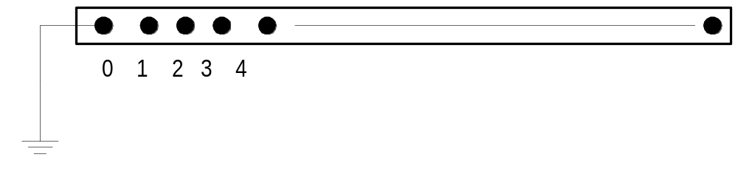
DSS Bus Model
Referring to Buses and Nodes
Bus1=BusName.1.2.3.0
(This is the default for a 3-phase circuit element)
Shorthand notation for taking the default
Bus1=BusName
Note: Sometimes this can bite you (e.g. – Transformers, or capacitors with ungrounded neutrals)

Slide 8
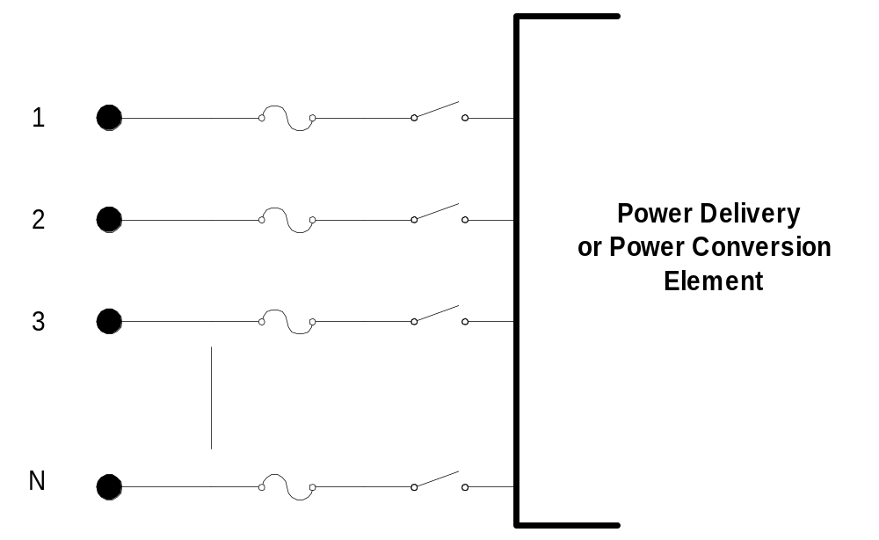
DSS Terminal Definition

Slide 9
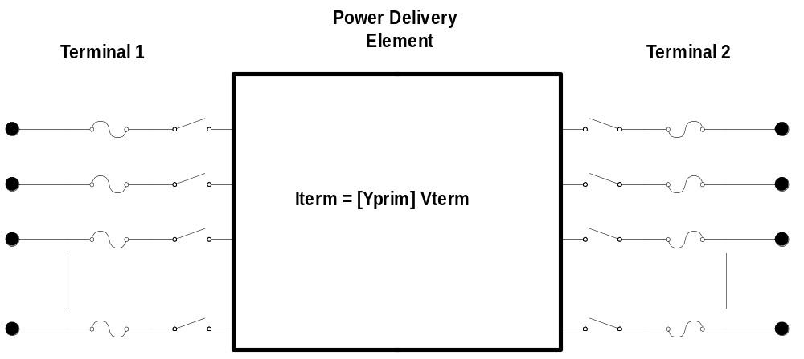
Power Delivery Elements

Slide 10
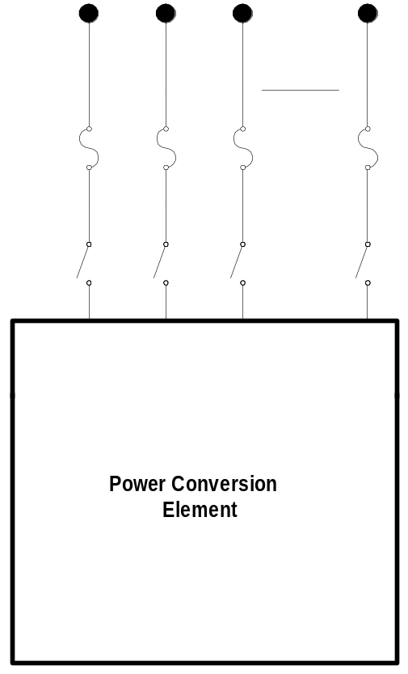

Power Conversion Elements
I_{Term}(t) = F(V_{Term}, [State], t)

Slide 11
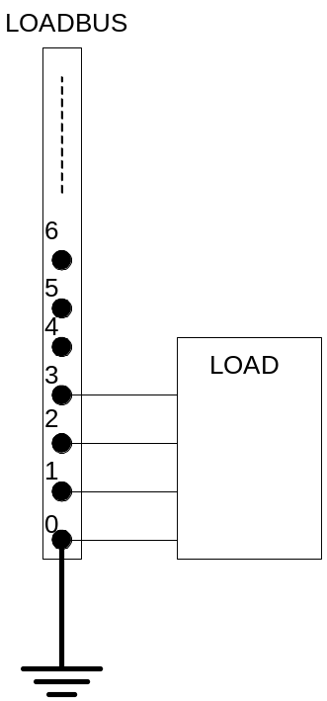
Specifying Bus Connections
Shorthand (implicit)
  New Load.LOAD1 Bus1=LOADBUS
    Assumes standard 3-phase connection by default

Slide 12
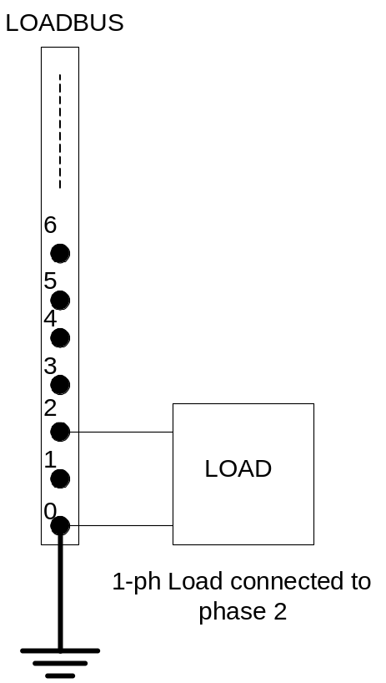
Specifying Bus Connections
Explicit
  New Load.LOAD1 Bus1=LOADBUS.1.2.3.0
      Explicitly defines which node
  New Load.1-PHASELOAD Phases=1 Bus1=LOADBUS.2.0
      Connects 1-phase load to phase 2 and ground

Slide 13
Specifying Bus Connections
Default Bus templates
    Node connections assumed if not explicitly declared
  Element declared Phases=1
    … LOADBUS.1.0.0.0.0.0.0.0.0.0. …
  Element declared Phases=2
    … LOADBUS.1.2.0.0.0.0.0.0.0.0. …
  Element declared Phases=3
    … LOADBUS.1.2.3.0.0.0.0.0.0.0. …

Slide 14
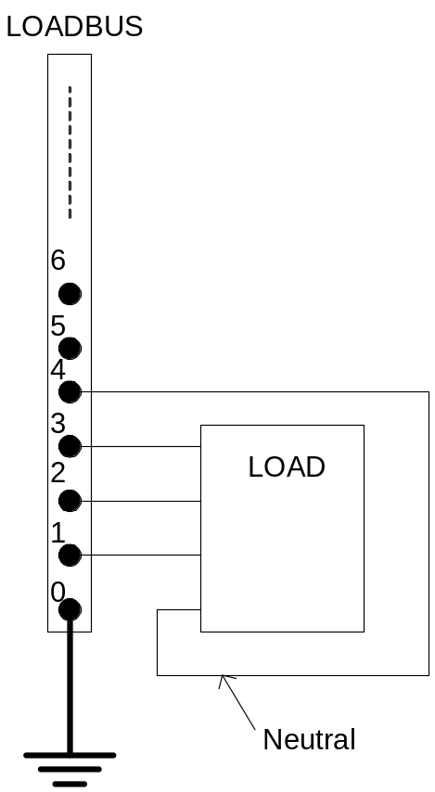
Specifying Bus Connections
  Ungrounded-Wye Specification
  Bus1=LOADBUS.1.2.3.4 (or some other unused Node number)

Slide 15
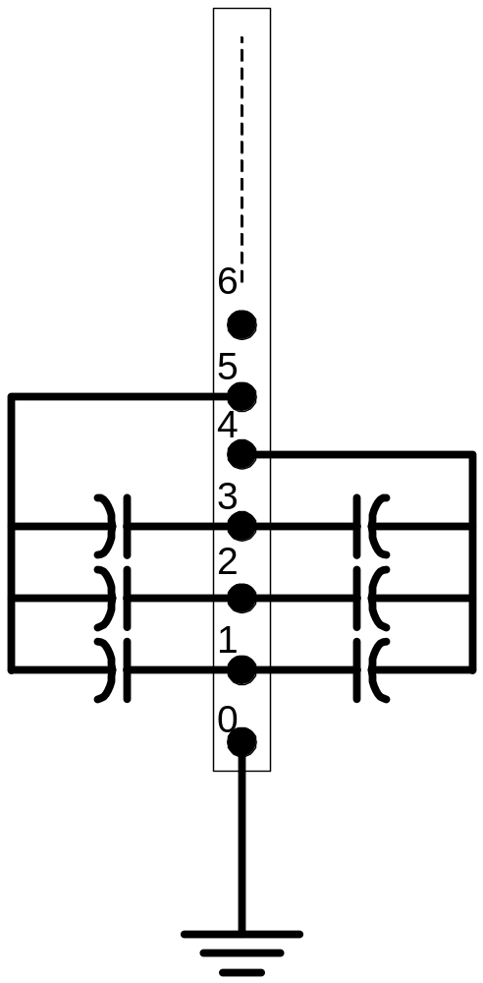
Specifying Two Ungrounded-Wye Capacitors on Same Bus
MyBus
… Bus1=MyBus.1.2.3 Bus2=MyBus.5.5.5
Neutrals are not connected to each other!
… Bus1=MyBus Bus2=MyBus.4.4.4

Slide 16
Circuit Elements are Connected together at the Nodes of Buses
MyBus
3
2
1
0
. . . Bus2 = MyBus.2.1.3.0 . . .
. . . Bus1 = MyBus . . .
(take the default)
(Explicitly define connections)
DSS Convention: A Terminal can be connected to only one Bus.
You can have any number of Nodes at a bus.

Slide 17
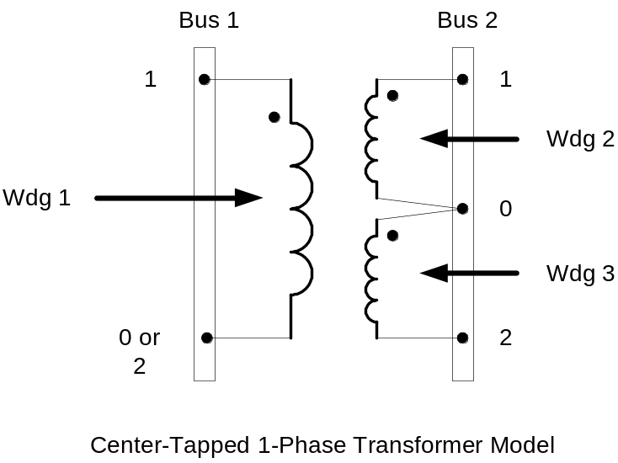
Example: Connections for 1-Phase Residential Transformer
! Line-to-Neutral Connected 1-phase Center-tapped transformer
New Transformer.Example_1-ph phases=1 Windings=3
! Typical impedances for small transformer with interlaced secondaries
~ Xhl=2.04 Xht=2.04 Xlt=1.36 %noloadloss=.2
! Winding Definitions
~ wdg=1 Bus=Bus1.1.0 kV=7.2 kVA=25 %R=0.6 Conn=wye
~ wdg=2 Bus=Bus2.1.0 kV=0.12 kVA=25 %R=1.2 Conn=wye
~ Wdg=3 Bus=Bus2.0.2 kV=0.12 kVA=25 %R=1.2 Conn=wye
Note: You may use XfmrCode to define a library of transformer definitions that are used repeatedly (like LineCode for Line elements)

Slide 18
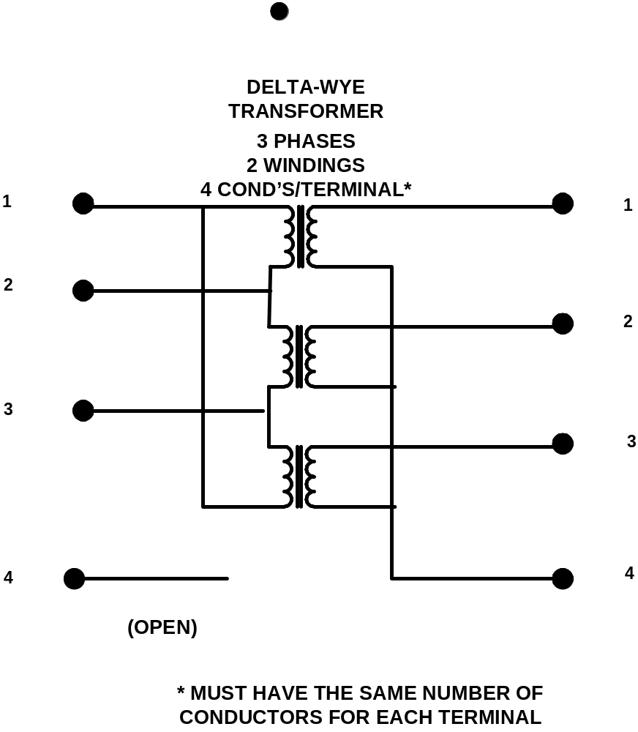
All Terminals of a Circuit Element Have Same Number of Conductors
3-Phase Transformer

Slide 19
Together…Shaping the Future of Electricity

