Slide 1
History of
GNU/Linux

Slide 2
Operating Systems
DOS
UNIX
Macintosh
Windows
GNU/Linux

Slide 3
Unix family Tree
1980
1980
1980
1990
1990
1970
1990
1970
1970
Time
Time
2000
Time
2000
2000
GNU
GNU
GNU
GNU / Linux
GNU / Linux
GNU / Linux
Linus Torvalds
Linus Torvalds
Richard Stallman
Linus Torvalds
Richard Stallman
Richard Stallman
You are here
You are here
FreeBSD
You are here
FreeBSD
FreeBSD
BSD family
BSD family
BSD family
OpenBSD
OpenBSD
OpenBSD
BSD (Berkeley Software Distribution)
BSD (Berkeley Software Distribution)
BSD (Berkeley Software Distribution)
NetBSD
NetBSD
NetBSD
SunOS (Stanford University Network)
SunOS (Stanford University Network)
SunOS (Stanford University Network)
Bell Labs (AT&T)
Bell Labs (AT&T)
Bell Labs (AT&T)
Bill Joy
Bill Joy
Bill Joy
MacOS X
MacOS X
NextStep
MacOS X
NextStep
NextStep
IRIX (SGI)
IRIX (SGI)
Ken Thompson
Dennis Ritchie (C language
created to implement a portable OS)
IRIX (SGI)
Ken Thompson
Dennis Ritchie (C language
created to implement a portable OS)
Ken Thompson
Dennis Ritchie (C language
created to implement a portable OS)
HP-UX
HP-UX
SRV5
HP-UX
SRV5
SRV5
Sun Solaris
Sun Solaris
Sun Solaris
System V family
System V family
System V family
AIX (IBM)
AIX (IBM)
AIX (IBM)

Slide 4
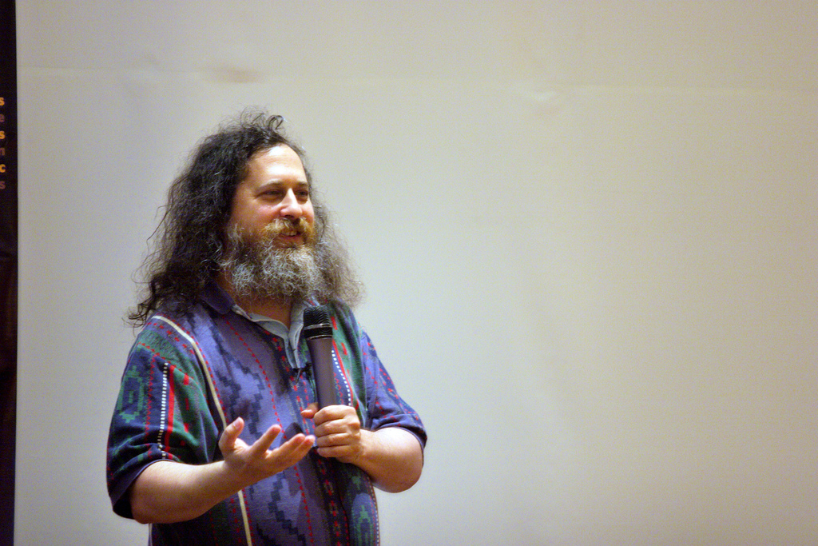
GNU
Richard M Stallman (RMS) MIT AI Lab ( 1980s )
  Printer problem. Program to send error message
  New Xerox Printer donated. Same problems
  Xerox refuses to give source code
  RMS decides to fight for Software Freedom
Http//www.stallman.org/

Slide 5

GNU = Gnu Not Unix
Ensures 4 freedoms
  0 Use for any purpose
  1 Study and adapt(modify)
  2 Distribute either free or gratis
  3 Distribute the modified source

Slide 6
GNU Software
Compilers
Editors
Languages
Network Tools
Servers
Databases
Device drivers
Desktop Utilities
Multimedia Apps
Games
Office Applications
and more

Slide 7

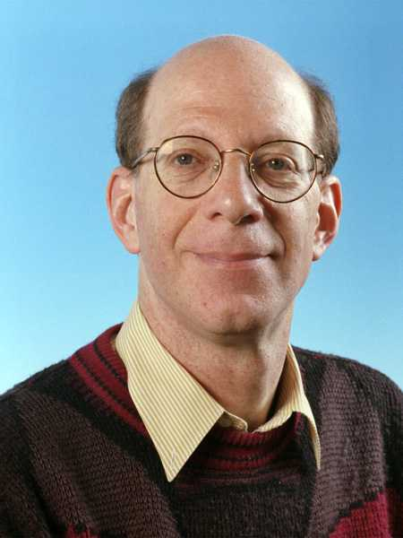
Andrew S. Tanenbaum

Slide 8
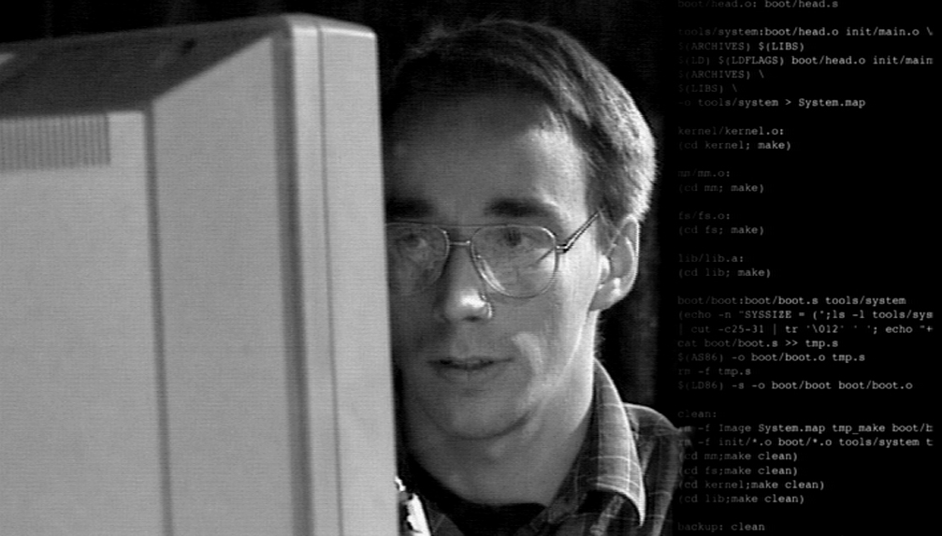
Linus Torvolds

Slide 9

Linux Kernel
Decides to develop a kernel based on AST's Minix for his project work
Leaves it on net for others to use/modify
Releases it under GPL license
Linux is typically used along with GNU
GNU/Linux

Slide 10
Timeline
1971 : First edition of UNIX comes out
1972 : Dennis Richie re-writes B and calls it C
1975 : Bourne shell is born
1977 : Berkeley Software Design releases BSD
1984 : Richard Stallman kicks off the GNU project
1985 : Richard Stallman starts Free Software Foundation
1989 : Release of GNU
1989 : Release of GNU GPL Version 1
1991 : Linus Torvalds announces the release of Linux Kernel

Slide 11
Timeline
10/1991 : v0.02 - first usable Linux
01/1992 : v0.12 - first 'actually working' version, under GPL
03/1992 : comp.os.linux
04/1992 : v0.95 - capable of using X
09/1992 : Linux stops being Minix-like and becomes UNIX-like
03/1994 : 1.0
06/1996 : 2.0.0
12/2003 : 2.6.0

Slide 12
GNU/Linux
Linux kernel + GNU apps = GNU/Linux
Tons of applications
Packaged into CDs/DVDs
Freely Downloaded from internet

Slide 13
GNU/Linux distributions
Take care of releasing a compatible set of kernel, C library, compilers and tools... A lot of work indeed!
Tools available in packages which can be easily installed, removed or upgraded. Tool version dependencies are automatically managed.
Commercial distributions: include support. Sources are free but usually not binaries.
Community distributions: both sources and binaries are free. No support by default.

Slide 14






GNU/Linux distributions
Fedora Core: http://fedora.redhat.com/
Stable, secure, user friendly, easy to install. Frequent full releases.
Ubuntu Linux: http://ubuntu-linux.org/
The growing community distribution. Debian based but stable releases every 6 months. User friendly. Great for beginners.
Debian: http://debian.org/
Very stable and safe, but more difficult to configure and install. Developer but no user friendly yet. Stable releases not frequent enough (every 2 or 3 years). Great for servers, but not for beginners!
Mandriva Community: http://mandrivalinux.com/
Easy to install, secure, user friendly, frequent full releases, but less stable (not enough testing and taking user feedback into account).
More than 200 Distributions

Slide 15


