Slide 1

Indian Linux User Group, Chennai
http://ilugc.in

Slide 2
Activities
Community Support
Mailing List
Monthly Meetings
Public Awareness Campaign
  Linux Demo Days
  Seminars at colleges, schools, public places
  Software Freedom Day celebrations
CD/DVD Sharing
Teaching, Training
No Entry/Membership Fee. Any one can Join

Slide 3

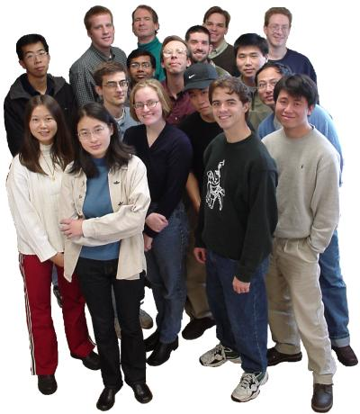
Community Support
Support from Local People
Immediate Response
Sharing Experience and Knowledge
Troubleshooting

Slide 4
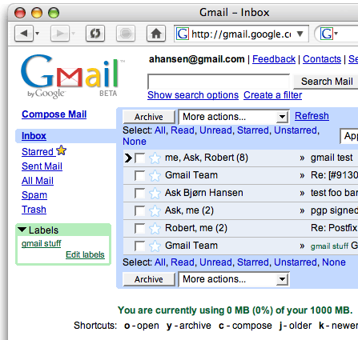
Mailing List
Over 2000 Members
Geeks, Experienced, Professors, Researchers, Students and more
24x7 Responses
you can ask any doubt.
Flame wars, Discussions, Reports, Kidding etc.
Join with us at
http://www.ae.iitm.ac.in/mailman/listinfo/ilugc

Slide 5
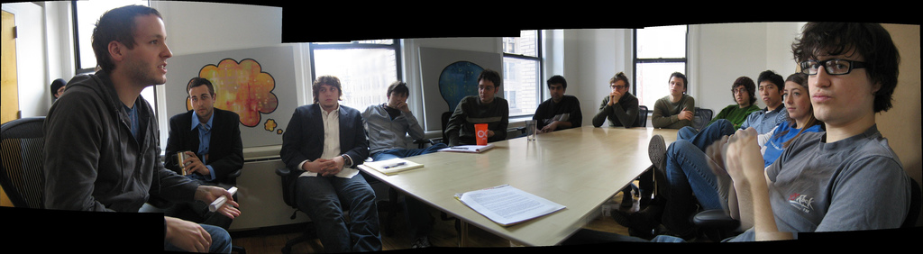
Monthly Meeting
Every 2nd Saturday
IIT Madras
Serious Discussions
Classes and Seminars
More Fun :-)
Free for All

Slide 6
Public Awareness Compaigns

Slide 7
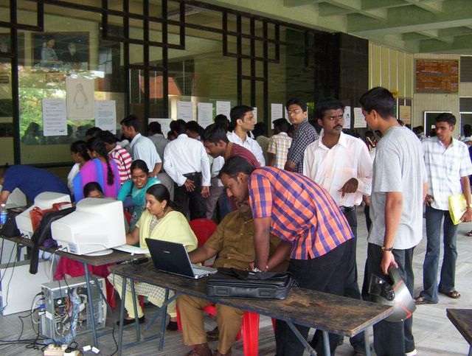
Linux Demo Day, Chennai

Slide 8
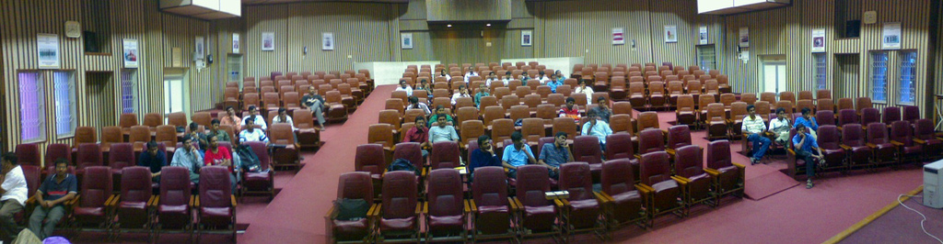
Public Seminar at IIT, Madras on Networking

Slide 9
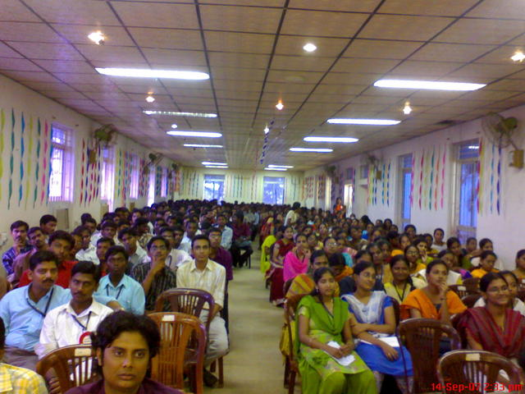
Software Freedom Day at
Jaya Engg College, Chennai

Slide 10
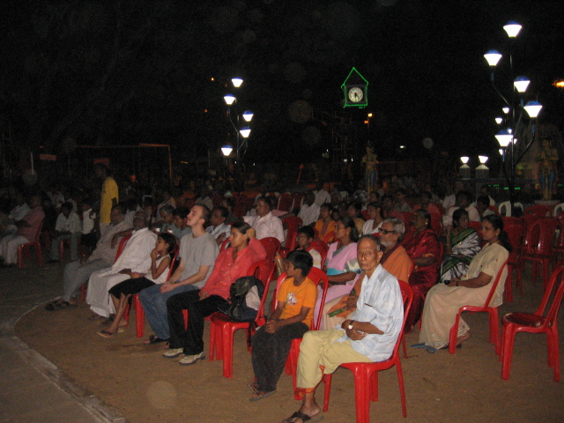
Software Freedom Day at
Anna Nagar,Chennai

Slide 11

Money ?

Slide 12
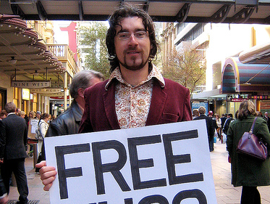
It is Really FREE

Slide 13

Join Today
http://ilugc.in

Slide 14


