Slide 1

Jobs in Open Source

Slide 2

Jobs in Open Source
Administration
Development
Support
Embedded Systems
Entrepreneurship

Slide 3
Domains
Bio Informatics
Computer Networks
Gaming Industry
Embedded Systems/VLSI
Operating Systems
Research
Service Industry
Systems Development
System / Network Administration
Training
Telecommunications

Slide 4
Job Designations
Application Developer
Graphics Designer
Embedded System Engineer
Freelance writer
Professor/Researcher
Marketing Specialist
Consultant
System/Network Administrator
VLSI Engineer
System Developer
Web Developer

Slide 5

Networking

Slide 6

Junior Administrator

Slide 7

Senior
Administrator

Slide 8
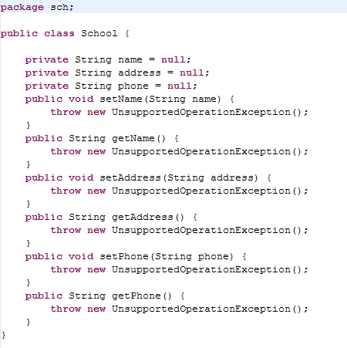
Programming

Slide 9


Programming Roles
Project Manager
Tech Lead
Project Leader
Team Leader
Senior Programmer
Junior Programmer

Slide 10
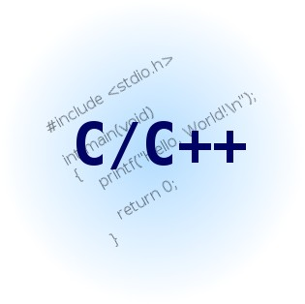






Languages

Slide 11






Desktop Development

Slide 12

Web Development

Slide 13

Web Development

Slide 14




Databases

Slide 15


LAMP

Slide 16

Software Testing

Slide 17

Training
Corporate Training
Training Centers

Slide 18



Support

Slide 19

Voice

Slide 20

Text

Slide 21

OnSite

Slide 22

Authoring

Slide 23

Embedded

Slide 24

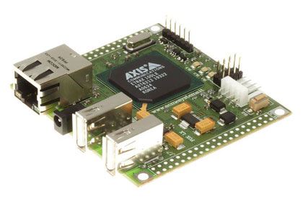
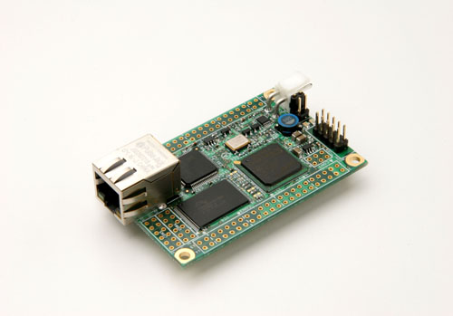
Embedded

Slide 25

















Industries
Using FOSS

Slide 26

Throw your Questions !

