Slide 1
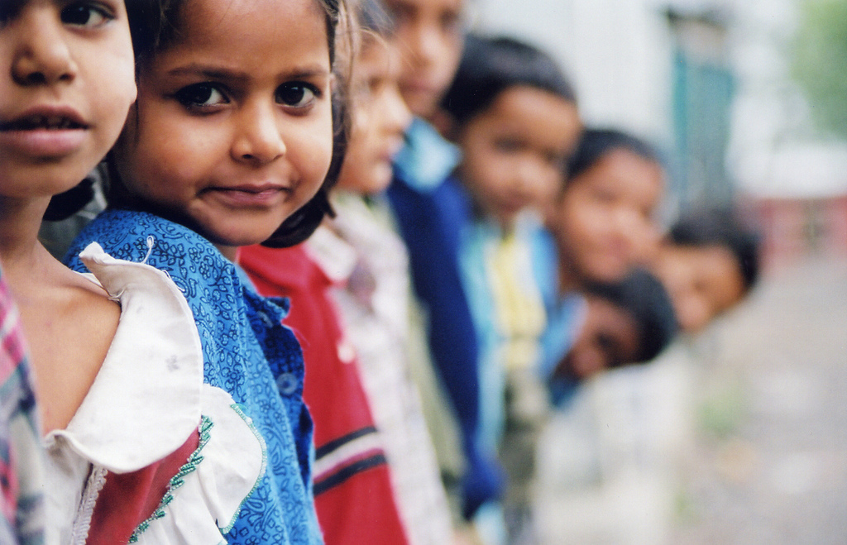
Why are we HERE?
What / Why Open Source ?

Slide 2
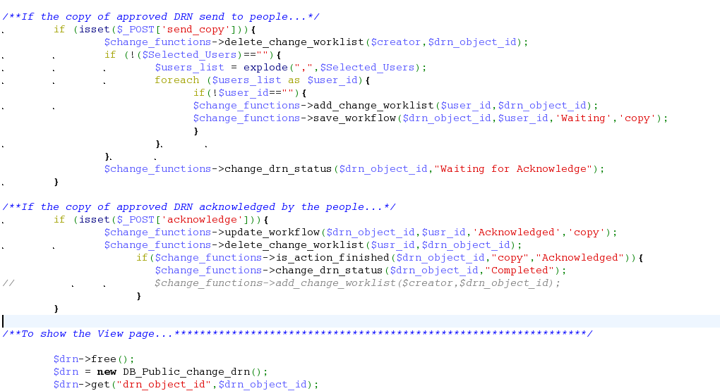

Source Code (Open Source)
Binary (Closed Source)

Slide 3
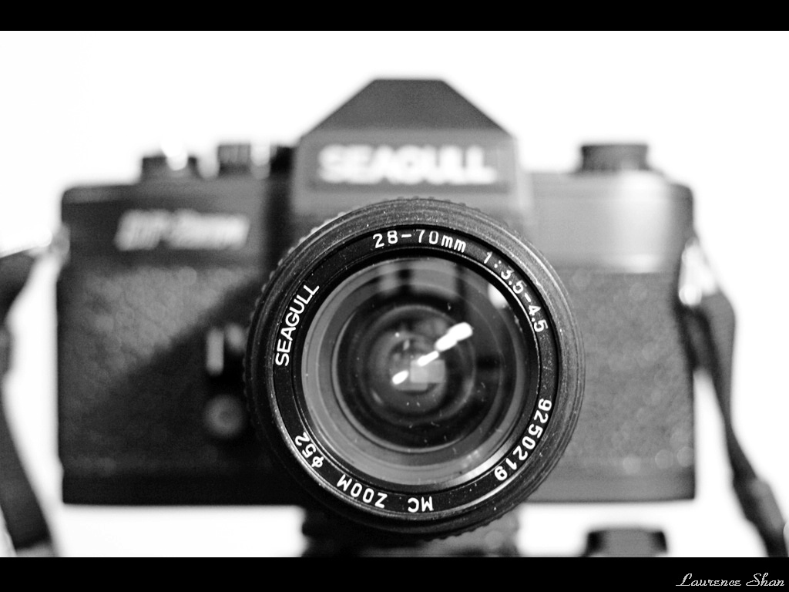
Case -1

Slide 4
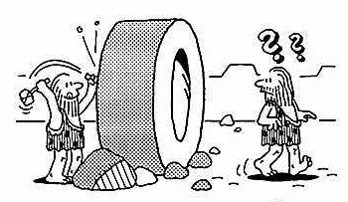
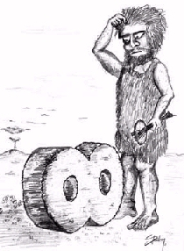
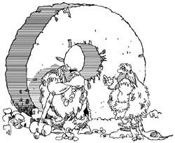
Reinventing Wheel

Slide 5
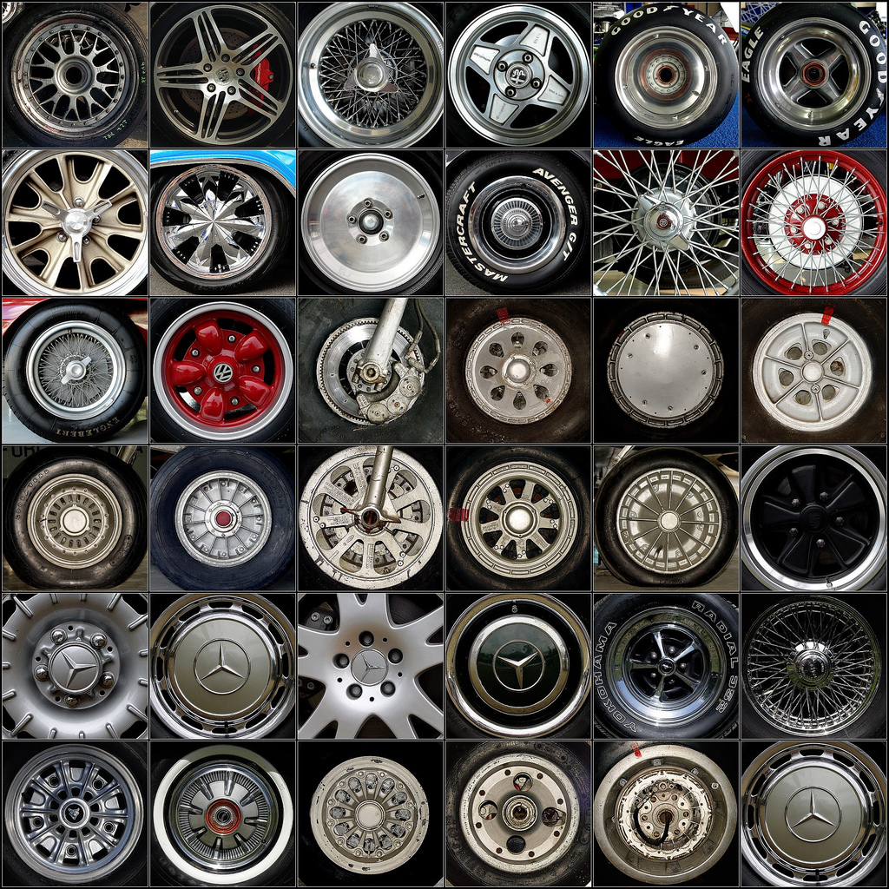
Continuous Improvement

Slide 6
?
Knowledge Sharing

Slide 7
Case -2

Slide 8
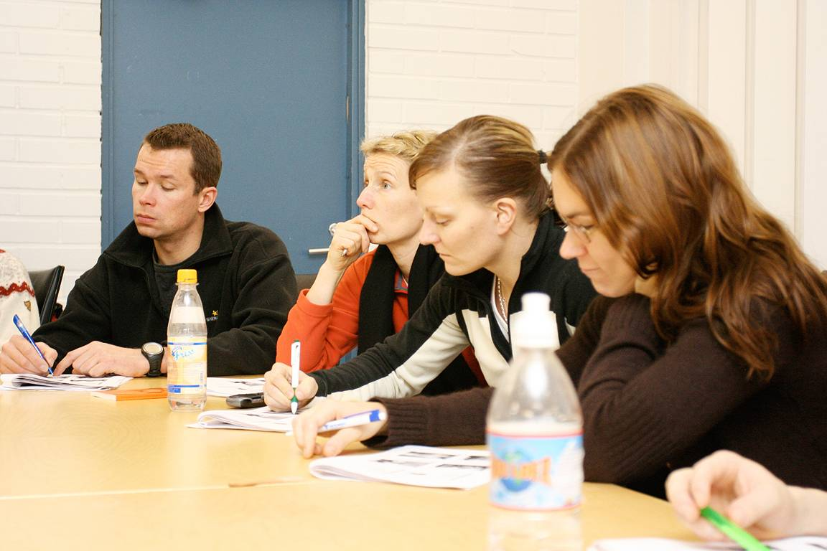
Review by few

Slide 9
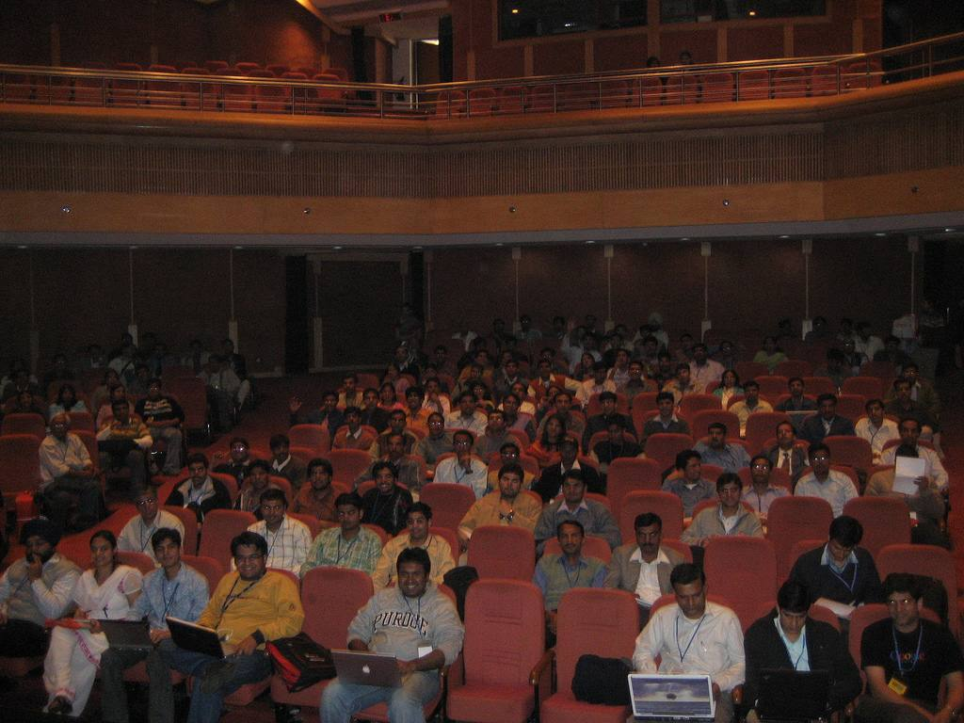
Review by more, more and More

Slide 10
?
More Corrections and
Less bugs

Slide 11
Case-3

Slide 12
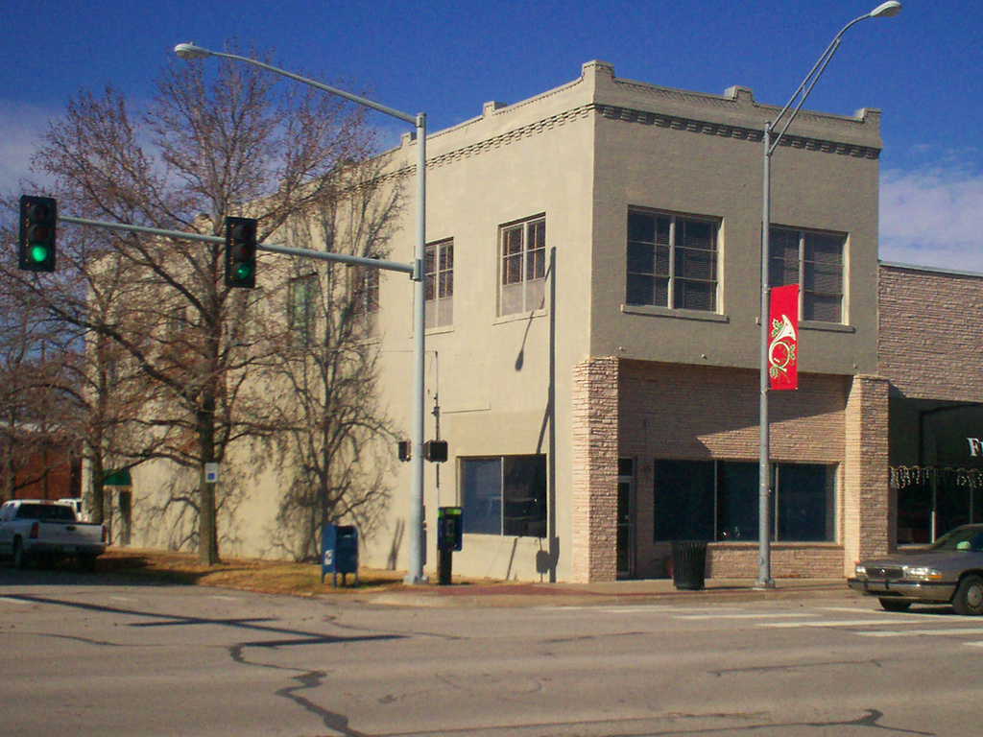
Closed Building with few Guards

Slide 13
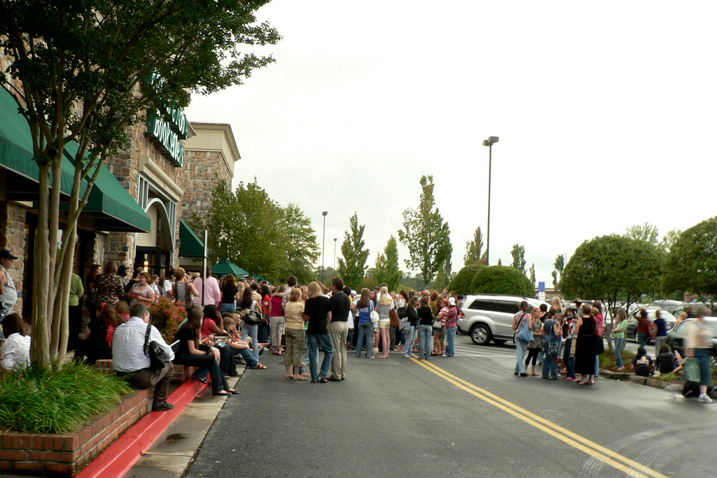
Open Building with more, more and
more Guards

Slide 14
?
More Security

Slide 15
Case -4

Slide 16
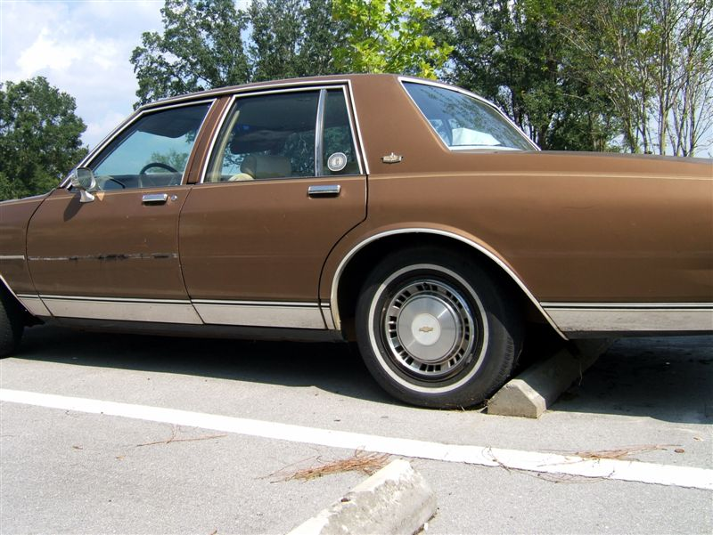
Sealed CAR ,
You can't see , open and repair
the Engine

Slide 17
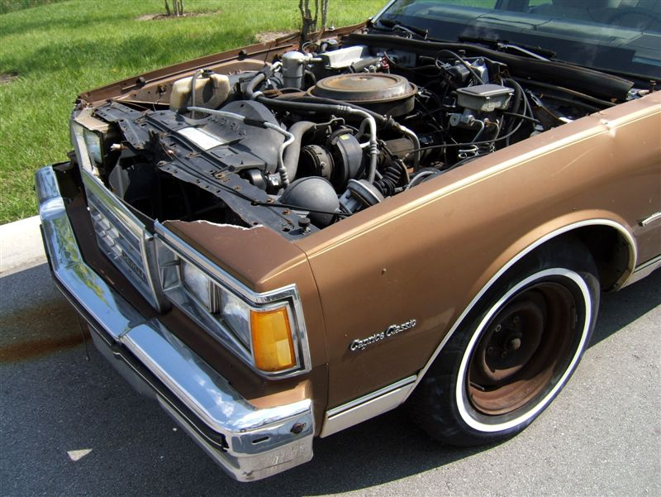
Opened CAR
You can see, open and fix the Problem.

Slide 18
?
Technical Freedom

Slide 19
Case -5

Slide 20
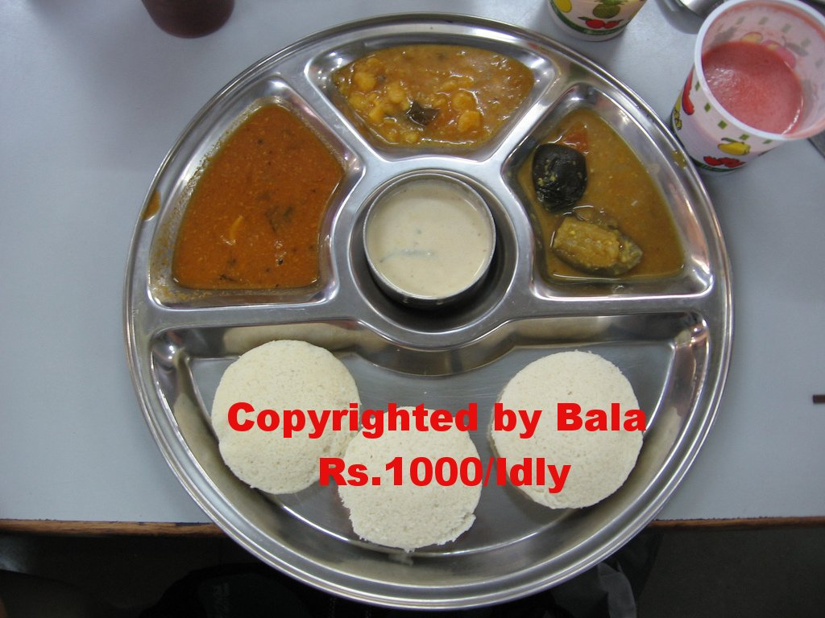
You can only EAT

Slide 21
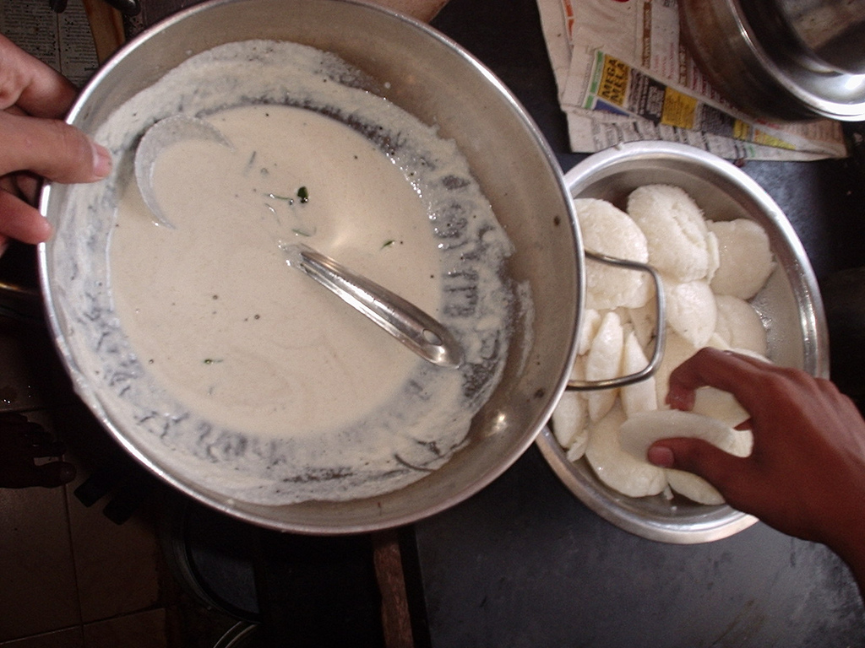
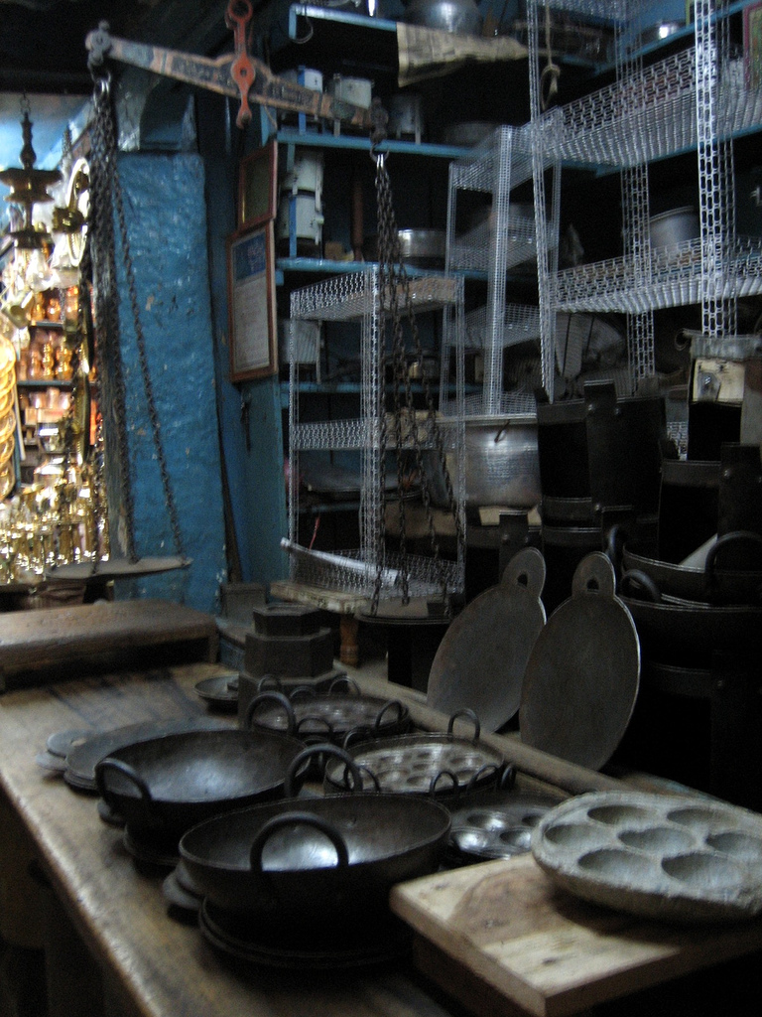
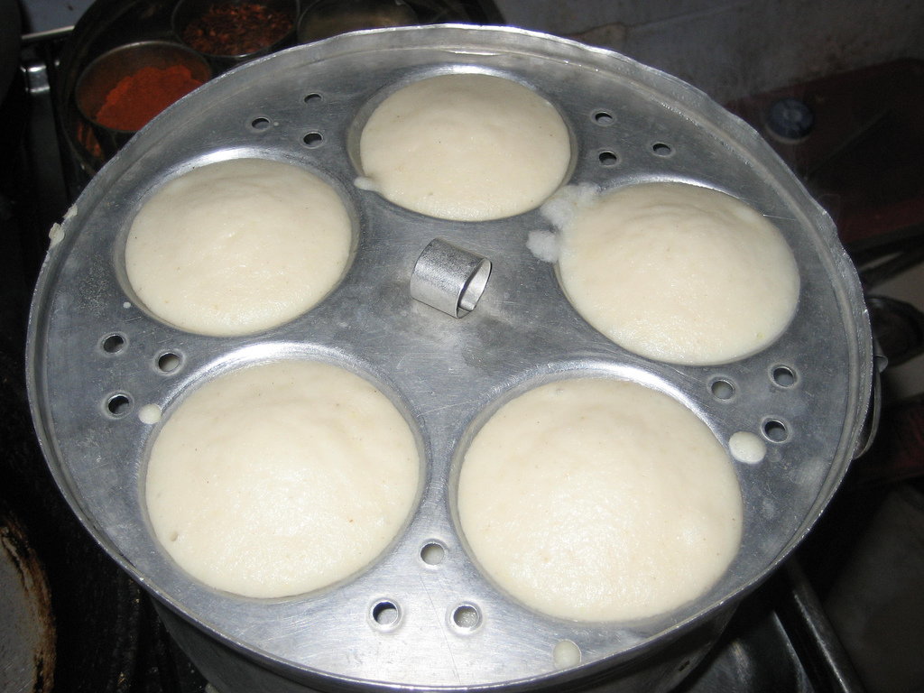
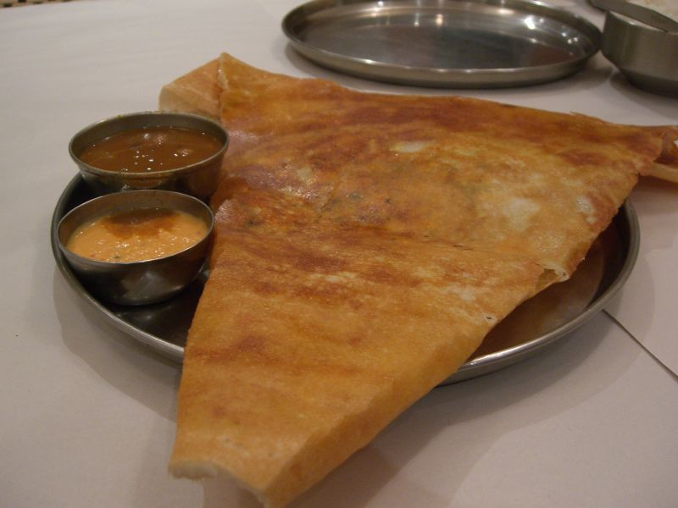
You can Prepare, Modify and Distribute

Slide 22

?
Personal Freedom

Slide 23


  Free(dom) Software
    Ensures 4 freedoms
      0 Use for any purpose
      1 Study and adapt(modify)
      2 Distribute either free or gratis
      3 Distribute the modified source
    (source code is mandatory for 1 and 3 Free as in
    Free Speech and not as in Free Lunch )
    GPL- General Public License

Slide 24

  Proprietary Softwares
    Owned by Company/individual
    Usually given in binary form.
    Users have restriction on its use
    Cannot modify it
    Cannot copy

Slide 25
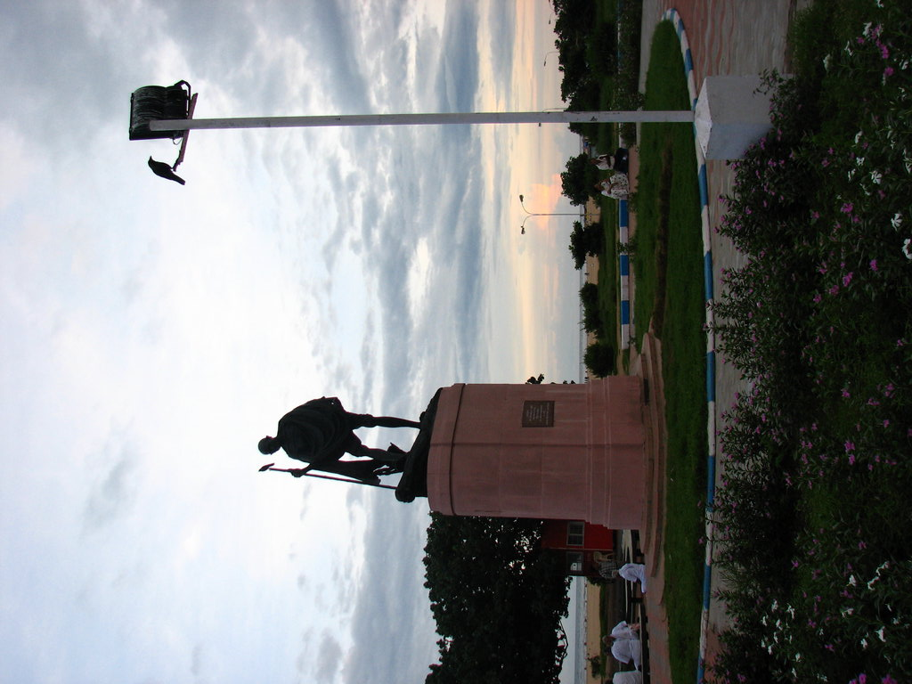
Why Software Freedom?
  Software is science and knowledge
    belongs to society
    not property of individuals
    freely available

Slide 26
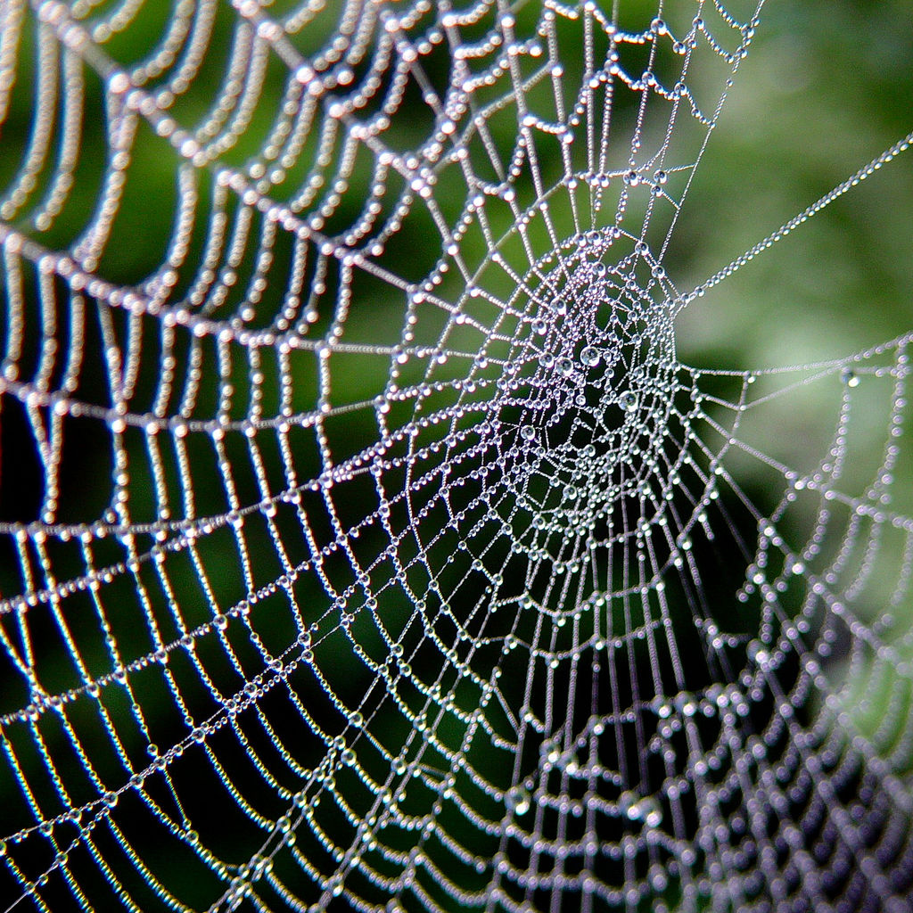
Opensource Development Model
  Web
  Source code
  Community
  Forums
  Developers
  CVS
  Mailing list
  Contributors – testing, documentation, localisation

Slide 27
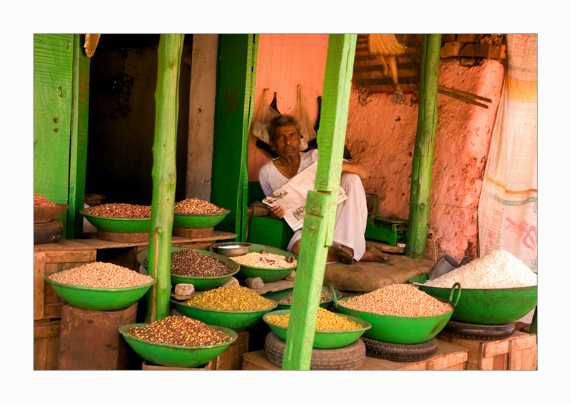
Opensource Business Model
  Service & Support
  Installation
    Training
    Customization
    Warranty
    Sell Distributions
    Facility Management

Slide 28
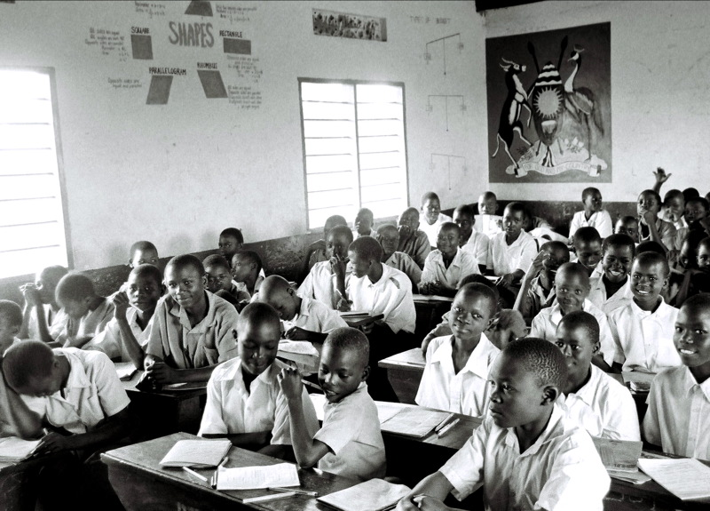
  Benefits to students
    Study the source code and
      Learn programming design & technics.
      Understand internals of programs.
      Modify/enhance.
      Apply the design & technics in other projects.
    Learn to create software

Slide 29
  Advantages to Students
  No need to beg industry for project.
    Plenty available on net. Contribute to it.
    Your contribution available for world.
    College faculty can be the guide & College itself
    can give the certificate.
    You can continue to work on the project.

Slide 30

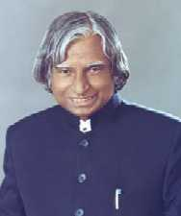
  Adoption of FOSS is a National Mission.
  The most unfortunate thing is that India still
  seems to believe in Proprietary solutions.
  In India FOSS will have to come and stay
  in a big way for the benefit of our billion people
Dr APJ Abdul Kalam
Ex. President of India

Slide 31

Images Taken from Flickr.com
wheels - http://flickr.com/photo_zoom.gne?id=877870174&size=l
review by few -http://flickr.com/photo_zoom.gne?id=290395598&size=l
building1 - http://flickr.com/photo_zoom.gne?id=484575444&size=l
building with people1 - http://flickr.com/photo_zoom.gne?id=1386361349&size=l
car not openable - http://flickr.com/photo_zoom.gne?id=55366220&size=o
car openable - http://flickr.com/photo_zoom.gne?id=55366129&size=o
hand lock - http://flickr.com/photo_zoom.gne?id=853883323&size=o
jumpling girl - http://flickr.com/photo_zoom.gne?id=780223591&size=o
review by many - http://flickr.com/photo_zoom.gne?id=383034378&size=l
idly1- http://flickr.com/photo_zoom.gne?id=1489588805&size=l
idly2- http://flickr.com/photo_zoom.gne?id=92074731&size=l
idly3- http://flickr.com/photo_zoom.gne?id=1691321700&size=l
idly4- http://flickr.com/photo_zoom.gne?id=203244154&size=l
idly5- http://flickr.com/photo_zoom.gne?id=164774821&size=l
idly - http://flickr.com/photo_zoom.gne?id=232680038&size=l
Dosai - http://flickr.com/photos/rumali/534768241/
binary - http://flickr.com/photo_zoom.gne?id=158530154&size=o
childs- http://flickr.com/photo_zoom.gne?id=1606105753&size=l
indian flag -http://flickr.com/photo_zoom.gne?id=128225160&size=l
gandhi - http://flickr.com/photo_zoom.gne?id=293040040&size=o
comp_cat_sleep- http://flickr.com/photo_zoom.gne?id=918128338&size=l
u can learn - http://flickr.com/photo_zoom.gne?id=6806473&size=l
web - http://flickr.com/photo_zoom.gne?id=9500503&size=l
grocery - http://flickr.com/photo_zoom.gne?id=101527478&size=o

Slide 32

Questions?

