Slide 1
How to Contribute to Open Source without Being a Programmer?
T Shrinivasan
OSI Days, Banglore

Slide 2
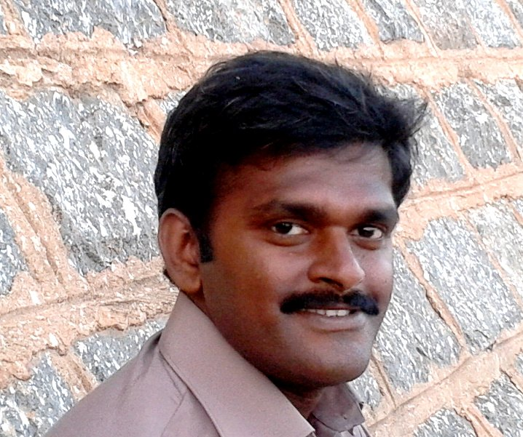

Who Am I?
T Shrinivasan
Providing Support for Subversion at
Co-ordinator of Indian Linux Users Group Chennai http://ilugc.in
Editor – Tamil E Magazine for FOSS
http://kaniyam.com
tshrinivasan@gmail.com
http://goinggnu.wordpress.com

Slide 3
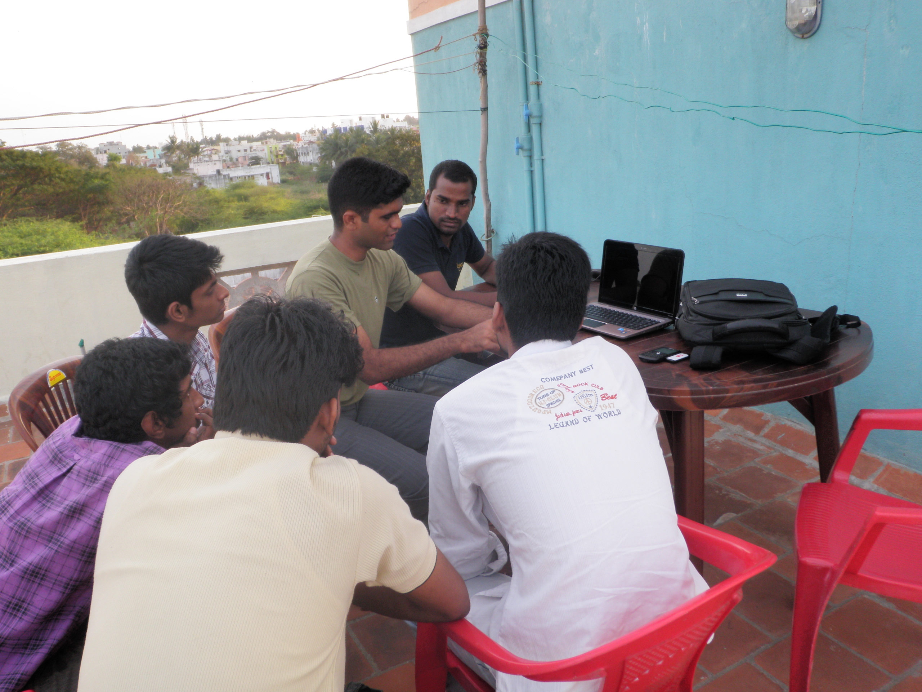
Join User Group

Slide 4

Mailing List

Slide 5

IRC

Slide 6

Documentation

Slide 7
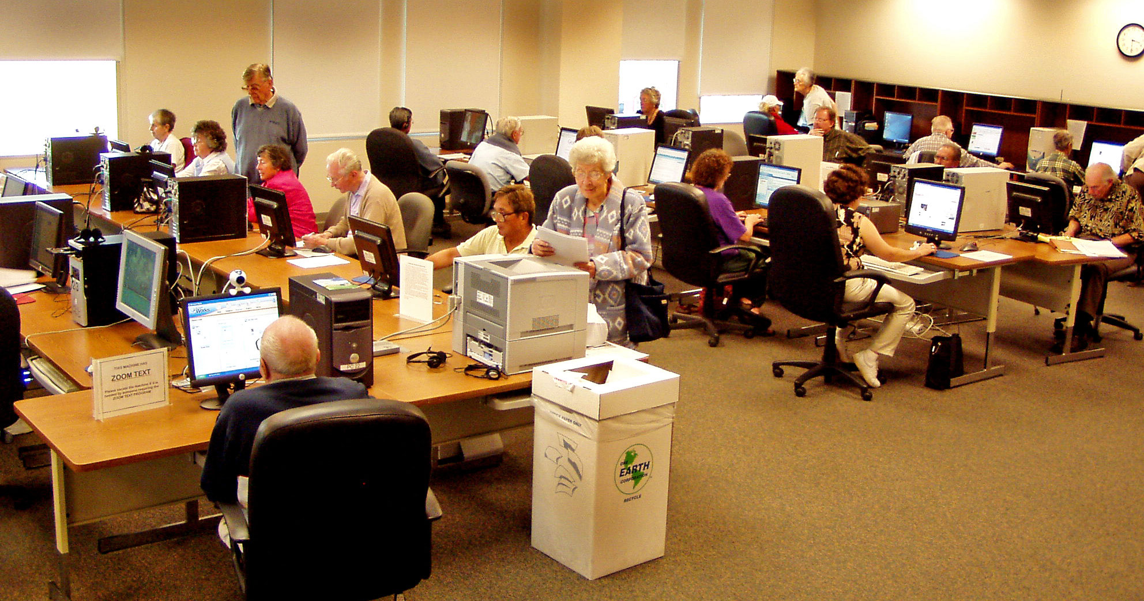
Workshops

Slide 8
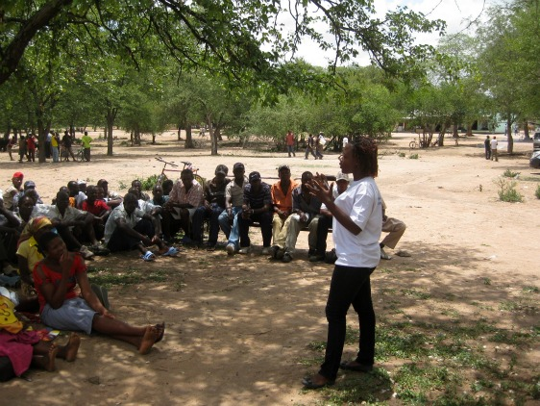
Public Events

Slide 9

Report Bugs

Slide 10

Package

Slide 11

Organize Events

Slide 12

Social Media

Slide 13

Print/Visual/Audio Media

Slide 14
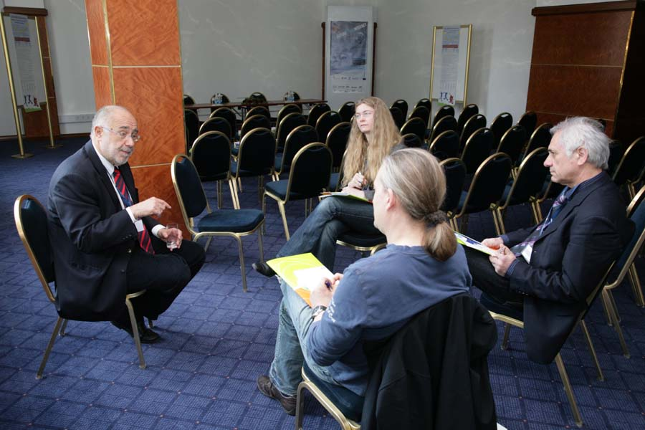
Interview

Slide 15

Podcast

Slide 16



Podcast

Slide 17

Blog

Slide 18



Blog

Slide 19

Translate

Slide 20

Test

Slide 21
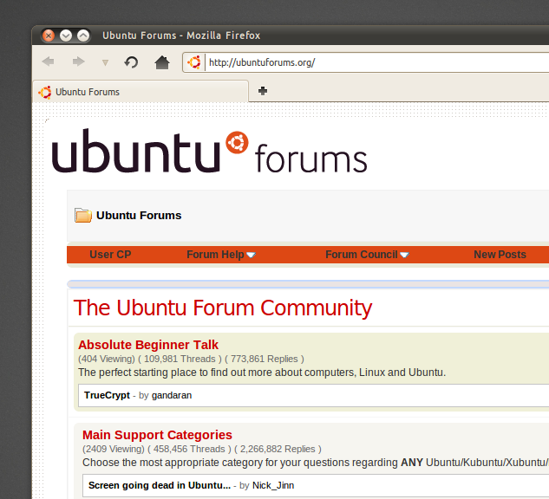
Forums

Slide 22
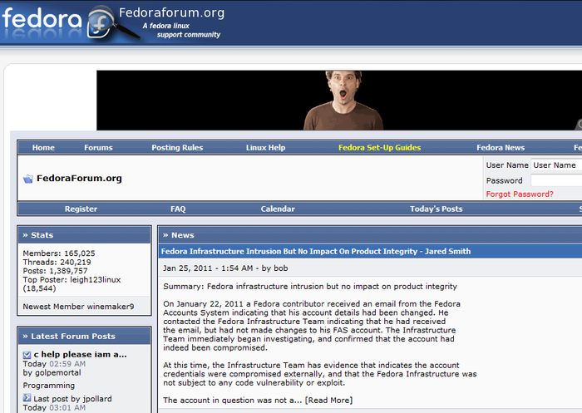
Forums

Slide 23
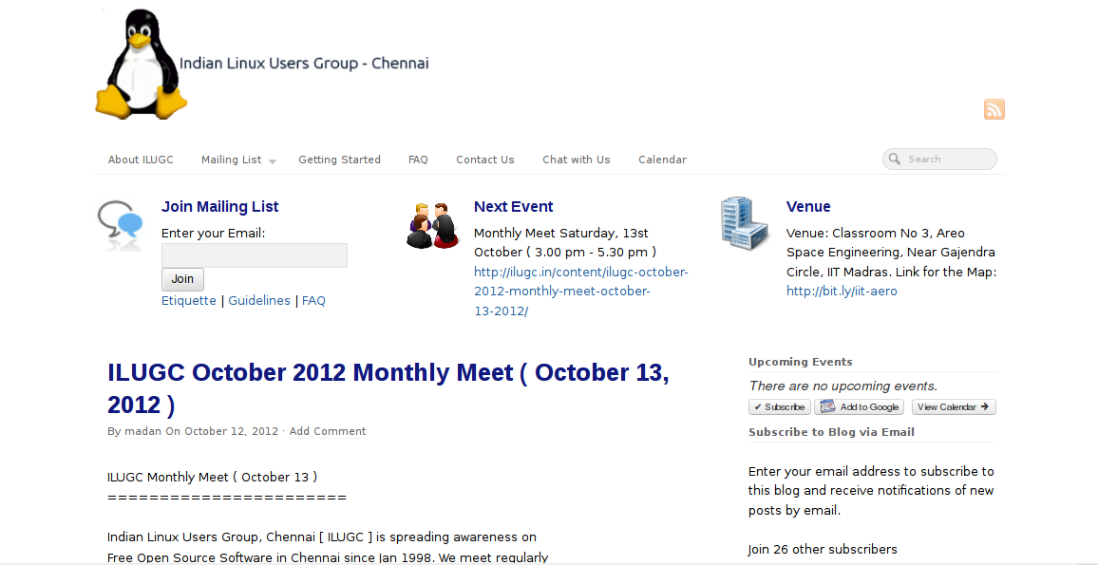
Design Website

Slide 24



Slide 25

Wall papers

Slide 26

Music

Slide 27

Music

Slide 28

Video Tutorial

Slide 29
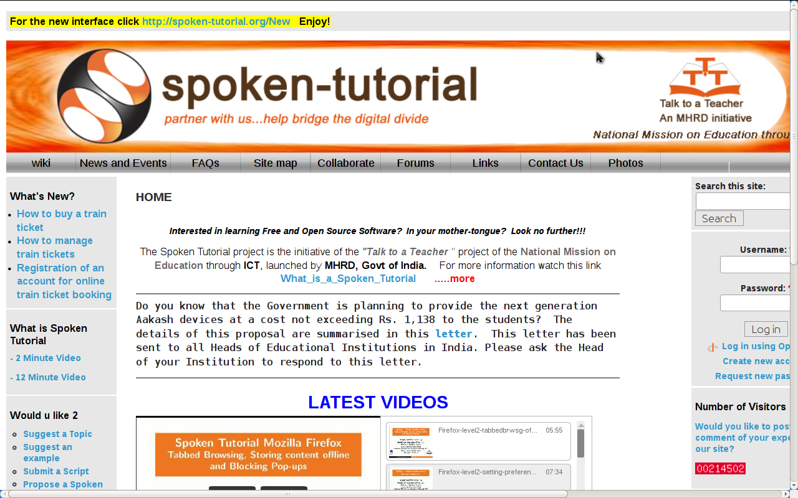

Slide 30

Free/Commercial Support

Slide 31

Free/Commercial Support

Slide 32

Donate Money

Slide 33
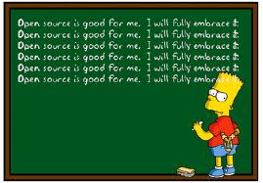
Use

Slide 34


