Slide 1

Python – An Introduction
Shrinivasan T
tshrinivasan@gmail.com
http://goinggnu.wordpress.com

Slide 2

Python is a Programming Language

Slide 3

There are so many
Programming Languages.
Why Python?

Slide 4
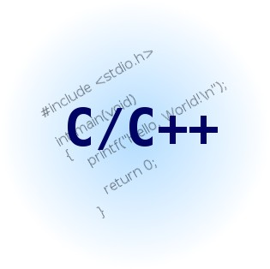


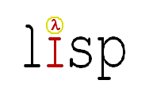




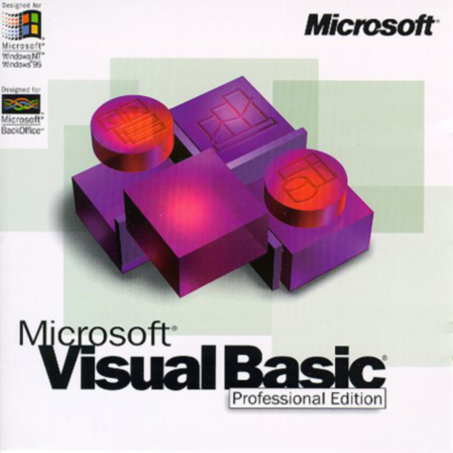



Slide 6
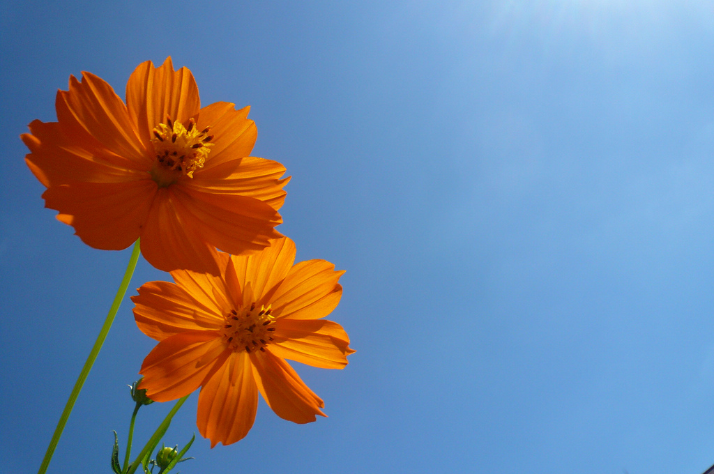
Python is simple and beautiful

Slide 7
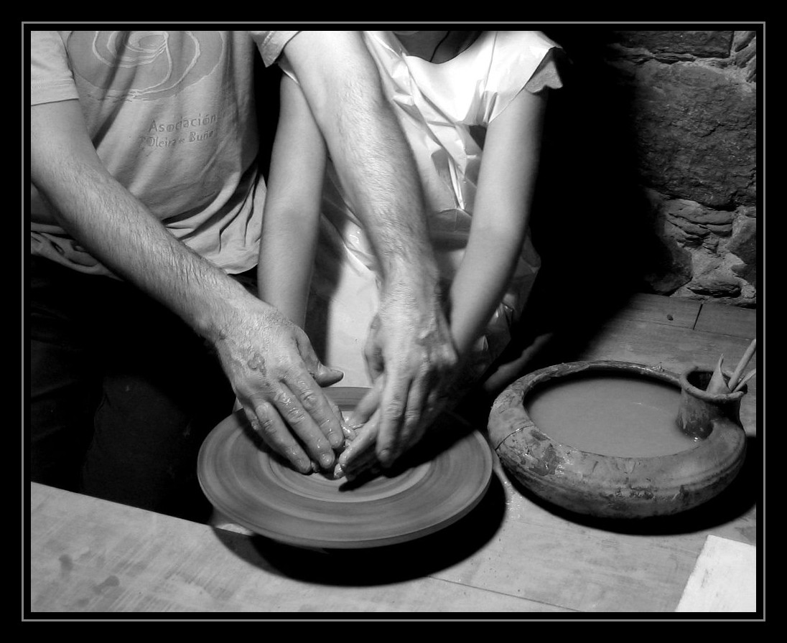
Python is Easy to Learn

Slide 8

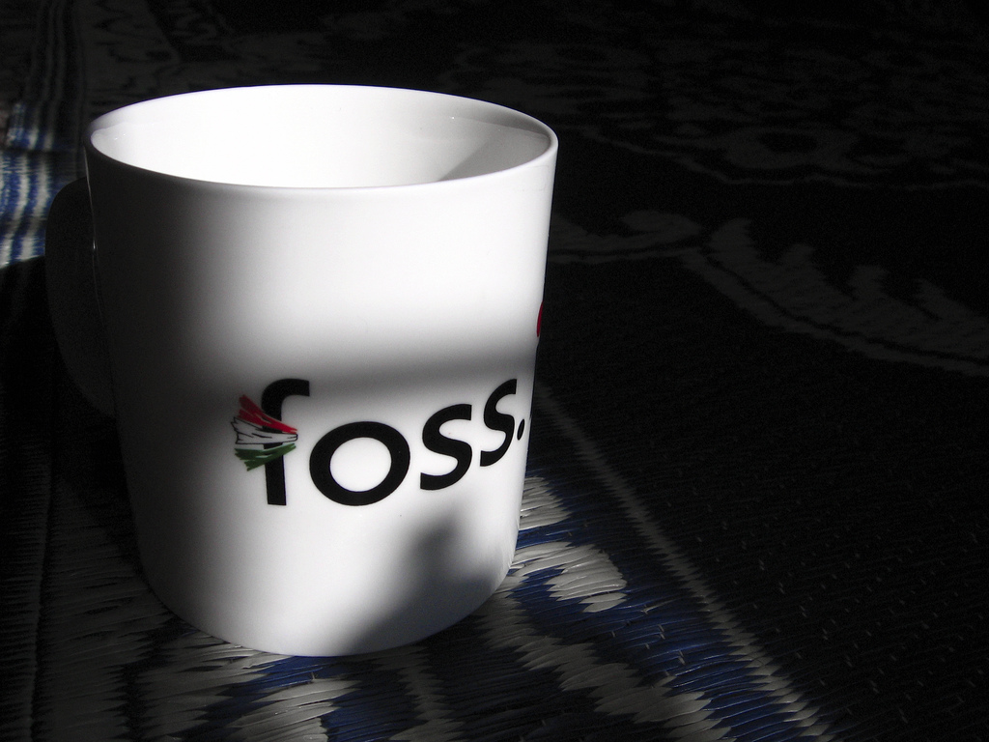
Python is Free Open Source Software

Slide 9
Can Do
Text Handling
System Administration
GUI programming
Web Applications
Database Apps
Scientific Applications
Games
NLP
...

Slide 10
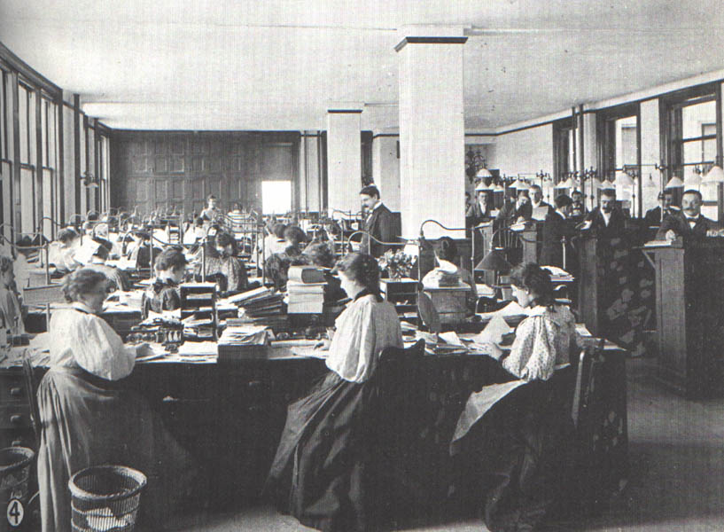
H i s t o r y

Slide 11
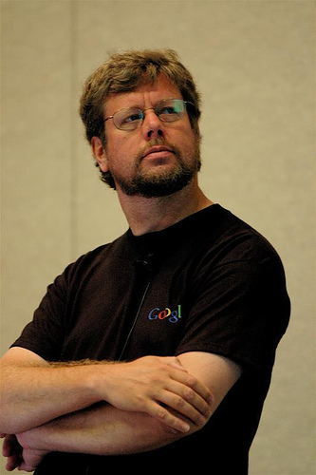
Guido van Rossum
Father of Python
1991

Slide 12
Perl Java Python Ruby PHP
1987 1991 1993 1995

Slide 13

What is Python?

Slide 14
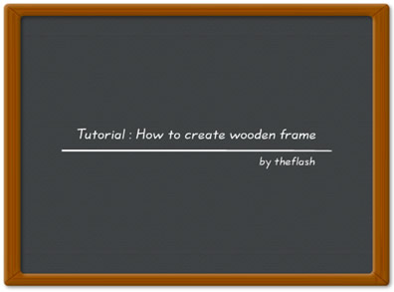
Python is...
A dynamic,open source programming language with a focus on
simplicity and productivity. It has an
elegant syntax that is natural to read and easy to write.

Slide 15
Quick and Easy
Intrepreted Scripting Language
Variable declarations are unnecessary
Variables are not typed
Syntax is simple and consistent
Memory management is automatic

Slide 16
Object Oriented Programming
Classes
Methods
Inheritance
Modules
etc.,

Slide 17
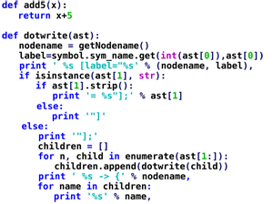
Examples!

Slide 18
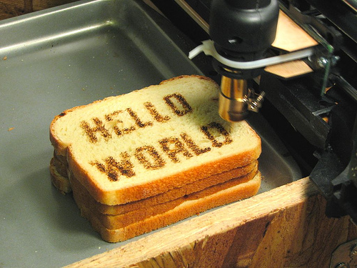

Slide 19
print “Hello World”

Slide 20
No Semicolons !

Slide 21
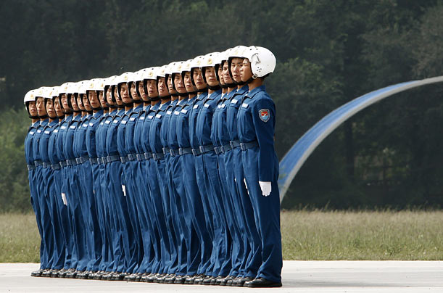
Indentation

Slide 22

You have to follow the Indentation
Correctly.
Otherwise,
Python will beat you !

Slide 23
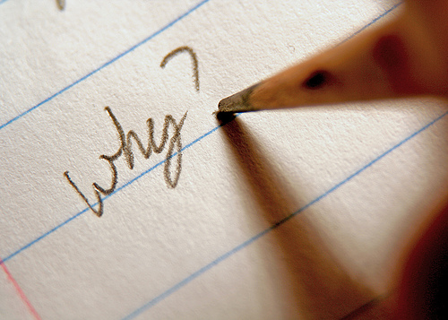

Slide 24
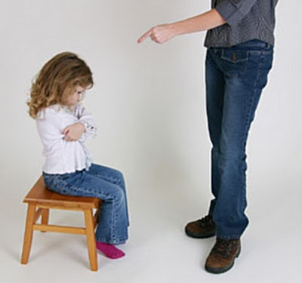
Discipline
Makes
Good

Slide 25
Variables
colored_index_cards

Slide 26
No Need to Declare Variable Types !
Python Knows Everything !

Slide 27
value = 10
print value
value = 100.50
print value
value = “This is String”
print value * 3

Slide 28

Input

Slide 29
name = raw_input(“What is Your name?”)
print "Hello" , name , "Welcome"

Slide 30

Flow

Slide 31
if score >= 5000 :
print “You win!”
elif score <= 0 :
print “Game over.”
else:
print “Current score:”,score
print “Done\n”

Slide 32
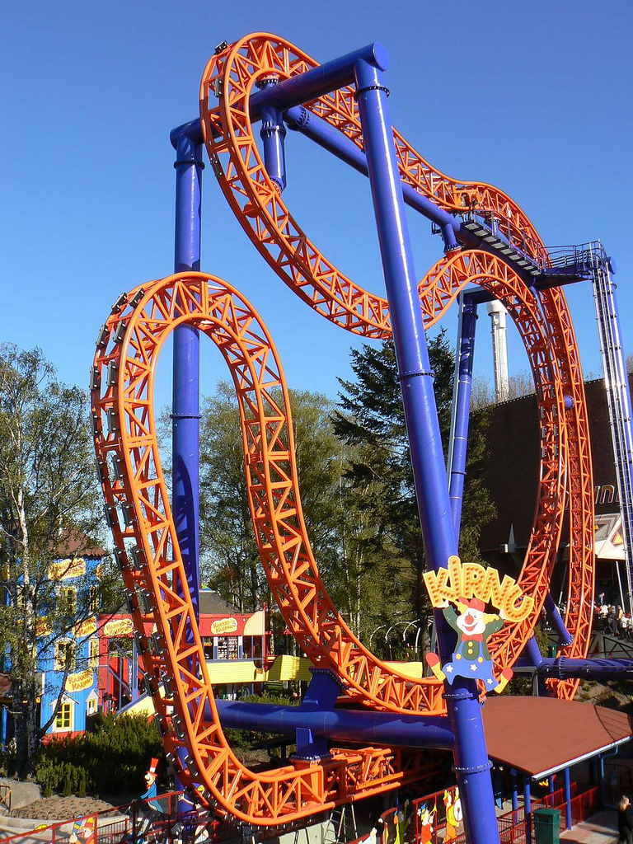
Loop

Slide 33
for i in range(1, 5):
print i
else:
print 'The for loop is over'

Slide 34
number = 23
running = True
while running :
guess = int(raw_input('Enter an integer : '))
if guess == number :
print 'Congratulations, you guessed it.'
running = False
elif guess < number :
print 'No, it is a little higher than that.'
else:
print 'No, it is a little lower than that.'
print 'Done'

Slide 35

Array

Slide 36
List = Array
numbers = [ "zero", "one", "two", "three", "FOUR" ]

Slide 37
List = Array
numbers = [ "zero", "one", "two", "three", "FOUR" ]
numbers[0]
>>> zero
numbers[4] numbers[-1]
>>> FOUR >>> FOUR
numbers[-2]
>>> three

Slide 38
Multi Dimension List
numbers = [ ["zero", "one"],["two", "three", "FOUR" ]]
numbers[0]
>>> ["zero", "one"]
numbers[0][0] numbers[-1][-1]
>>> zero >>> FOUR
len(numbers)
>>> 2

Slide 39
Sort List
primes = [ 11, 5, 7, 2, 13, 3 ]

Slide 40
Sort List
primes = [ 11, 5, 7, 2, 13, 3 ]
primes.sort()

Slide 41
Sort List
primes = [ 11, 5, 7, 2, 13, 3 ]
primes.sort()
>>> [2, 3, 5, 7, 11, 13]

Slide 42
Sort List
names = [ "Shrini", "Bala", "Suresh", "Arul"]
names.sort()
>>> ["Arul", "Bala","Shrini","Suresh"]
names.reverse()
>>> ["Suresh","Shrini","Bala","Arul"]

Slide 43
Mixed List
names = [ "Shrini", 10, "Arul", 75.54]
names[1]+10
>>> 20
names[2].upper()
>>> ARUL

Slide 44
Mixed List
names = [ "Shrini", 10, "Arul", 75.54]
names[1]+10
>>> 20
names[2].upper()
>>> ARUL

Slide 45
Append on List
numbers = [ 1,3,5,7]
numbers.append(9)
>>> [1,3,5,7,9]

Slide 46
Tuples
immutable

Slide 47
names = ('Arul','Dhastha','Raj')
name.append('Selva')
Error : Can not modify the tuple
Tuple is immutable type

Slide 48
String

Slide 49
name = 'Arul'
name[0]
>>>'A'
myname = 'Arul' + 'alan'
>>> 'Arulalan'

Slide 50
split
name = 'This is python string'
name.split(' ')
>>>['This','is','python','string']
comma = 'Shrini,Arul,Suresh'
comma.split(',')
>>> ['Shrini','Arul','Suresh']

Slide 51
join
li = ['a','b','c','d']
s = '-'
new = s.join(li)
>>> a-b-c-d
new.split('-')
>>>['a','b','c','d']

Slide 52
'small'.upper()
>>>'SMALL'
'BIG'.lower()
>>> 'big'
'mIxEd'.swapcase()
>>>'MiXwD'

Slide 53
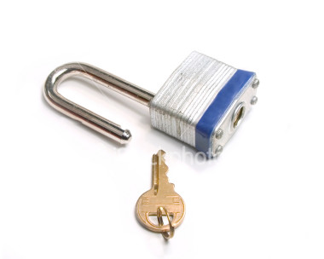
Dictionary

Slide 54
menu = {
“idly” : 2.50,
“dosai” : 10.00,
“coffee” : 5.00,
“ice_cream” : 5.00,
100 : “Hundred”
}
menu[“idly”]
2.50
menu[100]
Hundred

Slide 55
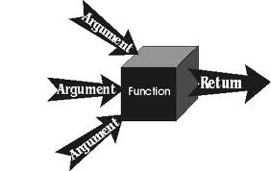
Function

Slide 56
def sayHello():
print 'Hello World!' # block belonging of fn
# End of function
sayHello() # call the function

Slide 57
def printMax(a, b):
if a > b:
print a, 'is maximum'
else:
print b, 'is maximum'
printMax(3, 4)

Slide 58
Using in built Modules

Slide 59
#!/usr/bin/python
# Filename: using_sys.py
import time
print 'The sleep started'
time.sleep(3)
print 'The sleep finished'

Slide 60
#!/usr/bin/python
import os
os.listdir('/home/arulalan')
os.walk('/home/arulalan')

Slide 61
Making Our Own Modules

Slide 62
#!/usr/bin/python
# Filename: mymodule.py
def sayhi():
print “Hi, this is mymodule speaking.”
version = '0.1'
# End of mymodule.py

Slide 63
#!/usr/bin/python
# Filename: mymodule_demo.py
import mymodule
mymodule.sayhi()
print 'Version', mymodule.version

Slide 64
#!/usr/bin/python
# Filename: mymodule_demo2.py
from mymodule import sayhi, version
# Alternative:
# from mymodule import *
sayhi()
print 'Version', version

Slide 65
Class

Slide 66
Classes
class Person:
pass # An empty block
p = Person()
print p

Slide 67
Classes
class Person:
def sayHi(self):
print 'Hello, how are you?'
p = Person()
p.sayHi()

Slide 68
Classes
class Person:
def __init__(self, name):
#like contstructor
self.name = name
def sayHi(self):
print 'Hello, my name is', self.name
p = Person('Arulalan.T')
p.sayHi()

Slide 69
Classes
Inheritance

Slide 70
Classes
class A:
def hello(self):
print ' I am super class '
class B(A):
def bye(self):
print ' I am sub class '
p = B()
p.hello()
p.bye()

Slide 71
Classes
class A:
Var = 10
def __init__(self):
self.public = 100
self._protected_ = 'protected'
self.__private__ = 'private'
Class B(A):
pass
p = B()
p.__protected__

Slide 72
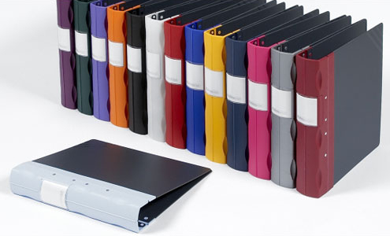
File Handling

Slide 73

File Writing

Slide 74
poem = ''' Programming is fun
When the work is done
if you wanna make your work also fun:
use Python!
'''
f = file('poem.txt', 'w') # open for 'w'riting
f.write(poem) # write text to file
f.close()

Slide 75

File Reading

Slide 76
f= file('poem.txt','r')
for line in f.readlines():
print line
f.close()

Slide 77
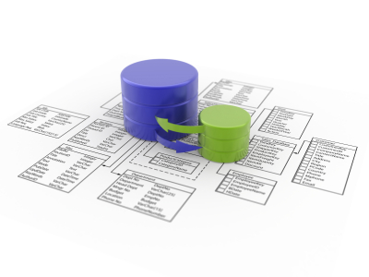
Database Intergration

Slide 78
import psycopg2
conn = psycopg2.connect(" dbname='pg_database' user='dbuser' host='localhost' password='dbpass' ")
cur = conn.cursor()
cur.execute("""SELECT * from pg_table""")
rows = cur.fetchall()
print rows
cur.close()
conn.close()

Slide 79
import psycopg2
conn = psycopg2.connect(" dbname='pg_database' user='dbuser' host='localhost' password='dbpass' ")
cur = conn.cursor()
cur.execute("'insert into pg_table values(1,'python')"')
conn.commit()
cur.close()
conn.close()

Slide 80
THE END
of code :-)

Slide 81
How to learn ?

Slide 82
Python – Shell
Interactive Python
Instance Responce
Learn as you type

Slide 83
bpython
ipython
}
teach you very easily

Slide 84
Python can communicate
With
Other
Languages

Slide 85
C
+
Python

Slide 86


Slide 87
Java
+
Python

Slide 88
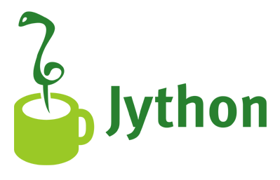

Slide 89
GUI
With
Python

Slide 90




Slide 91
Glade
+
Python
+
GTK
=
GUI APP

Slide 92
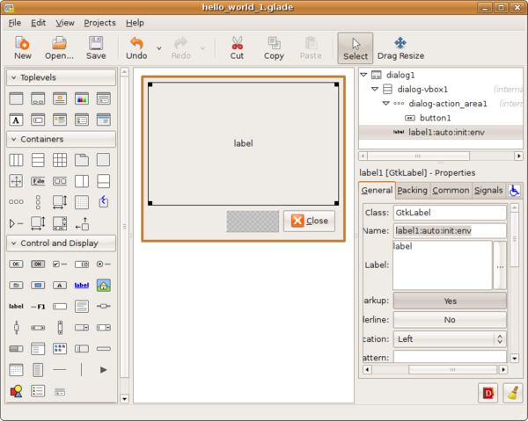
GLADE

Slide 93

Using Glade + Python

Slide 94
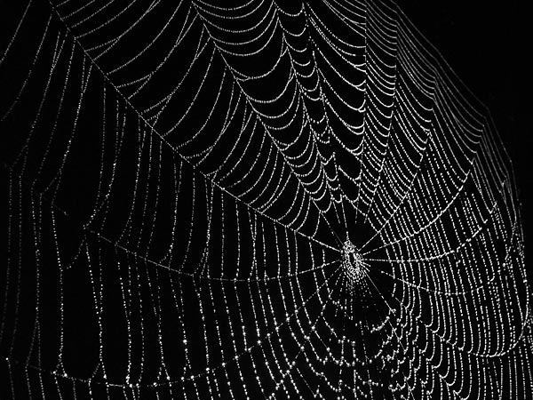
Web
Web

Slide 95

Web Frame Work in Python

Slide 96
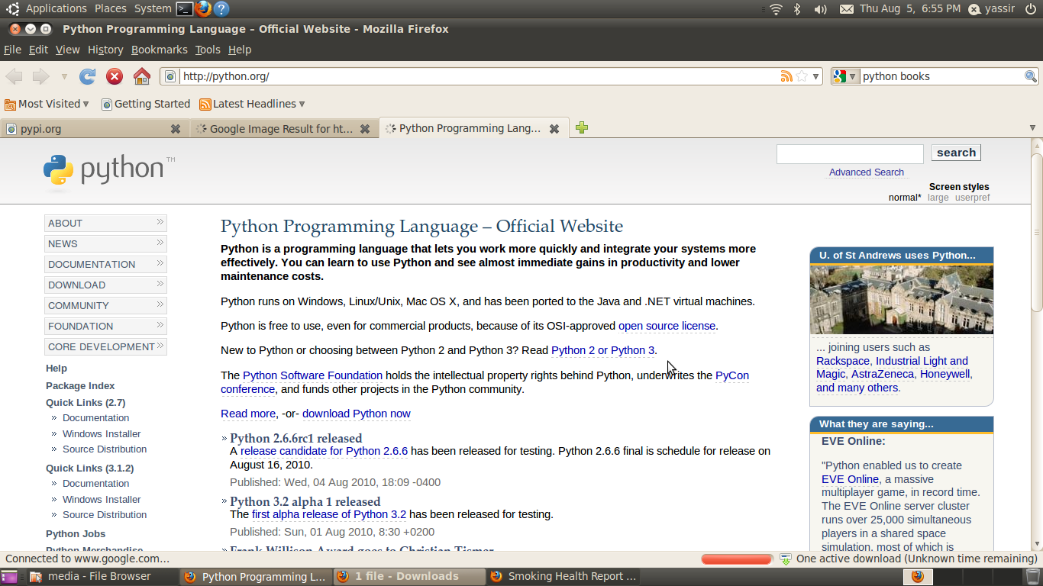

Slide 97
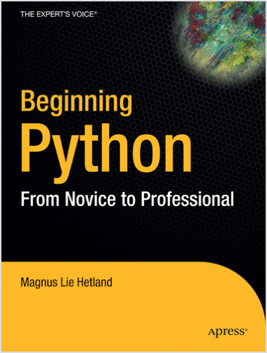
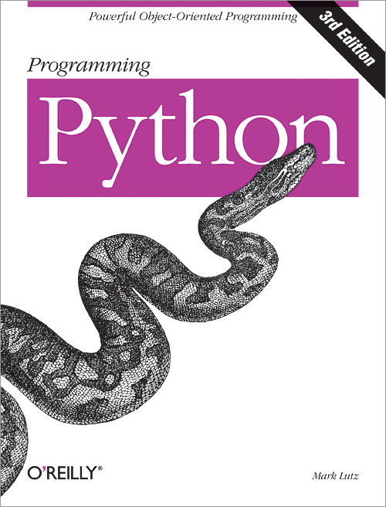
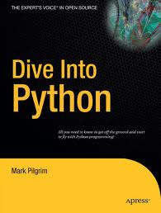

Slide 98
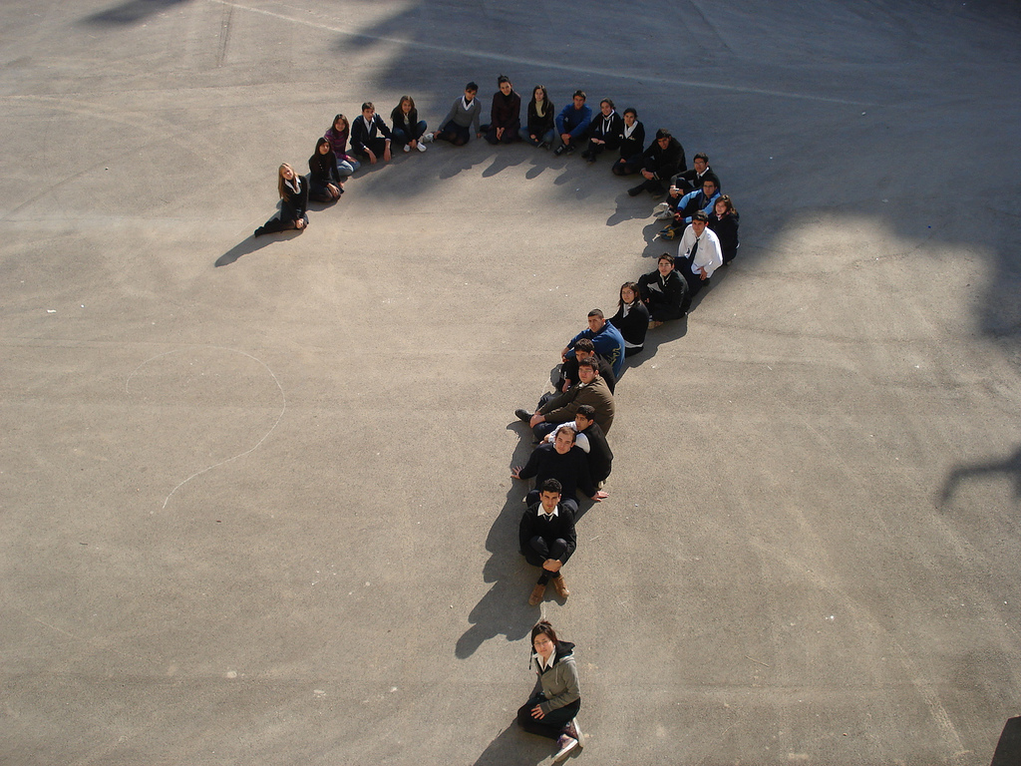

Slide 99


