Slide 1
Investigating the
impact of Russia-Ukraine war on foreign trade
An overall analysis of the conflict on global trade
Presented by:
Tanvi Shroff
Thapasya Murali

Slide 2
Content overview
Brief about the trade between Russia, Ukraine and impacted countries
Countries and commodities taken into account
- China, USA, UK, India, Italy, Poland
- Oil, Steel
Exploratory Data Analysis
Methodology
- ARIMA
- Multiple Linear Regression
- ANOVA
Inference

Slide 3
Import of mineral fuel and crude oil from Russia to various countries
Russian export of crude oil was USD 212.42 billion during 2021.
We analyse the import of this product from Russia in countries such as China, USA, India, Italy, Germany and Poland.

Slide 4
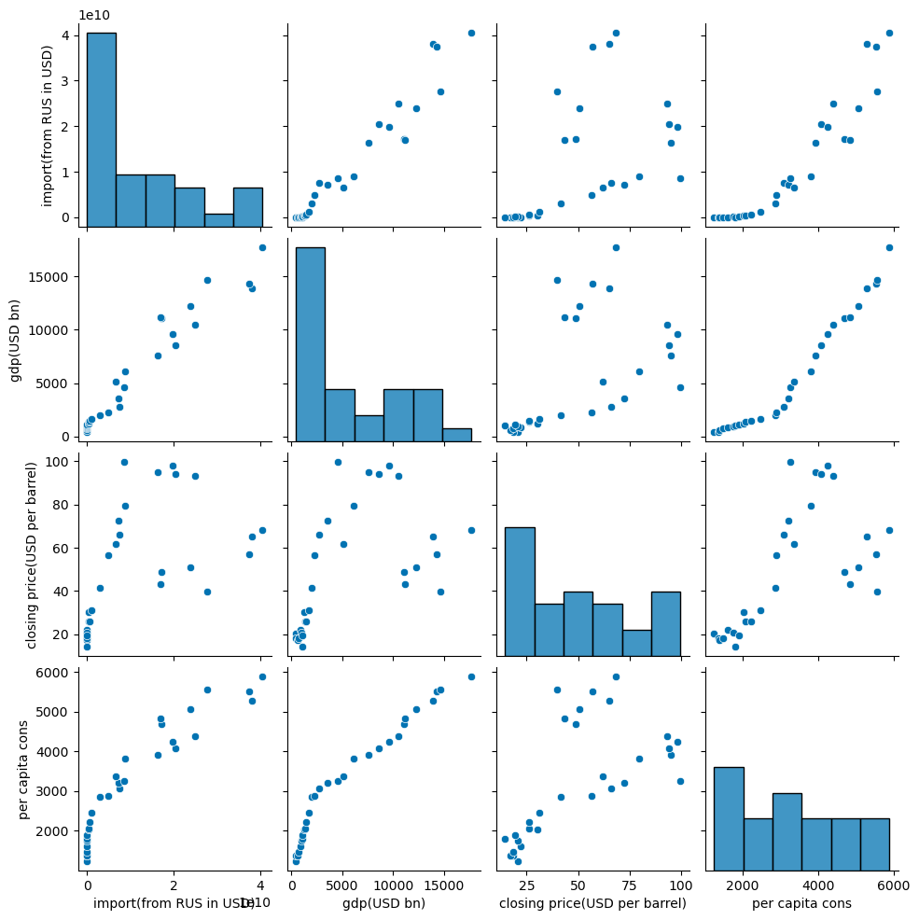
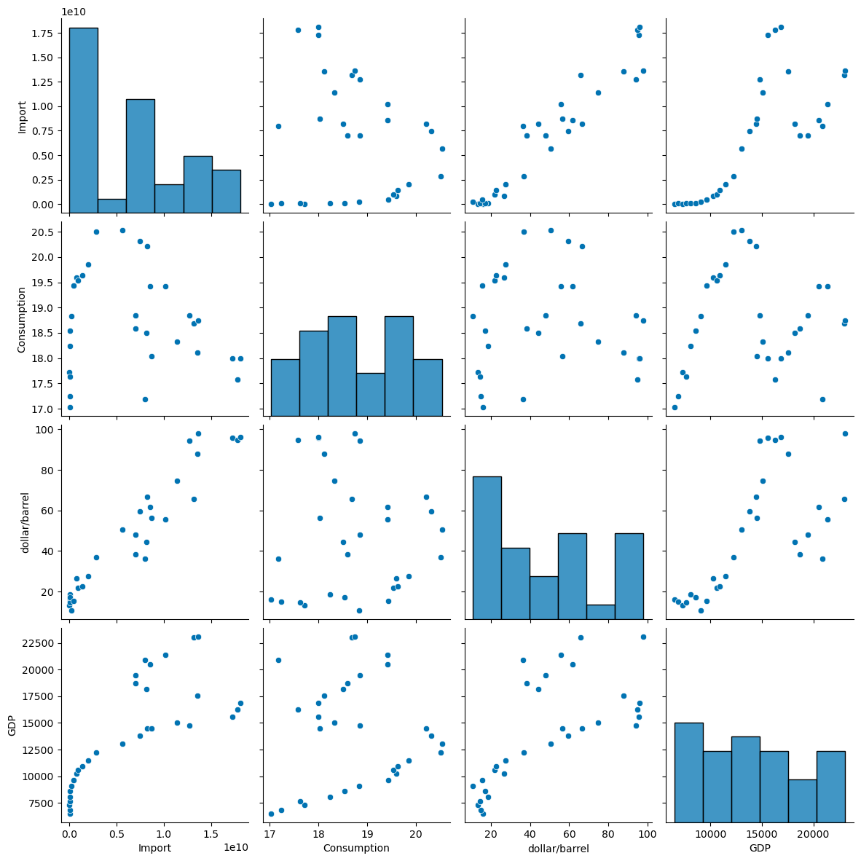
Exploratory Data Analysis
USA
China

Slide 5
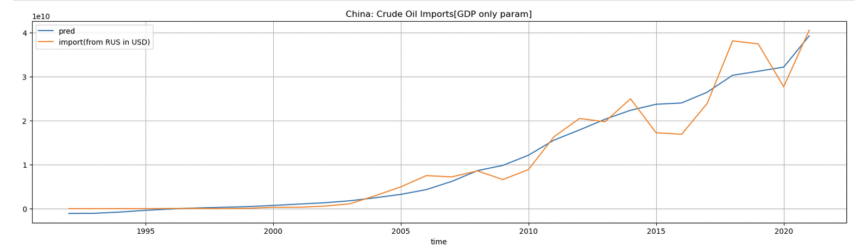
Crude Oil: Russia’s export to China
Graph depicts the variation in fitted import value and actual import trend over decades
The import growth has been found to be linear to a steady per capita consumption (oil & petroleum) and fast increase in national GDP of China
Notes:
Russia is 2nd biggest exporter of crude petroleum to China (https://www.reuters.com/business/energy/russian-oil-supplies-china-up-22-year-close-second-saudi-data-2022-10-24/)
Strong correlation between the gro

Slide 6
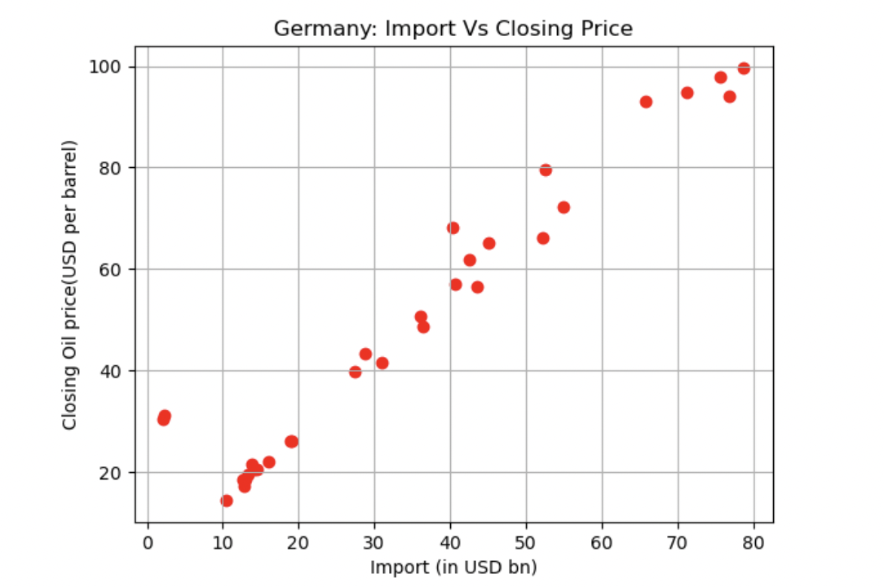
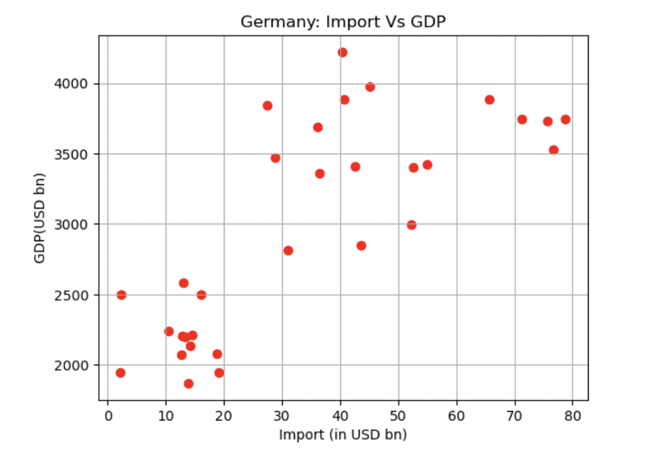
Crude Oil: Germany’s Import
The scatter plot visually depicting the correlation between the import values and oil closing price corresponding years than national GDP over the decades
Variance in import correlation to GDP in comparison to country like China
Notes:
Similar regression model for germany import trend for Crude oil for last 30 years
Finding of the model: The import value is more linearly correlated to oil Closing price as predictor variable (https://www.macrotrends.net/1369/crude-oil-price-history-chart)

Slide 7
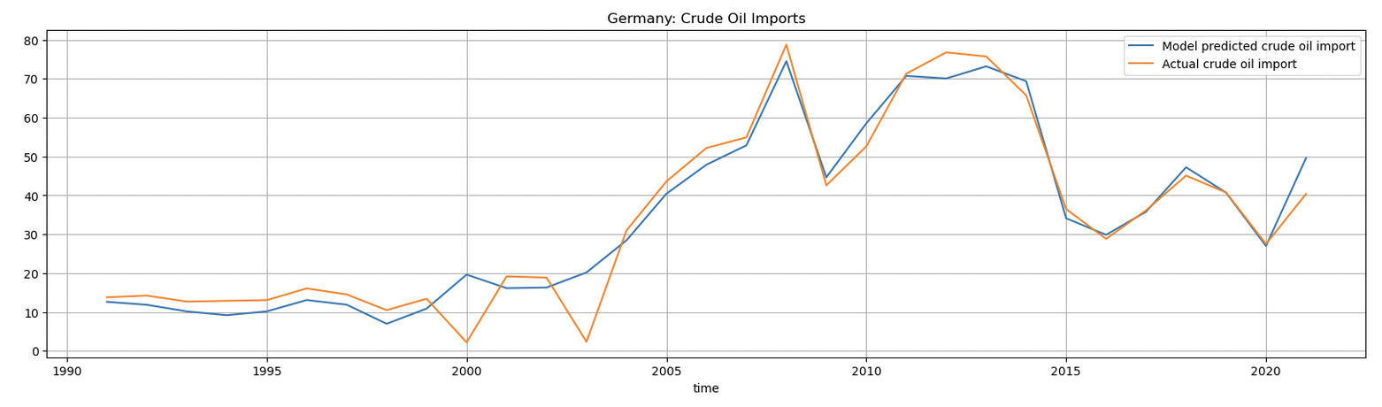

Crude Oil: Germany’s Import
Graphical representation of model and performance statistics (taking only strongly correlated variable in the model)
Notes:
Similar regression model for germany import trend for Crude oil for last 30 years
Finding of the model: The import value is more linearly correlated to oil Closing price as predictor variable (https://www.macrotrends.net/1369/crude-oil-price-history-chart)

Slide 8
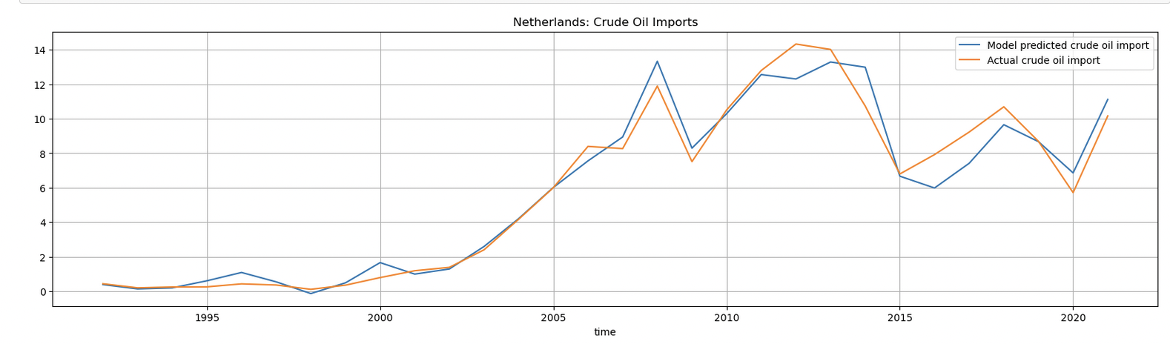
Crude Oil:Russia’s Crude oil Export to Netherlands
Graphical representation of model and performance statistics (taking only strongly correlated variable in the model .ie. GDP)
Notes:
Similar regression model for netherlands import trend for Crude oil from Russia for last 30 years
A upward trend in last 3 years can be noted
https://tradingeconomics.com/netherlands/imports/russia

Slide 9
Methodology
ARIMA
We use ARIMA for data imputation for values which are not available such as GDP of 2022.
Multiple Linear Regression
We use Multiple linear regression to estimate the relationship between two or more independent variables ( per capita consumption of oil, GDP etc.) and one dependent variable ( import value).
ANOVA
Analysis of variance is used to determine whether our complex model perform better than a simpler model. If the value is less than 0.05 we can conclude that our model performs better than other simpler model.

Slide 10
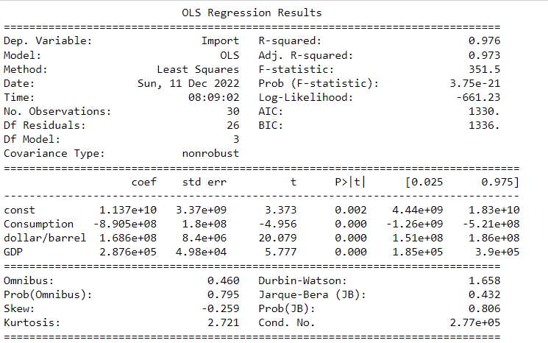
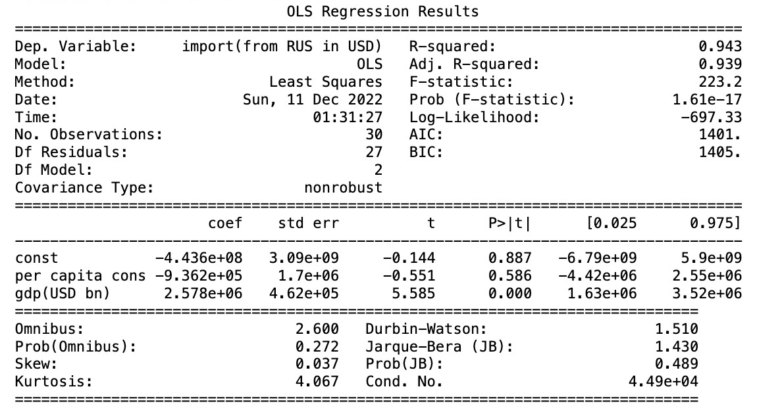
Multiple Linear Regression Results
Due to the occurrence of war, import drops which would have a direct impact on consumption as can be seen from the negative coefficient in results for US and China
R-squared value is more than 0.94 which shows model is effective
USA
China

Slide 11
ANOVA
F value below 0.05 signifies multiple linear regression model behaves better than simple linear regression model
USA
China

Slide 12
Import of iron,steel and edible oils from Ukraine to various countries
Ukraine exports of iron and steel was US $13.14 billion during 2021, according to the United Nations COMTRADE database on international trade.

Slide 13
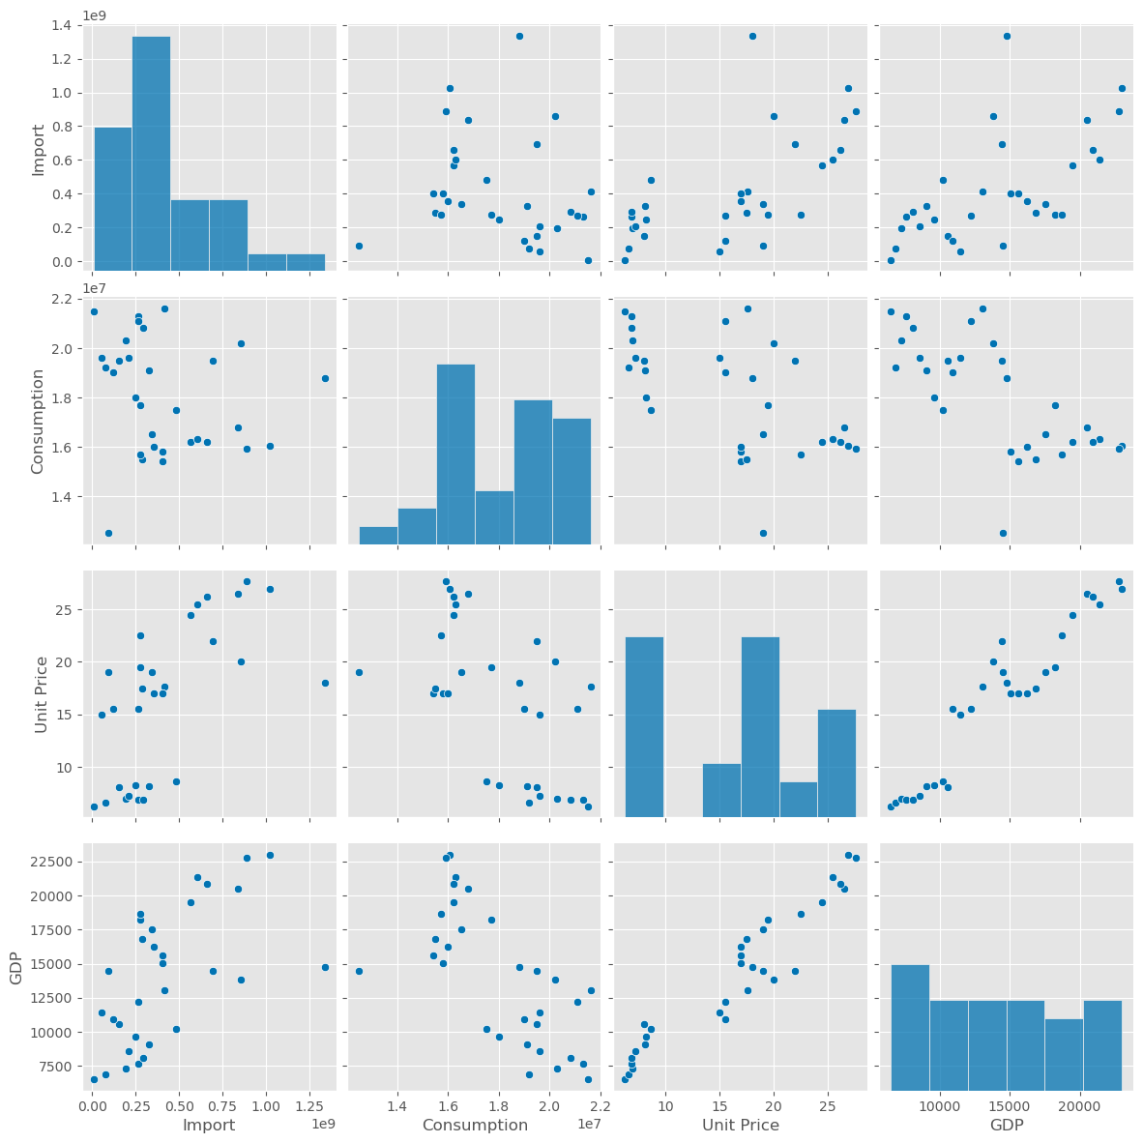
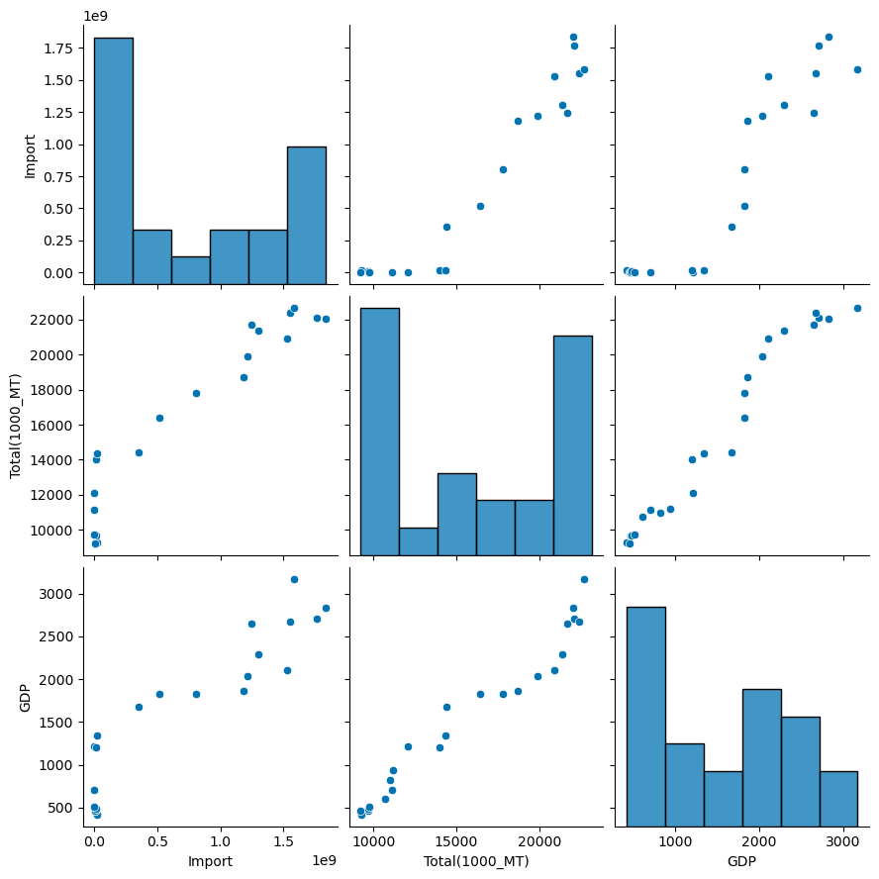
Exploratory Data Analysis
For USA, as unit price increases GDP increases while consumption decreases. While, in case of India as consumption increases overall GDP of country increases.
USA
India

Slide 14
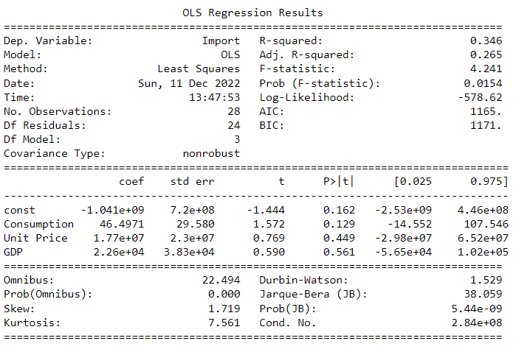
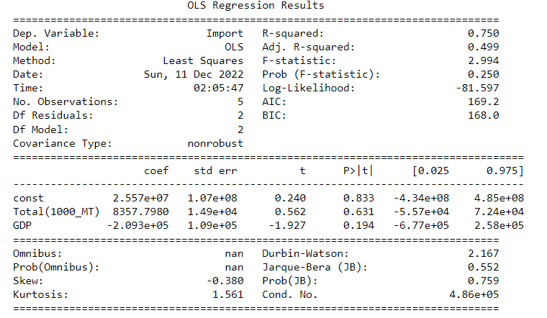
Multiple Linear Regression Results
For India, R squared value is a high positive number suggesting model behaves correctly. While for USA, R-squared value is a low positive value which can be further improved if we add more dimensionality to the data
USA
India

Slide 15
ANOVA
F value less than 0.05 signifying current model is better than simple regression model for USA
USA
India

Slide 16
Future Scope
The current models work well for some countries which can be further improved by adding more dimensionality to the overall data.
Since the Russia-Ukraine War is a very recent and ongoing incident, there lacks an extensive and concluded data is available. With more awareness, volume of data available will increase which can be used to refine the model further.
When data of import value is released for every product for 2022, using the predicted value for import of the respective product from the ARIMA model, we will be able to calculate evaluation metrics such as sum of squared error. On the basis of that we can evaluate our model.
Also, the model can be trained for monthly updated dataset of other major commodity before and after the war to analyse the nuanced change in trade. As of now, as data is not released officially by Comtrade, EU.org, USDA, or other trusted international organization.

Slide 17
Thank You!

Slide 18
Bibiliography
[1] Y. Zhao, C. Huang, J. Luo, “Preparing for the Next Pandemic: Investigation of Correlation Between Food Prices and the COVID-19 Pandemic from Global and Local Perspectives”
[2] 3. K. Imai, J. Weinstein, “Measuring the Economic Impact of Civil War” CID Working Paper No. 51
[3] 4. Jagtap, S.; Trollman, H.; Trollman, F.; Garcia-Garcia, G.; Parra-López, C.; Duong, L.; Martindale, W.; Munekata, P.E.S.; Lorenzo, J.M.; Hdaifeh, A.; Hassoun, A.; Salonitis, K.; Afy-Shararah, M. The Russia-Ukraine Conflict: Its Implications for the Global Food Supply Chains. Foods 2022, 11, 2098. https://doi.org/10.3390/foods11142098
[4] Kuzio, Taras. "Russia–Ukraine crisis: The blame game, geopolitics and national identity." Europe-Asia Studies 70.3 (2018): 462-473.
[5] Liadze, Iana, et al. "The economic costs of the Russia-Ukraine conflict." NIESR Policy Paper 32 (2022).
[6] Reuters coverage on Russia’s oil export to China in 2022
[7] USDS press release briefing the sanction and implied trade control
[8] Report on Implicatications for Ukraine post Russia’s attack
[9] Anderson, J.D.; Mitchell, J.L.; Maples, J.G. Invited Review: Lessons from the COVID-19 Pandemic for Food Supply Chains. Appl.
Anim. Sci. 2021, 37, 738–747
[10] Impact of war on supply of raw material

