Slide 1
Coffee Hub: Review Analysis
Profiling reviewed coffees across origin, roast, value, roaster, student taste-match and cost

Slide 2
Data & Method
Loaded the raw CSV and fixed Excel/UTF-8 encoding (Latin-ASCII) so accented origin & roaster names are clean.
Dropped coffees missing a roast type or any of the three reviewer descriptions to avoid biased averages.
Engineered Cost_rands (USD x 16.17, 17 Jun 2026 rate) and desc_all (merged reviews for keyword scoring).
Scored each coffee against 29 top Stellenbosch student keywords (kw_hits) and flagged student_match at/above the median.
Summarised seven key factors; the five most decision-relevant are visualised next.

Slide 3
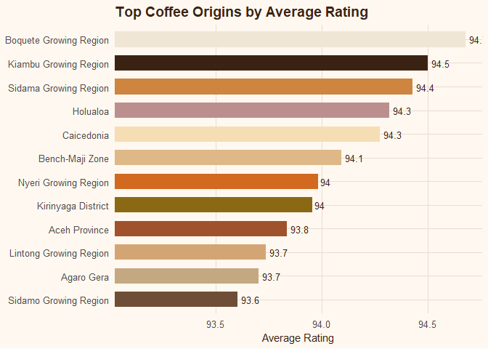
Top Coffee Origins by Average Rating
East African regions and a few premium single-origins lead: Boquete (Panama, ~94.6), Kiambu (Kenya, 94.5) and Sidama (Ethiopia, 94.4).
All twelve top origins sit in a very narrow 93.6-94.6 band - barely one rating point apart.
Origin signals quality (classic high-altitude specialty regions), but differences among the leaders are small, so origin alone weakly separates the best coffees.

Slide 4
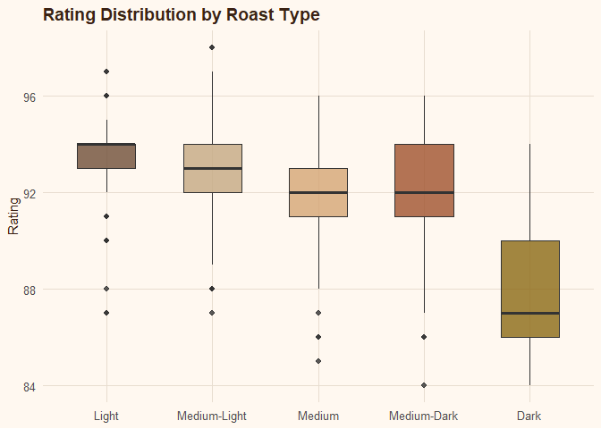
Rating Distribution by Roast Type
Lighter roasts score higher, almost monotonically.
Light & Medium-Light have the highest medians (~93) with tight boxes; Medium / Medium-Dark sit near 92.
Dark roast is the clear laggard - median ~87.5 and a much wider spread (lower AND less consistent).
Takeaway: favour light / medium-light roasts for the highest, most reliable scores.

Slide 5
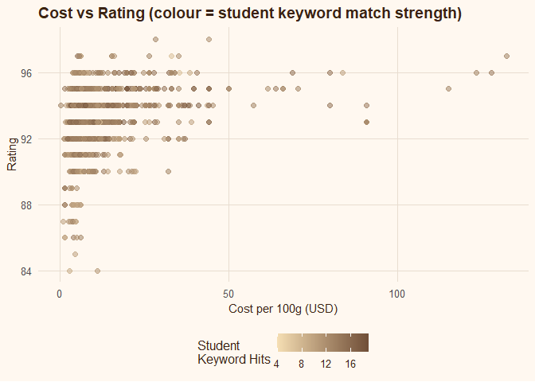
Cost vs Rating
Price is a poor predictor of quality.
Points cluster below ~$20/100g and span almost the full rating range (88-97), so many cheap coffees score as well as expensive ones.
Only a faint upward tilt with strong diminishing returns; $50-$130 coffees are not meaningfully better.
Student keyword hits (colour) spread across all prices - good taste-fit is NOT confined to pricey coffees.

Slide 6
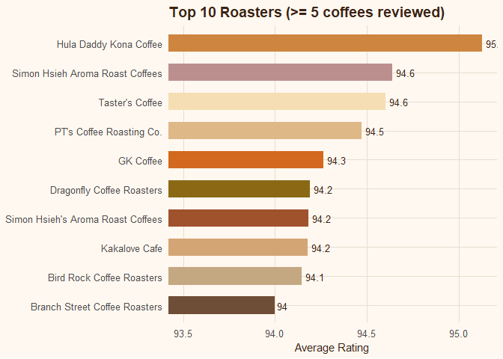
Top 10 Roasters (>= 5 coffees reviewed)
Hula Daddy Kona Coffee stands out at ~95.1 - the only roaster clearing 95 and visibly ahead of the field.
Simon Hsieh Aroma Roast and Taster's Coffee (~94.6) and PT's Coffee Roasting Co. (94.5) lead a tight 94.0-94.3 chase pack.
As with origins, leaders differ by ~one point: read roaster reputation as 'consistently excellent', with Hula Daddy the lone top outlier.

Slide 7
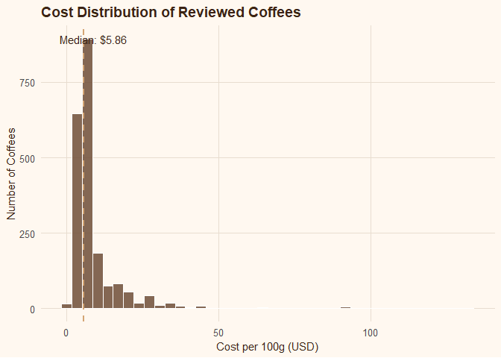
Cost Distribution of Reviewed Coffees
The price distribution is heavily right-skewed.
Most coffees cluster around the median of $5.86/100g, dropping off sharply after ~$15, with a long thin premium tail past $100.
The mean is pulled up by those outliers, so the median is the fairer 'typical price'.
The market is overwhelmingly affordable; luxury coffees sell on scarcity, not a rating premium.

Slide 8
Overall Conclusion
Quality is broad and shallow at the top: best origins (93.6-94.6) and roasters (94.0-95.1) are bunched within ~one rating point.
Roast level moves ratings most - lighter is better; dark roast underperforms and is erratic.
Origin character matters - East African and select premium single-origins lead.
Price barely tracks quality - most coffees ~$5.86/100g and the expensive tail buys little extra rating.
Recommendation for a Stellenbosch-student buyer: a light-to-medium, East-African or top-roaster coffee with high student keyword hits, at a low price - no trade-off required.

