Slide 1
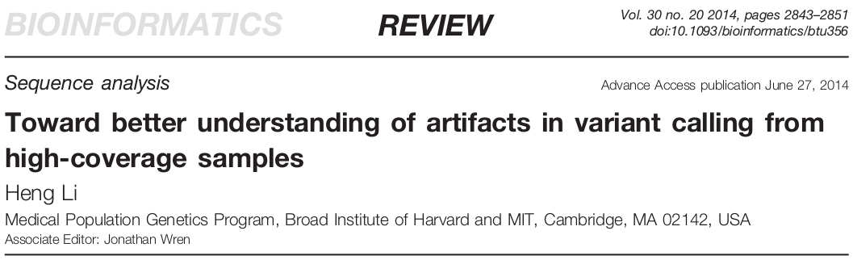
Mullins Lab Journal Club
Thomas Sibley – 20 January 2015 – Mullins Lab Journal Club
Notes:
Heng Li is the creator of many bioinformatics tools for next-gen sequencing, including samtools, BWA, and MAQ. He’s widely regarded as an expert on the analysis of sequences. I came across this paper while working on a data analysis pipeline for the drug-resistance project Ross is working on in Lisa’s lab.

Slide 2
Sanger vs. NGS
Sanger is easier
Less data
More confidence in sequence alignment
Higher variant levels
NGS promises more
More data
Less confidence in read mapping
Lower variant levels
Notes:
For NGS data, the total error rate of SNP/SNV call is pretty unclear. Additionally, there are many possible sources of error, and it’s unclear which are the leading causes of error in calls. There’s no good, standardized, general-purpose “truth set” for calibration of SNP calls. The lack of both of these make it hard to determine “good” from “bad” SNP calls, or assign a probability of correctness.
That said, being able to detect low-level variation reliably is useful in innumerable contexts, so we try to do this anyway with all sorts of modeling, filtering, and thresholding.

Slide 3
Problems with Simulation
Modeling the affect of:
non-random distribution
dependent errors
imperfect references
copy number variation
Notes:
Simulation of NGS data is one potential means of calibrating SNP callers, but it suffers from a number of intractable problems causing diminishing returns that make it less appealing.
All of these factors affect or have the potential to affect variant calls, but they are also hard to simulate realistically. If we try, do the results say more about the simulated data itself than the variant calling methods? If we ignore them, we underestimate error rates.

Slide 4
Problems with real data
Can’t see large-scale systematic errors
“Relative accuracy”
Often ignores false-negatives (type II)
Notes:
Real data is an improvement in terms of a calibration truth set, but it too has issues which are hard to resolve. For example, using real variant data hides systematic errors which all callers make. Comparison methods operating on real data, either via experimental genotyping of select sites or comparing against other tools/pipelines, only produce a relative accuracy without any grounding point for overall accuracy. False-negatives are usually hard to ascertain since they require some level of ground-truth, and comparison methods which only look at existing data don’t necessarily tell the full story on these type II errors. Li notes that experimental validation using microarrays tends towards easier regions, and so doesn’t necessarily provide an unbiased look across all regions.

Slide 5
Instead, compare:
Multiple mappers and callers, on…
… a haploid human cell line (CHM1hTERT), and
… a control cell line (NA12878)
... using filters independent of any one caller.
Notes:
Li’s solution to these problems with simulation and real variant data is to instead use a haploid human cell line to call variants using multiple mappers (aligners) and callers. The hypothesis is that “vast majority” of heterozygous calls should be errors of some sort, and the affect of extent of the true heterozygous sites in the cell line (such as those via somatic mutations) should only put a lower bound on the error rate estimation. Theoretically the fewer heterozygous variants called, the better the caller. The haploid cell line is derived from a molar pregnancy where the egg was missing a nucleus.
A positive control cell line is used to avoid overrating callers which simply aren’t as sensitive. Using filters independent of any particular caller provides another level of control on the variant calls, and also hopefully suggests good overall filters regardless of the specific pipeline used.
CHM1 is from a PCR library, the control is not.

Slide 6
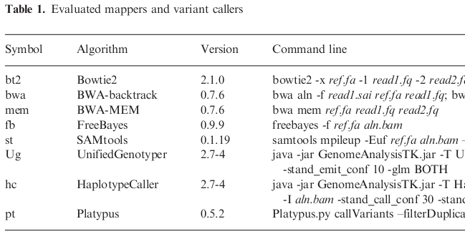
Notes:
The two primary mappers used were Bowtie2 and BWA-MEM (maximal exact matches). The callers are Freebayes, from the Marth lab at Boston College, samtools, two different ones from the Genome Analysis ToolKit (GATK) by the Broad Institute, and Platypus.

Slide 7
Filters
Low-complexity (LC)
Maximum-depth (MD)
Allele balance (AB)
Double strand (DS)
Fischer strand (FS)
Variant quality (QU)
Notes:
Panel of filters, which are applied in order regardless of pipeline, so they’re cumulative.

Slide 8
Measuring accuracy
Estimate false-positive rate using N_{h}/N_{d}
# of heterozygote calls in haploid vs. control
assumes the call errors in control approximated by all calls in haploid
Sensitivity proxy as N_{d} - N_{h}
Notes:
The paper asserts that the two sequence datasets are very similar. For example, both are from 100bp Illumina reads, both have about the same coverage (after PCR duplicate removal from CHM1 data), and both have roughly the same number of called variants per haplotype. Haplotypes in this case are alleles which are close to each other and statistically associated in the data, or more simply put, alleles which occur together.
All right, so let’s look at the first figure.

Slide 9
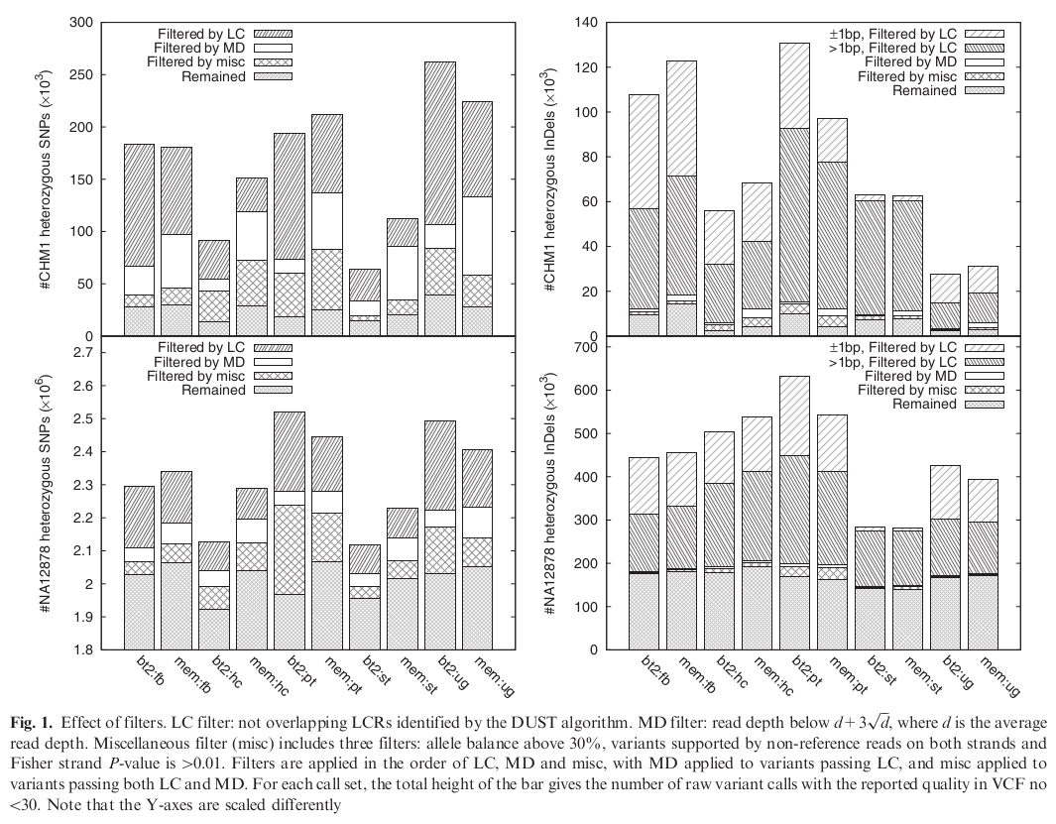
Notes:
Calls after filtering. Columns alternate by mapper (bt2 then mem), grouped by caller. Note that y axes are in thousands except the lower left, which is in millions, and the scales are different.
80-90% of heterozygous indel calls in the haploid cell line fall within LCRs, while up to 60% of heterozygous SNP calls do. False-positive rate for indels is calculated as 10-40% in LCRs, but only 1-8% outside. If you assume that all calls in CHM1 are errors, then after filtering the error rate looks like about 15-30k per human genome (~3 billion bp), or 1 error per 100-200kbp.
The question still remains: Is the haploid cell line actually haploid? What fraction of heterozygous calls are true positives rather than false positives is important, and if it’s too high than it’s not a good negative control. The paper tries to address that with the next two figures.

Slide 10
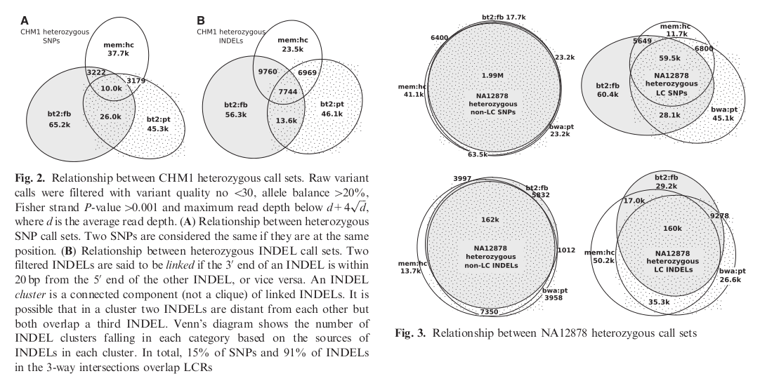
Sources of heterozygotes:
not truly haploid
somatic mutations
library construction (i.e. PCR) and/or sequencing errors
mapping and/or variant calling flaws
Notes:
The paper gives the following options for possible sources of heterozygotes. Obviously the paper thinks, or hopes, 1 and 2 are minimal and that 3 and 4 are the vast majority of sources. In particular, the premise is that the mappers and callers should take 3 into account, and so error rate estimations lump the last two sources together.
The author seems to be convinced that CHM1 is effectively haploid due to the a) small overlap of heterozygous callsets in figure 2 (suggesting sequencing error and/or algorithm artifacts as causes) and b) that there is an order of magnitude difference between the raw calls against the positive control vs. the haploid line (the implication being that there should be 10x more if it wasn’t haploid). However, Li speculates after a perusal of other datasets that “there may be 5-20k heterozygotes in CHM1 with strong alignment support from multiple Illumina libraries,” but that “it is hard to get a more accurate estimate … with the data we are using.” … which isn’t exactly confidence enhancing.
However, the argument goes, even if the 3-way intersections of figure 2 are treated as real heterozygotes, then it only places a lower bound of error rate estimation at 17.7k per genome, or about 1 per 170k. The rest of the heterozygous calls made in CHM1 by callers can be used to calculate an error rate at least above that lower bound of accuracy.

Slide 11
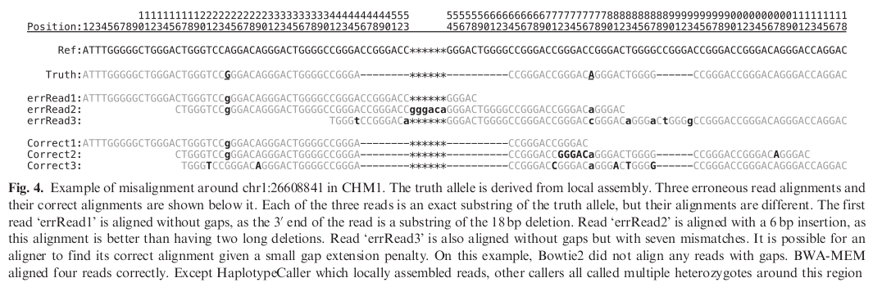

Slide 12
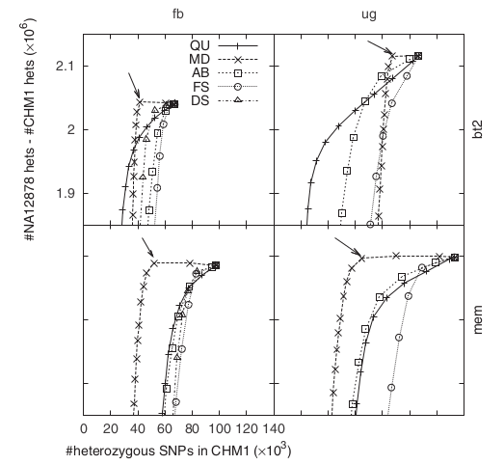

Slide 13
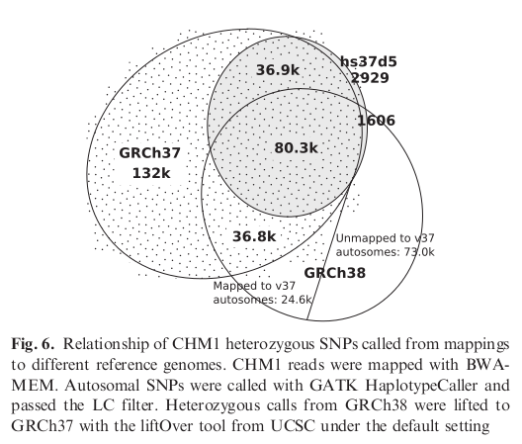

Slide 14
Conclusions and Questions
Raw: 1 error per 10-15kb
Filtered: 1 error per 100-200kb
Low-complexity filter is best against false pos.
Use intersection of two pipelines + filter
Is CHM1 actually haploid?
Notes:
The raw call sets suggests a calling error every 10-15kb. This is a “total error” estimate, which includes errors caused by PCR, sequencing, alignment, etc. After filtering, it’s an order of magnitude better. Their one concrete suggestion is to use the intersection of two raw callsets and then apply filtering to that shared subset.
The methods Li uses in this paper are intriguing, and I was hoping for results that would help inform our look at variants in HIV. Unfortunately the results mostly support what we already know or suspect, and they don’t contain much in the way of concretely usable findings, at least for us. Part of this is that some techniques are based on the well-studied human genome datasets used and aren’t applicable to viral sequencing.

