Slide 1

Cs425-SWE-PROJECT
Course Registration System (CRS)

Slide 2

Group Members:
Adonay Gebrerufael
Wycliff Kasirye
Samsom Michael
Henok Gebremichael
Tsigereda Hagos
August 15^{th,} 2024

Slide 3
Objective:
- Develop a comprehensive system to streamline the course registration process.
- Improve communication about registration deadlines.
- Efficiently manage course and student information.
Target Users: Students, Registrar Faculty, and Administrative Staff.
introduction

Slide 4
Problem scenario
Maharishi International University needs a system to manage course registration, verify prerequisites, and handle waitlists.
- Student Enrollment Process: Students create a plan of study, select courses, and choose faculty advisors.
- Course Registration: Students can view schedules, select courses, and enroll if prerequisites and availability are met.
- Waitlist Management: If a course is full, students are waitlisted and automatically enrolled if space becomes available.

Slide 5
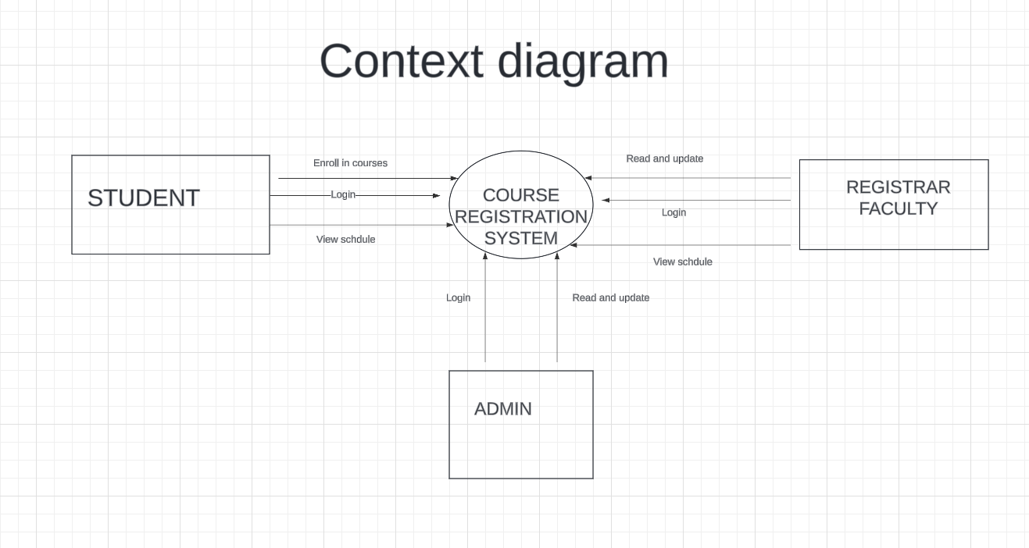

Slide 6
Use-Cases
Registrar Faculty Use-Cases:
Send Notifications: As Registrar Faculty, I can send email notifications to all students about registration deadlines.
Schedule Notifications: As Registrar Faculty, I can schedule notifications to be sent automatically at specific times.
Admin Use-Cases:
Retrieve Student List: As an admin, I can retrieve a list of all students enrolled in a particular course.
Database Management: As an admin, I can check the database to update and retrieve course and student information, including updating student contact information.
Student Use-Cases:
Login: As a student, I want to log in using my email and password to easily enroll.
Password Reset: As a student, I can reset my password if I forget it.
Enroll/Drop Courses: As a student, I can enroll in or drop courses.
View Schedule: As a student, I can view my course schedule.

Slide 7
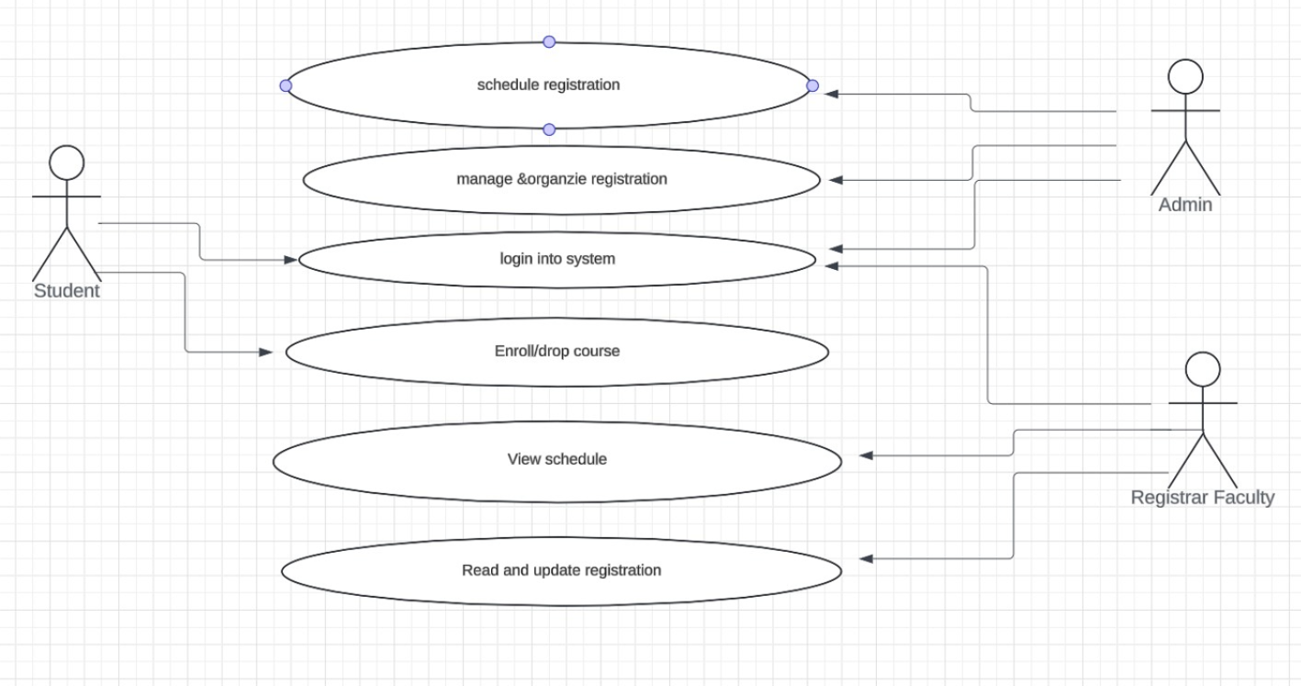
Use case diagram

Slide 8
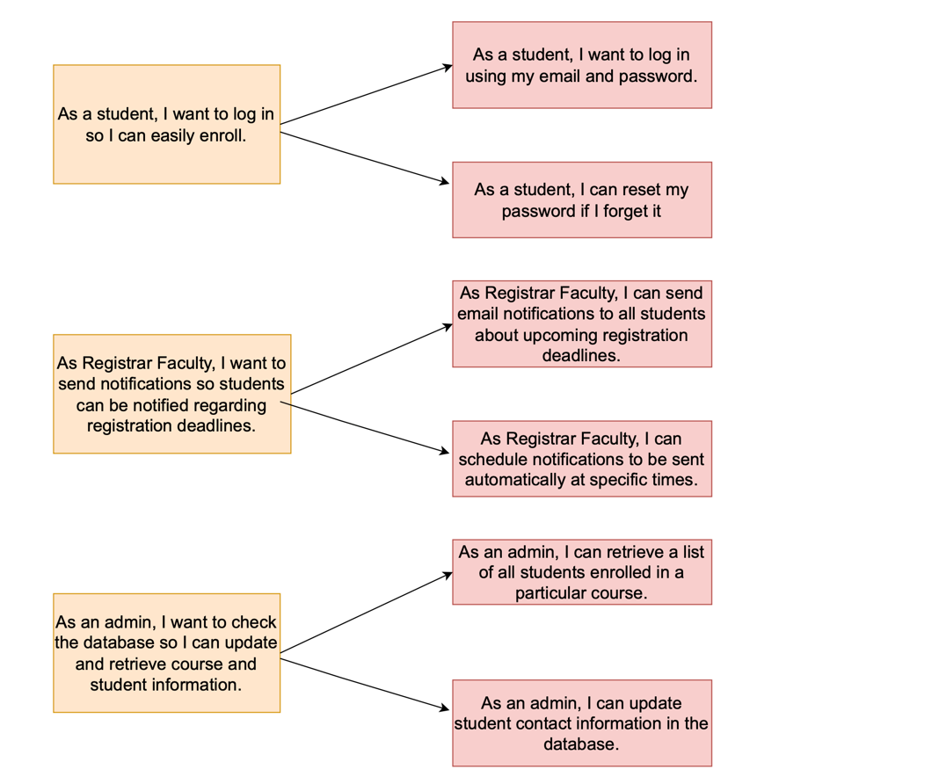
User story

Slide 9
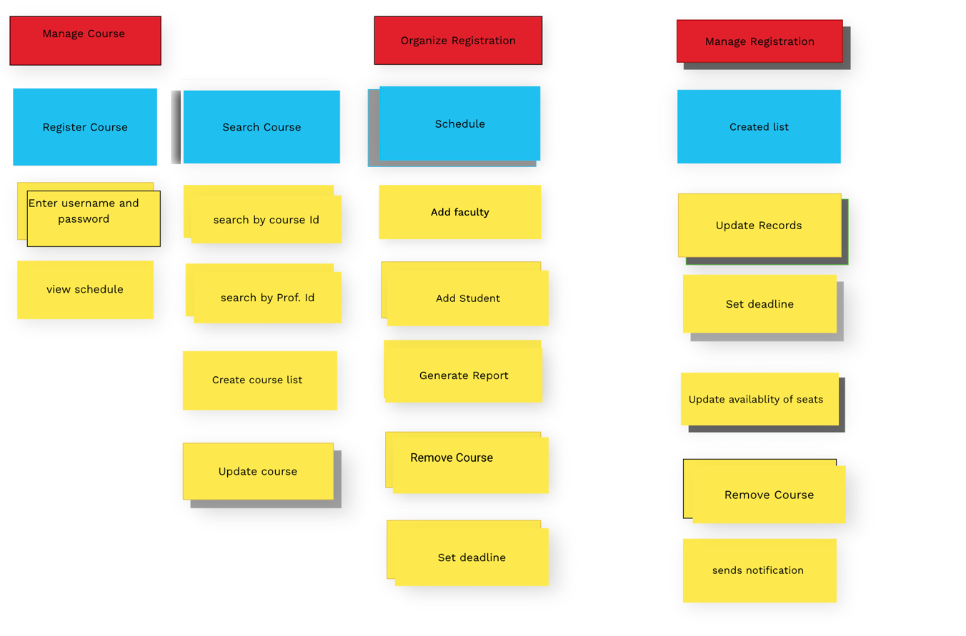
User map

Slide 10
Acceptance Criteria for User Stories
User Story 1: Student Login and Enrollment
Login Page:
- Display a login page with a 'Login' button.
- Redirect to the course enrollment page on successful login.
- Show an error message and provide a password reset option on failed login.
- Securely store user credentials.
Course Management:
- Display all available courses and allow filtering by subject, level, etc.
- Search for courses by name and display matching results.
- Provide detailed course information, including the syllabus and materials.
- Show currently enrolled courses with details.
User Story 2: Registrar Faculty Notifications
Send Notifications:
- Send notifications to all students via email or other platforms.
- Customize notifications for specific groups or individuals.
- Track and view sent notifications and their success rate.
- Schedule notifications for specific times and dates.
User Story 3: Admin Database Management
Database Access:
- Log in and access the list of courses and student information.
- Update course details and make changes as needed.
- Retrieve course and student information for reporting or other purposes.

Slide 11
Scenario 1: Student Enrollment and Course Management
1. Log In and View Courses:
A student logs into their account, navigates to the course selection page, and views all available courses.
2. Filter and Select Courses:
The student filters courses by subject and level, selects a course, and views detailed information, including the syllabus.
3. Enroll in Course:
The student enrolls in a selected course after meeting prerequisites and availability requirements.
4. Review Enrolled Courses:
The student reviews all currently enrolled courses and course details.

Slide 12
Scenario 2: Notification Sending by Registrar Faculty
1. Send Notification:
The Registrar Faculty logs into the system and sends a notification to all students about an upcoming registration deadline.
2. Customize Notifications:
The Registrar Faculty customizes notifications for a specific group of students who have not yet registered.
3. Track and Schedule Notifications:
The Registrar Faculty tracks the success rate of sent notifications and schedules future notifications.

Slide 13
Scenario 3: Database Management by Admin
1. Update Course Information:
An admin logs into the system, accesses the course list, and updates course information by adding new details or editing existing ones.
2. Retrieve Student List:
The admin retrieves a list of students enrolled in a particular course for reporting purposes.
3. Generate Reports:
The admin generates a report of all courses and student details, which is then exported for further analysis.

Slide 14
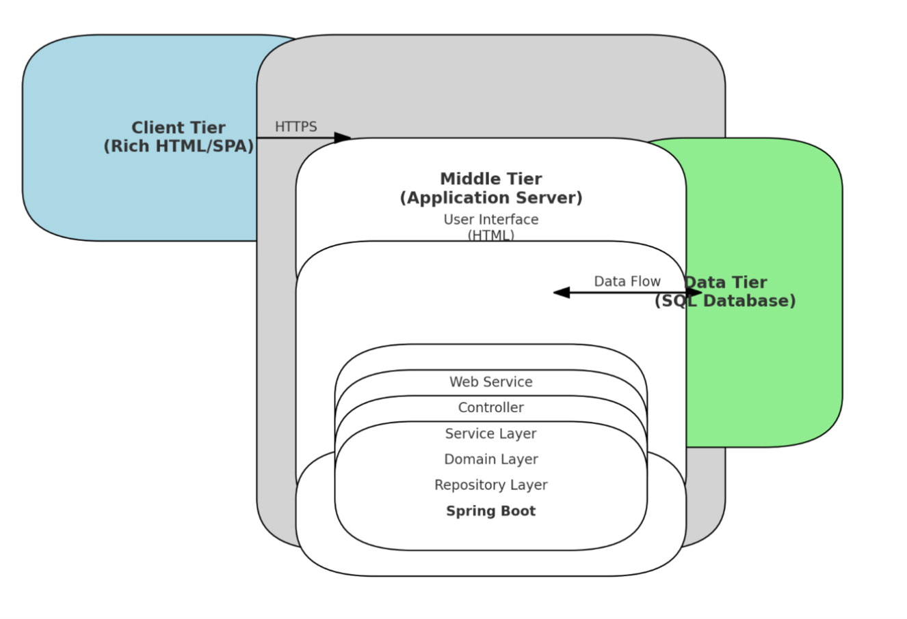
Architectural diagram

Slide 15
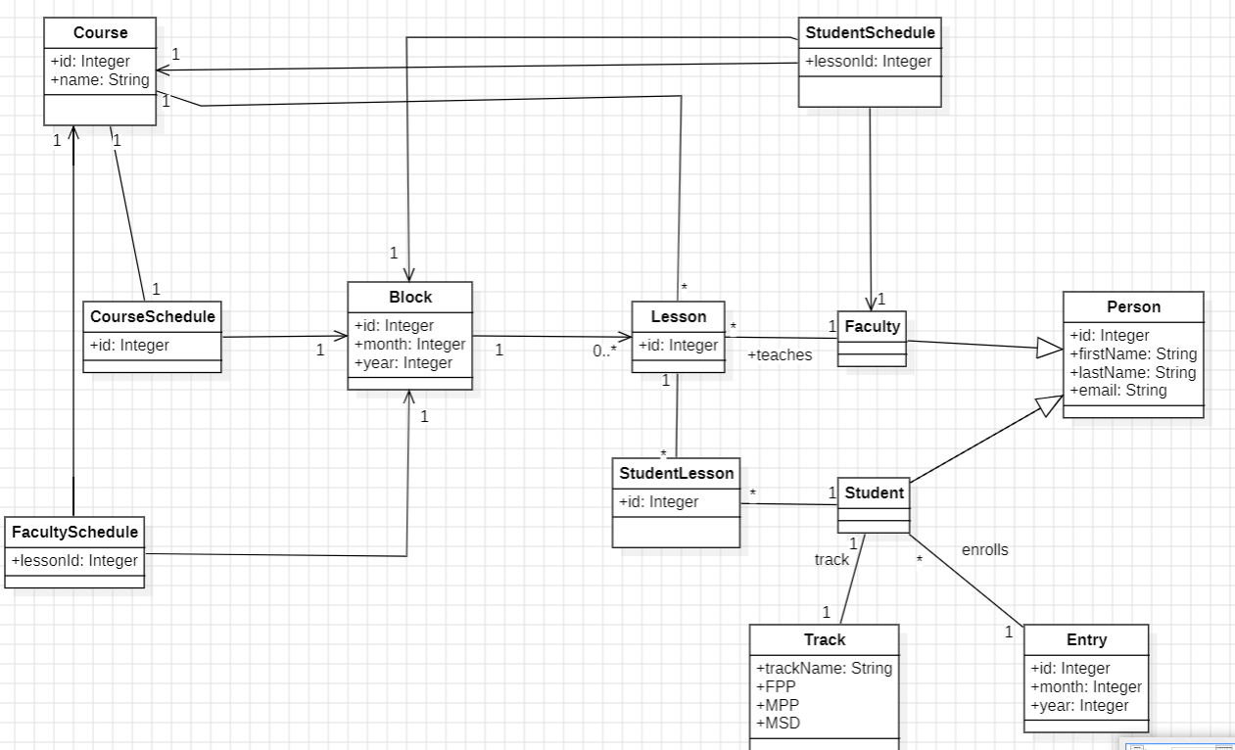
Domain Model

Slide 16
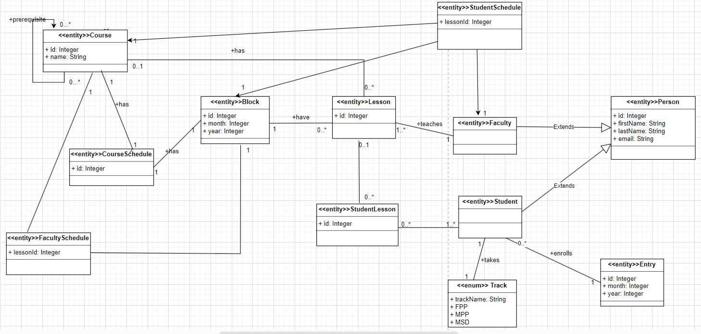
Class diagram

Slide 17
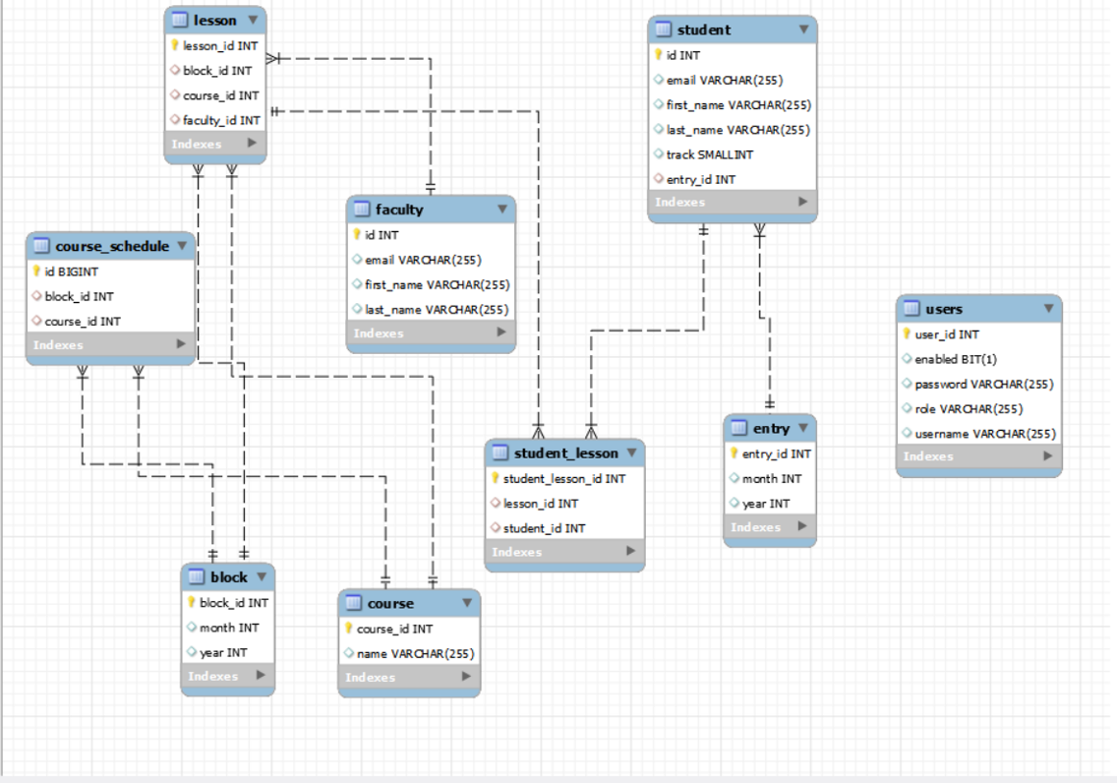
Database design model (E-R diagram)

Slide 18
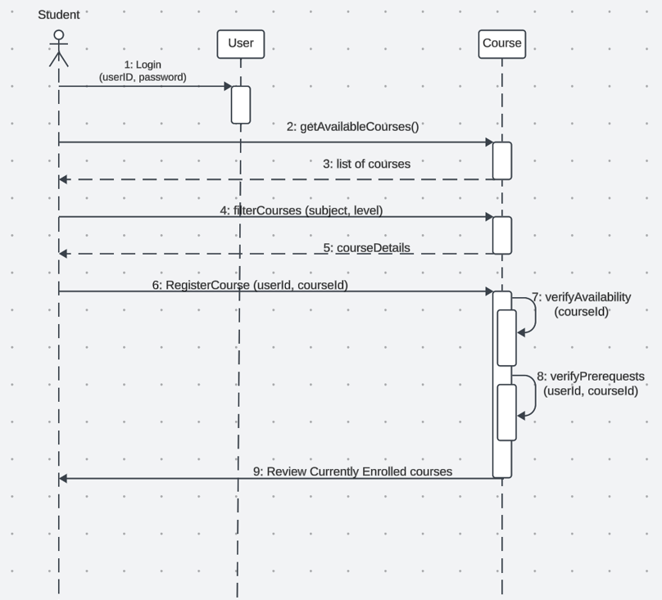
Sequence Diagram - Student Enrollment Process

Slide 19
THANK YOU!!!

