Slide 1
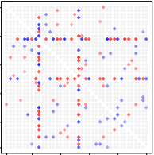
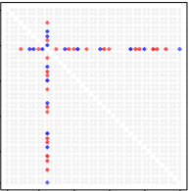
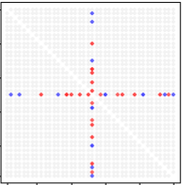
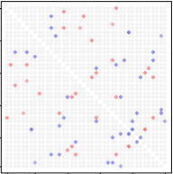
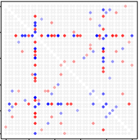
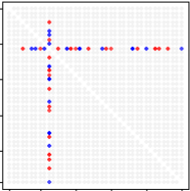
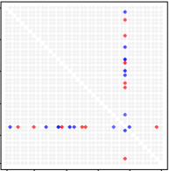
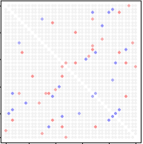

$Θ^{(1)} = {\tilde{Θ}}_{J} + {\tilde{Θ}}_{I1} + {\tilde{Θ}}_{R1}$
$Θ^{(2)} = {\tilde{Θ}}_{J} + {\tilde{Θ}}_{I2} + {\tilde{Θ}}_{R2}$
Low rank:
$${\tilde{Θ}}_{J}=λvv^{T}$$

Slide 2
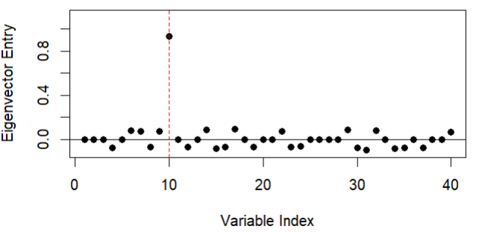
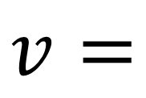
$$v=$$

