Slide 1




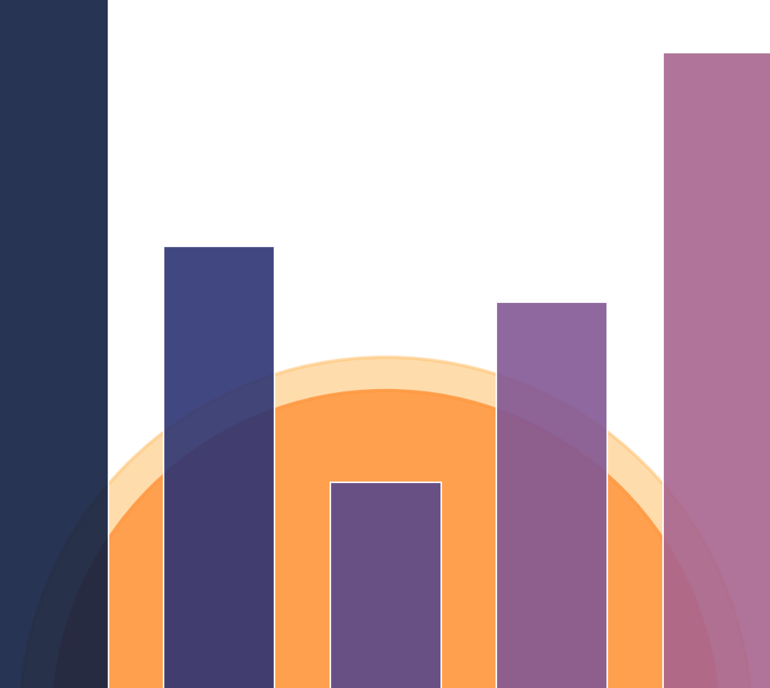

Twilight: Adaptive Attention Sparsity with Hierarchical Top-$p$ Pruning
Chaofan Lin, Jiaming Tang, Shuo Yang, Hanshuo Wang, Tian Tang, Boyu Tian, Ion Stoica, Song Han, Mingyu Gao
Tsinghua University
Massachusetts Institute of Technology
University of California, Berkeley
https://github.com/tsinghua-ideal/Twilight

Slide 2
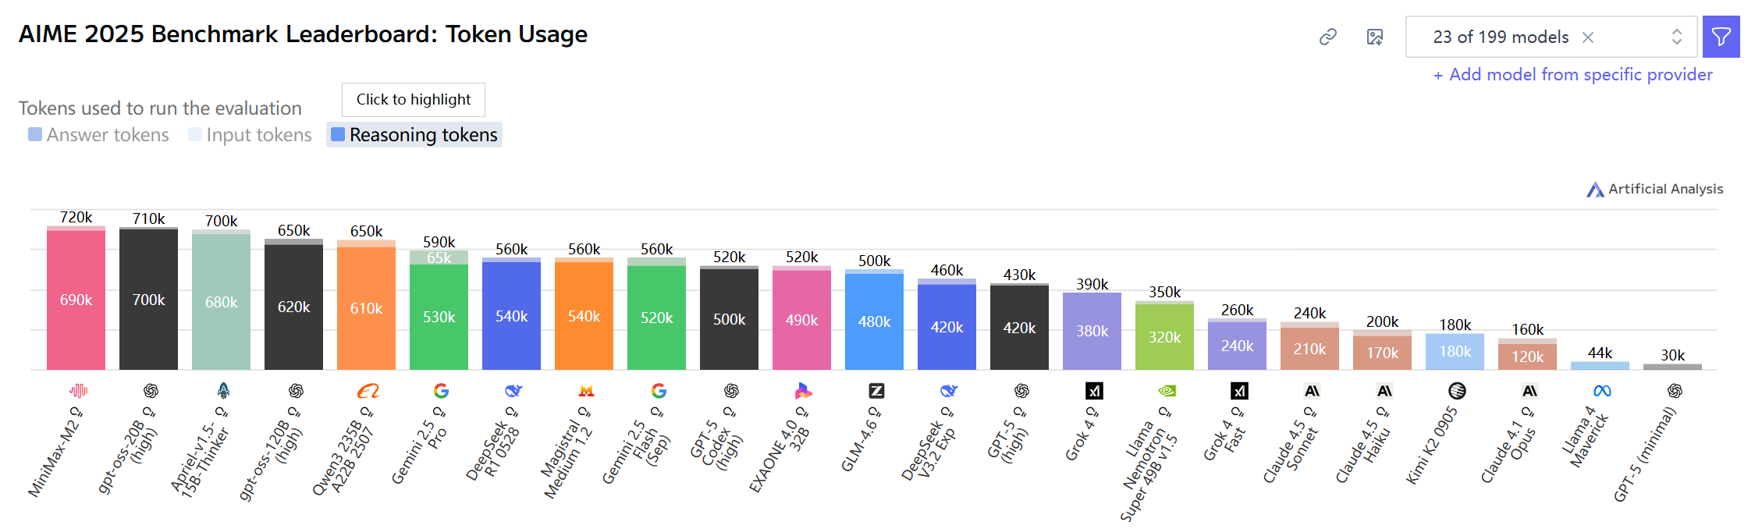
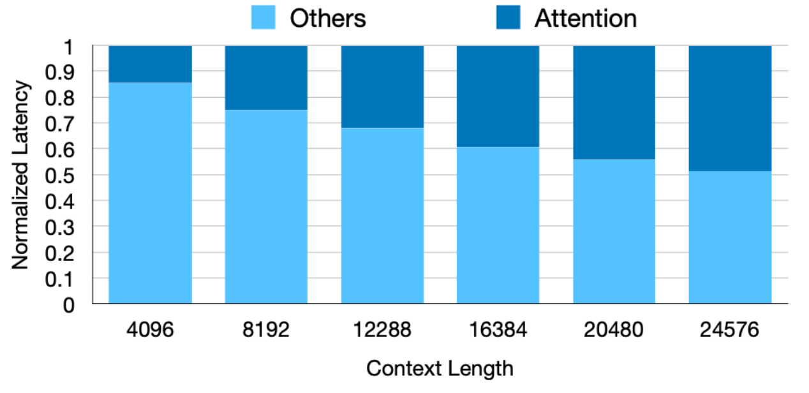
Background
Long-context LLMs are powerful but computationally expensive
Trend: Long Context windows are becoming the new standard for state-of-the-art LLMs, especially for reasoning models.
For long context LLM inference, attention dominates the latency.
Reasoning tasks like AIME cost nearly 1M tokens
Attention becomes the bottleneck as the sequence length increases

Slide 3
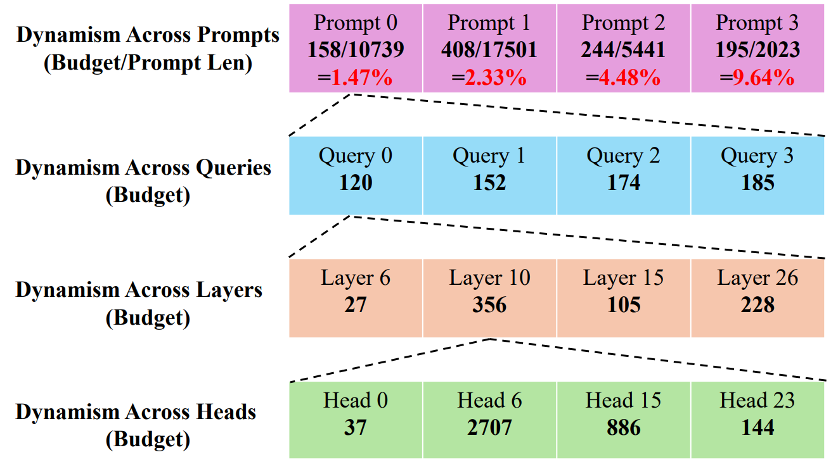
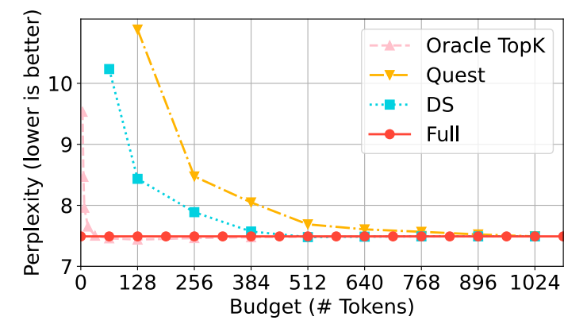
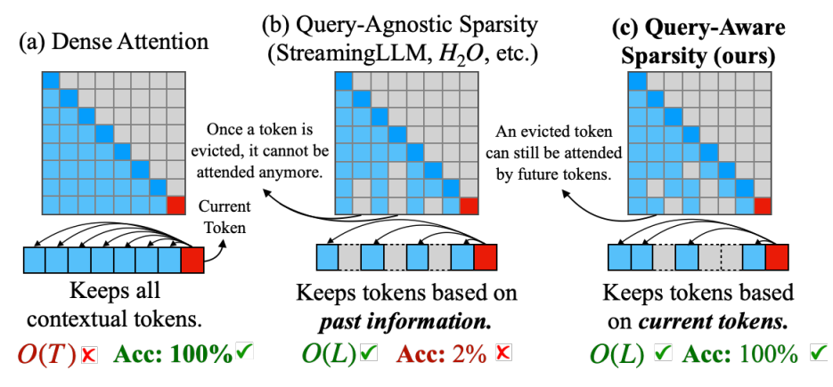
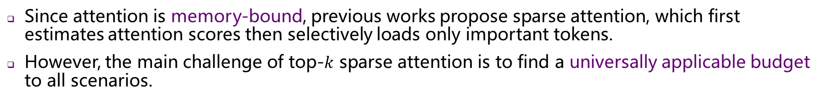
Background
Top-$k$ Sparse Attention to reduce KV cache loading
Since attention is memory-bound, previous works propose sparse attention, which first estimates attention scores then selectively loads only important tokens.
However, the main challenge of top-$k$ sparse attention is to find a universally applicable budget to all scenarios.
Previous work (Quest)
The best budget choices vary dynamically across different levels.
Quest: Query-Aware Sparsity for Efficient Long-Context LLM Inference. Tang et al.

Slide 4
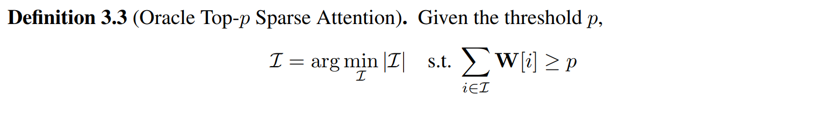
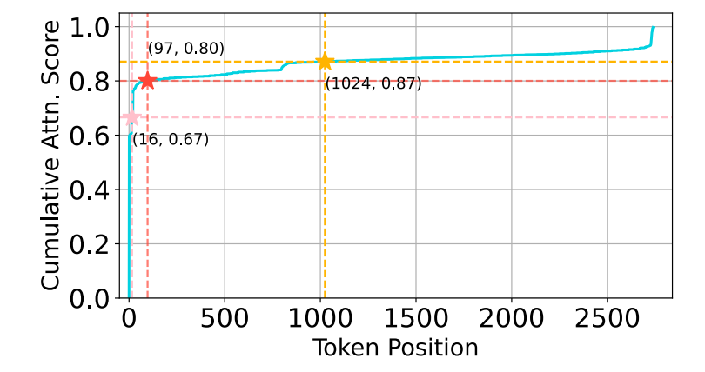
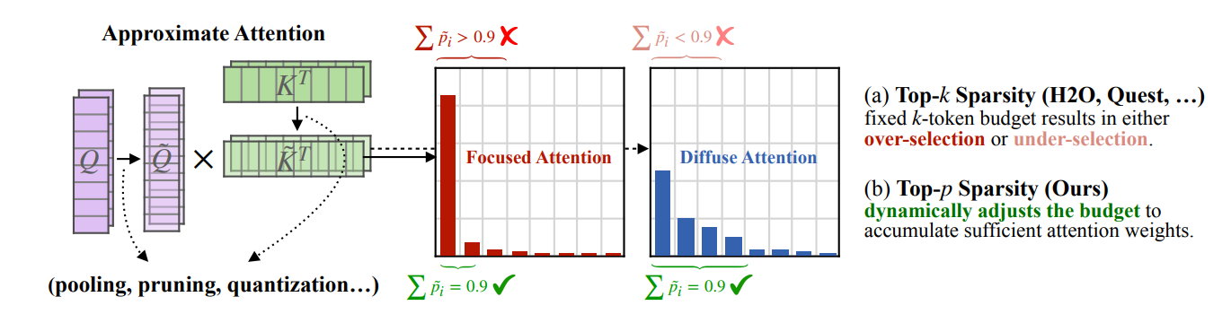
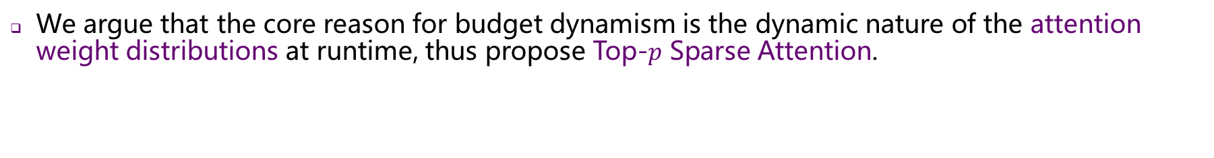
Bringing Top-𝒑 Sampling to Sparse Attention
Top-$p$ Sparse Attention is inherently budget-adaptive
We argue that the core reason for budget dynamism is the dynamic nature of the attention weight distributions at runtime, thus propose Top-$p$ Sparse Attention.
Diverse distributions observed in attention weights of
different attention heads.
Cumulative attention scores of different
budget selections in one example attention head.

Slide 5
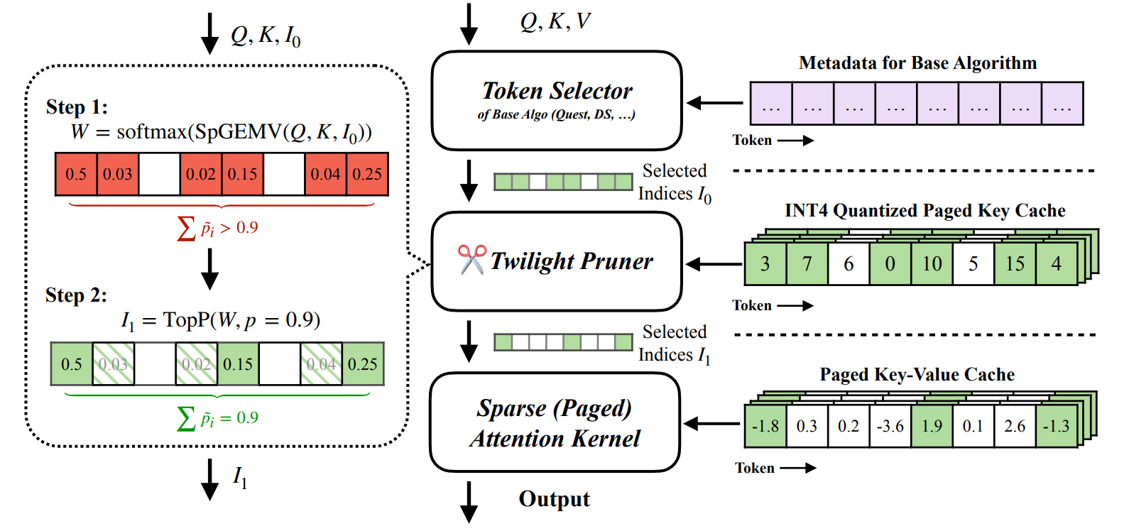
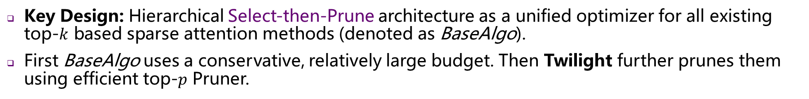
Twilight
Key Design: Hierarchical Select-then-Prune architecture as a unified optimizer for all existing top-$k$ based sparse attention methods (denoted as BaseAlgo).
First BaseAlgo uses a conservative, relatively large budget. Then Twilight further prunes them using efficient top-$p$ Pruner.

Slide 6
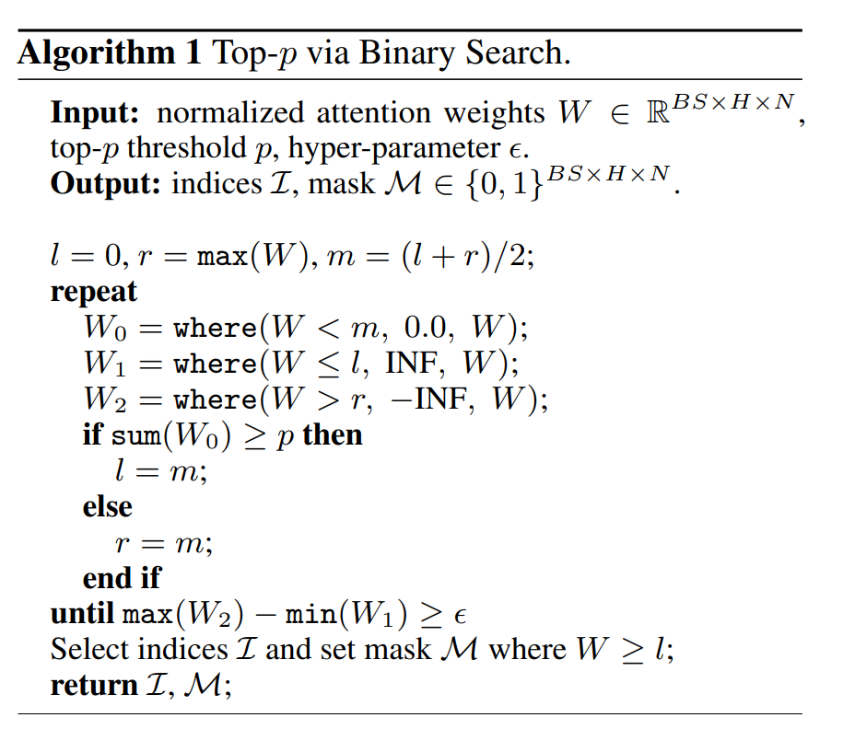
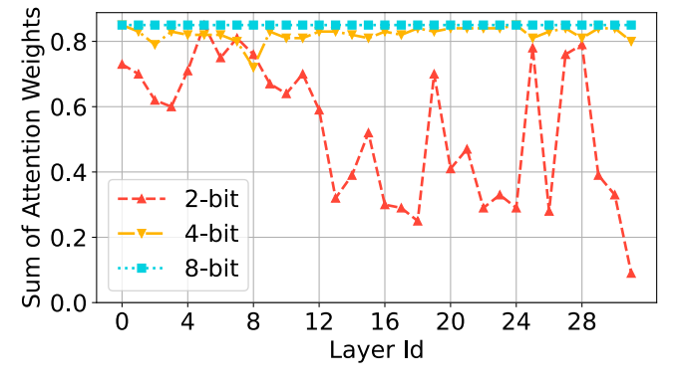
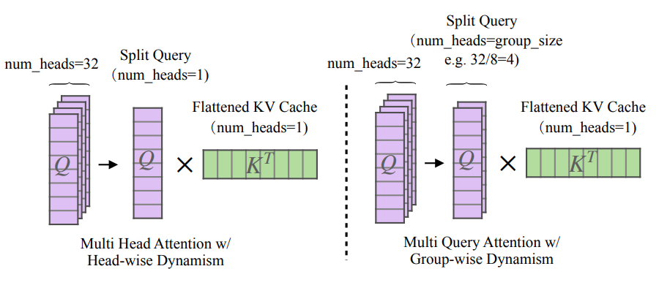
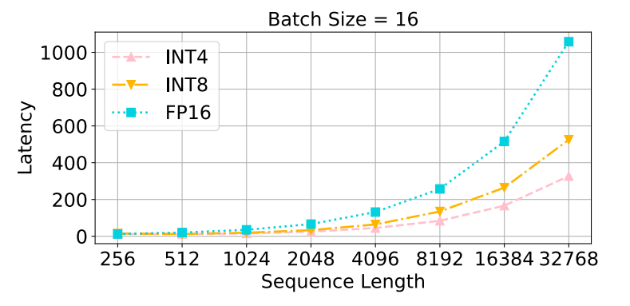
Twilight
To Achieve the Efficient Pruner
Efficient SpGEMV with 4-bit Quantization of Key Cache to estimate token importance: we find that 4-bit strikes a balance between accuracy and efficiency.
Efficient Sorting-free Top-p via binary search modified from FlashInfer.
Load Balancing with Awareness of Head Dynamism with GQA adaption.
FlashInfer: Efficient and Customizable Attention Engine for LLM Inference Serving. Ye et al.

Slide 7
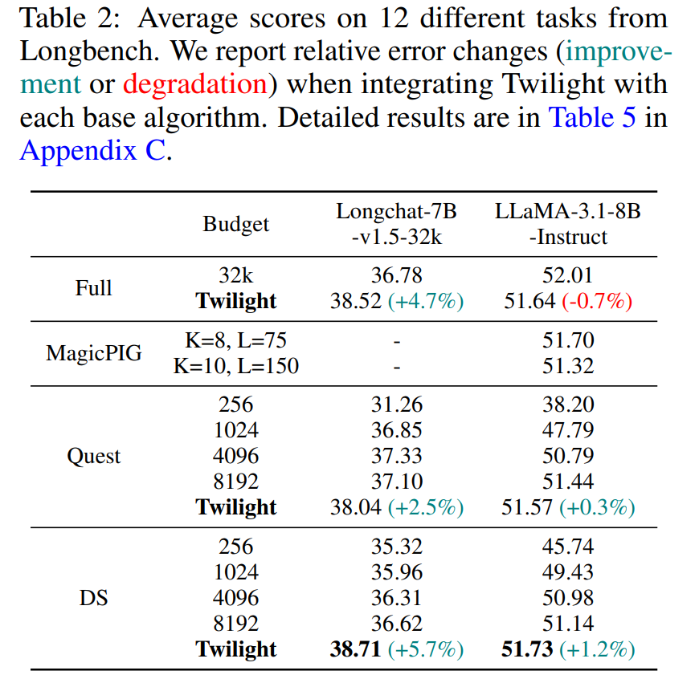
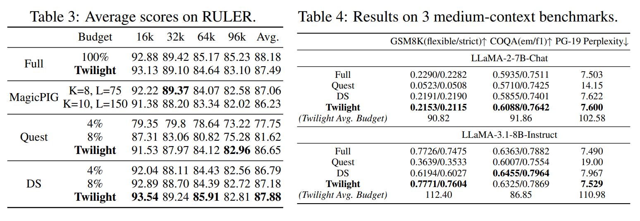
Accuracy Evaluation
Twilight achieves nearly no accuracy loss on three medium-context benchmarks and two long-context benchmarks (LongBench, RULER).

Slide 8
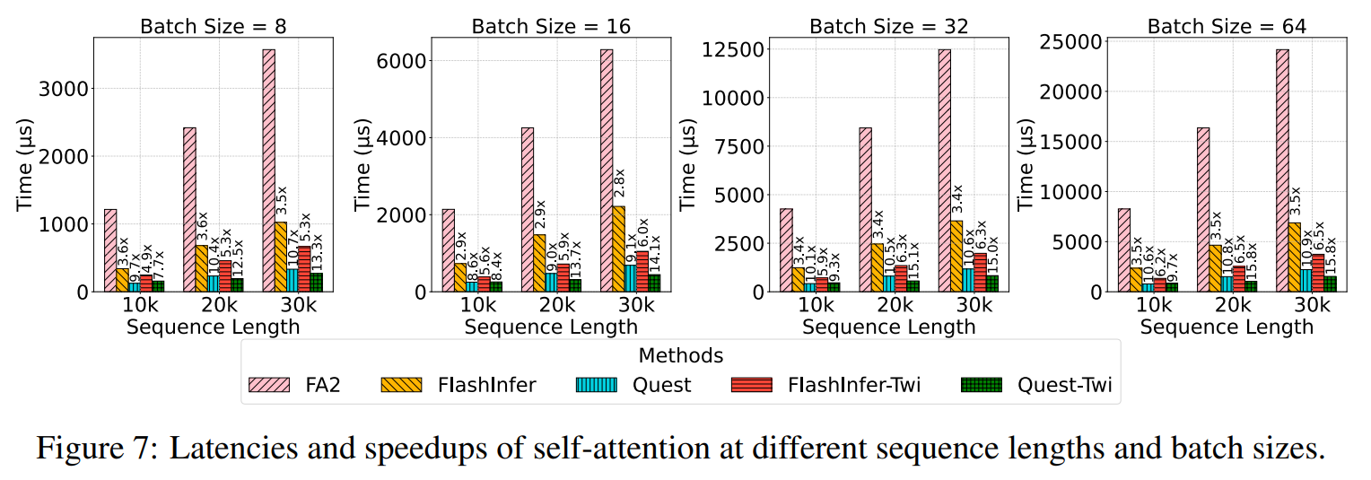
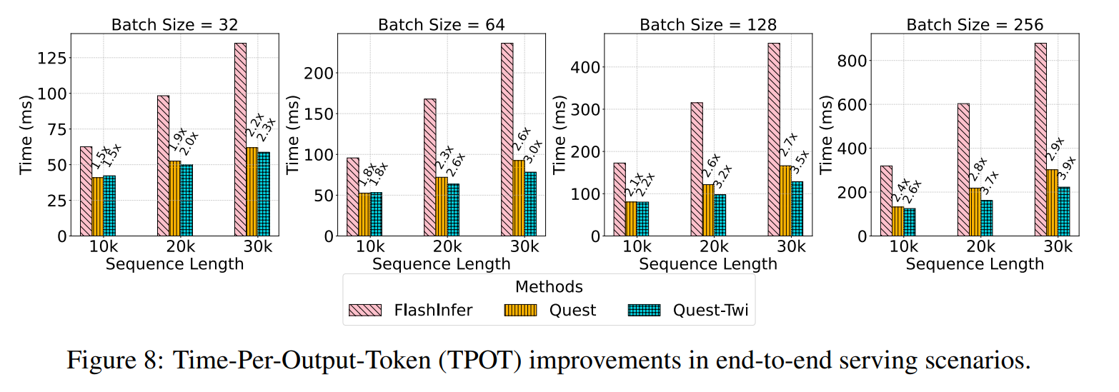
Efficiency Evaluation
Twilight accelerates self-attention operator by 2.4$×$ (FlashInfer) and 1.4$×$(Quest) at batch size=64
And for E2E per-token latency, Quest-Twi is 3.9$×$ compared to FlashInfer and 1.35$×$ to Quest at batch size=256.

Slide 9
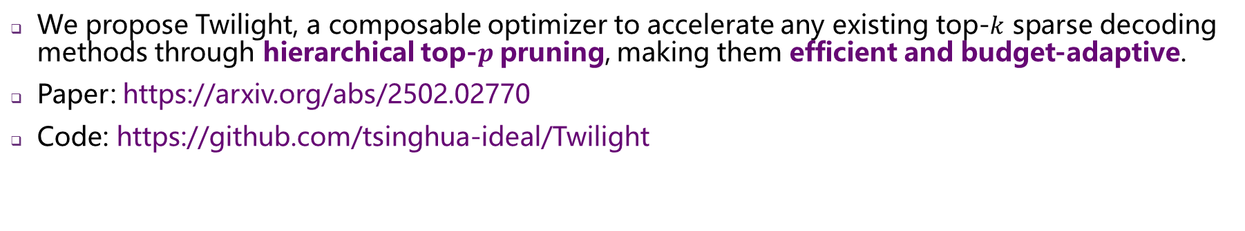
Thanks for Listening
Chaofan Lin lcf24@mails.tsinghua.edu.cn
We propose Twilight, a composable optimizer to accelerate any existing top-$k$ sparse decoding methods through hierarchical top-$p$pruning, making them efficient and budget-adaptive.
Paper: https://arxiv.org/abs/2502.02770
Code: https://github.com/tsinghua-ideal/Twilight

