Slide 1

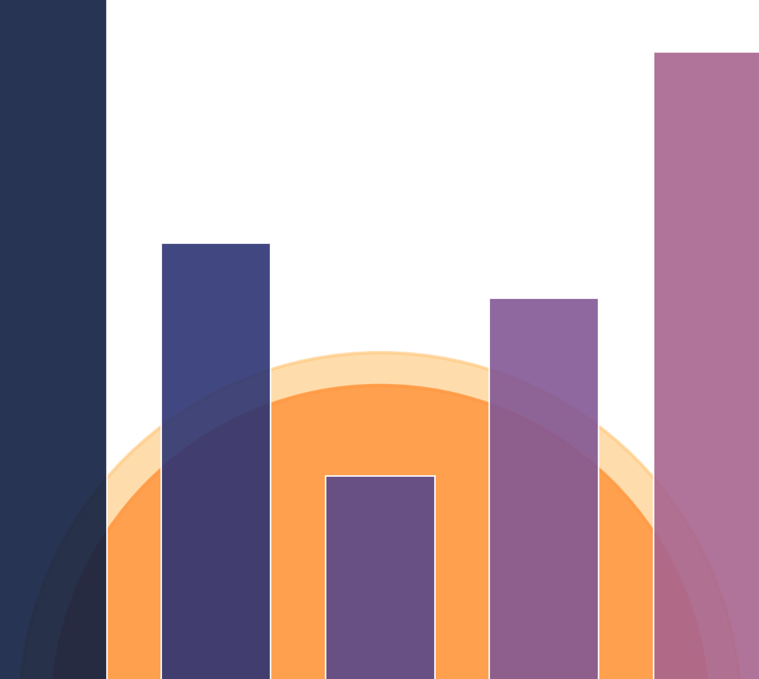




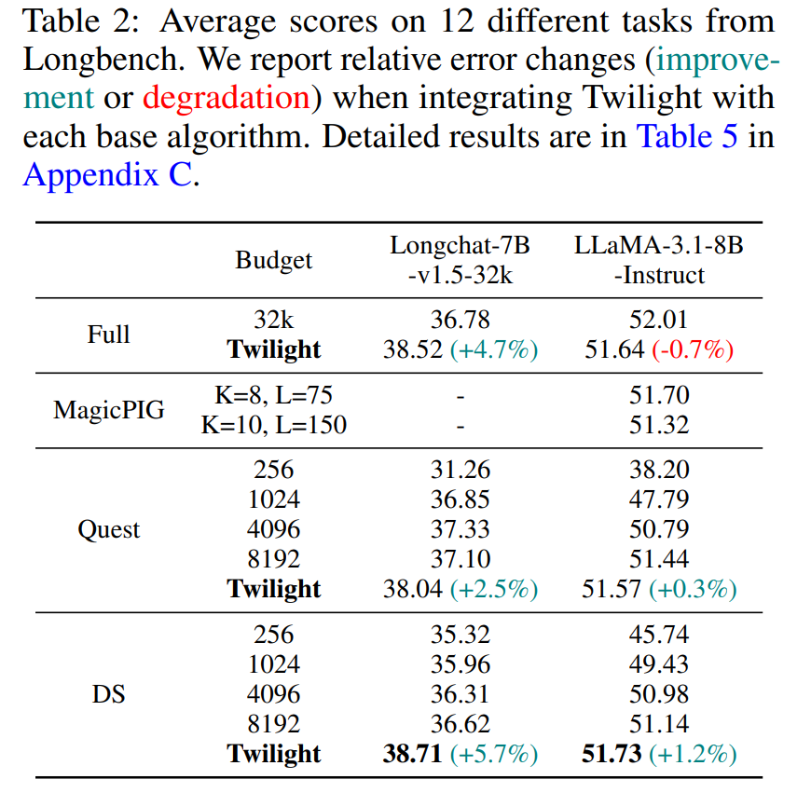
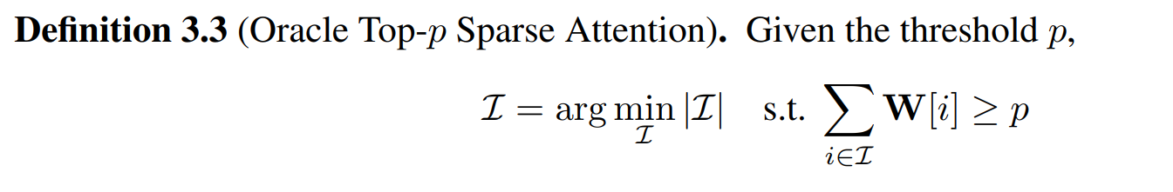
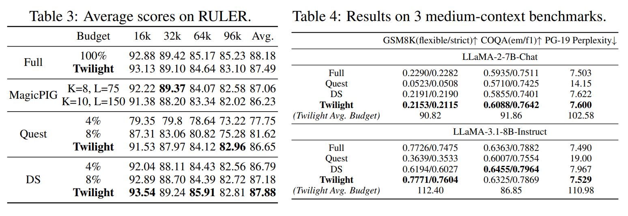
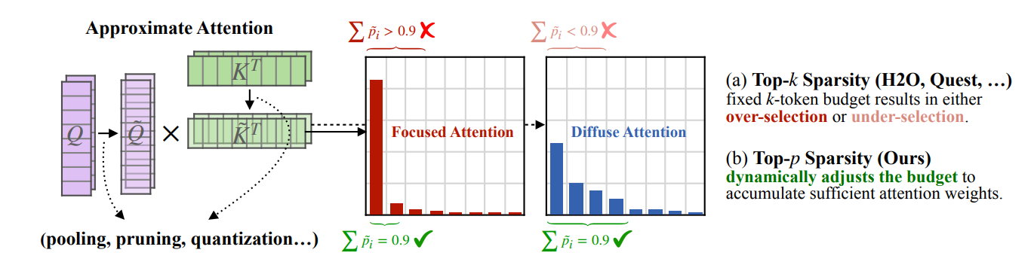
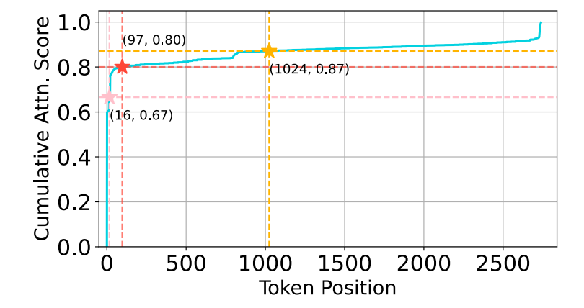
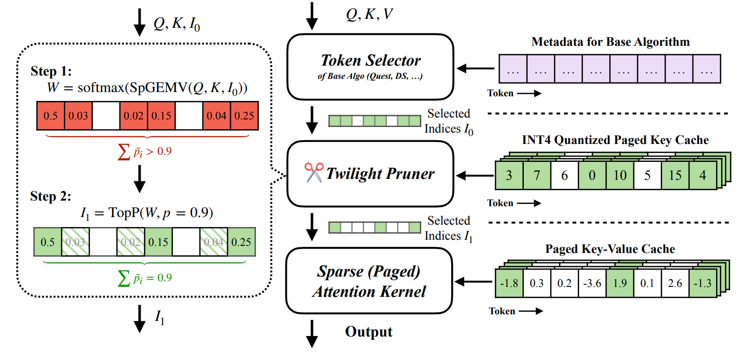
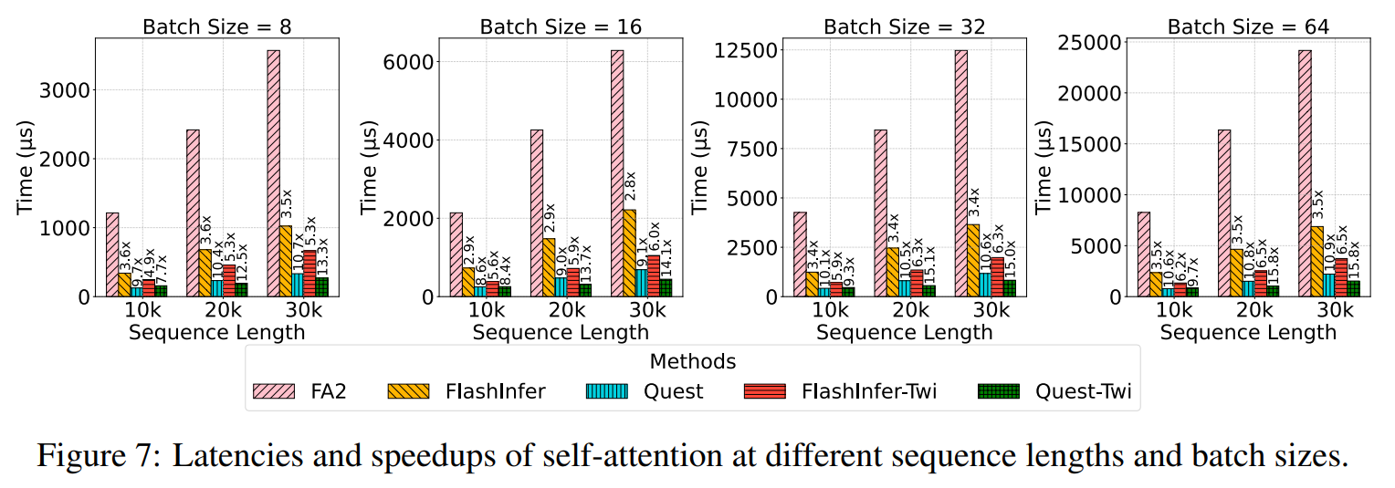
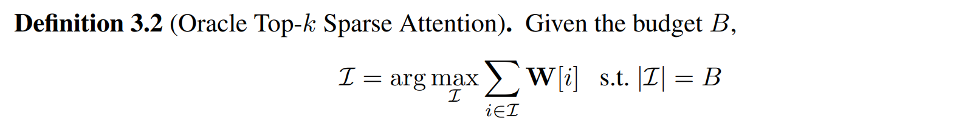
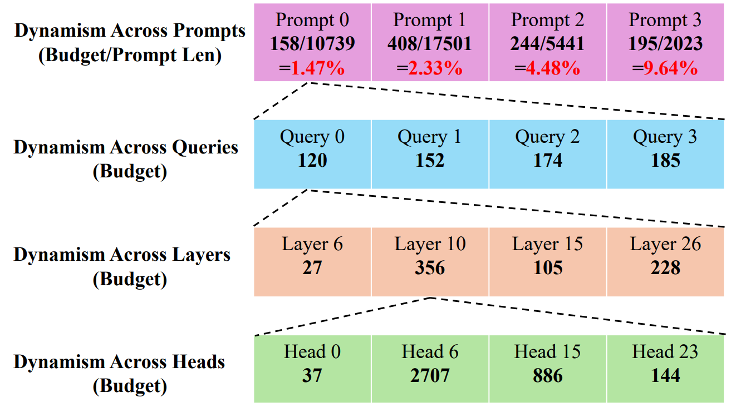
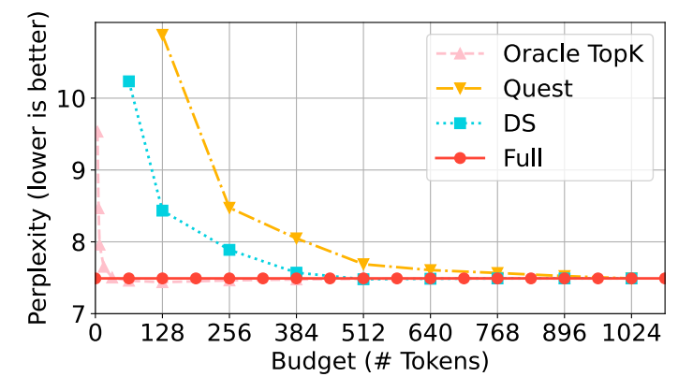
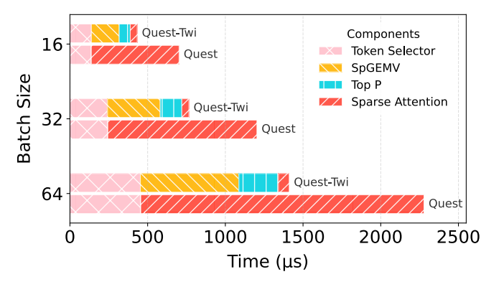


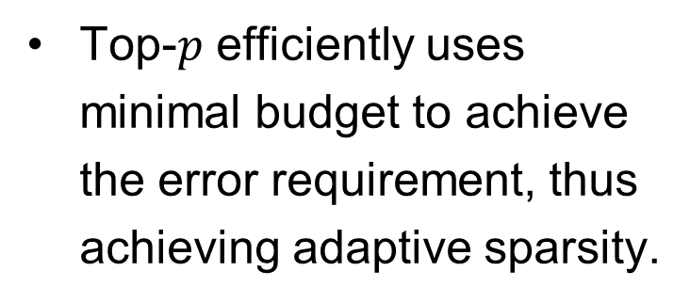
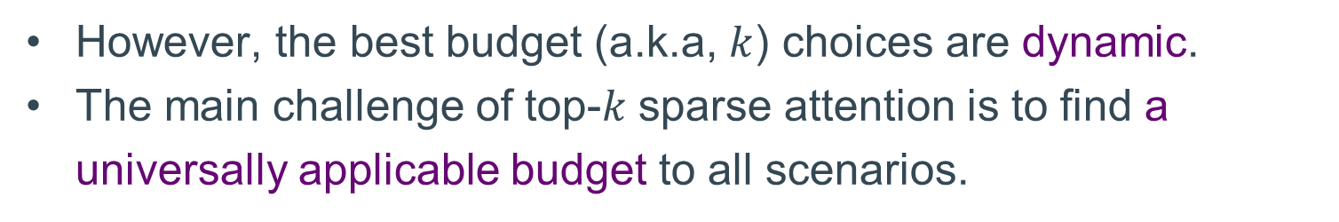
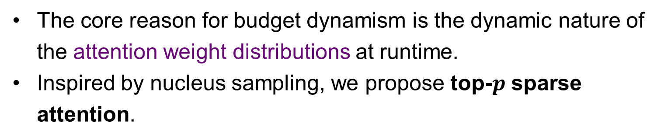
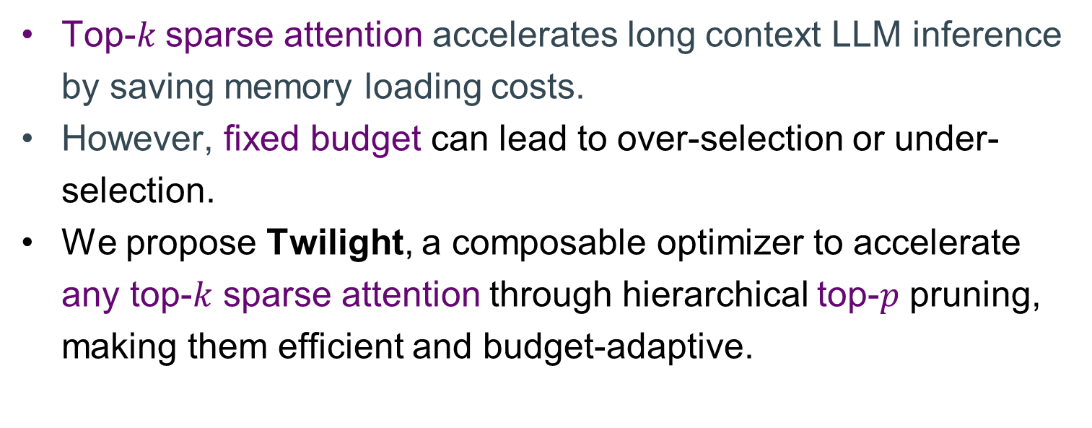
Twilight: Adaptive Attention Sparsity with Hierarchical Top-$p$Pruning
Chaofan Lin, Jiaming Tang, Shuo Yang, Hanshuo Wang, Tian Tang, Boyu Tian, Ion Stoica, Song Han, Mingyu Gao
Tsinghua University, MIT, UC Berkeley
Introduction
Bringing Top-𝒑 Sampling to Sparse Attention
Accuracy Evaluation
Introduction
Top-𝑘 sparse attention accelerates long context LLM inference by saving memory loading costs.
However, fixed budget can lead to over-selection or under-selection.
We propose Twilight, a composable optimizer to accelerate any top-$k$ sparse attention through hierarchical top-$p$ pruning, making them efficient and budget-adaptive.
Twilight achieves nearly no accuracy loss on three medium-context benchmarks and two long-context benchmarks (LongBench, RULER).
The core reason for budget dynamism is the dynamic nature of the attention weight distributions at runtime.
Inspired by nucleus sampling, we propose top-$p$ sparse attention.
Top-$p$ efficiently uses minimal budget to achieve the error requirement, thus achieving adaptive sparsity.
Top-$k$ Sparse Attention for Long Context Large Language Model Inference
Twilight Design
Efficiency Evaluation
Twilight adopts a hierarchical Select-then-Prune architecture to accelerate existing sparse attention methods.
Speedup on self-attention operator compared to FlashInfer and Quest without Twilight.
For long context LLM inference, attention dominates the latency. Top-𝑘 sparse attention is proposed to save memory loading cost.
However, the best budget (a.k.a, $k$) choices are dynamic.
The main challenge of top-𝑘 sparse attention is to find a universally applicable budget to all scenarios.
Latency breakdown of Quest with Twilight.
Three key kernel optimizations to accelerate Twilight Pruner:
1) Efficient SpGEMV with 4-bit Quantization of Key Cache.
2) Efficient Sorting-Free Top-p via Binary Search.
3) Load Balancing Attention Kernel with Awareness of Head
Dynamism and GQA adaption.
The best budget choices vary dynamically across different levels.
Twilight: Adaptive Attention Sparsity with Hierarchical Top-$p$ Pruning (NeurIPS 2025) https://github.com/tsinghua-ideal/Twilight lcf24@mails.tsinghua.edu.cn

