Slide 1
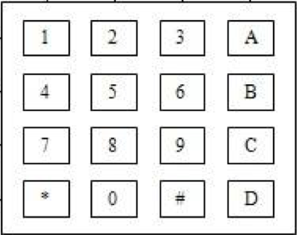
Software
(codes)
control
serial
control
logic
UART
process
logic
SH3 board
output
core
GPIO
GPIO
tmu
watchdog
ISR
……
GPIO
buffer
NMI_ISR
NMI
information
sensor
light
sound

Slide 2
Software
(codes)
control
control
logic
process
logic
SH3 board
output
core
GPIO
scan
tmu
watchdog
ISR
……
ISR
ISR
angles
PWM
GPIO
NMI_ISR

