Slide 1




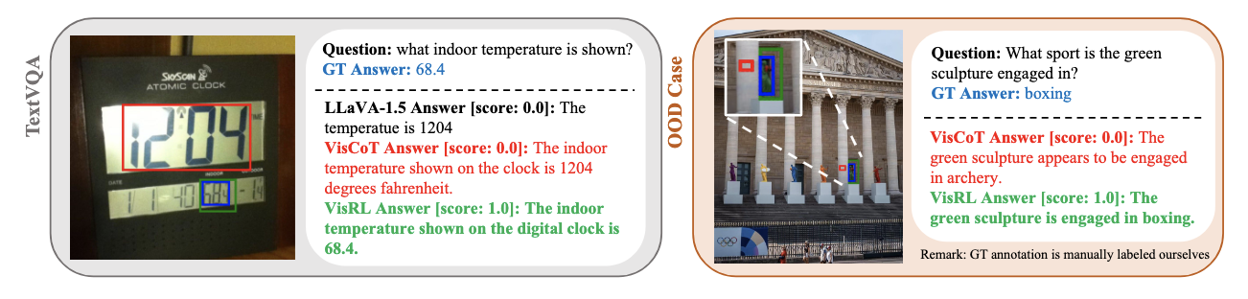
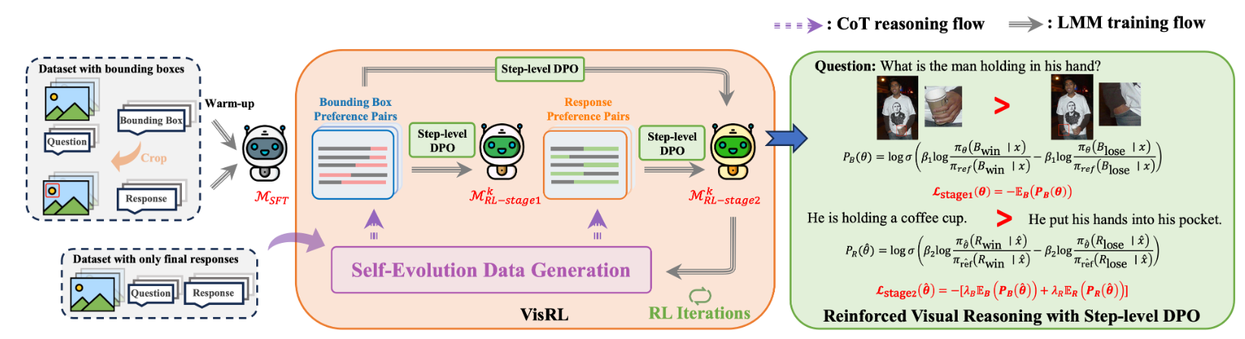
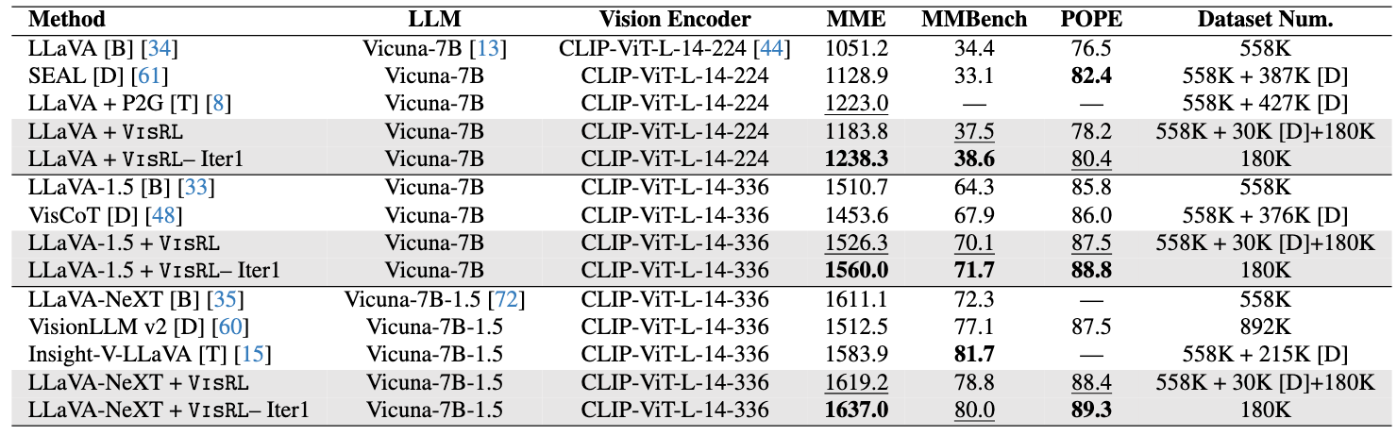
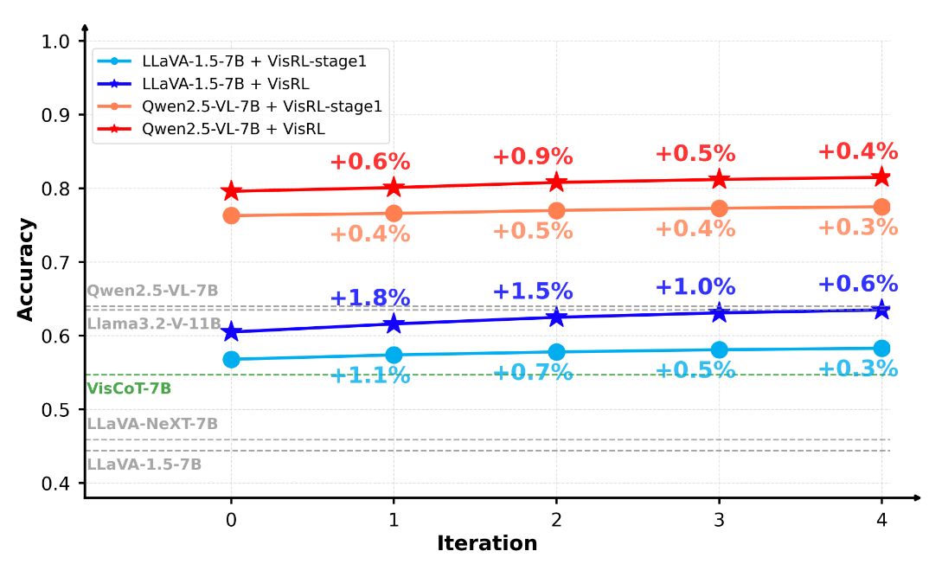
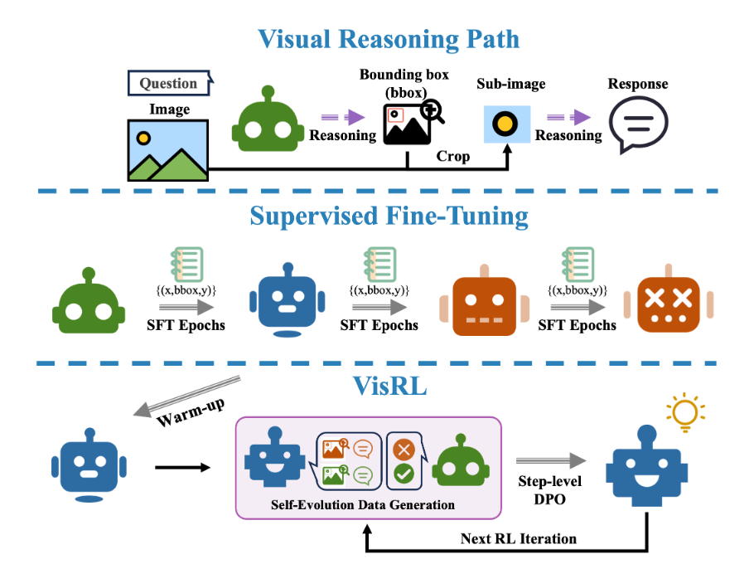
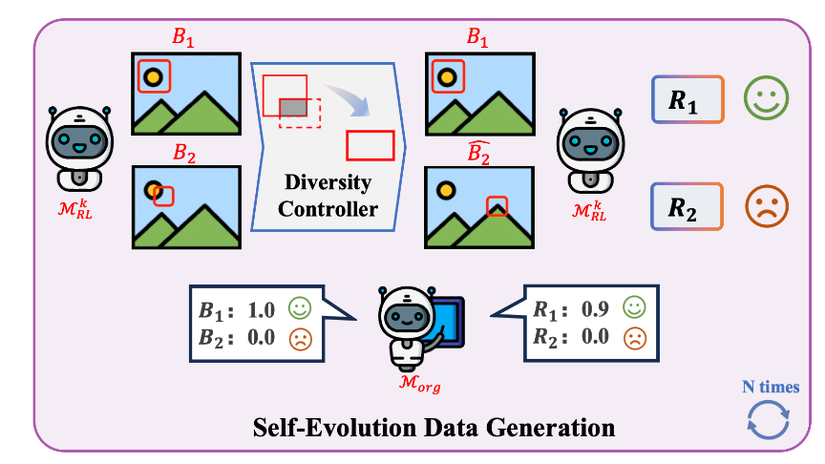
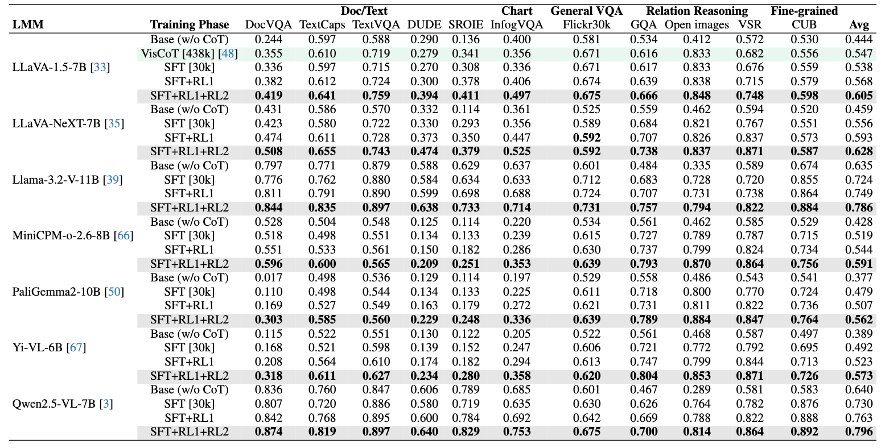
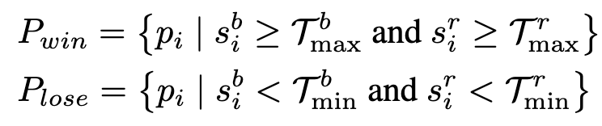
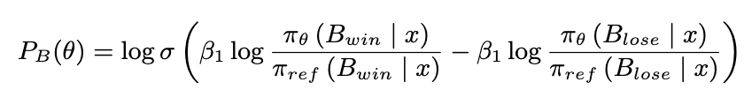

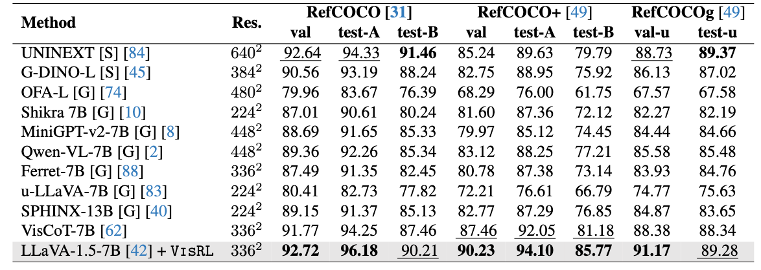
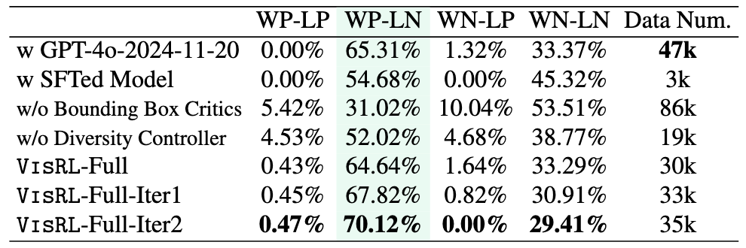
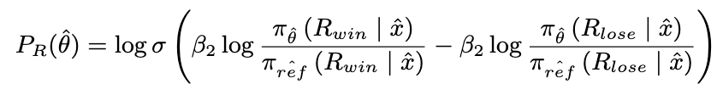

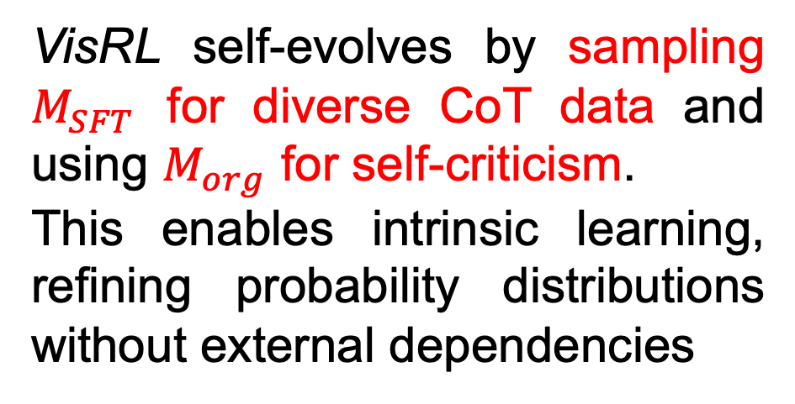
VisRL: Intention-Driven Visual Perception via Reinforced Reasoning
Zhangquan Chen, Xufang Luo, Dongsheng Li
Code available
Contact: xufluo@microsoft.com
1. Overview
2. Method
3. Results
Goal：Learn intention-driven visual perceptron
Common models process entire image uniformly
Human focus on different aspects of a scene depending on their goals
Intelligent models should also adapt their focus based on the task at hand
Multimodal large language models (MLLMs) can help
The intension can now be expressed in a highly flexible way, nature language. MLLMs generate the location of the focusing area as the intermedia step.
Disadvantages
Huge annotation complexity (image × query)
Not a human-like learning
Schematic illustration of VisRL
Comparison with different baselines
VisRL over multiple iterations
We first conduct a small-scale SFT warm-up, then perform RL training on large-scale data without bounding box annotations. The RL phase iterates between self-evolution data generation and step-level DPO optimization, ensuring reasoning improvement without external models or annotations.
Solution: developing an intrinsic reinforced reasoning
Data Generation
VisRL self-evolves by sampling $M_{SFT}$ for diverse CoT data and using $M_{org}$ for self-criticism.
This enables intrinsic learning, refining probability distributions without external dependencies
Performance on the VisCoT dataset across different LMMs
Step-level DPO
VisRL uses a step-level DPO method in two stages.
Stage 1: optimizes the bounding box
Contributions:
Referring Expression Comprehension (REC) tasks
VisRL: the first RL-based framework for intention-driven visual perception, removing reliance on dense annotations.
Self-Evolution Pipeline: a novel data generation pipeline, integrating a diversity controller and step-level DPO optimization.
Effectiveness: outperforms strong baselines and generalizes well.
Ablation on data generation
Stage 2: optimizes both the bounding box and the final response
Notes:
1

