Slide 1
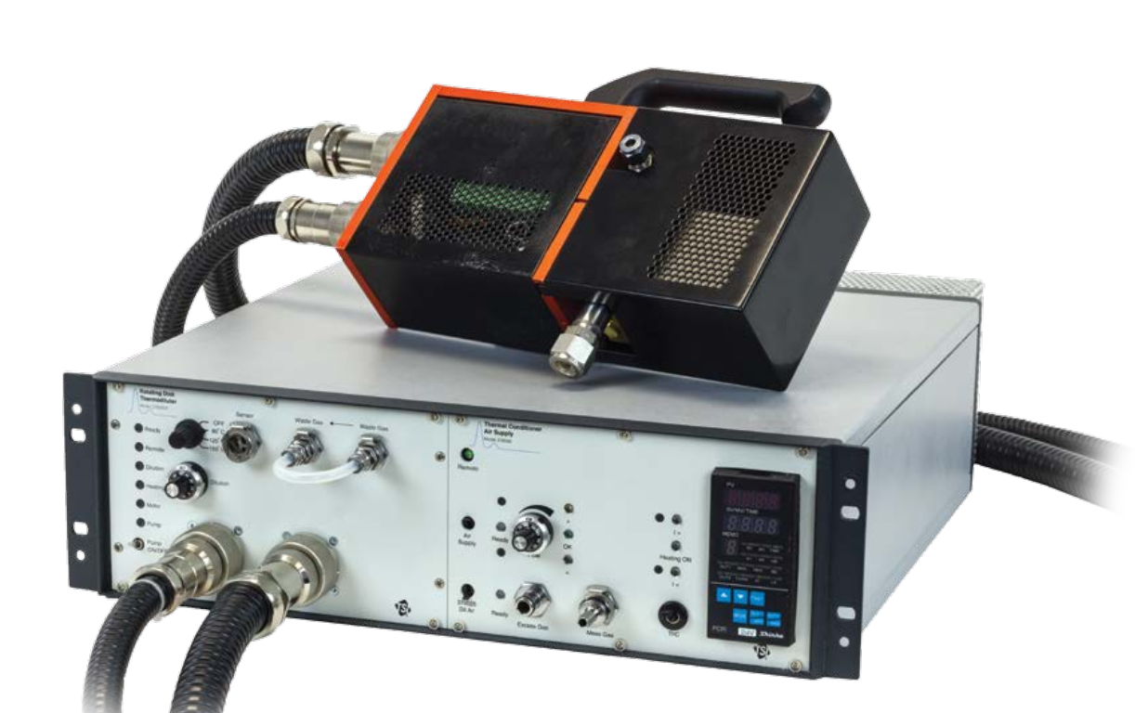
Gas cylinder
Dryer
Filter holder
Pump
HEPA filter
Cyclone
MFC
Impactor
Rotating disk diluter
Neutralizer
DMA
CPC

Slide 2
Nebulizer
Aerosol generator
Electrospray Aerosol Generator
MISG
miniCAST
Six jet atomizer
Fluidized bed generator
Gas turbine

Slide 3
CPMA
UDAC
AAC
FCAE
OPS
SP2-XR
SP2-XR
SP2
PAX
CAPS
LII
Aethalometer
microAeth

Slide 4
Li-Cor CO2 Analyzer
Dekati DI-1000
Partector
Thermophoretic sampler
Catalytic stripper
Organic coating unit / humidifier
ELPI

