Slide 1
Nebulizer
Aerosol generator
Electrospray Aerosol Generator
MISG
miniCAST
Syringe pump
Six jet atomizer
Fluidized bed generator
Standard particle generator
Gas turbine
Engine

Slide 2
Gas cylinder
Dryer
Static mixer
Filter holder
Pump
HEPA filter
Cyclone
MFC
Impactor
Rotating disk diluter
Diluter DI-1000
eDiluter
Neutralizer
DMA w/ neutralizer
DMA
CPC

Slide 3
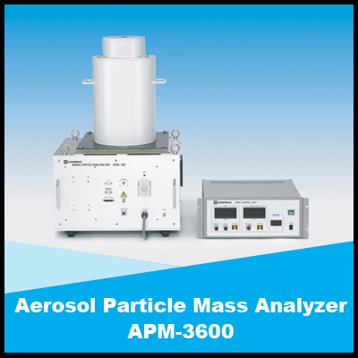
CPMA
UDAC
AAC
FCAE
OPS
ELPI
APM
SP2-XR
SP2
PAX
CAPS
LII
PTAAM-2λ
Aethalometer
microAeth
LAP Aerosol Spectrometer

Slide 4
CO2 Analyzer
Partector
Thermophoretic sampler
Catalytic stripper
Organic coating unit / humidifier
AMS

