Slide 1

How are Alcohol Consumption and Poverty Level Associated?
An exploratory research based on NHANES dataset
Authors:
John Tsirigotis, Lingxuan Kong, Savannah Howard

Slide 2

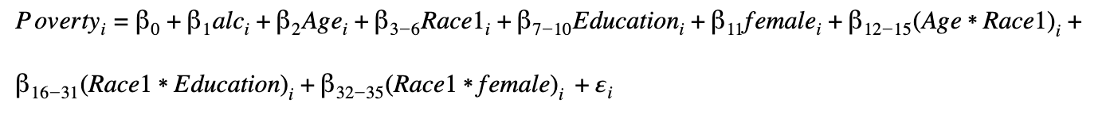

Literature Review and Models
Literature Review Research:
Alcohol
Age
Race
Education
Gender
Age and Race
Race and Education
Race and Gender
Models:

Slide 3
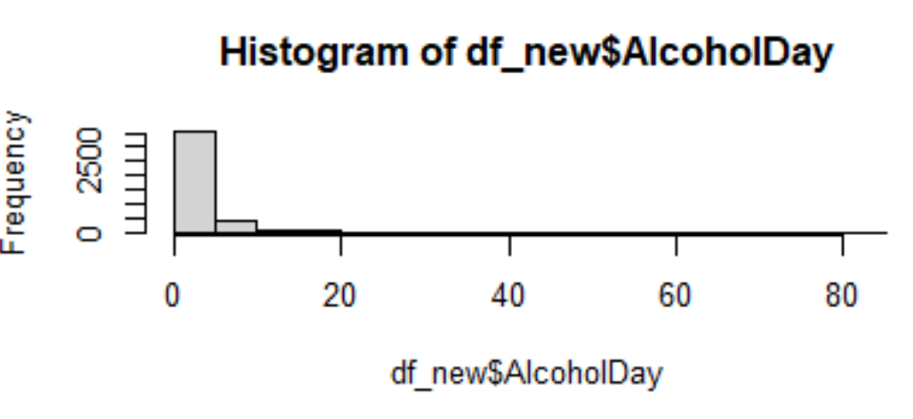
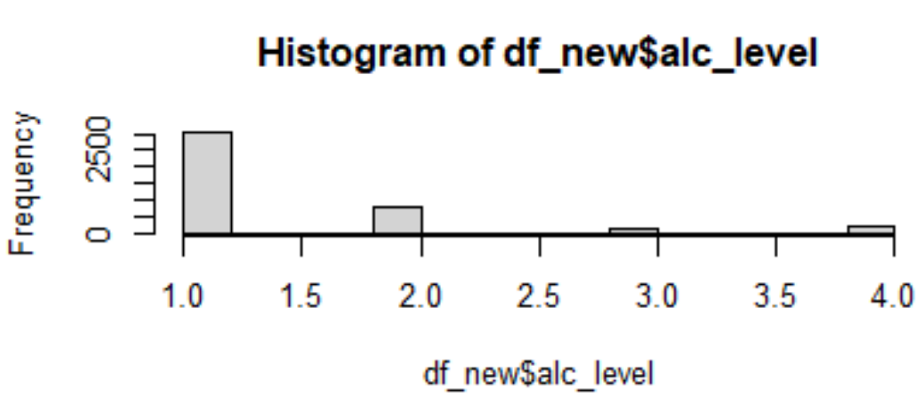
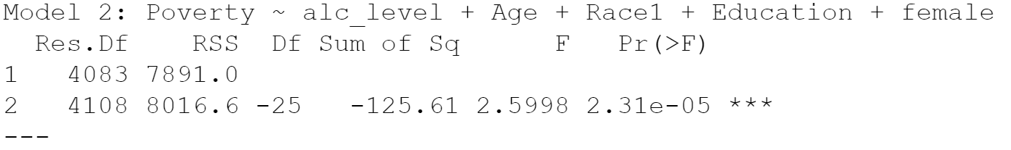
Methods
Drop NAs
n = 4,125
Ages: 20 - 69

Slide 4
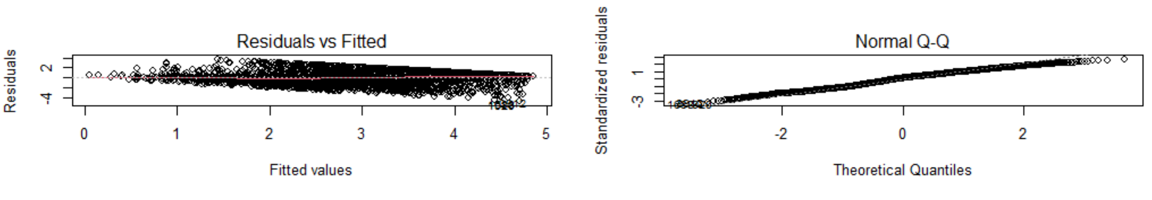
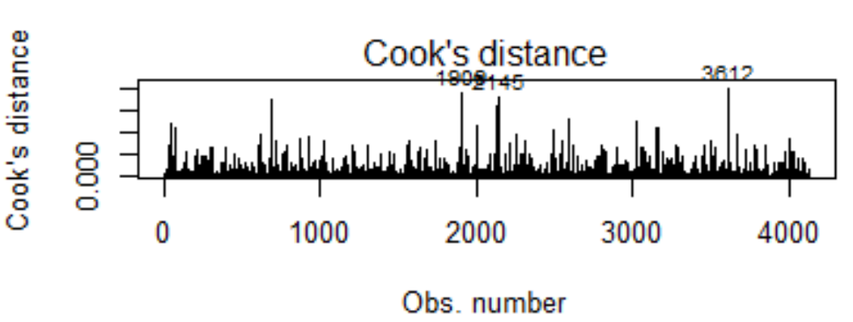
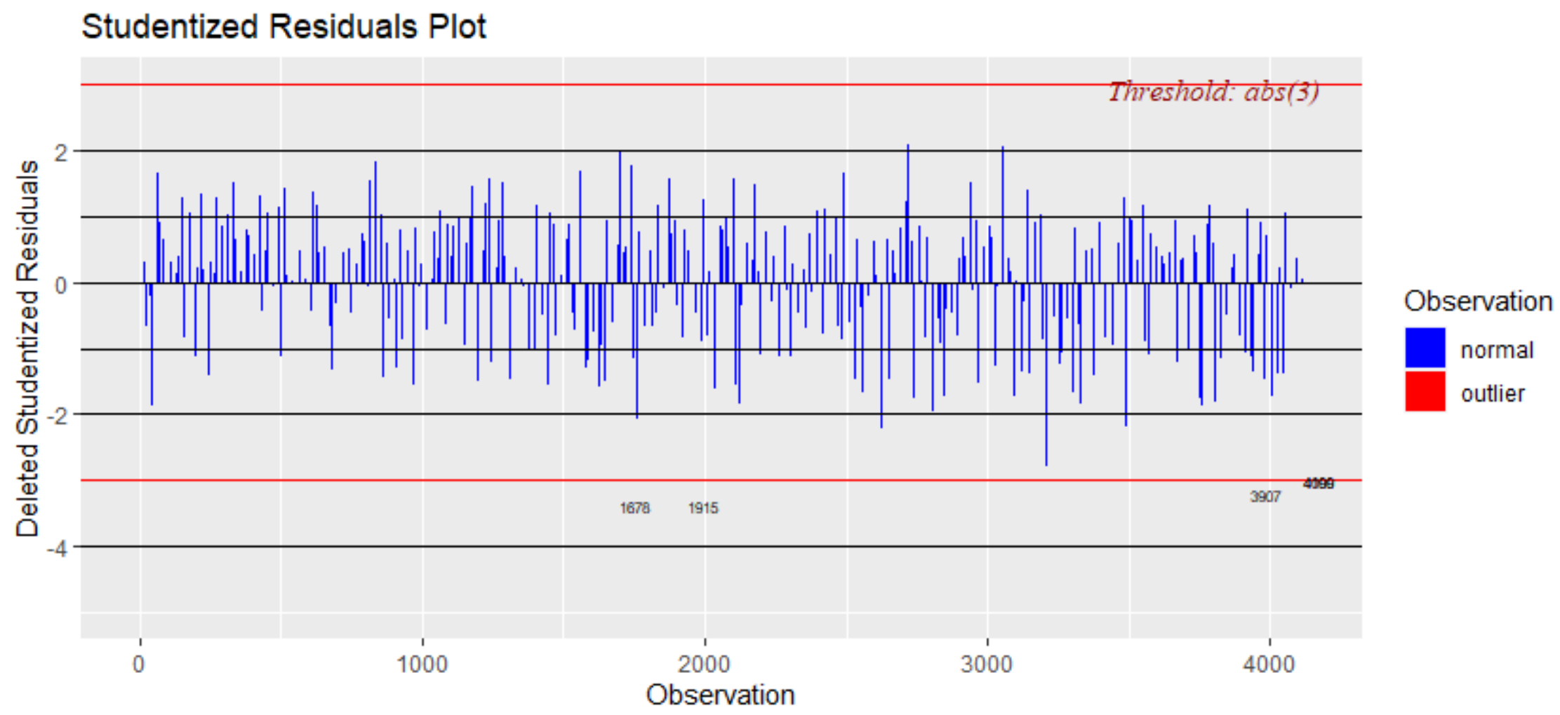
LINE ASSUMPTIONS & MODEL DIAGNOSTICS

Slide 5
Results
Significant association between average daily alcohol consumption and poverty score
higher educational levels are strongly correlated with a higher poverty score
there are some differences between races in regards to education level and gender with respect to poverty level
Age is significantly associated with poverty score
 | Estimate | Pr (>|t|) | 95% CI
(Intercept) | 0.397 | 0.027* | (0.046,0.748)
Alc_level | -0.164 | 7.77e-7*** | (-0.228,-0.099)
Age | 0.025 | <2e-16*** | (0.021,0.028)

Slide 6
Limitations
Limitations of Investigation
used categorical regressions with categorical variables
only 4125 observations
somewhat low R^2 value when alc_level and Poverty are plotted together
recoded Poverty variable to make more sense (low poverty score = less poverty experienced)

Slide 7
Thanks for listening!

