Slide 1

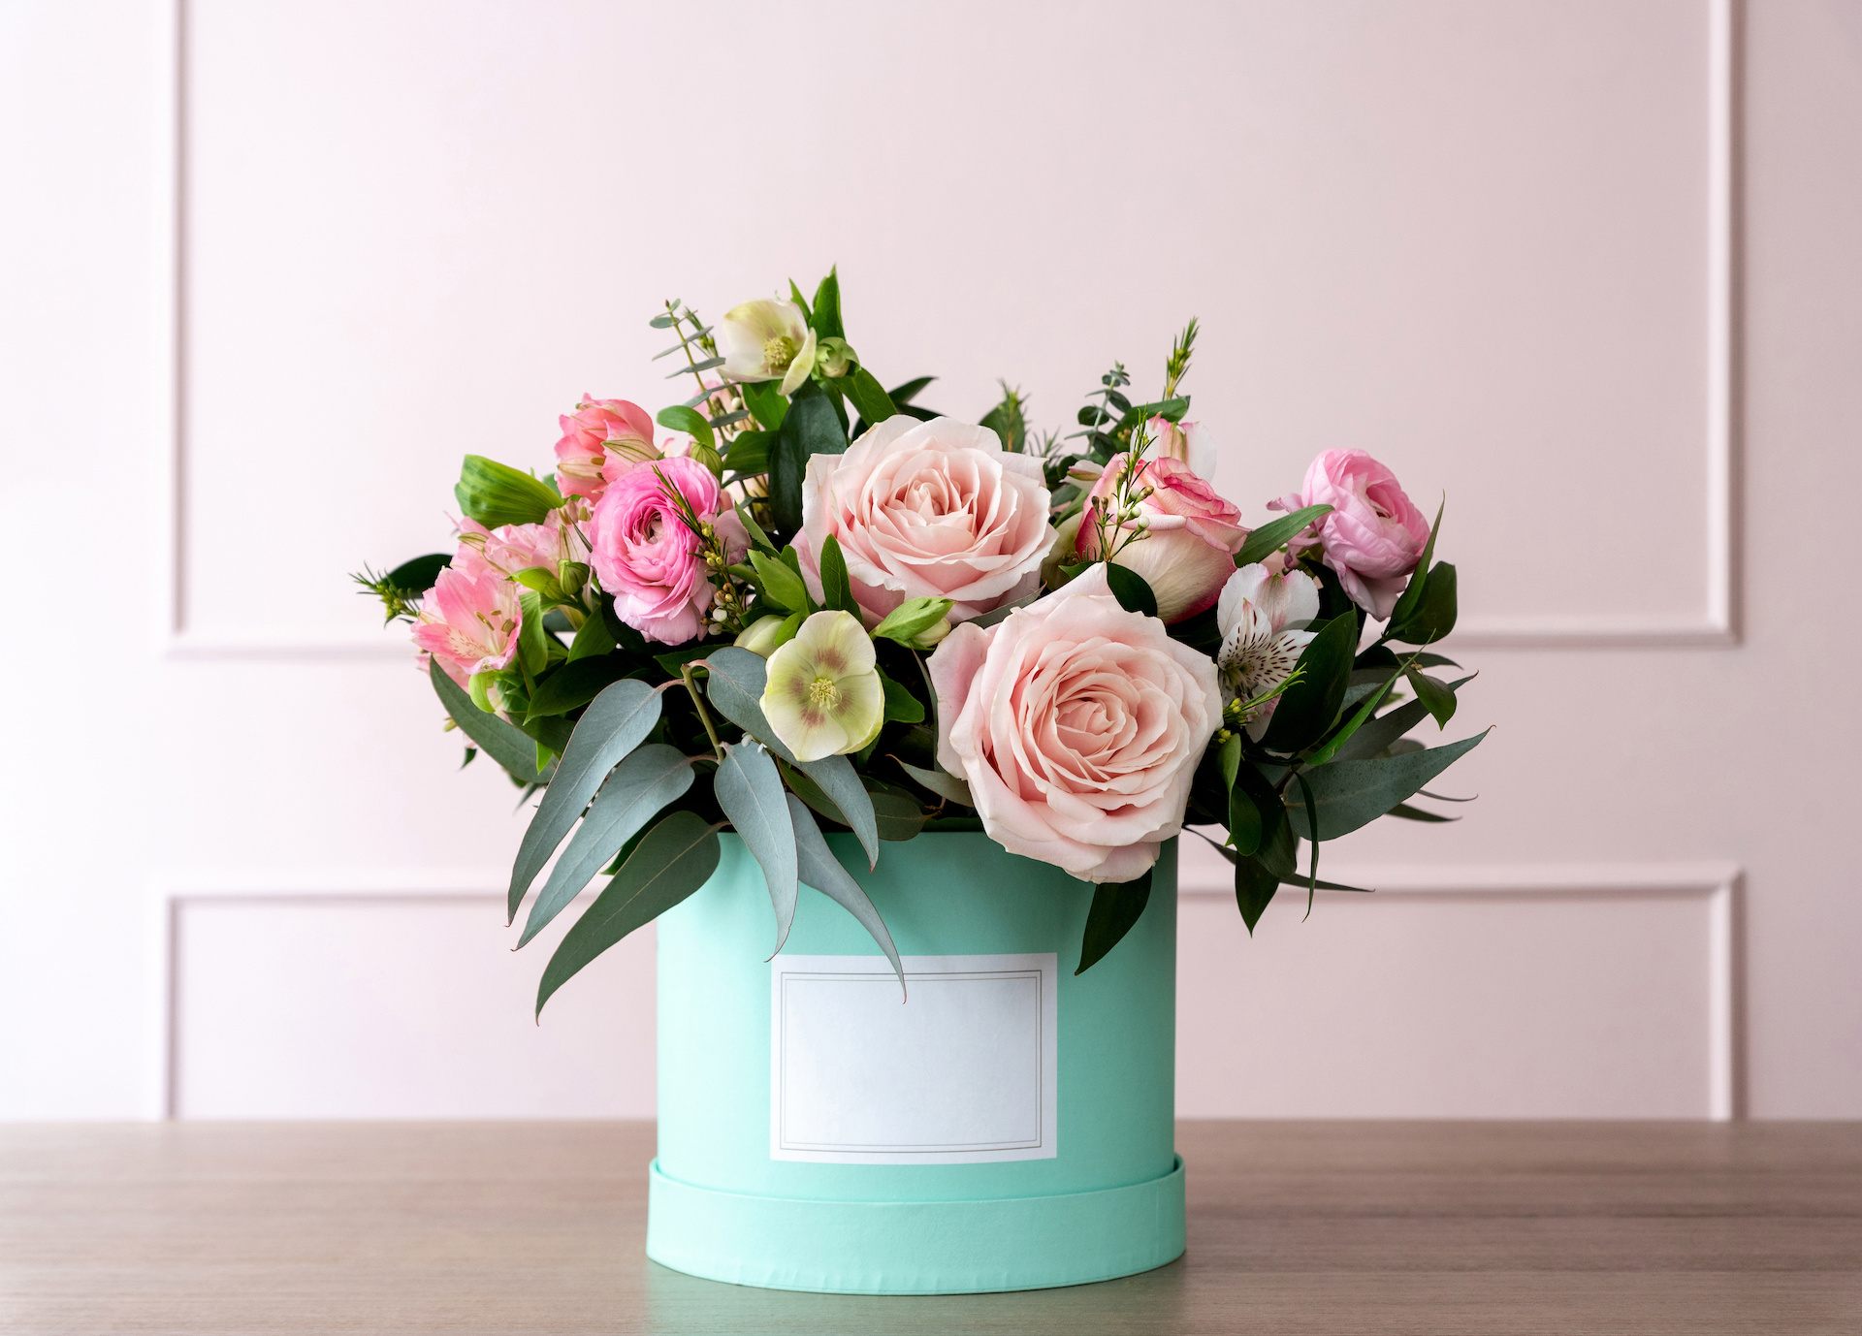

Calla & Ivy’s Campaign Goal

Slide 2
Goal
Increase in sales of 10% by the end of Q1 (the first quarter of the year)
Campaign Objective:
Consideration
KPI:
Driving traffic to the website and generating revenue from purchases.

Slide 3
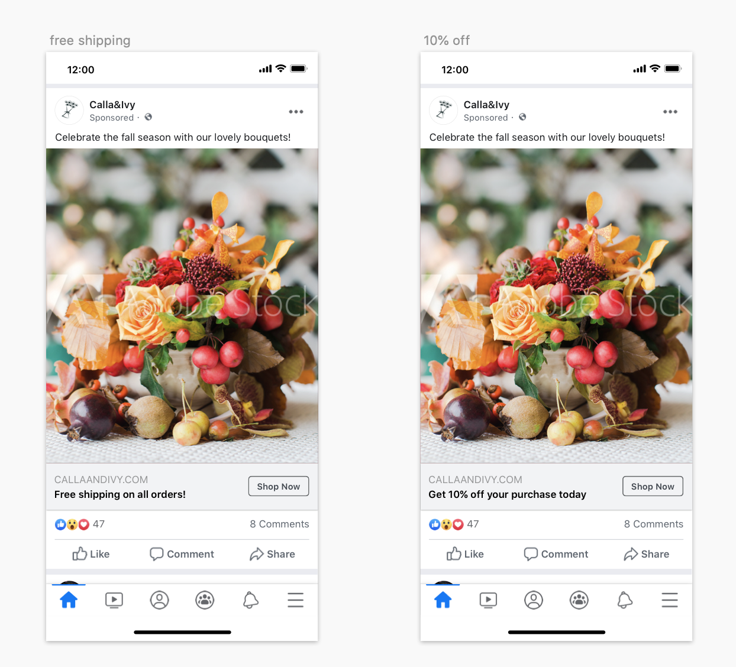
Creative
Assets

Slide 4
Campaign
Settings
Objective:
Generate more purchase to the website
Audience:
Women between the ages 24 and 55 yo
Residing in Northern Holland
Interested in cut flowers
Placement:
Facebook platform (Facebook, Instagram and the Audience Network)
Duration:
During Q1 2024
Budget:
$50 per daily

Slide 5
Results
Campaign Result
Conversion rate: 2%
Average purchase value: $40
Average cost per purchase: $15
Campaign Cost
$2,824.50
ROAS: 11,4 ($32,280/$2,824.50)
Revenue
$32,280 (40,350*2%*$40)
Total Investment
Advertising: $2,824.50
Cost: $12,105 (40,350*2%*$15)
Total Investment: $14,929.5
ROI: 1,16

Slide 6

Results
A/B Testing:
CPR of promo free shipping: $0.08 (Winning the campaign)
CPR of promo 10% off: $0,48
Image placeholder
Image placeholder

Slide 7
Conclusion & Next Steps
Free shipping campaign is gaining more attention and achieving a better Click per Result (CPR)
Continuing the free shipping campaign
Keep on conducting A/B testing for other campaigns
Optimize the Click-through rate (CTR) to reach 2%
Extend the data collection period for a longer timeframe

Slide 8
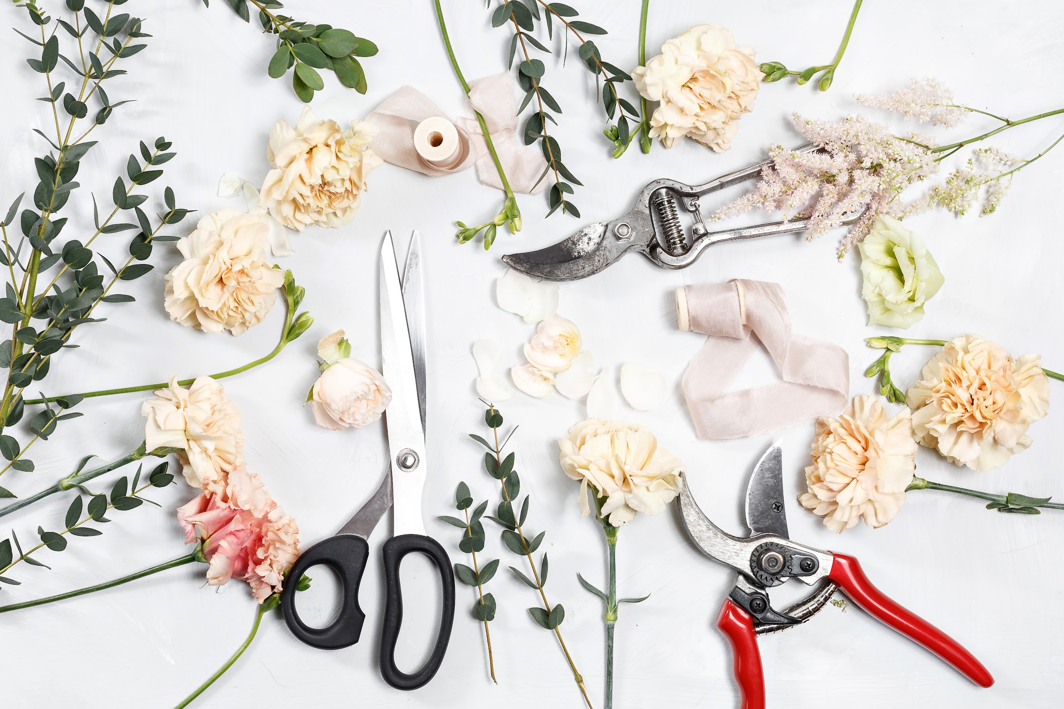

Thank
You!
Image placeholder

