Slide 1
CODEBASICS
RESUME CHALLENGE 4
-by Satheeshkumar T

Slide 2

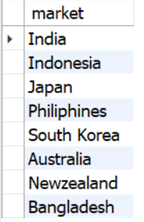
Ad Hoc Request 1
Provide the list of markets in which customer "Atliq Exclusive" operates its business in the APAC region
Solution
Output
Insights
In the Asia Pacific Region, “Atliq Exclusive” operates in 8 countries.

Slide 3
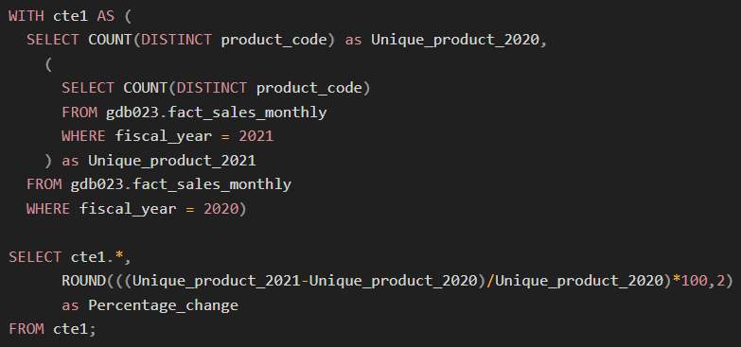
Ad Hoc Request 2
What is the percentage of unique product increase in 2021 vs 2020?
Solution
Insights
In 2020, Atliq Mart achieved sales of 245 products, and in 2021, their sales significantly increased to 334 unique products, marking a substantial growth rate of 36.33%.
Output

Slide 4
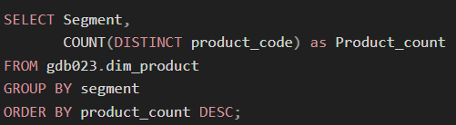
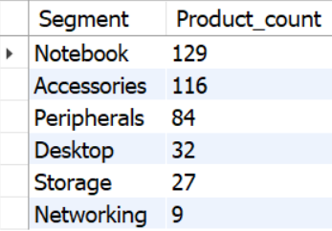
Ad Hoc Request 3
Provide a report with all the unique product counts for each segment and sort them in descending order of product counts.
Solution
Output
Insights
The Notebook segment has the highest number of unique products when compared to other segments and the Networking segment has the lowest number of unique products.

Slide 5
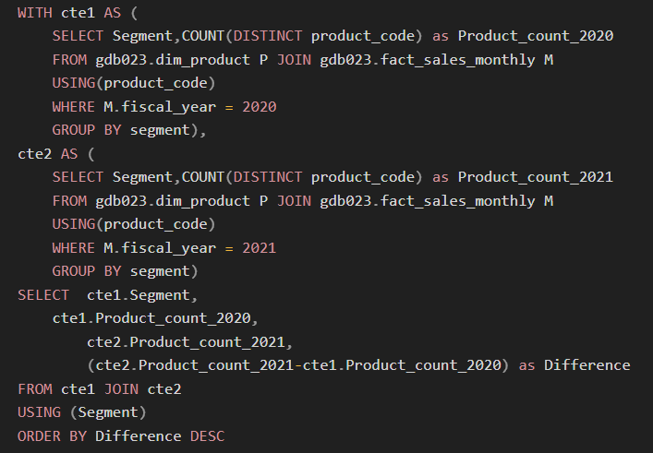
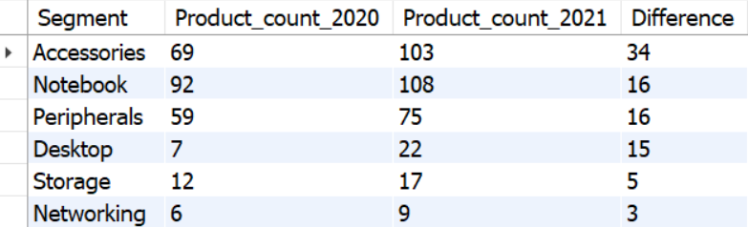
Ad Hoc Request 4
Which segment had the most increase in unique products in 2021 vs 2020?
Solution
Output
Insights
The Accessories segment has introduced 34 new unique products in the year 2021.

Slide 6
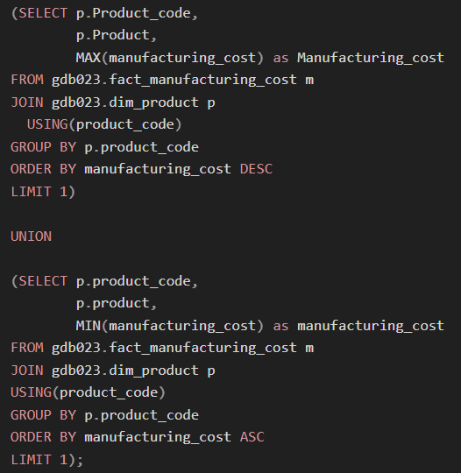
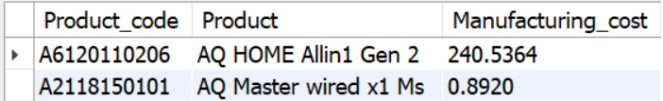
Ad Hoc Request 5
Get the products that have the highest and lowest manufacturing costs
Solution
Output
Insights
The product “AQ HOME All in 1 Gen 2” has the highest manufacturing cost, and the “AQ Master Wired x1 MS” has the lowest manufacturing cost.

Slide 7
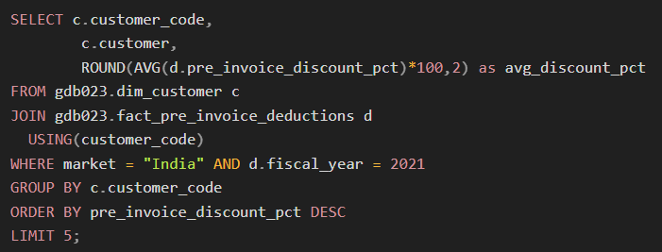
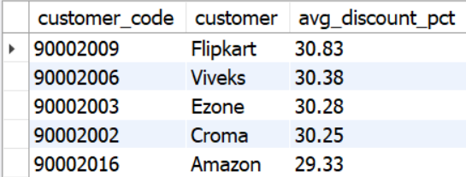
Ad Hoc Request 6
Generate a report that contains the top 5 customers who received an average high pre-invoice discount pct for the fiscal year 2021 and in the Indian market.
Solution
Output
Insights
In the Indian market for FY 2021, Flipkart has the highest average discount percentage of 30.83 % and Amazon with the lowest average discount percentage of 29.33 %.

Slide 8
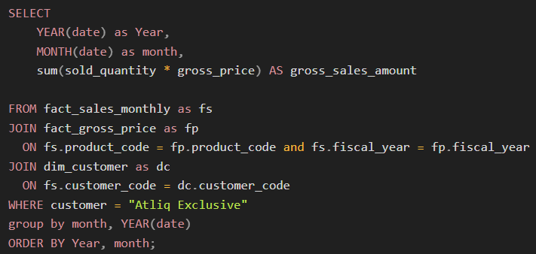
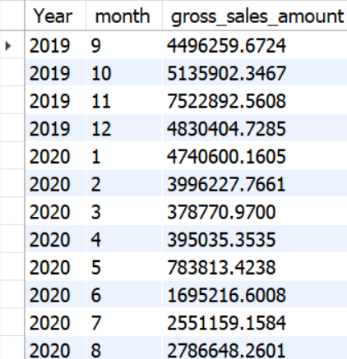
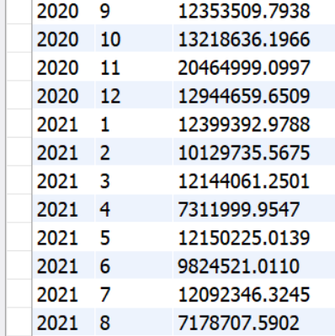
Ad Hoc Request 7
Get the complete report of the Gross sales amount for the customer “Atliq Exclusive” for each month
Solution
Output

Slide 9
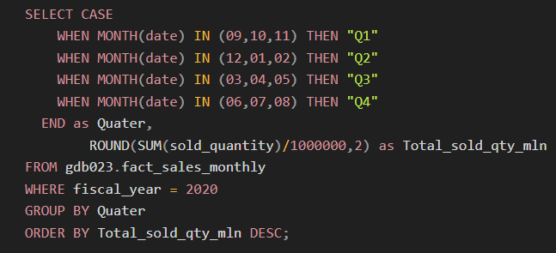
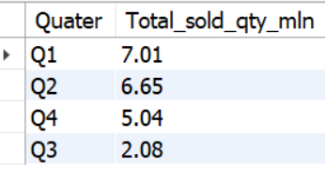
Ad Hoc Request 8
In which quarter of 2020, got the maximum total sold quantity?
Solution
Output
Insights
The “Atliq mart” has sold 7.01 million units in the 1st quarter of 2020, it’s the highest when compared to remaining 3 quarter in the same fiscal year.

Slide 10
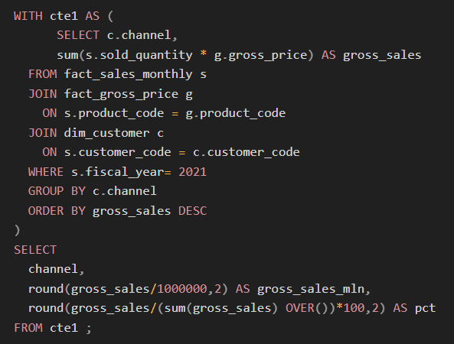
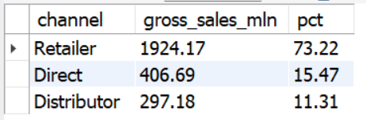
Ad Hoc Request 9
Which channel helped to bring more gross sales in the fiscal year 2021 and what was the contribution percentage?
Solution
Output
Insights
In FY 2021, the Retailer channel has contributed the highest of about 73.22 %,to generated a gross sales amount of Rs.1924.17 millions.

Slide 11
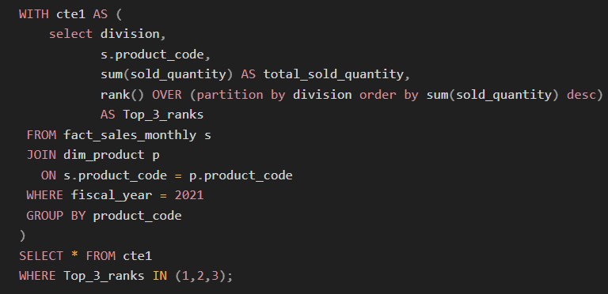
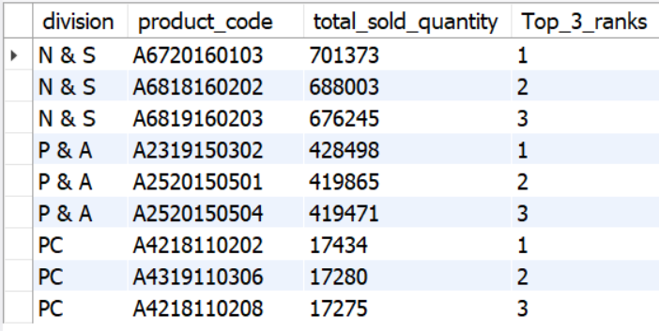
Ad Hoc Request 10
Get the Top 3 products in each division that have a high total sold quantity in the fiscal year 2021?
Solution
Output

Slide 12
Thank you!

