Slide 1

Shield Insurance Company
Nov 2022 – April 2023
Presented by
Satheeshkumar T

Slide 2
Shielded cities with our Shield Insurance
Chennai
Hyderabad
Delhi NCR
Indore
Mumbai

Slide 3
Ways to get shielded with help of our Shield Insurance
Offline - Agent
Offline – Direct
Online – App
Online - Website

Slide 4
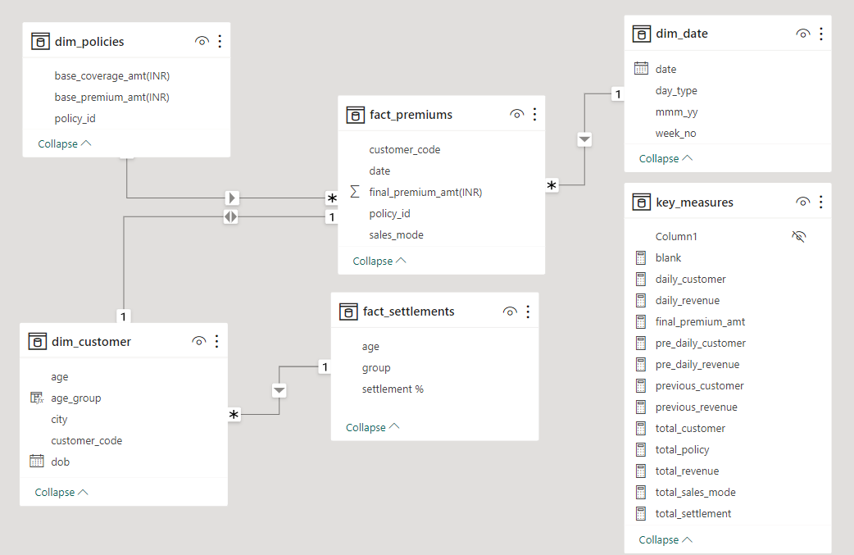
Data Model

Slide 5
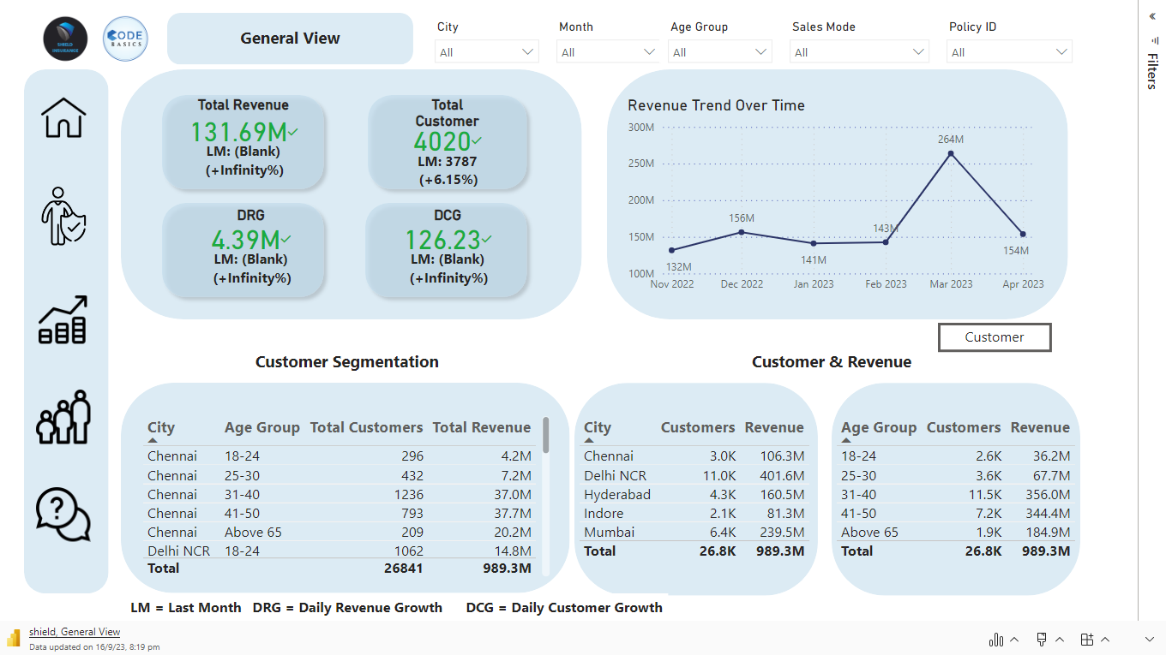

Slide 6
Thank you!

