Slide 1

CIST 2931, Fall 2016 Final Presentation 12/05/2016
i c i o u s
Cnrl/alt/Delicious
Steven Alcorn, Zachary Weaver, Tyrus Skipper, Antonio Mosquera, Rupa Shrestha
Notes:
Everyone introduces themselves.
Title page of the group

Slide 2
Project Tools
NetBeans IDE 8.1 (Build 201510222201)
Java 1.8 SDK
MySQL Workbench
Notes:
Tyrus

Slide 3
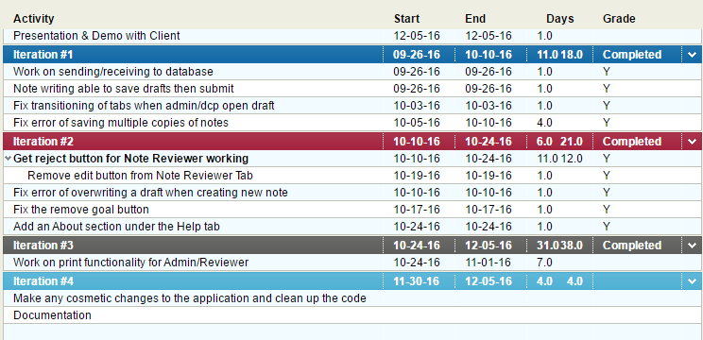
Project Plan for the Semester
Notes:
Tyrus
This was our plan and goals for the semester.
Iterations
1st
had to get done so we could do the next
2nd
had to do so we could work the print more accurately
3rd
Was our primary focus
4th
Because we had the time.

Slide 4
Notes:
Tyrus

Slide 5
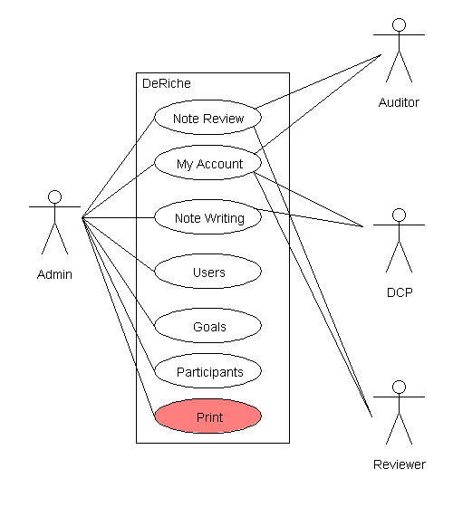
Deliverables
Notes:
Antonio, This is the use case diagram, explain to the audience how each actor has different capabilities within the application.

Slide 6
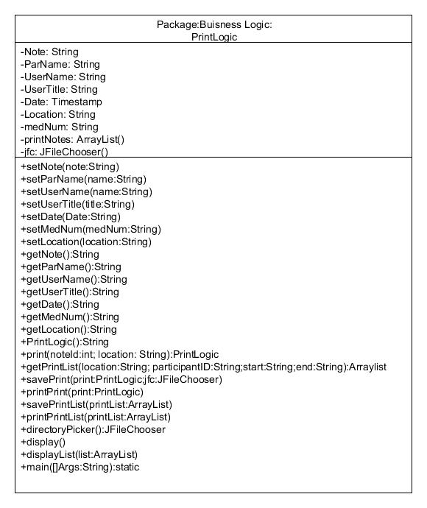
i c i o u s
Notes:
Antonio, talk about how this is the Print class diagram of the new class that we added into the application.

Slide 7
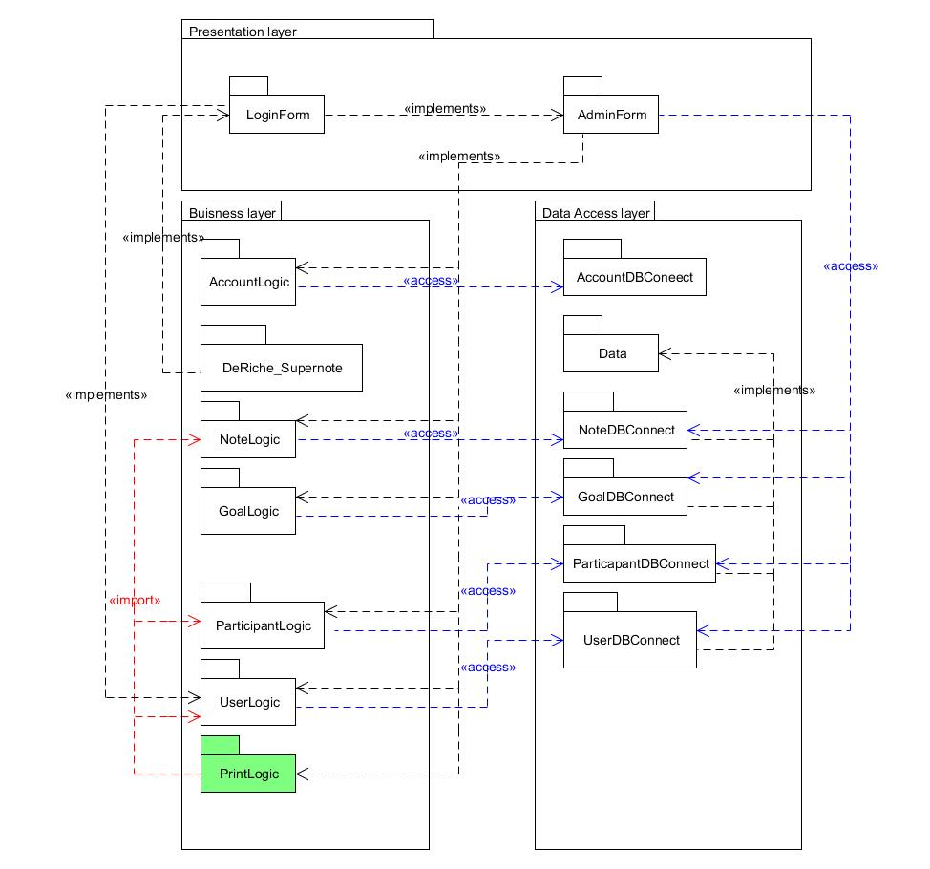
i c i o u s
Notes:
Steven
This is the Architecture of the program and how each class talks to one another.
Print is green because we built that from the ground up.

Slide 8
i c i o u s
Goal Table Schema
 | GoalID | Description | Objective | GuidanceNote | Frequency | isWeekly | ParticipantID
 | Int(255) | text | text | text | int(1) | TinyInt(1) | Int(9)
 | primary Key
 | Not null | not null |  |  | not null | not null | not null
Note table Schema
 | NoteID | Text | Time_Started | Last_Updated | Time_Submitted | Time_Accepted | Comment | Submitted | TimeReviewer_Accepted | NoteReviewer_Accepted | ParticipantID | UserID
 | Int(255) | longText | TimeStamp | TimeStamp | TimeStamp | TimeStamp | LongText | int(11) | TimeStamp | TimeStamp | int(11) | int(11)
 | Primary Key
 | Not null | not null | not null |  | not null | not null |  |  |  | not null | not null
Participant Table Schema
 | ParticipantID | Firstname | Lastname | Insurance | MedicaidNumber
 | Int(11) | VarChar(25) | VarChar(50) | VarChar(20) | Char(13)
 | Primary Key
 | not null | not null | not null
User Table Schema
 | UserID | UserName | Password | FirstName | LastName | Title | Clearance
 | int(11) | VarChar(20) | VarChar(20) | VarChar(25) | VarChar(50) | VarChar(50) | int(1)
 | primary key
 | not null | not null | not null |  |  |  | not null
Notes:
Steven
This is a schema of the data table for the next group so they have the basic layout of the database

Slide 9
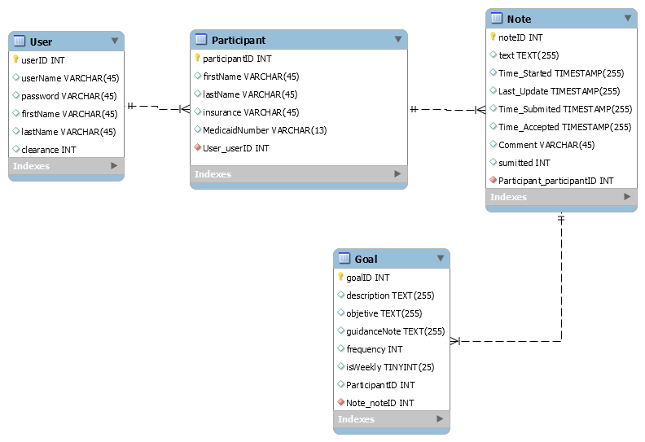
i c i o u s
Notes:
Antonio, Talk about how this is a representation of the variable that each schema of the database uses.
This is a ERD Diagram.

Slide 10
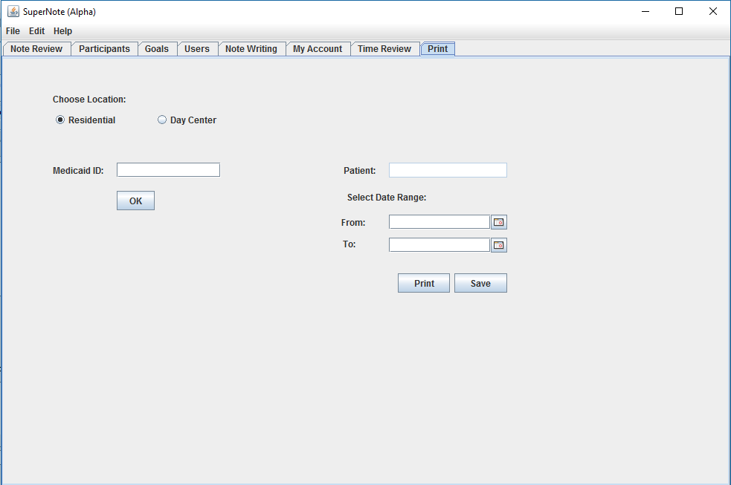
i c i o u s
Notes:
Rupa
The GUI of the print screen
Can choose location
Input Medicaid id and check for valid user by clicking ok
And select a date range

Slide 11
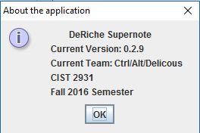
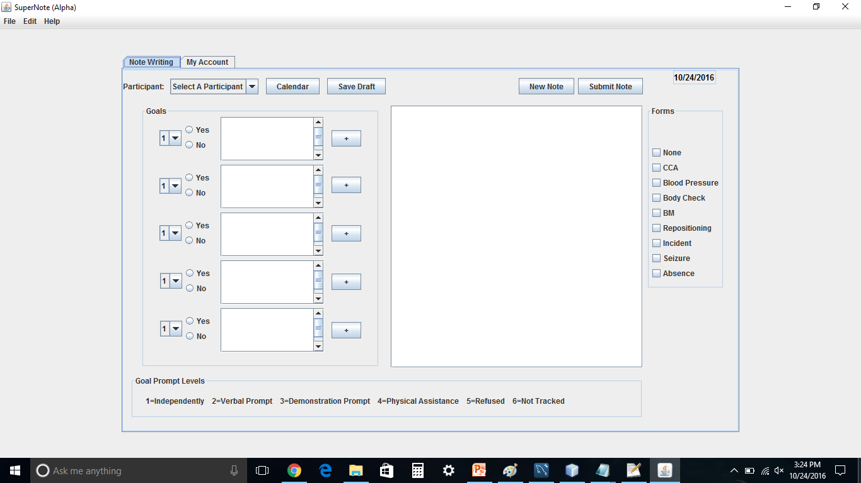
i c i o u s
Notes:
Zach, talk about how we added an about section for the application and the second image is about how we have made the application fullscreen.

Slide 12
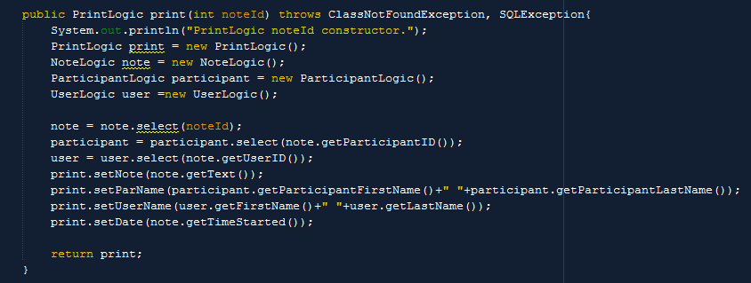
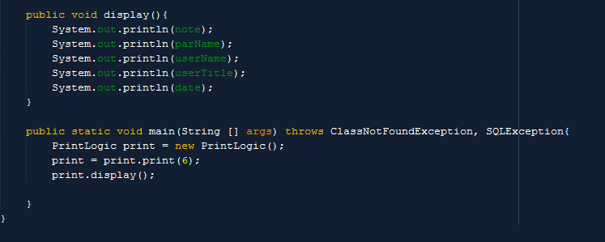
i c i o u s
Notes:
Steven
Code of the printlogic class

Slide 13
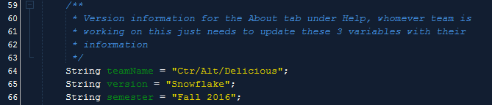
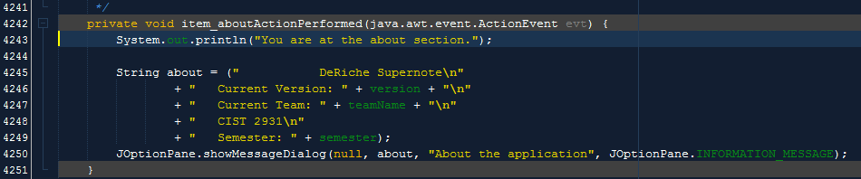
i c i o u s
Notes:
Steven
The code about the update tab
Next group needs to update the variable to there group.

Slide 14
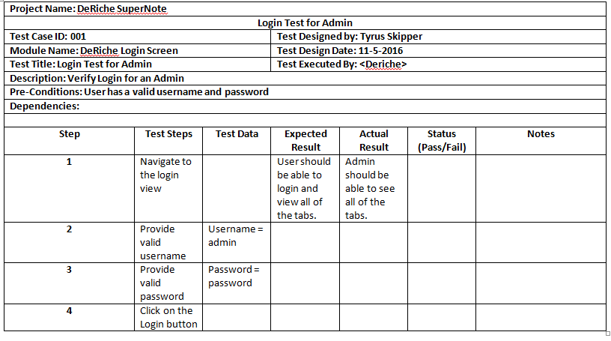
i c i o u s
Click Me!
Notes:
Steven
Test scrips for the program.

Slide 15
Installation Process
i c i o u s
Locate the DeRiche Application .zip file
Extract and choose where you want the application to run.
Run the .jar file
Notes:
Steven
How the users are installing the program.

Slide 16
How to build the .jar file
i c i o u s
Open up the project in your IDE
Build and Compile the project to create the .jar file
Locate the dist folder and then compress all of the contents in the folder
This is the .zip file that you use to run the application from any computer
How build a Jar file Click for more information
Notes:
Steven
How the users are installing the program.

Slide 17


Documentation
Java Doc
User Guide
Notes:
Steven
Documentations of the program.

