Slide 1

Developing an Image Binary Classifier with Batch Normalization Using NumPy
Tom Lever
27 October 2019 -

Slide 2
The simplest standard neural networks…

Slide 3
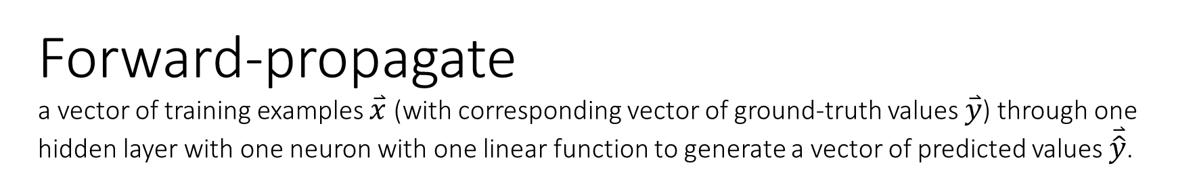


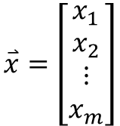

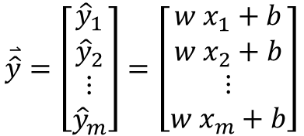




Slide 4
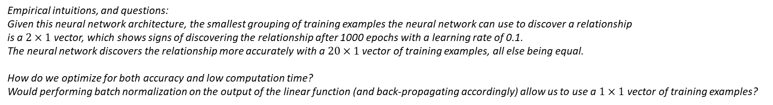

Slide 5
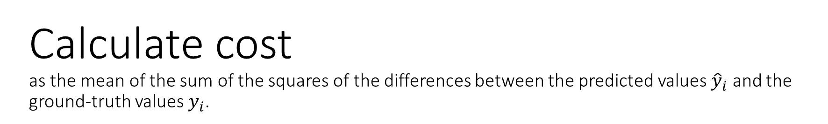
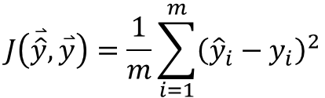

Slide 6
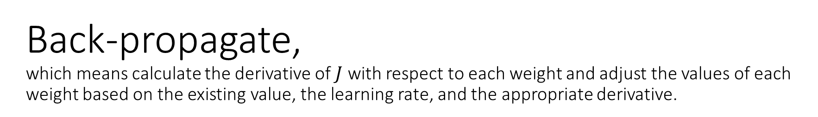



Slide 7
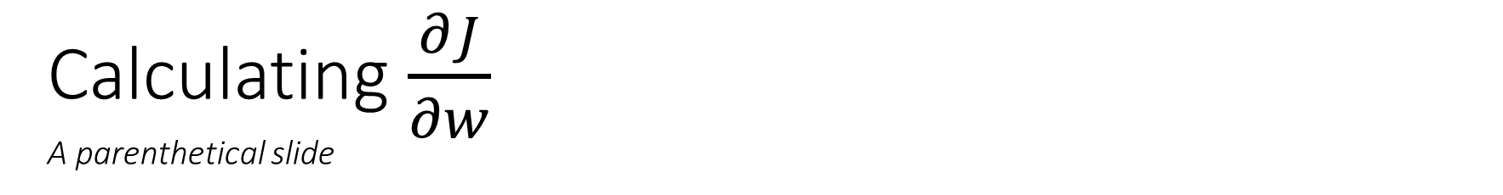
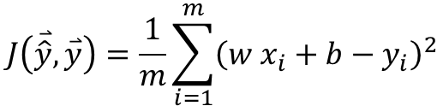
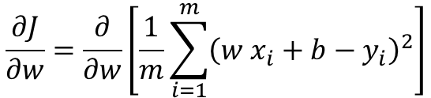
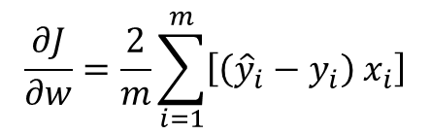

Slide 8
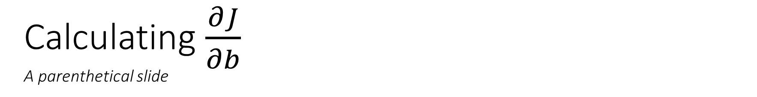
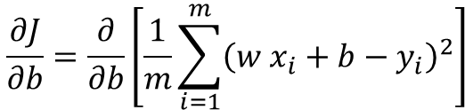

Slide 9


Slide 10
Iterate for all subdivisions of batches of training examples in the training dataset, and for many epochs.

Slide 11






Forward-propagate, after training, one user input in the same format as a training example, to generate a final prediction.

Slide 12
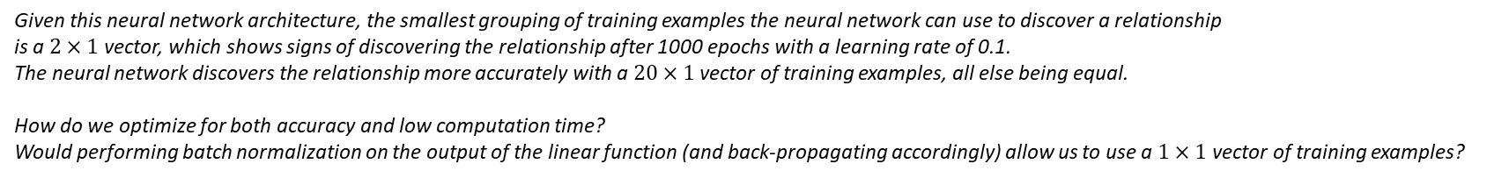
Empirical Intuitions and Questions

Slide 13
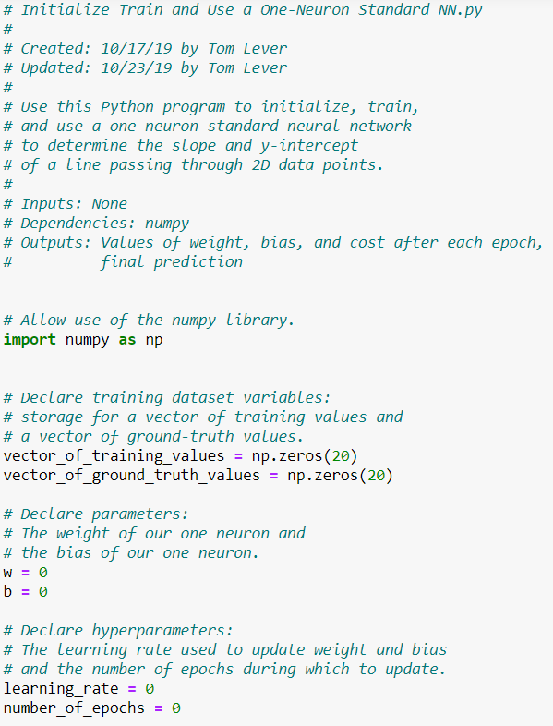

Slide 14
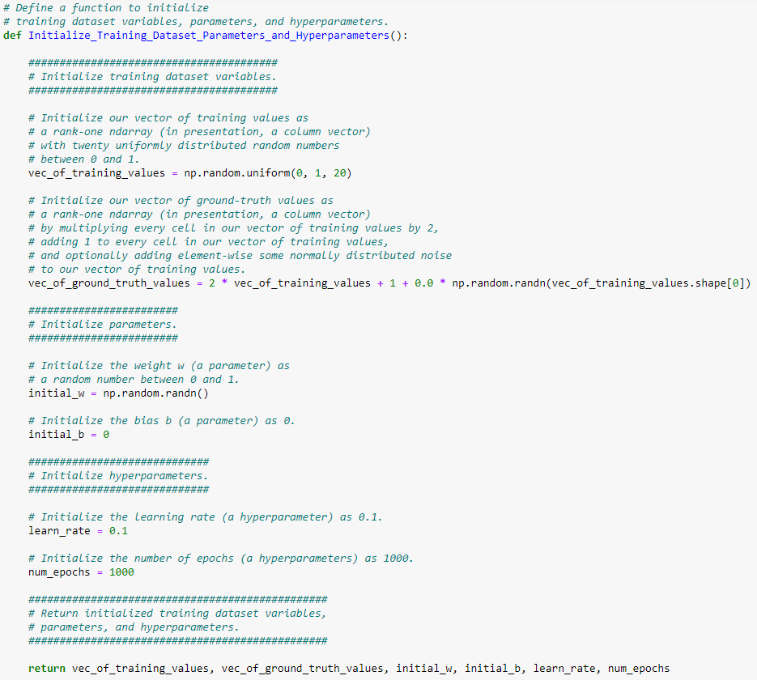

Slide 15
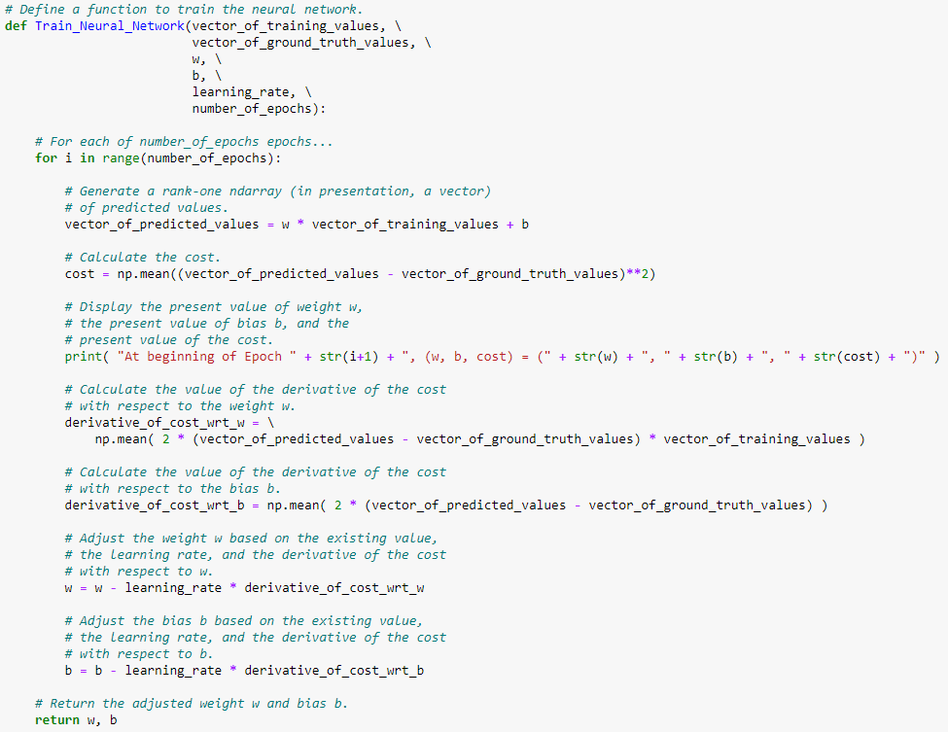

Slide 16
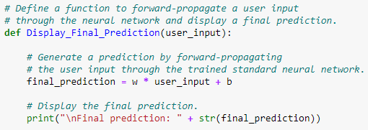

Slide 17
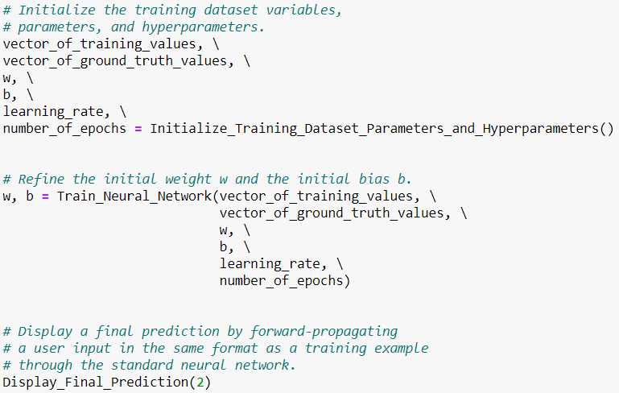

Slide 18
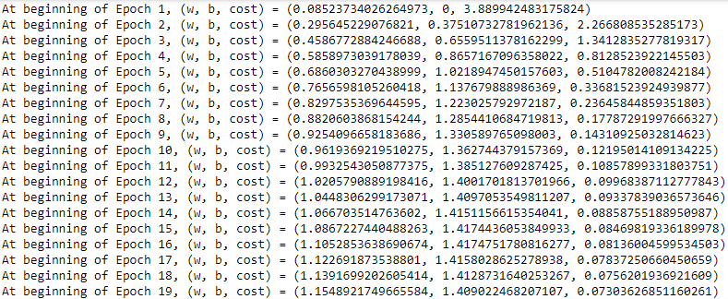

Slide 19
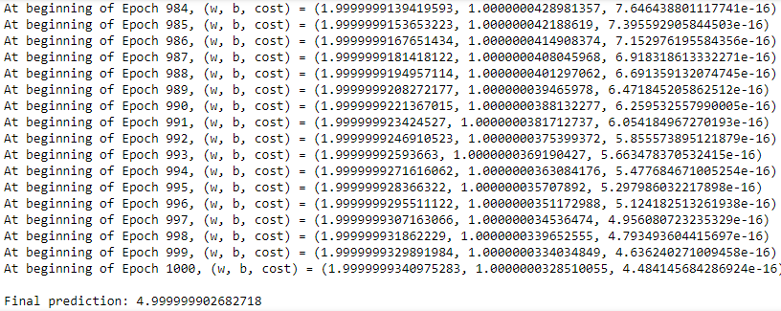

Slide 20
Empirical Intuitions and Questions

Slide 21
Image classifiers and object detectors…

Slide 22
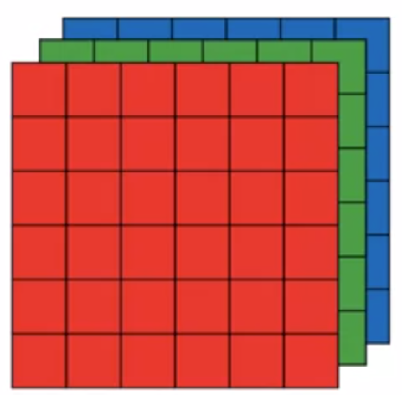


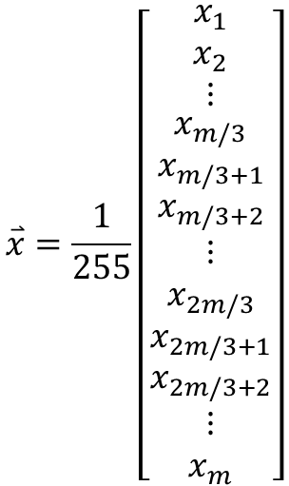





Rely on flattened, normalized images.

Slide 23
Very simple image binary classifiers…

Slide 24
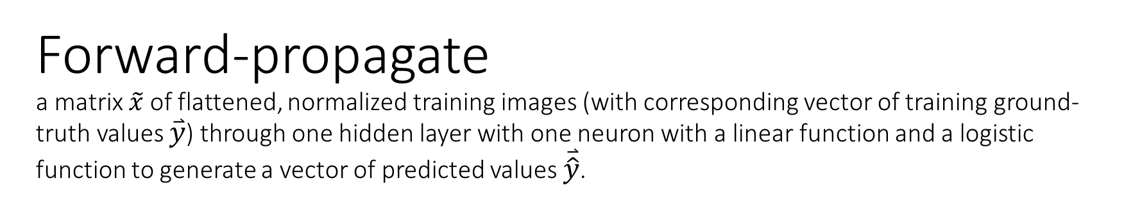

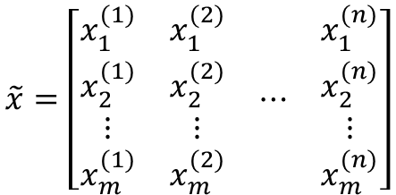



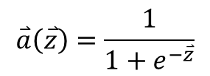

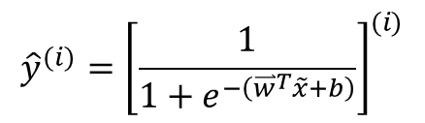



Slide 25
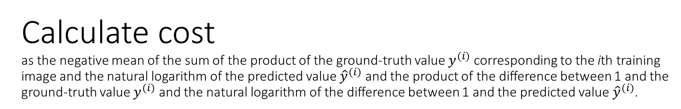
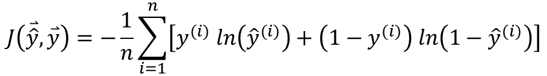

Slide 26



Slide 27
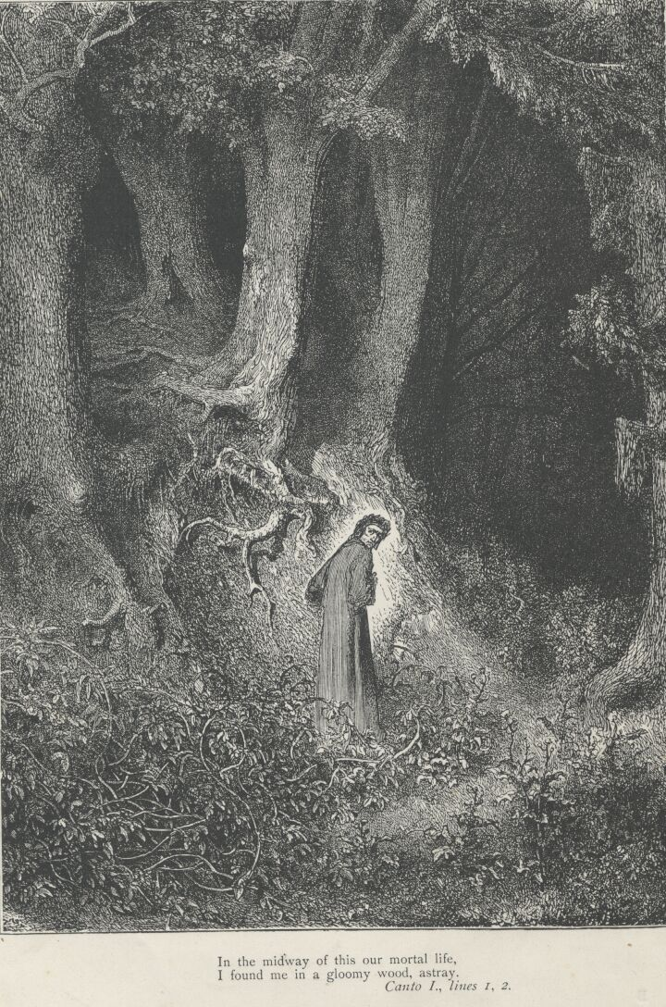
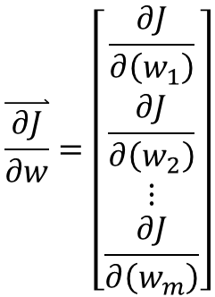


“You must return here with [two derivatives]… or else you will never pass through this wood… alive.”
-- Head Knight of Ni
Monty Python and
the Holy Grail
mathematical

Slide 28
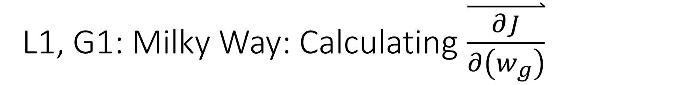
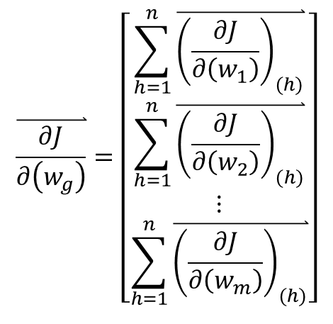

Slide 29
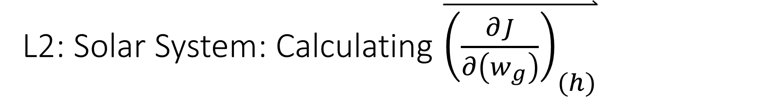
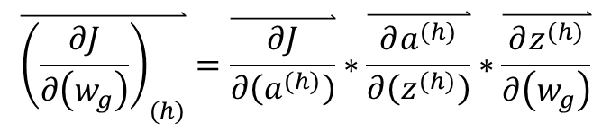

Slide 30
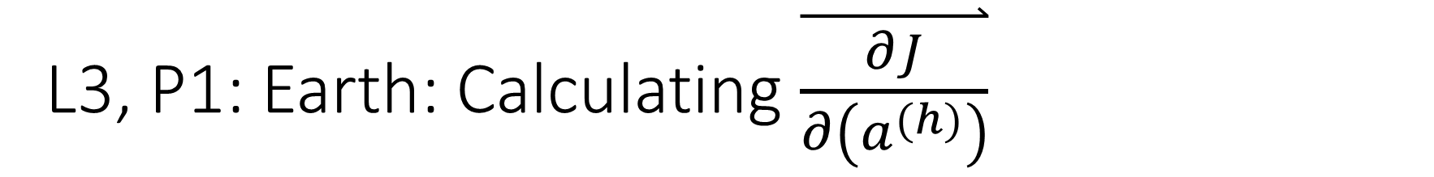
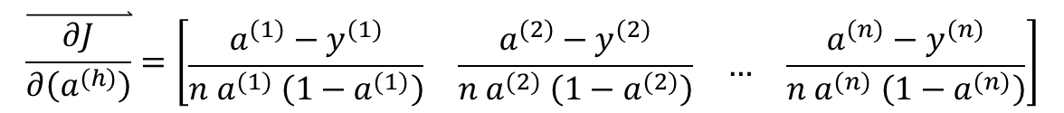
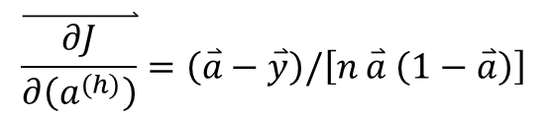

Slide 31
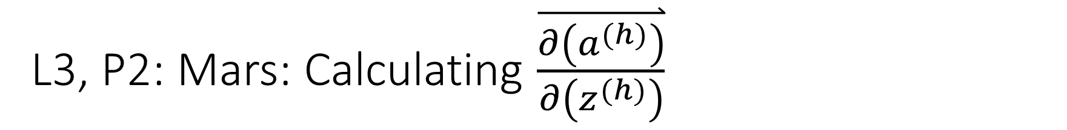
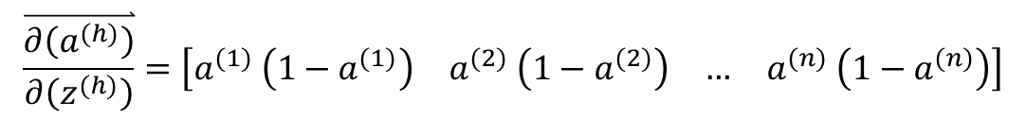
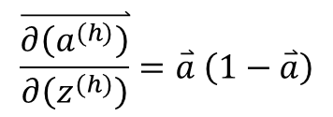

Slide 32
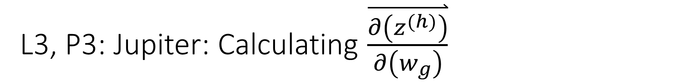
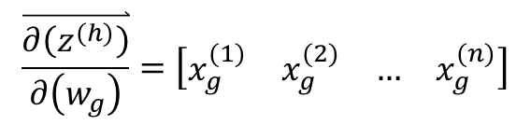
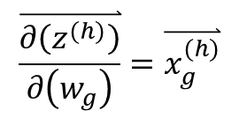

Slide 33
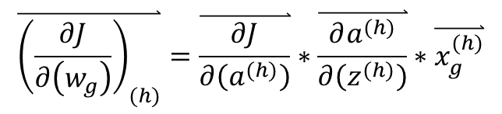

Slide 34
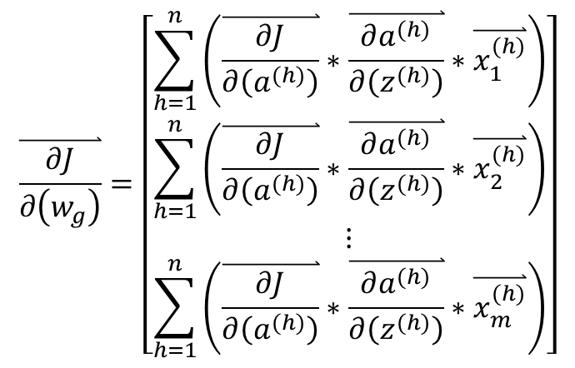

Slide 35
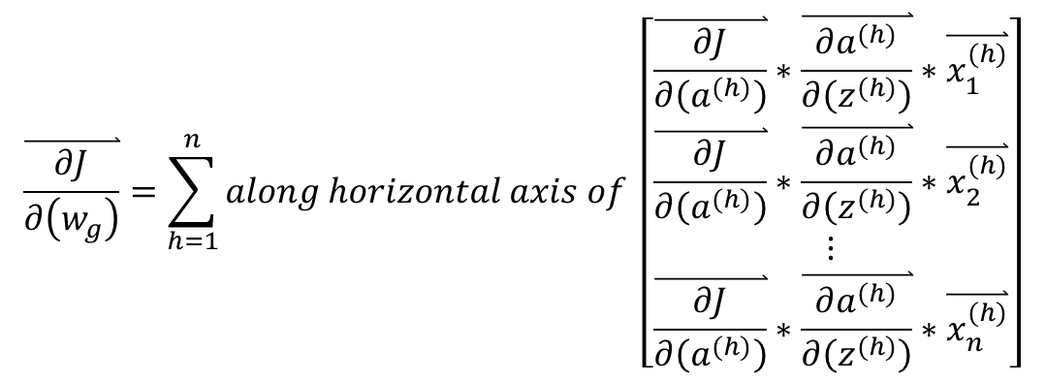

Slide 36
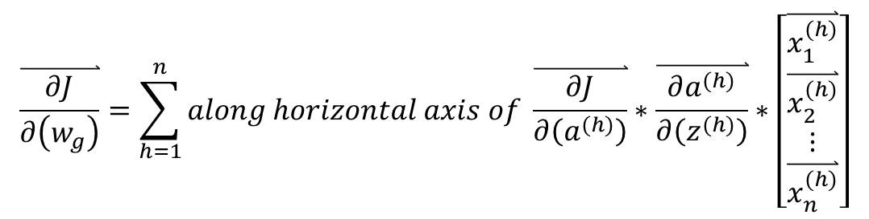

Slide 37
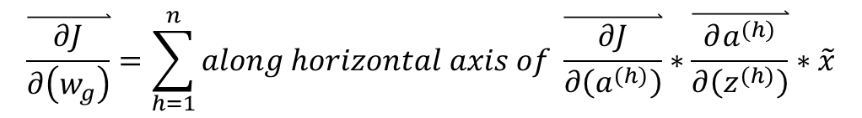

Slide 38
“You must return here with [two derivatives]… or else you will never pass through this wood… alive.”
-- Head Knight of Ni
Monty Python and
the Holy Grail
mathematical

Slide 39
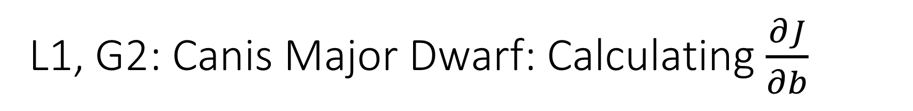


Slide 40



Slide 41




Slide 42


Slide 43



Slide 44
“You must return here with [two derivatives]… or else you will never pass through this wood… alive.”
-- Head Knight of Ni
Monty Python and
the Holy Grail
mathematical

Slide 45


Slide 47
Iterate for all subdivisions of batches of training images in the training dataset, and for many epochs.

Slide 48


Slide 49


Slide 50













Slide 52





Slide 53
“You must return here with [four derivatives]… or else you will never pass through this wood… alive.”
-- Head Knight of Ni
Monty Python and
the Holy Grail
mathematical

Slide 55


Slide 57




Slide 58




Slide 59



Slide 60



Slide 61


Slide 62


Slide 63



Slide 64


Slide 65


Slide 66
“You must return here with [four derivatives]… or else you will never pass through this wood… alive.”
-- Head Knight of Ni
Monty Python and
the Holy Grail
mathematical

Slide 68



Slide 69



Slide 70


Slide 71


Slide 72
“You must return here with [four derivatives]… or else you will never pass through this wood… alive.”
-- Head Knight of Ni
Monty Python and
the Holy Grail
mathematical

Slide 73



Slide 74



Slide 75



Slide 76


Slide 77


Slide 78
“You must return here with [four derivatives]… or else you will never pass through this wood… alive.”
-- Head Knight of Ni
Monty Python and
the Holy Grail
mathematical

Slide 79



Slide 80



Slide 82




Slide 83


Slide 84


Slide 85
“You must return here with [four derivatives]… or else you will never pass through this wood… alive.”
-- Head Knight of Ni
Monty Python and
the Holy Grail
mathematical

Slide 88
Iterate for all subdivisions of batches of training images in the training dataset, and for many epochs.

Slide 89


