Slide 1

End-to-End Survey of BSDS Students
Tom Lever
July 16, 2024

Slide 2
End to End Survey
the process of creating and distributing questions; collecting, analyzing, and reporting on answers; and planning the above

Slide 3
Objectives
Gather comprehensive feedback from recent graduates of the BSDS program.
Evaluate various aspects of the BSDS program from the perspectives of recent graduates.
Gather insights to improve the BSDS program and better support future students.

Slide 4
Collaborators
you all
every faculty member, staff member, PhD student, MSDS student, and BSDS student who is willing to respond to an email requesting questions for a hypothetical questionnaire that meets objectives
everyone listed in “Table of Collaborators”

Slide 5
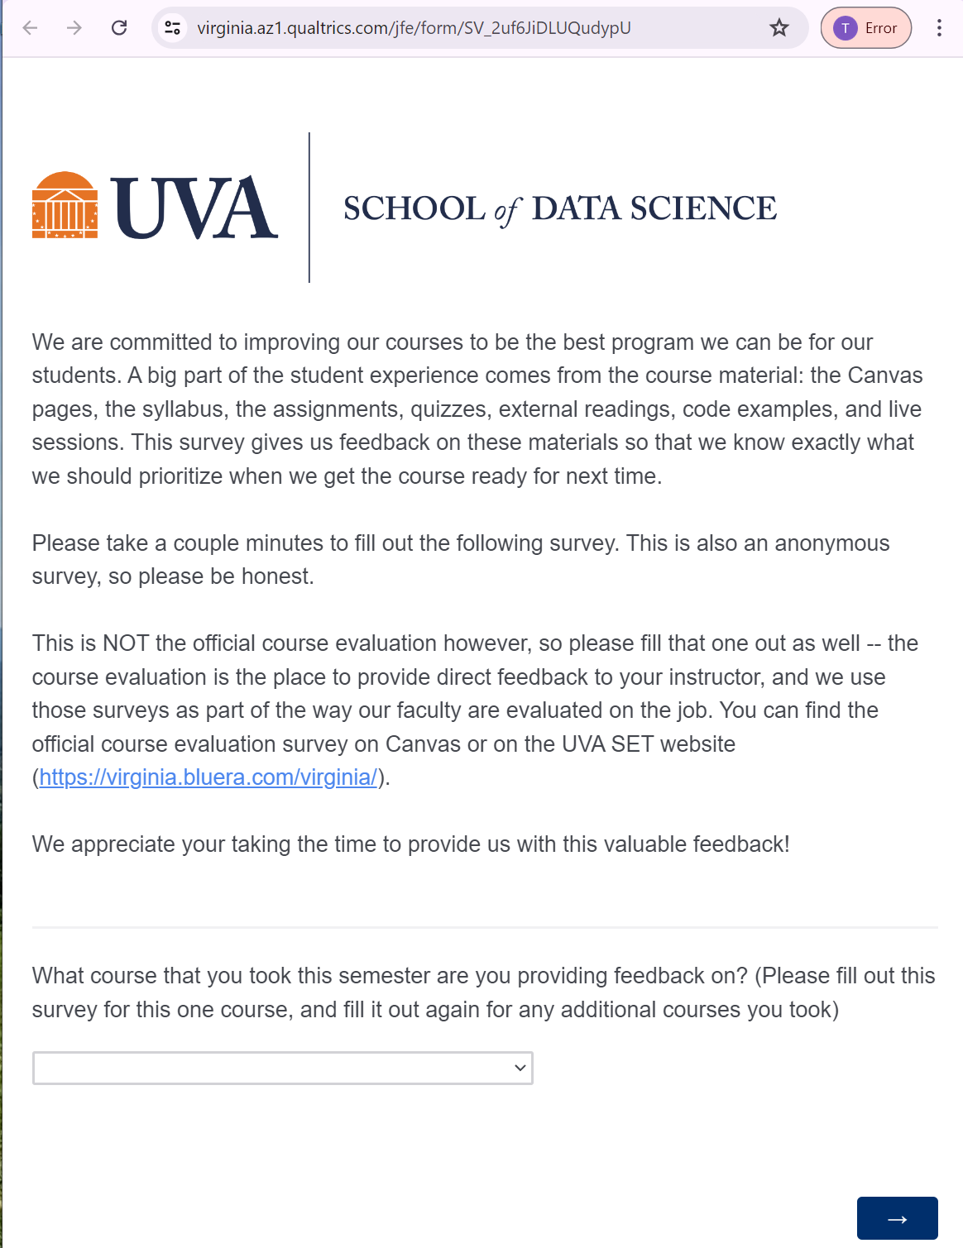
Questionnaire to Improve Course

Slide 6
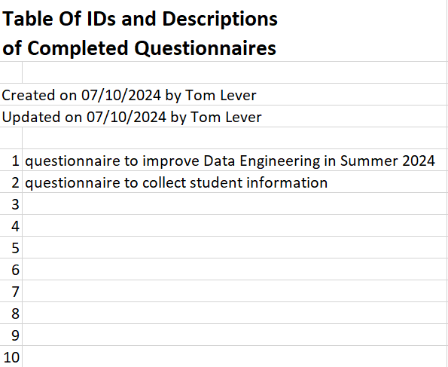
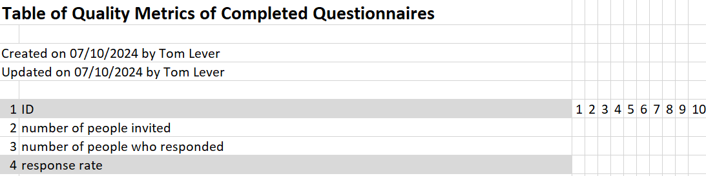
Comparing Existing Questionnaires

Slide 7
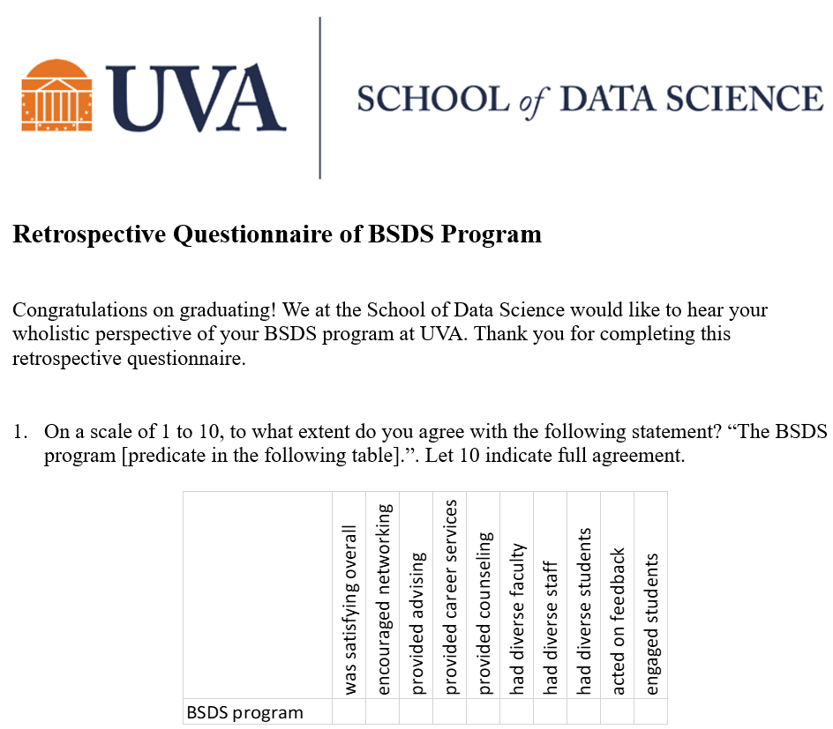
Retrospective Questionnaire Of BSDS Program

Slide 8
Deployment

Slide 9
Data Collection

Slide 10
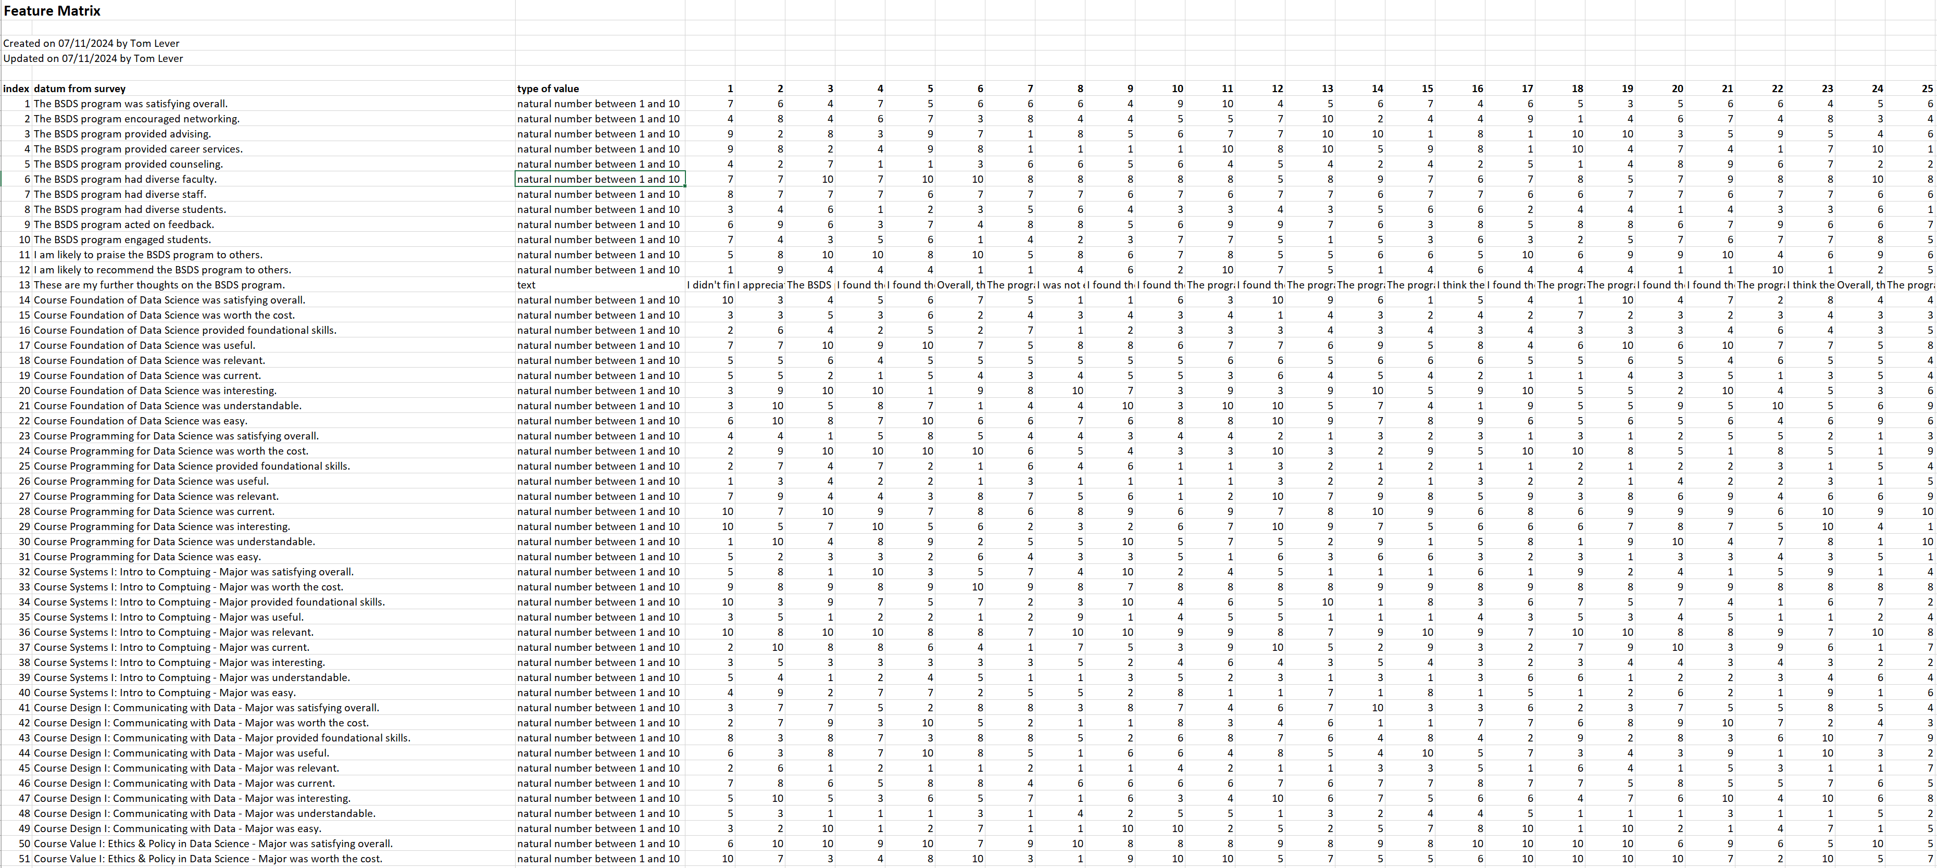
Feature Matrix

