Slide 1

End-to-End Survey of BSDS Students
Tom Lever
July 16, 2024

Slide 2
End to End Survey
the process of creating and distributing questions; collecting, analyzing, and reporting on answers; and planning the above

Slide 3
General Objectives
Gather comprehensive feedback from recent graduates of the BSDS program.
Evaluate various aspects of the BSDS program from the perspectives of recent graduates.
Gather insights to improve the BSDS program and better support future students.

Slide 4
Specific Objectives
Create a binary classifier, multiclass classifier, or regression model that may predict whether a student found the BSDS program to be satisfying overall.
Understand which predictors are most likely to determine whether a student found the BSDS program to be satisfying overall.

Slide 5
Collaborators
you all
every faculty member, staff member, PhD student, MSDS student, and BSDS student who is willing to respond to an email requesting questions for a hypothetical questionnaire that meets objectives
everyone listed in “Table of Collaborators”

Slide 6
Proposal
Introduction, discussion of questions of interest, discussion of models, discussion of data visualizations

Slide 7
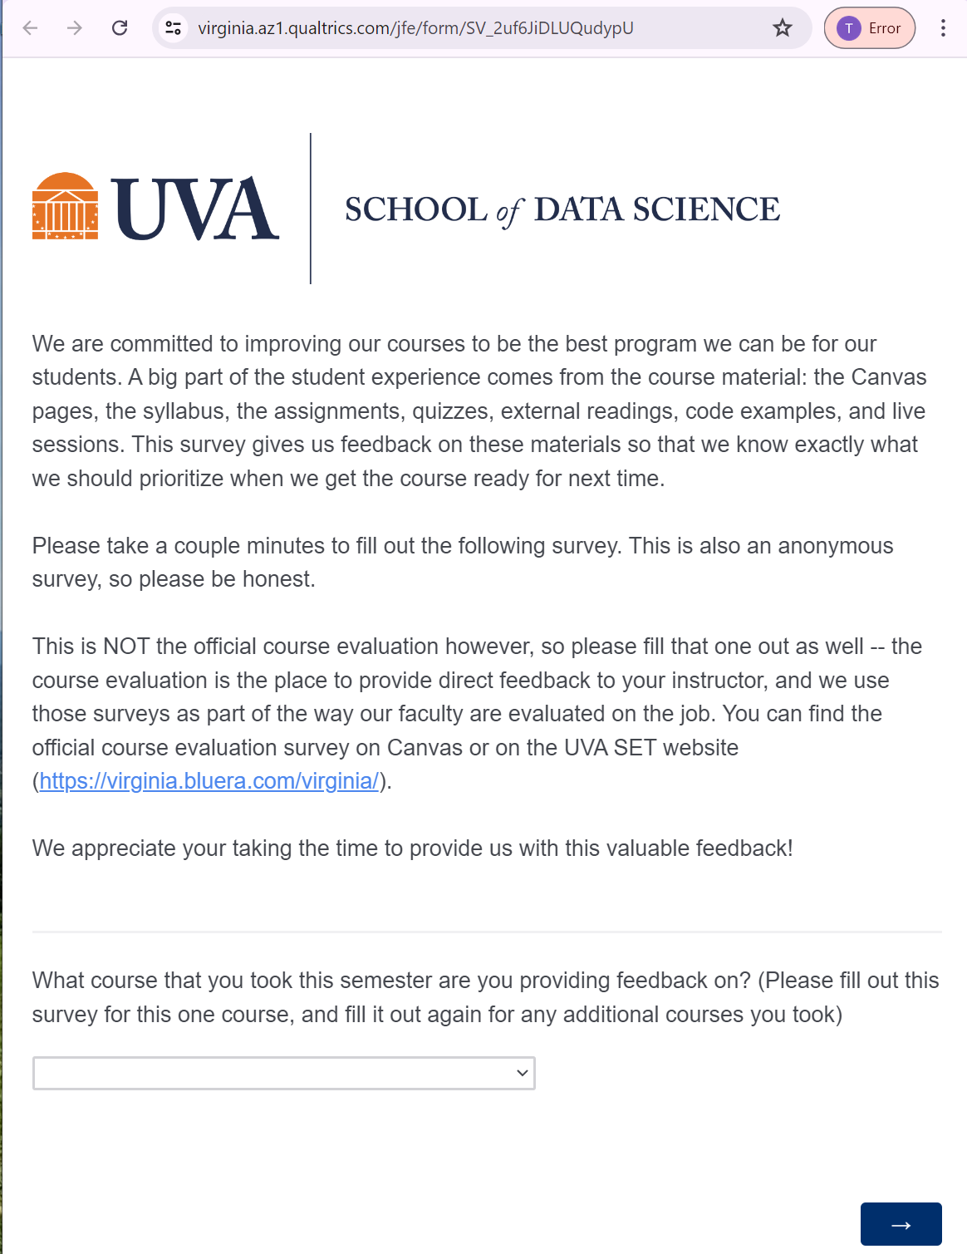
Questionnaire to Improve Course

Slide 8
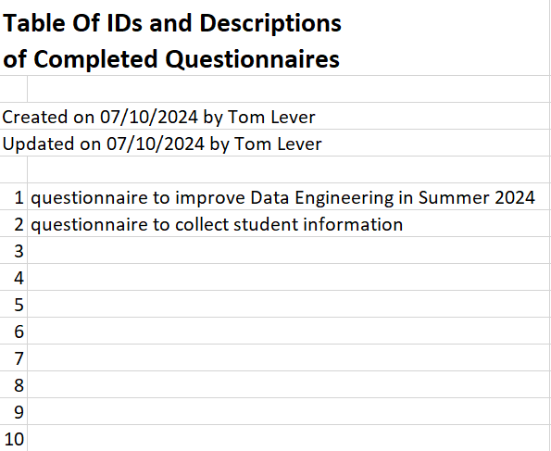
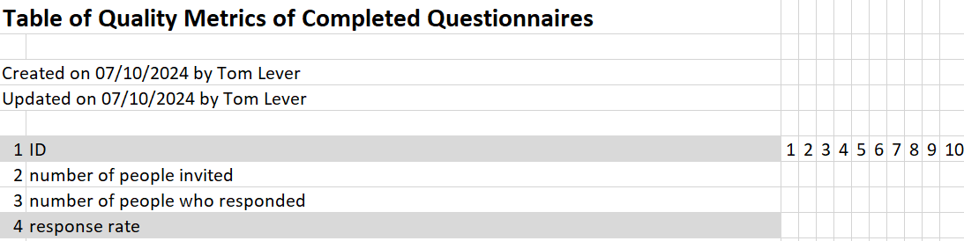
Comparing Existing Questionnaires

Slide 9
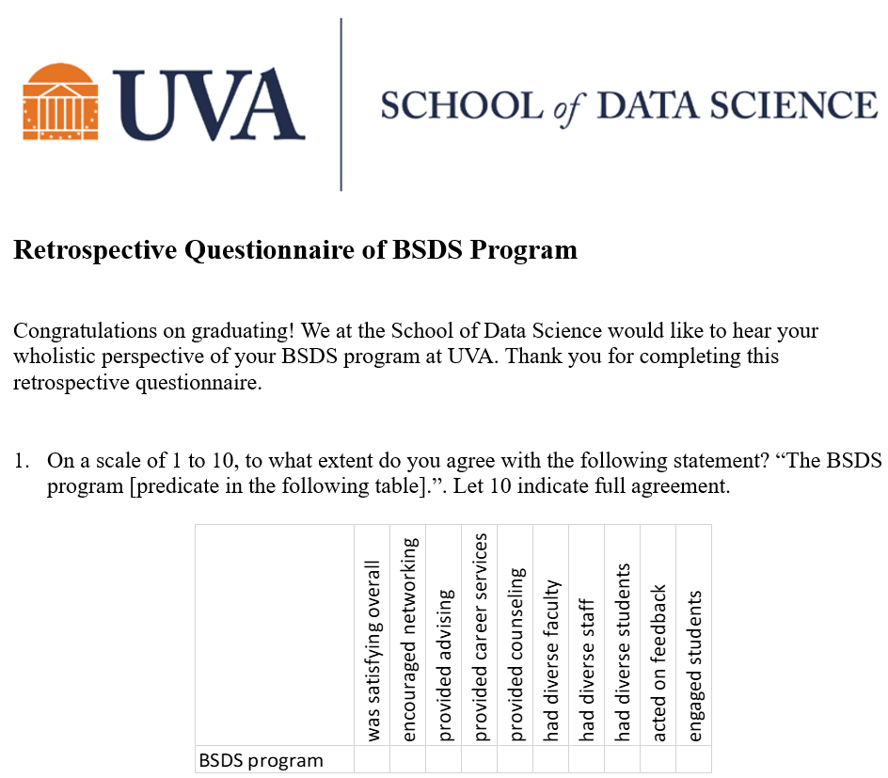
Retrospective Questionnaire Of BSDS Program

Slide 10
Deployment

Slide 11
Data Collection

Slide 12
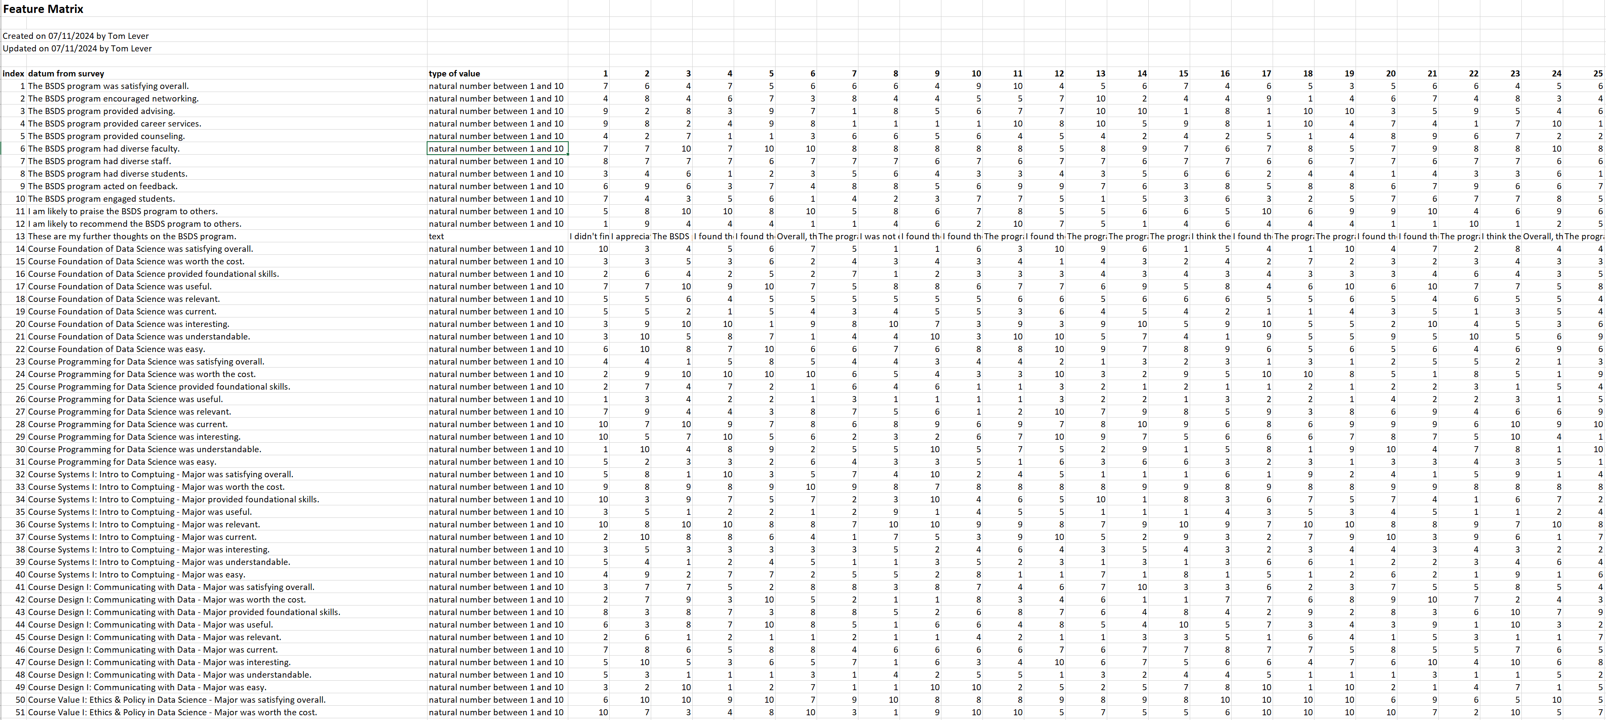
Feature Matrix

Slide 13
Analyses of Feature Matrix
We might rely on autogenerated analyses by Qualtrics.
We might or guide analyses using Qualtrics.
See “Analyses of Feature Matrix”.

Slide 14
Report
Executive summary and presentation and analysis of data
Executive summary, description of data, discussion of questions of interest
Dashboard
Introduction, discussion of data, discussion of methods, analysis, conclusions, appendices
Abstract, introduction, motivation, methods, experiments, results, conclusion, contributions, references, appendices

Slide 15
Presentation to Stakeholders
Like this one, with focus on conclusions

Slide 16
Updating Metadata

Slide 17
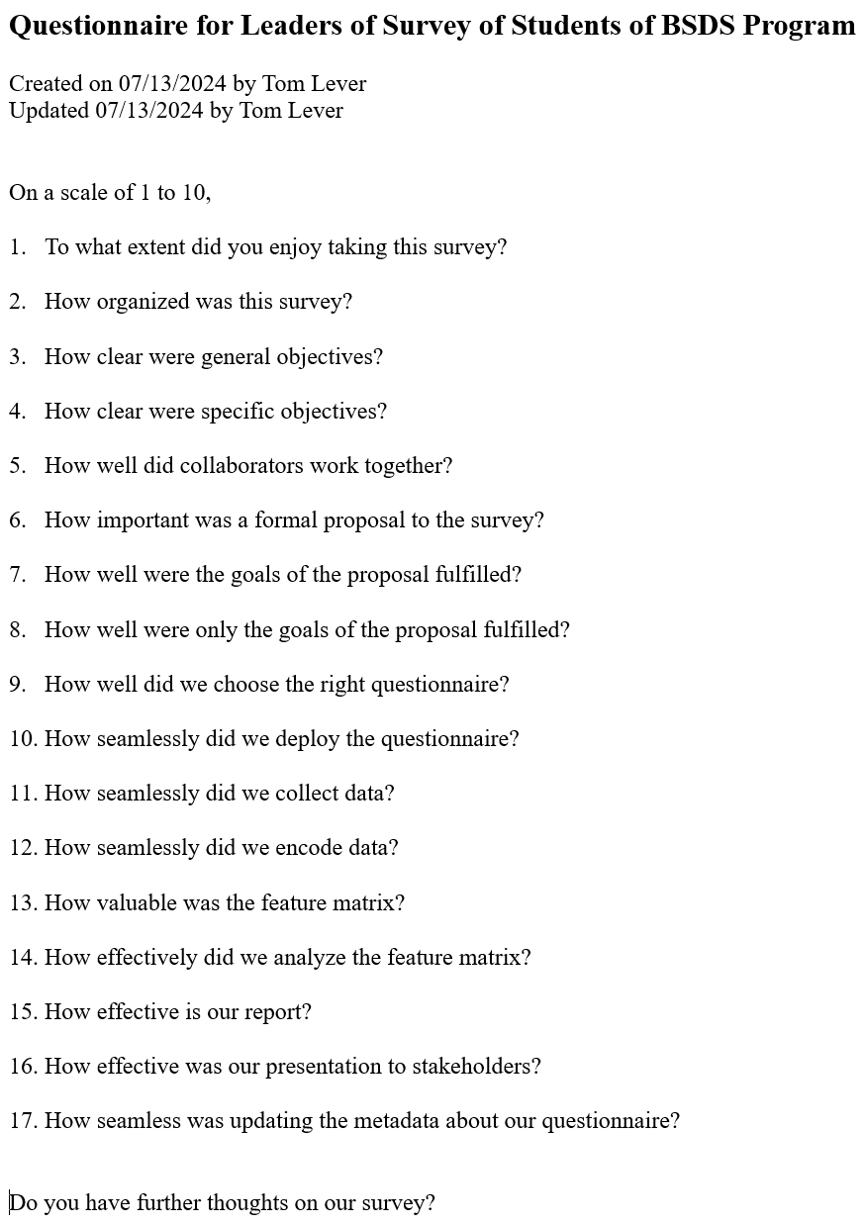
Feedback

Slide 18
Meet to Consider Changes
BSDS program
Questionnaire of students

Slide 19
Communicate
Thank students and leaders who responded
Inform students of any changes to the BSDS program

