Slide 1

End-to-End Survey of BSDS Students
Tom Lever
July 16, 2024

Slide 2
End to End Survey
the process of creating and distributing questions; collecting, analyzing, and reporting on answers; and planning the above

Slide 3
General Objectives
Gather comprehensive feedback from recent graduates of the BSDS program.
Evaluate various aspects of the BSDS program from the perspectives of recent graduates.
Gather insights to improve the BSDS program and better support future students.

Slide 4
Specific Objectives
Create a binary classifier, multiclass classifier, or regression model that may predict whether a student found the BSDS program to be satisfying overall.
Understand which predictors are most likely to determine whether a student found the BSDS program to be satisfying overall.

Slide 5
Collaborators
you all
every faculty member, staff member, PhD student, MSDS student, and BSDS student who is willing to respond to an email requesting questions for a hypothetical questionnaire that meets objectives
everyone listed in “Table of Collaborators”

Slide 6
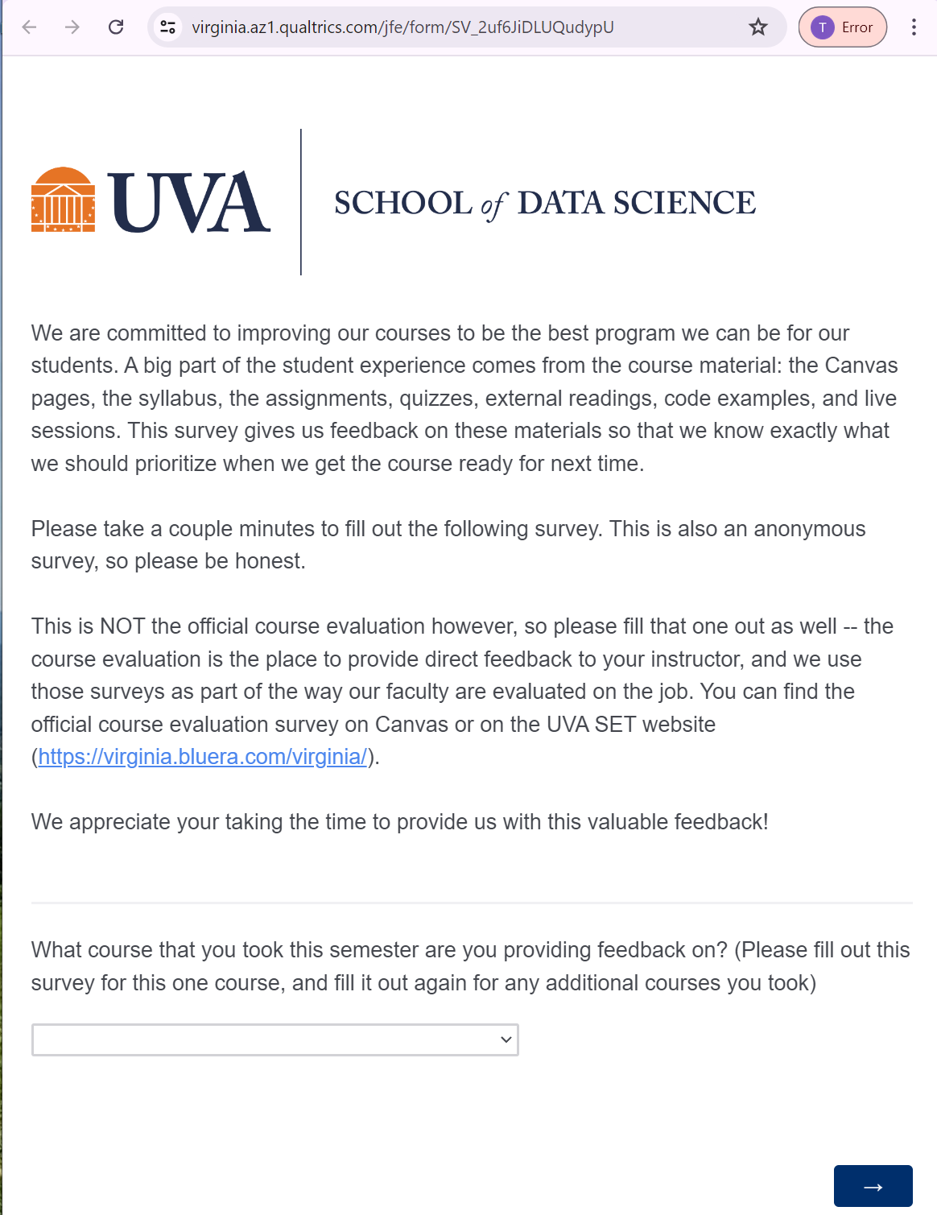
Questionnaire to Improve Course

Slide 7
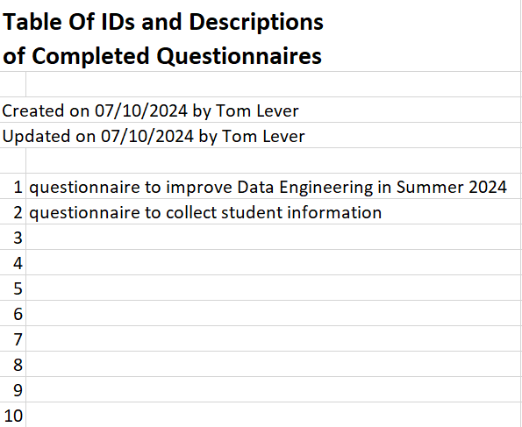
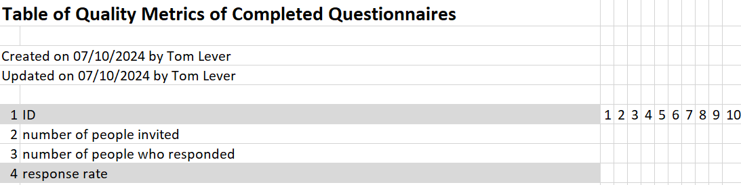
Comparing Existing Questionnaires

Slide 8
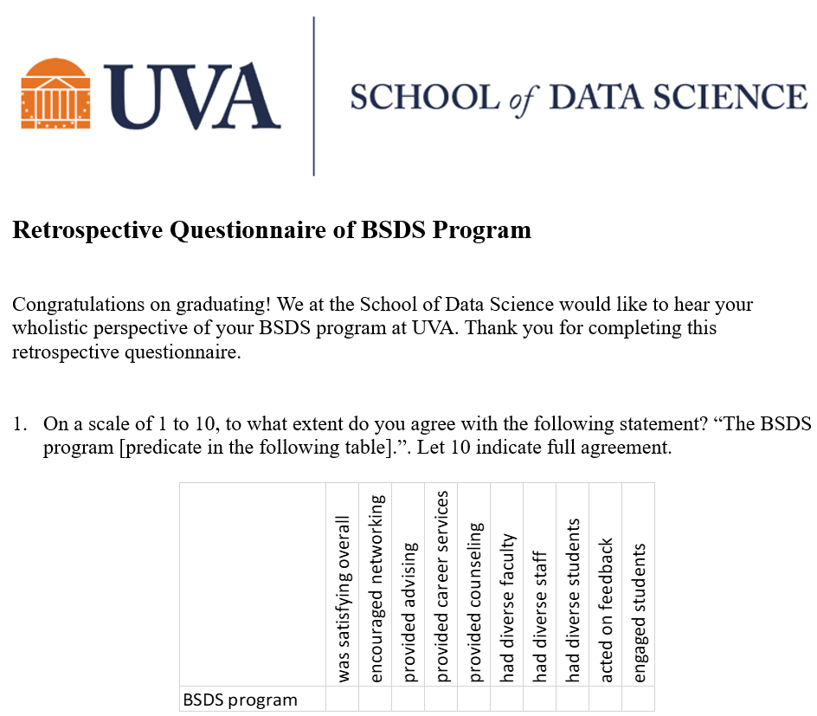
Retrospective Questionnaire Of BSDS Program

Slide 9
Deployment

Slide 10
Data Collection

Slide 11
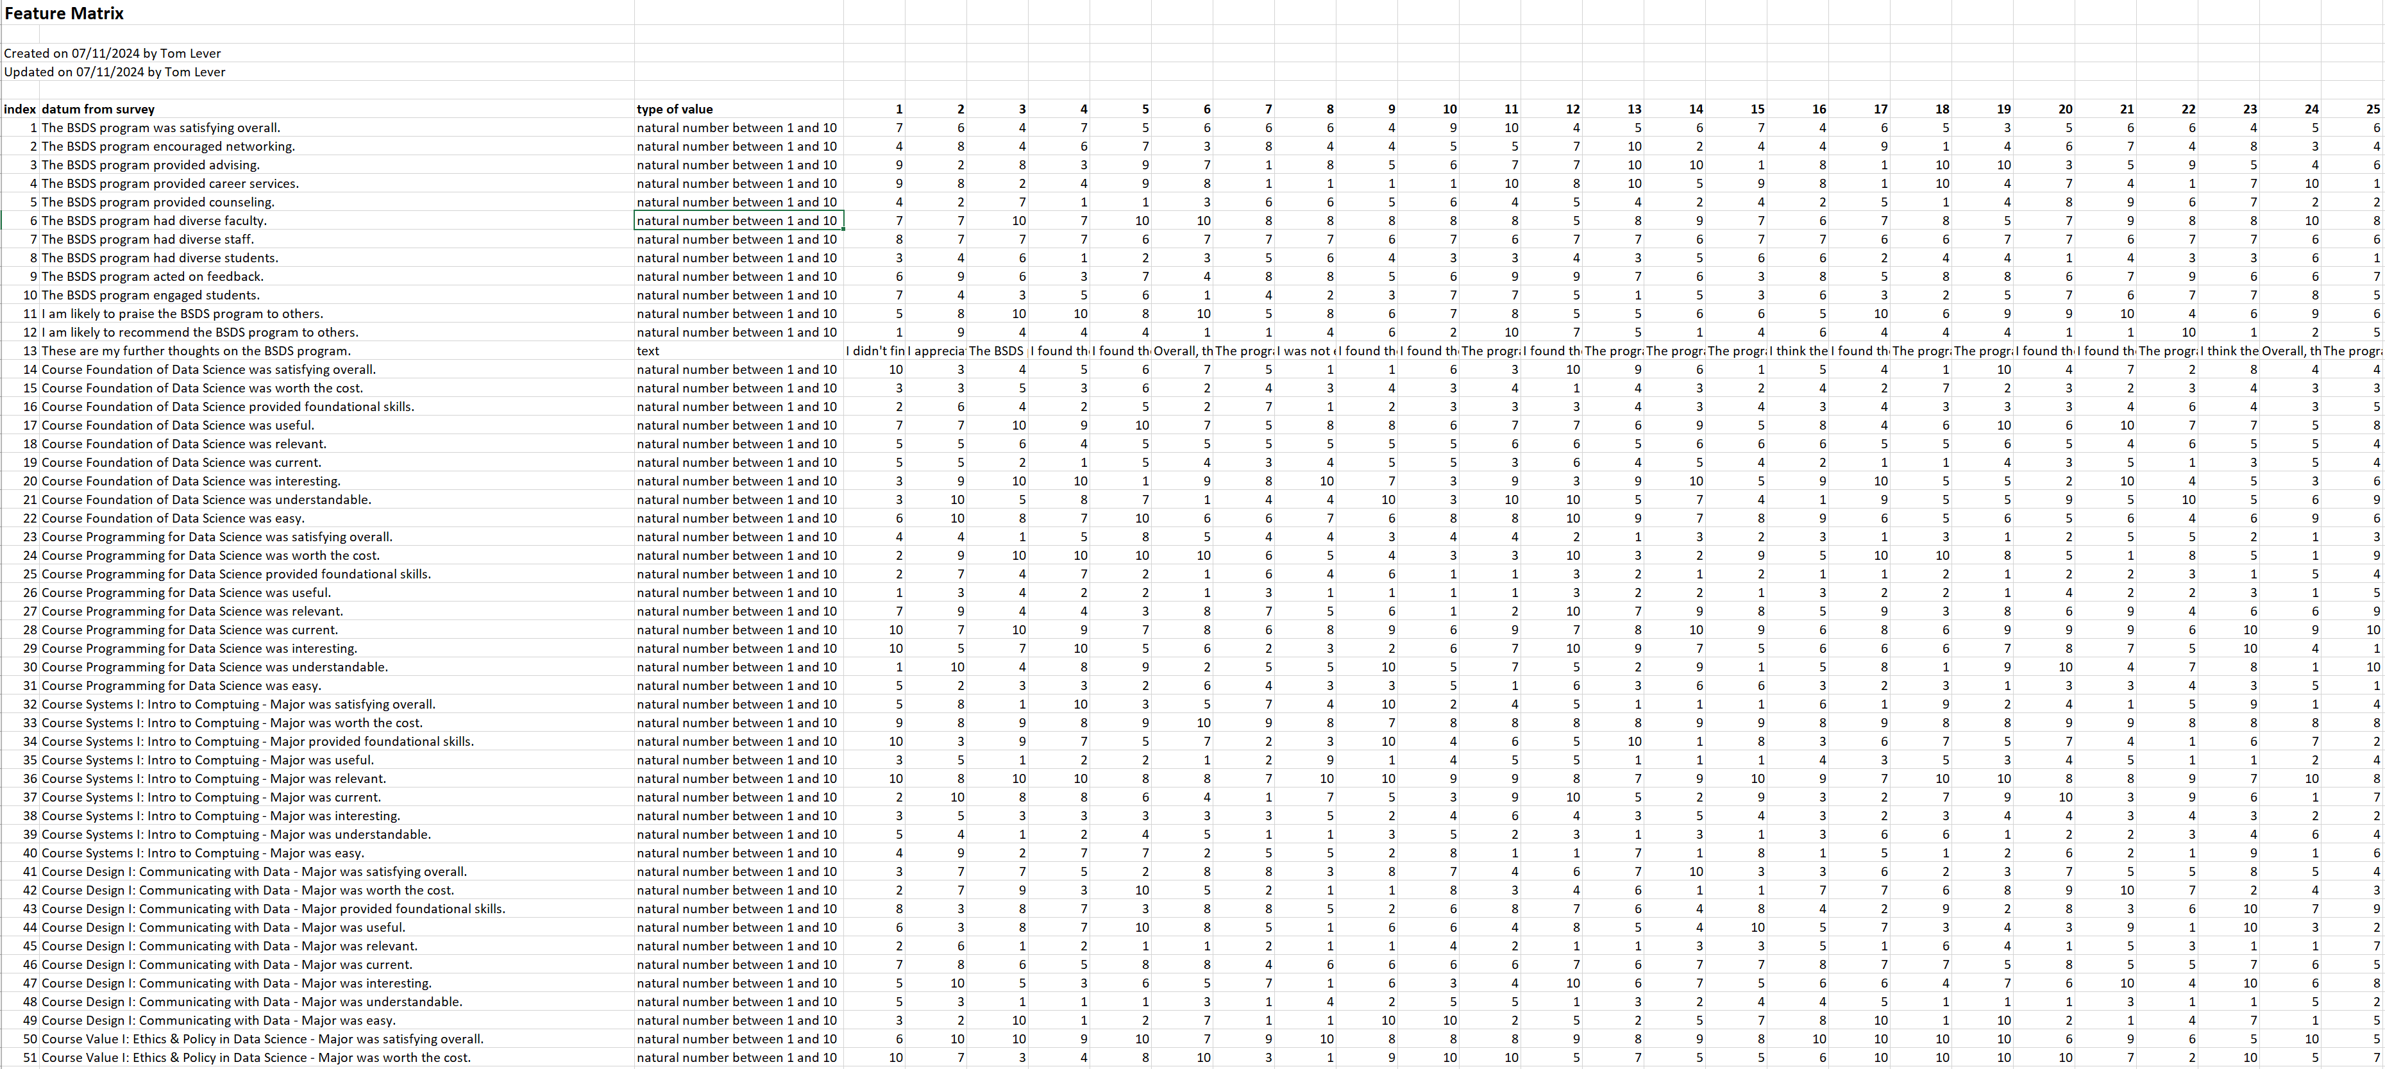
Feature Matrix

