Slide 1

Survival Analysis For Hospital LOS Prediction For CoViD-19 Patients
Tom Lever
10/18/2024

Slide 2
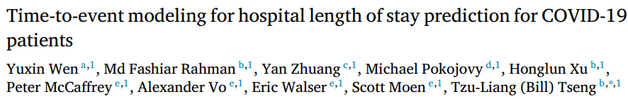
Introduction

Slide 3
Length Of Stay
Cumulative duration of patient hospitalization
Affected by:
Demographics
Treatment
Discharge planning
Disease

Slide 4
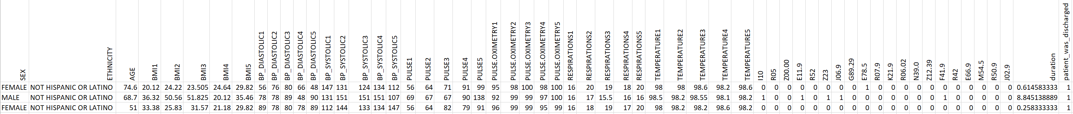
Data

Slide 5
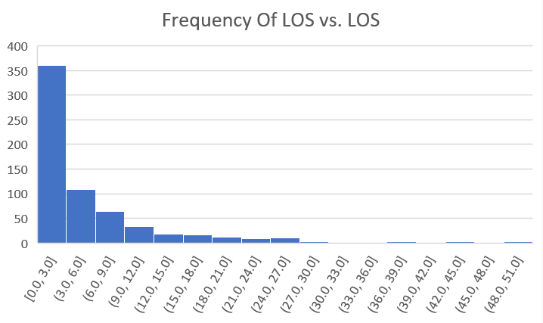
Exploratory Data Analysis
Frequency Of LOS
LOS

Slide 6
Classification, Regression, and Survival Analysis
Classification: Short, Medium, Long LOS
Regression: LOS
Survival Analysis: PDF of LOS

Slide 7

Survival Analysis
$$P$$
$${PDF}_{P}(LOS)$$
$${CDF}_{P}\left(LOS\right)=\int_{l=0}^{LOS}{{PDF}_{P}\left(l\right) dl}$$
$$S_{P}\left(LOS\right)=1 −{CDF}_{P}(LOS)$$
$$S\left(LOS\right)=RSF(test data)$$

Slide 8

COVID.LOS.prep

Slide 9
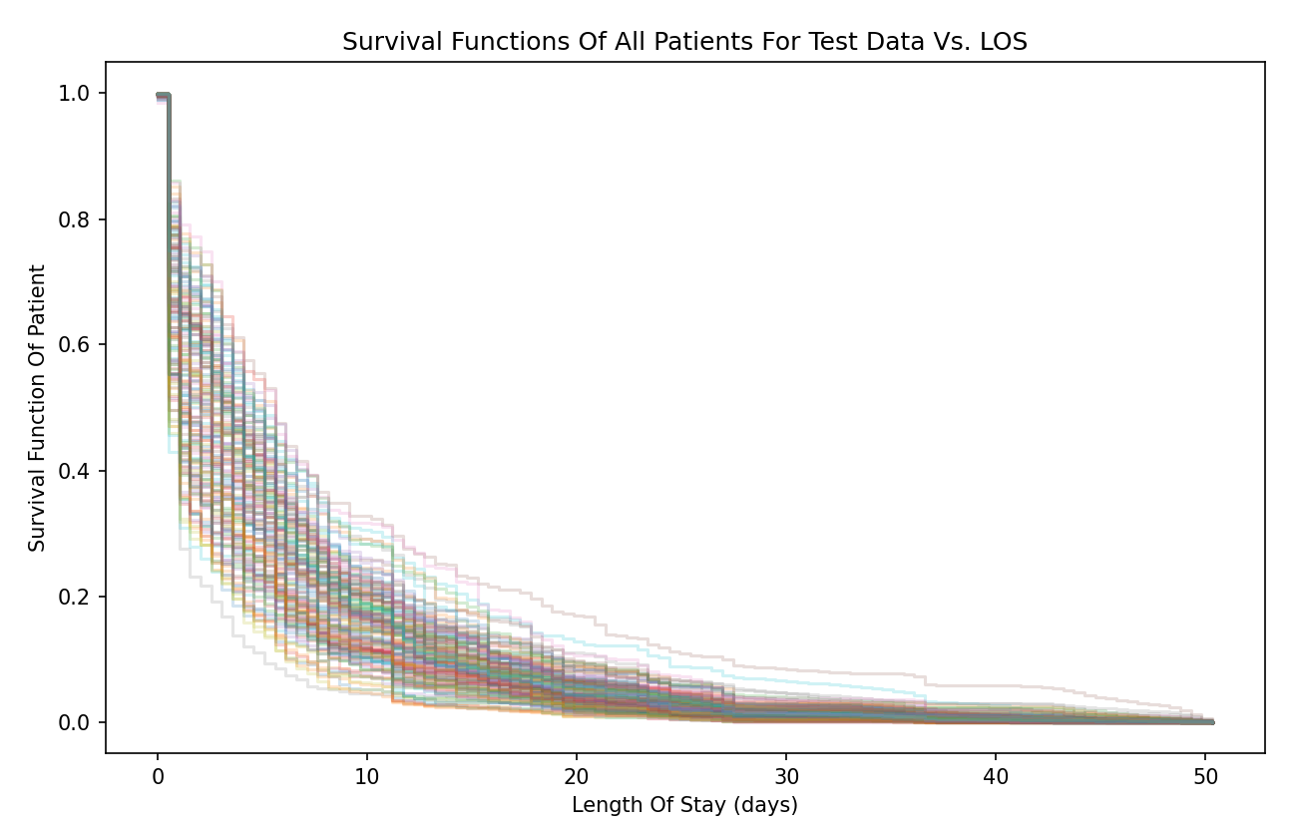

Slide 10
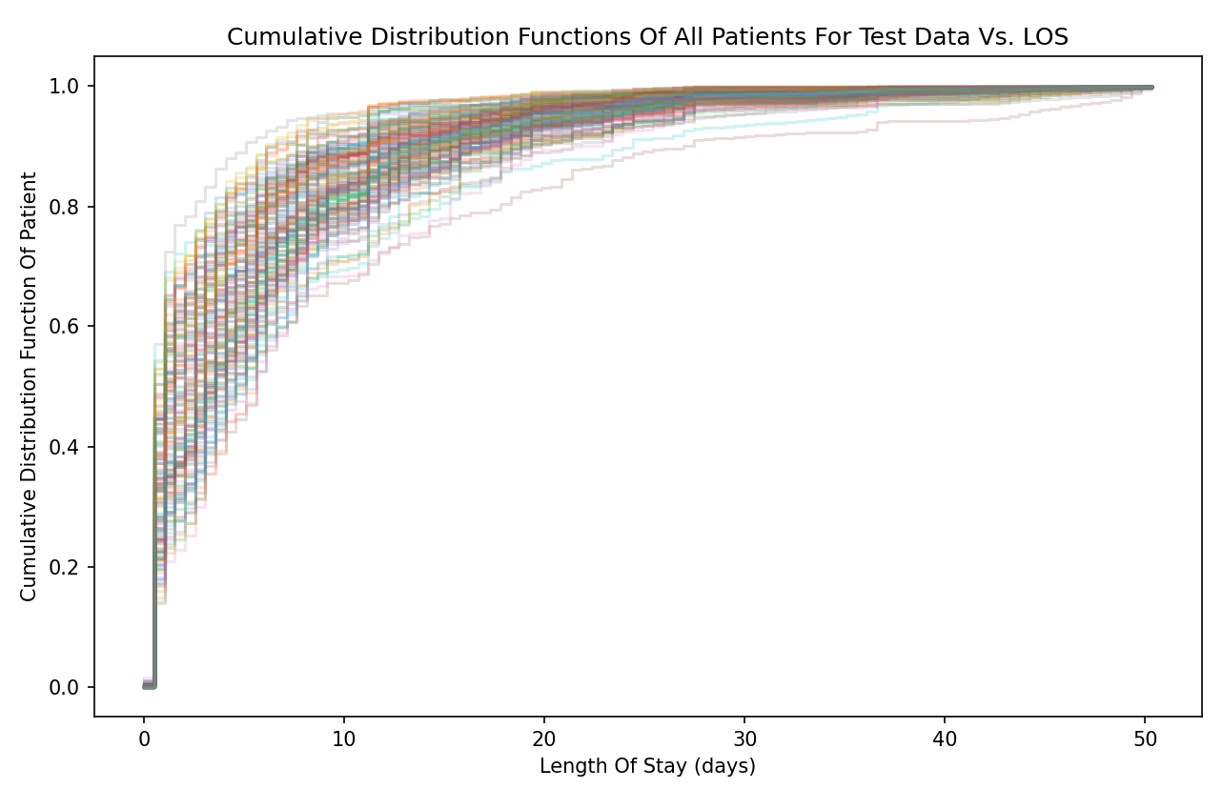

Slide 11
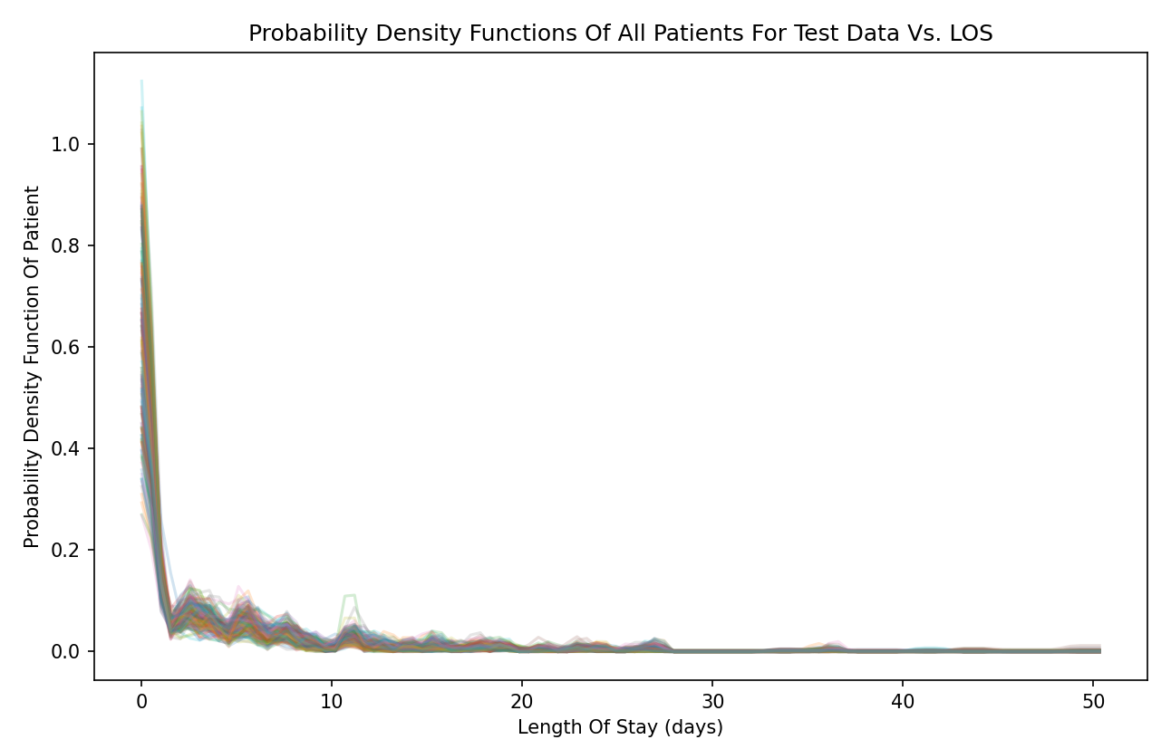

Slide 12
References
Wen et al. (2022). "Time-to-event modeling for hospital length of stay prediction for COVID-19 patients". Machine Learning with Applications. Volume 9. Jun 18, 2022. Accessed on 10/17/2024 via https://pmc.ncbi.nlm.nih.gov/articles/PMC9213016/pdf/main.pdf .
Michael Pokojovy (2022). "COVID.LOS.prep". Accessed on 10/18/2024 via https://github.com/tslever/COVID.LOS.prep .
OpenAI (2024). "ChatGPT". Accessed on 10/18/2024 via https://chatgpt.com/ .

