Slide 1

Neighbor Counter
Tom Lever
April 8, 2021

Slide 2
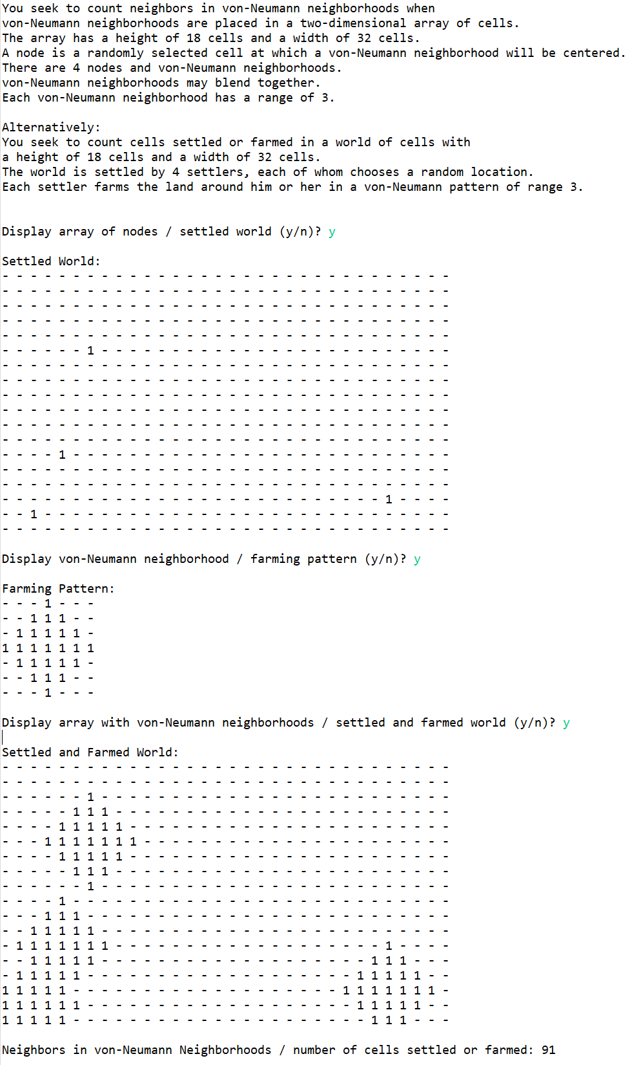
Execution

Slide 3

System Description Context: CCRi’s Spatial Analysis
CCRi distills spatial data and develops GIS tools.

Slide 4
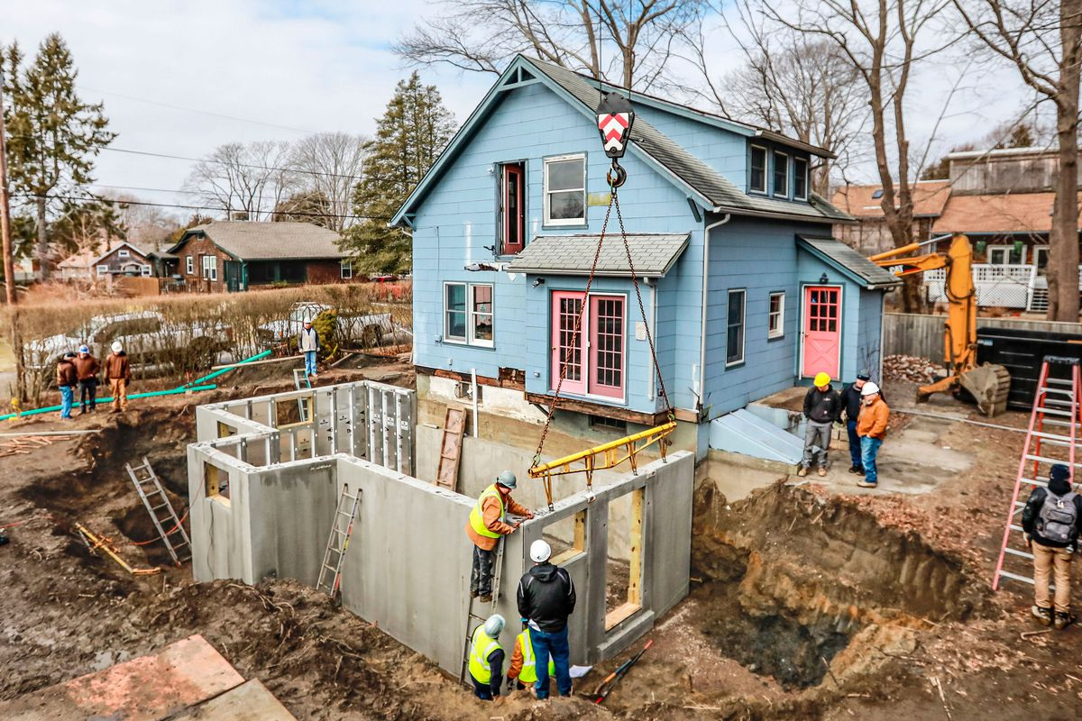
System Description Opportunity Neighbor Counter will Address
Getting me thinking

Slide 5
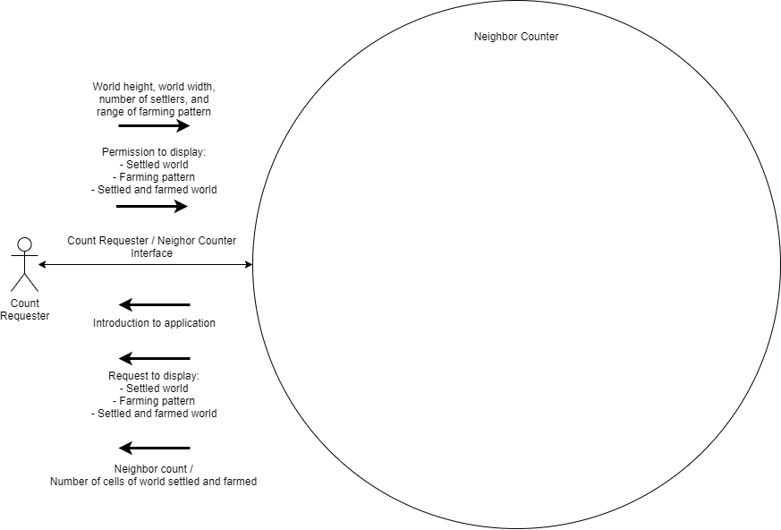
System Description What Neighbor Counter Will Do

Slide 6
System Description Iterations of Development
Minimum viable capability
Customizing
GUI

Slide 7
Requirements Use-Case Description Request Neighbor Count
Main Flow
18 steps
Presented in sets of 3

Slide 8
Requirements Use-Case Description Request Neighbor Count
Main Flow
The Count Requester signals a desire to request a neighbor count / total number of cells of the world farmed.

Slide 9
Requirements Use-Case Description Request Neighbor Count
Main Flow
The Requester signals a desire to request a neighbor count / total number of cells of world farmed.
The Requester provides to the Neighbor-Counter system: world height, world width, number of settlers, and range of farming pattern.

Slide 10
Requirements Use-Case Description Request Neighbor Count
Main Flow
The Requester signals a desire to request a neighbor count / total number of cells of world farmed.
The Requester provides to the Neighbor-Counter system: world height, world width, number of settlers, and range of farming pattern.
The system provides to the Requester an introduction to: the goal of the Requester, and the world, settlers, and farming pattern.

Slide 11
Requirements Use-Case Description Request Neighbor Count
Main Flow
4. The system sets up a world based on world height and world width,
based on a two-dimensional array of cells.

Slide 12
Requirements Use-Case Description Request Neighbor Count
Main Flow
4. The system sets up a world based on world height and world width,
based on a two-dimensional array of cells.
5. The system has settlers organize based on the world and the number
of settlers.

Slide 13
Requirements Use-Case Description Request Neighbor Count
Main Flow
4. The system sets up a world based on world height and world width,
based on a two-dimensional array of cells.
5. The system has settlers organize based on the world and the number
of settlers.
6. The system has settlers settle the world.

Slide 14
Requirements Use-Case Description Request Neighbor Count
Main Flow
7. The system asks to display the settled world.

Slide 15
Requirements Use-Case Description Request Neighbor Count
Main Flow
7. The system asks to display the settled world.
8. The Requester lets the system display the settled world.

Slide 16
Requirements Use-Case Description Request Neighbor Count
Main Flow
7. The system asks to display the settled world.
8. The Requester lets the system display the settled world.
9. The system displays the settled world.

Slide 17
Requirements Use-Case Description Request Neighbor Count
Main Flow
10. The system sets up a farming pattern based on the provided range.

Slide 18
Requirements Use-Case Description Request Neighbor Count
Main Flow
10. The system sets up a farming pattern based on the provided range.
11. The system asks to display the farming pattern.

Slide 19
Requirements Use-Case Description Request Neighbor Count
Main Flow
10. The system sets up a farming pattern based on the provided range.
11. The system asks to display the farming pattern.
12. The Requester lets the system display the farming pattern.

Slide 20
Requirements Use-Case Description Request Neighbor Count
Main Flow
13. The system displays the farming pattern.

Slide 21
Requirements Use-Case Description Request Neighbor Count
Main Flow
13. The system displays the farming pattern.
14. The system has the settlers farm the world based on the farming
pattern.

Slide 22
Requirements Use-Case Description Request Neighbor Count
Main Flow
13. The system displays the farming pattern.
14. The system has the settlers farm the world based on the farming
pattern.
15. The system asks to display the settled and farmed world.

Slide 23
Requirements Use-Case Description Request Neighbor Count
Main Flow
16. The Requester lets the system display the settled and farmed world.

Slide 24
Requirements Use-Case Description Request Neighbor Count
Main Flow
16. The Requester lets the system display the settled and farmed world.
17. The system displays the settled and farmed world.

Slide 25
Requirements Use-Case Description Request Neighbor Count
Main Flow
16. The Requester lets the system display the settled and farmed world.
17. The system displays the settled and farmed world.
18. The system provides the neighbor count / total number of cells of
the world farmed.

Slide 26
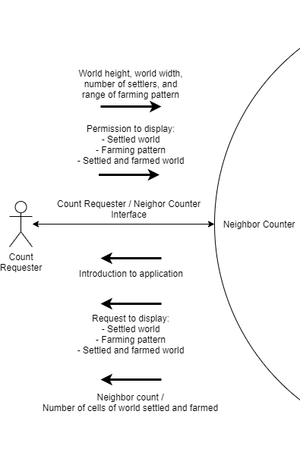
Requirements Count Requester and Neighbor Counter Interface Design
Inputs from Requester
Outputs to Requester

Slide 27
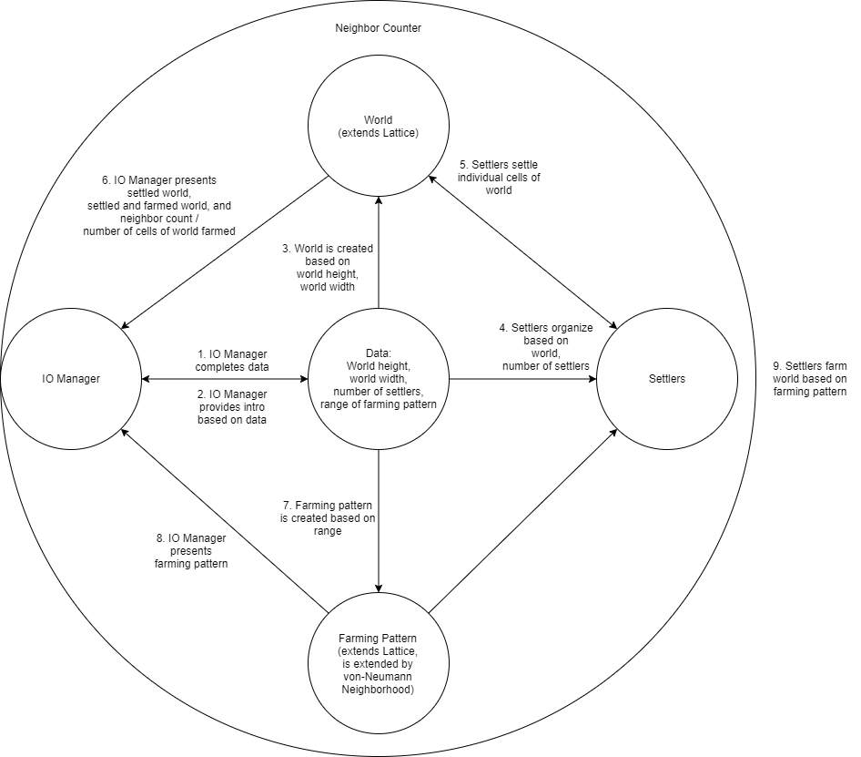
Requirements Decomposition and Sequential Flow

Slide 28
Design Classes
IoManager
Data
World
Settlers
FarmingPattern
Lattice
VonNeumannNeighborhood
Settler
Location

Slide 29





Development Tools

Slide 30
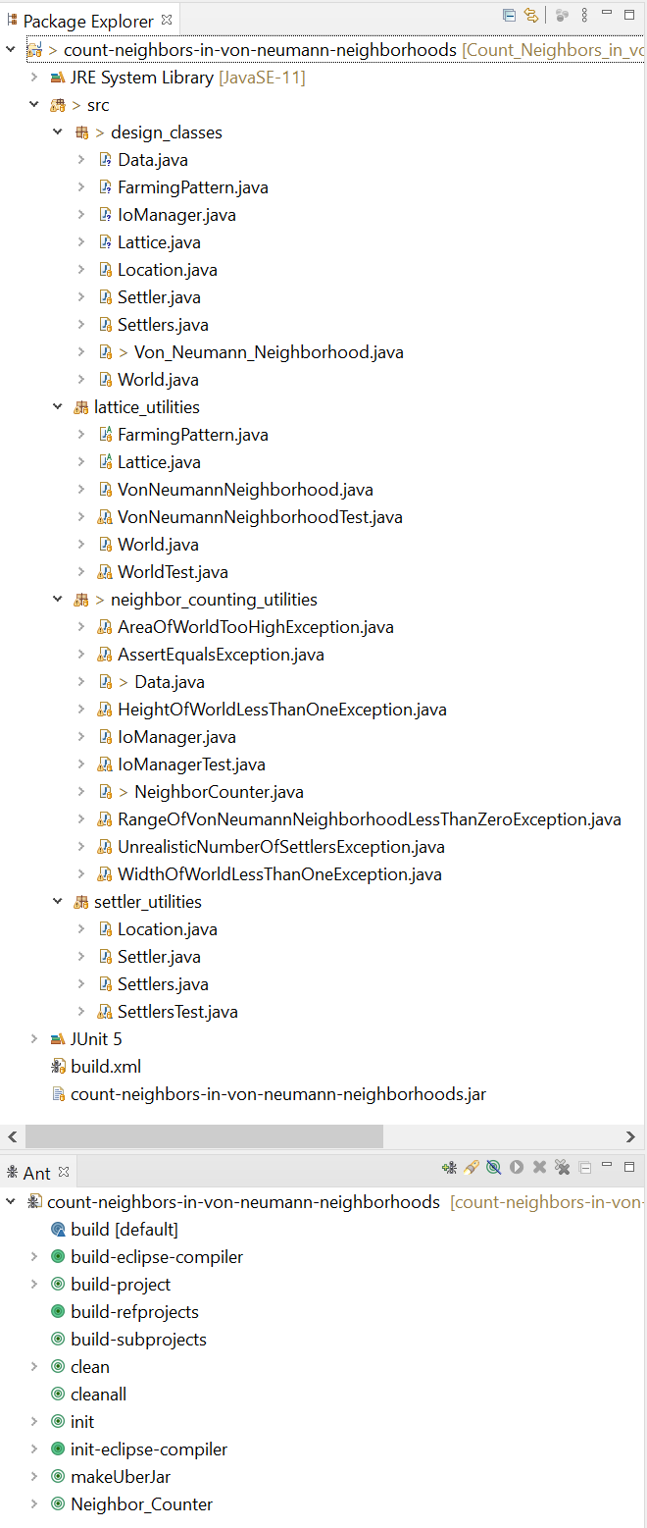
Project Structure

Slide 31
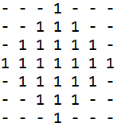
VonNeumannNeighborhood .fillCells

Slide 32

VonNeumannNeighborhood .fillCells

Slide 33
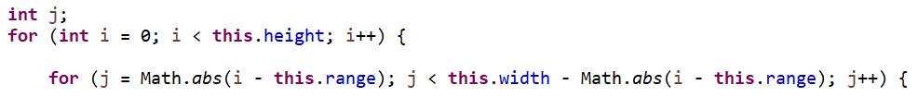
VonNeumannNeighborhood .fillCells

Slide 34
VonNeumannNeighborhood .fillCells
When i is 0, j goes from range to range.
When i is 1, j goes from (range-1) to (range-1).
When i is 2, j goes from (range-2) to (range-2).
…
When i is (range-1), j goes from 1 to (width-1).
When i is range, j goes from 0 to width.
When i is (range+1), j goes from 1 to (width+1).
…
When i is (height-3), j goes from (range-2) to (range-2).
When i is (height-2), j goes from (range-1) to (range-1).
When i is (height-1), j goes from range to range.

Slide 35
VonNeumannNeighborhood …MethodForWhenWorldWrapsVerticallyAndHorizontally

Slide 36
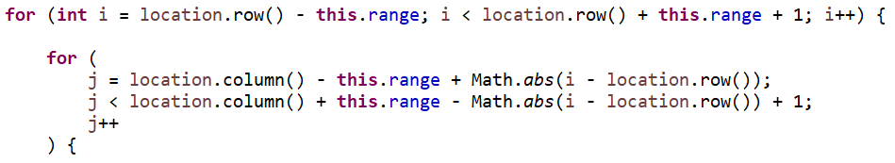
VonNeumannNeighborhood …MethodForWhenWorldWrapsVerticallyAndHorizontally

Slide 37
VonNeumannNeighborhood …MethodForWhenWorldWrapsVerticallyAndHorizontally
When i is (location.row – range), j goes from (location.column) to (location.column).
When i is (location.row – range + 1), j goes from (location.column-1) to (location.column+1).
When i is (location.row – range + 2), j goes from (location.column-2) to (location.column+2).
…
When i is (location.row – 1), j goes from (location.column – range + 1) ...
When i is (location.row), j goes from (location.column – range) ...
When i is (location.row – 1), j goes from (location.column – range + 1) ...
…
When i is (location.row + range - 2), j goes from (location.column-2) to (location.column+2).
When i is (location.row + range - 1), j goes from (location.column-1) to (location.column+1).
When i is (location.row + range), j goes from (location.column) to (location.column).

