Slide 1
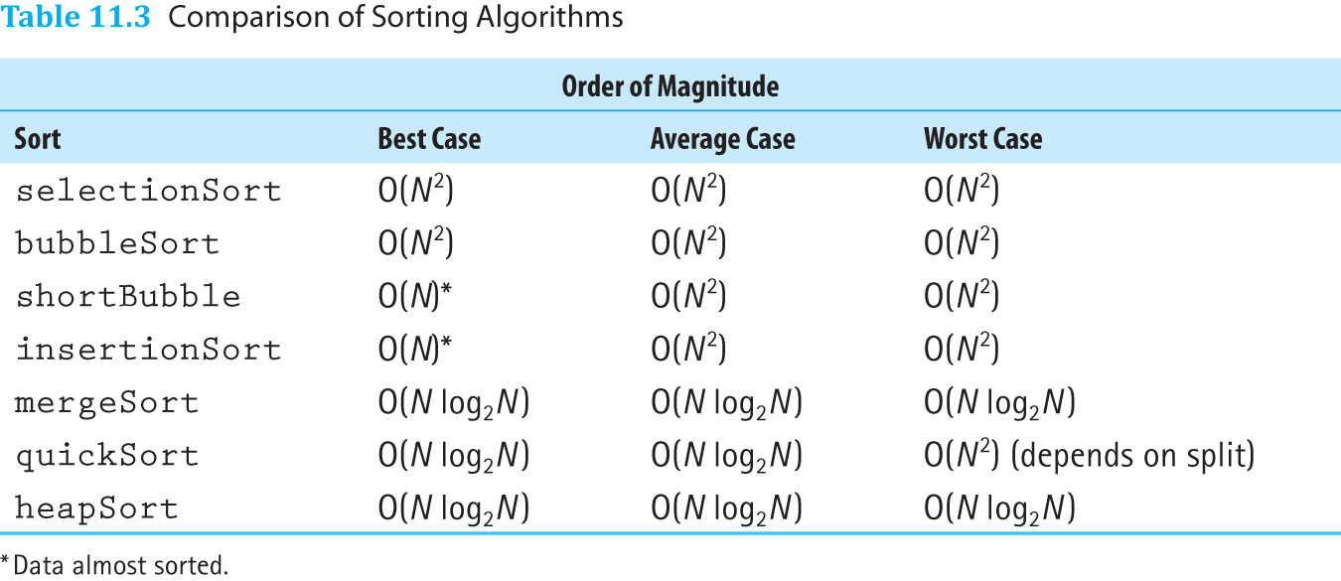
Comparison of Sorting Algorithms

