Slide 1
Probability Distributions
Instructions: Have these slides completed and have your likelihoods on the last slide ready to share in Live Session Module 1. The first slide for the Bernoulli distribution is completed as an example for you. You may use any references or resources you want.
We will discuss results on Live Session Module 1, and they will be submitted by the end of Module 1.

Slide 2
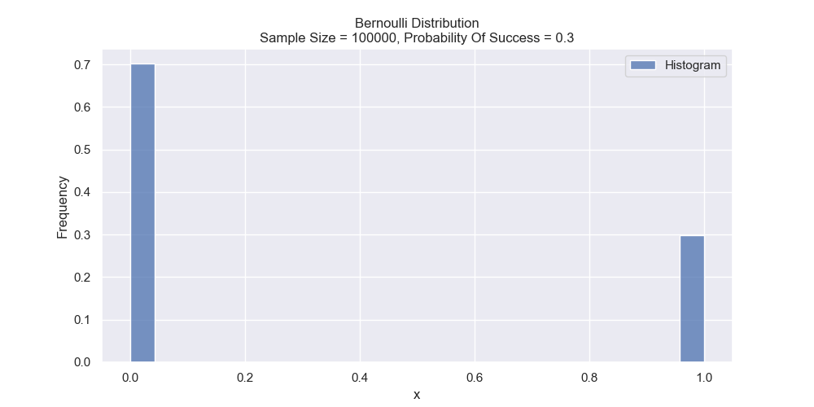
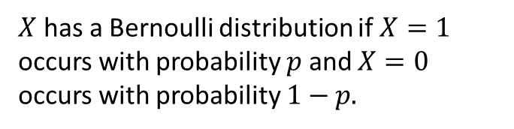
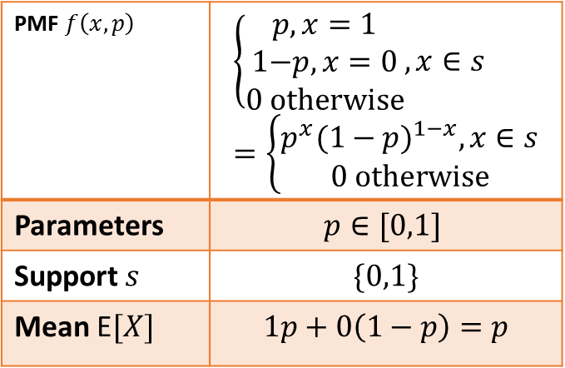
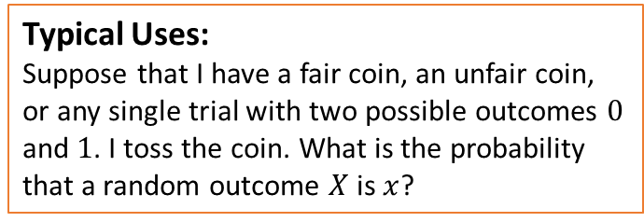
Bernoulli Distribution
Support Type:
Support Type: scalar single variable $x$. Distribution is discrete.
Plot of the distribution:
$X$ has a Bernoulli distribution if $X=1$ occurs with probability $p$ and $X=0$ occurs with probability $1−p.$
PMF $f\left(x, p\right)$ | $$\left\{\begin{aligned}p, x=1 \\ \text{1−}p, x=0 \\ 0 otherwise\end{aligned},x∈s\right.=\left\{\begin{matrix}p^{x}{(1−p)}^{1−x}, x∈s \\ 0 otherwise\end{matrix}\right.$$
Parameters | $$p∈[0,1]$$
Support $s$ | $$\{0,1\}$$
Mean E$[X]$ | $$1p+0\left(1−p\right)=p$$
Typical Uses:
Suppose that I have a fair coin, an unfair coin, or any single trial with two possible outcomes $0$ and $1$. I toss the coin. What is the probability that a random outcome $X$ is $x$?
Resources:
https://online.stat.psu.edu/stat504/lesson/1/1.3
https://www.probabilitycourse.com/chapter3/3_1_5_special_discrete_distr.php

Slide 3
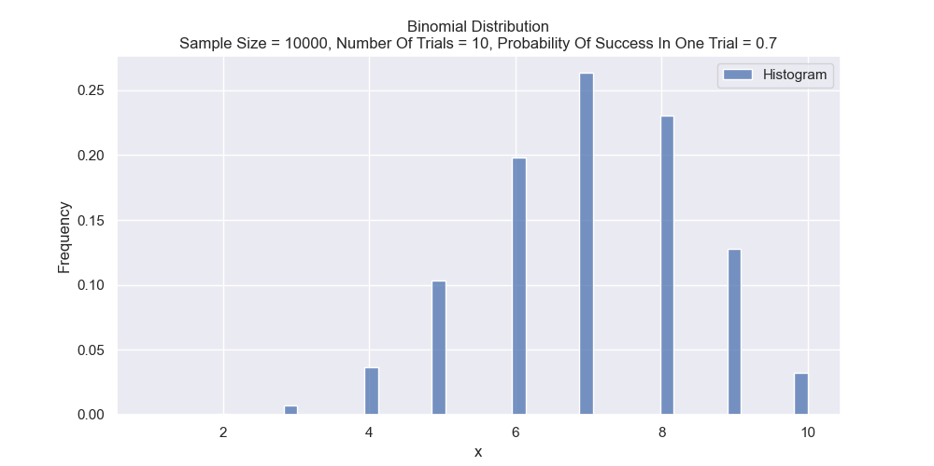
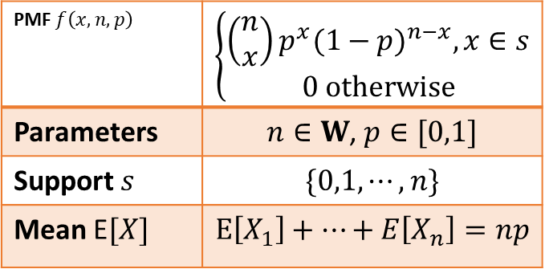
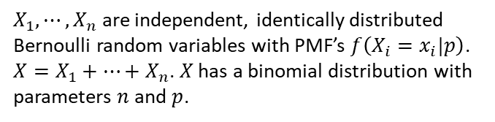
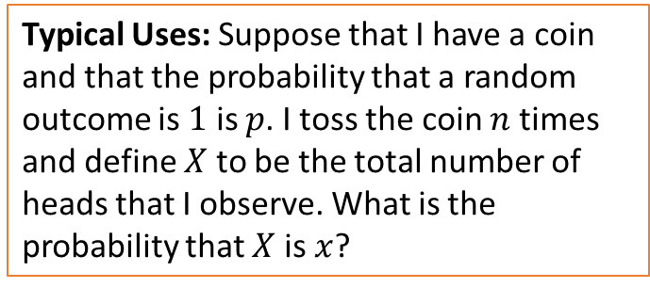
Binomial Distribution
Support Type:
Support Type: scalar single variable $x$. Distribution is discrete.
Plot(s) of the distribution:
$X_{1},⋯,X_{n}$ are independent, identically distributed Bernoulli random variables with PMF’s $f\left(X_{i}=x_{i}|p\right)$. $X=X_{1}+⋯+X_{n}$. $X$ has a binomial distribution with parameters $n$ and $p$.
PMF $f\left(x,n,p\right)$ | $$\left\{\begin{aligned}\left(\begin{matrix}n \\ x\end{matrix}\right)p^{x}{(1−p)}^{n−x}, x∈s \\ 0 otherwise\end{aligned}\right.$$
Parameters | $n∈W$, $p∈[0,1]$
Support $s$ | $$\{0,1,⋯,n\}$$
Mean E$[X]$ | $$E\left[X_{1}\right]+⋯+E\left[X_{n}\right]=np$$
Typical Uses: Suppose that I have a coin and that the probability that a random outcome is $1$ is $p$. I toss the coin $n$ times and define $X$ to be the total number of heads that I observe. What is the probability that $X$ is $x$?
Resources:
https://online.stat.psu.edu/stat504/lesson/1/1.3
https://www.probabilitycourse.com/chapter3/3_1_5_special_discrete_distr.php

Slide 4
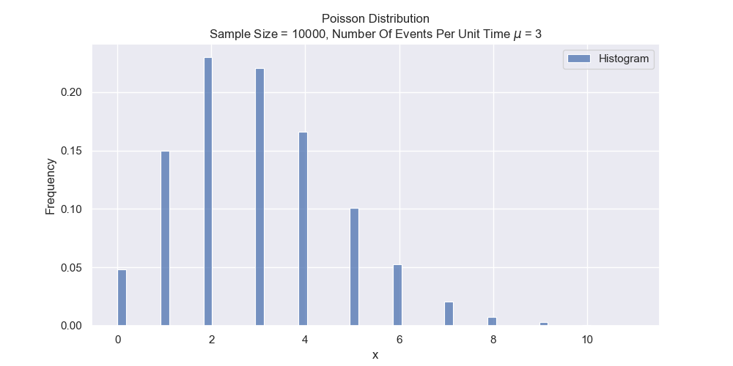
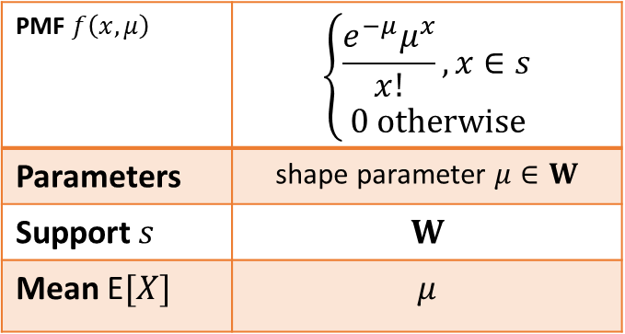
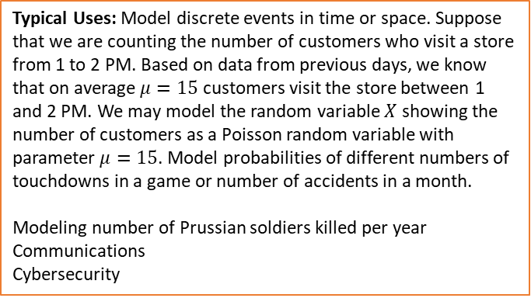
Poisson Distribution
Support Type:
Support Type: scalar single variable $x$. Distribution is discrete.
Plot(s) of the distribution:
PMF $f\left(x,μ\right)$ | $$\left\{\begin{aligned}\frac{e^{−μ}μ^{x}}{x!},x∈s \\ 0 otherwise\end{aligned}\right.$$
Parameters | shape parameter $μ∈W$
Support $s$ | $$W$$
Mean E$[X]$ | $$μ$$
Typical Uses: Model discrete events in time or space. Suppose that we are counting the number of customers who visit a store from 1 to 2 PM. Based on data from previous days, we know that on average $μ=15$ customers visit the store between 1 and 2 PM. We may model the random variable $X$ showing the number of customers as a Poisson random variable with parameter $μ=15$. Model probabilities of different numbers of touchdowns in a game or number of accidents in a month.
Modeling number of Prussian soldiers killed per year
Communications
Cybersecurity
Resources:
https://online.stat.psu.edu/stat504/lesson/1/1.3
https://www.probabilitycourse.com/chapter3/3_1_5_special_discrete_distr.php

Slide 5
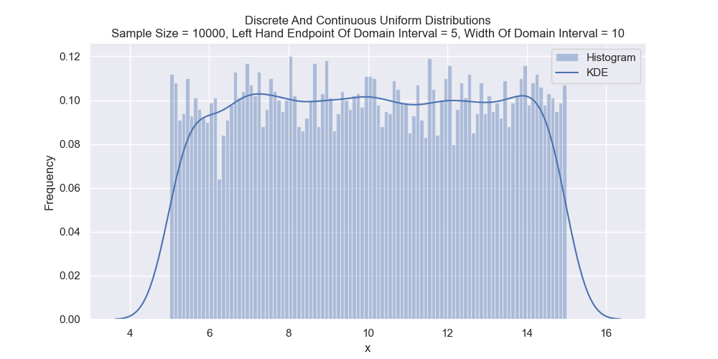

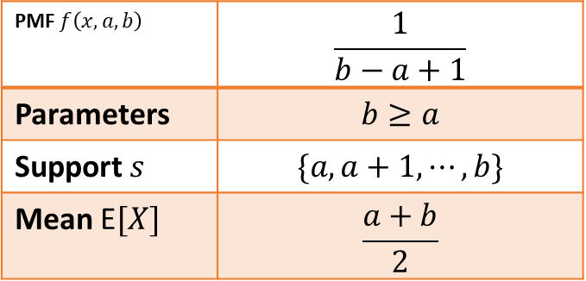
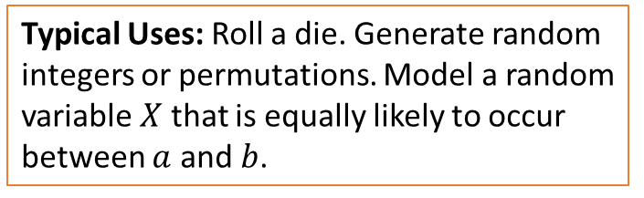
Discrete Uniform Distribution
Support Type: scalar single variable $x$. Distribution is discrete.
Support Type:
Plot(s) of the distribution:
From here on we omit “$x∈s$” and “$0 otherwise$”.
PMF $f\left(x,a,b\right)$ | $$\frac{1}{b−a+1}$$
Parameters | $$b≥a$$
Support $s$ | $$\{a, a+1, ⋯, b\}$$
Mean E$[X]$ | $$\frac{a+b}{2}$$
Typical Uses: Roll a die. Generate random integers or permutations. Model a random variable $X$ that is equally likely to occur between $a$ and $b$.
Resources:
http://www.math.wm.edu/~leemis/chart/UDR/UDR.html

Slide 6
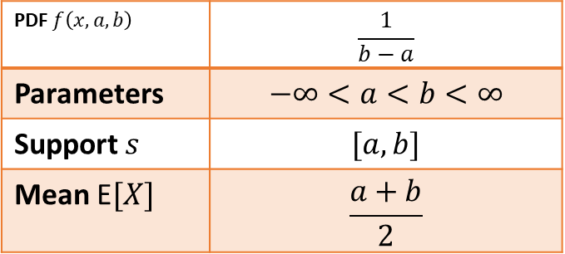
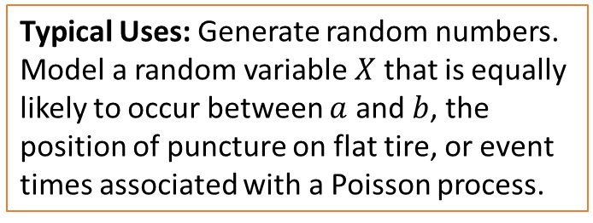
Continuous Uniform Distribution
Support Type:
Support Type: scalar single variable $x$. Distribution is continuous.
Plot(s) of the distribution:
PDF $f\left(x,a,b\right)$ | $$\frac{1}{b−a}$$
Parameters | $$−∞<a<b<∞$$
Support $s$ | $$[a, b]$$
Mean E$[X]$ | $$\frac{a+b}{2}$$
Typical Uses: Generate random numbers. Model a random variable $X$ that is equally likely to occur between $a$ and $b$, the position of puncture on flat tire, or event times associated with a Poisson process.
Resources:
http://www.math.wm.edu/~leemis/chart/UDR/UDR.html

Slide 7
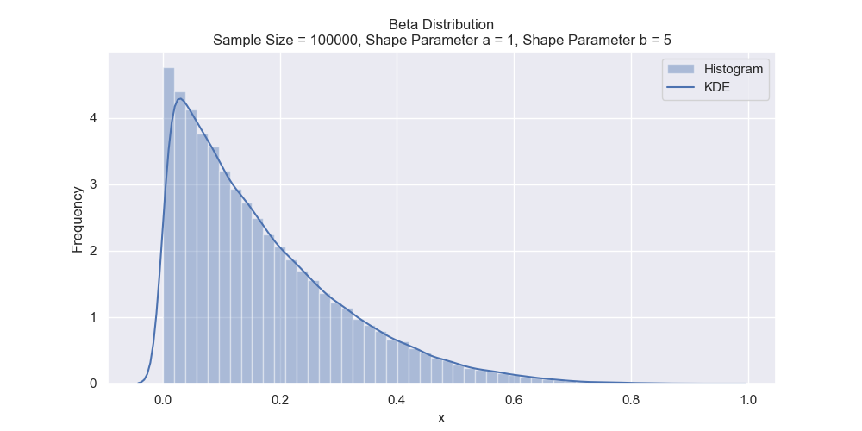
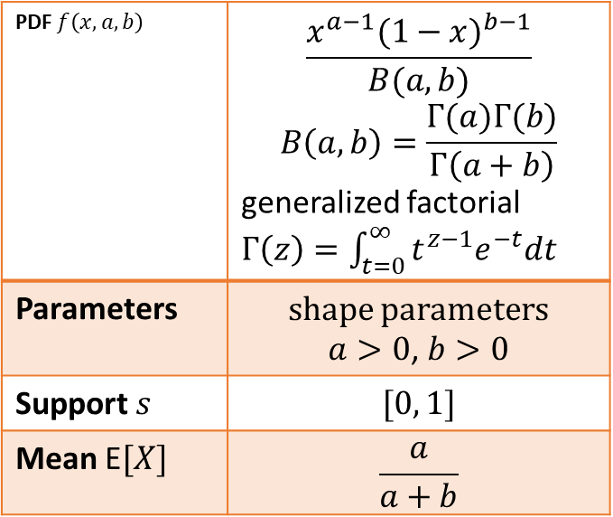

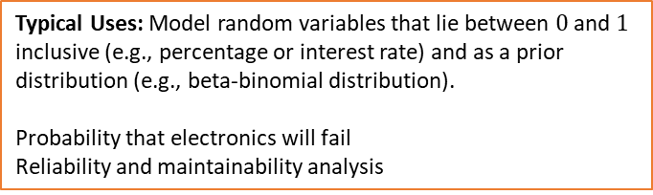
Beta Distribution
Support Type:
Support Type: scalar single variable $x$. Distribution is continuous.
Plot(s) of the distribution:
PDF $f\left(x,a,b\right)$ | $$\frac{x^{a−1}{(1−x)}^{b−1}}{B(a,b)}$$ $$B\left(a,b\right)=\frac{Γ(a)Γ(b)}{Γ\left(a+b\right)}$$ generalized factorial $Γ\left(z\right)=\int_{t=0}^{∞}{t^{z−1}e^{−t}dt}$
Parameters | shape parameters $a>0$, $b>0$
Support $s$ | $$[0, 1]$$
Mean E$[X]$ | $$\frac{a}{a+b}$$
Typical Uses: Model random variables that lie between $0$ and $1$ inclusive (e.g., percentage or interest rate) and as a prior distribution (e.g., beta-binomial distribution).
Probability that electronics will fail
Reliability and maintainability analysis
Resources:
http://www.math.wm.edu/~leemis/chart/UDR/UDR.html
https://gregorygundersen.com/blog/2020/12/24/dirichlet-multinomial/

Slide 8
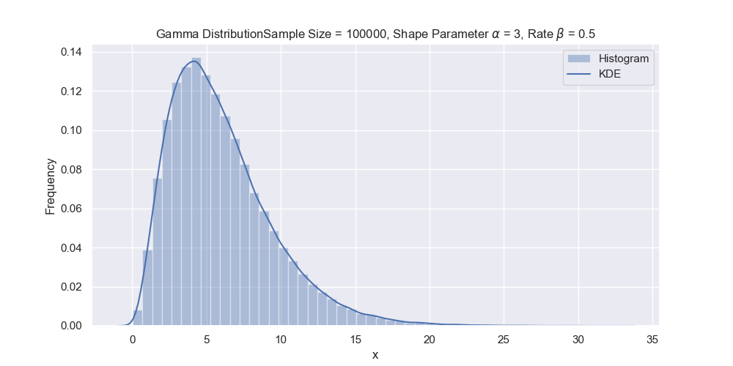
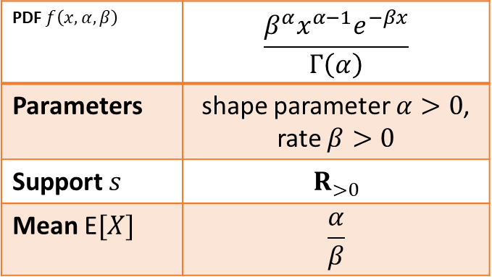

Gamma Distribution
Support Type:
Plot(s) of the distribution:
Support Type: scalar single variable $x$. Distribution is continuous.
PDF $f\left(x,α,β\right)$ | $$\frac{β^{α}x^{α−1}e^{−βx}}{Γ\left(α\right)}$$
Parameters | shape parameter $α>0$, rate $β>0$
Support $s$ | $$R_{>0}$$
Mean E$[X]$ | $$\frac{α}{β}$$
Typical Uses: Model service times, lifetimes of objects, and repair times.
Resources:
http://www.math.wm.edu/~leemis/chart/UDR/UDR.html

Slide 9
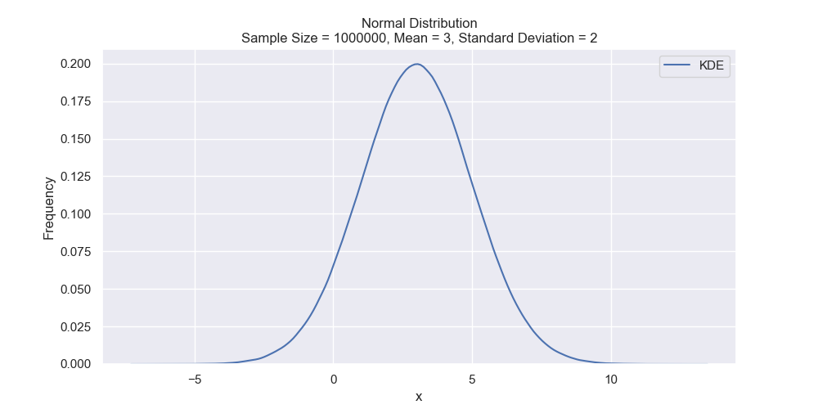
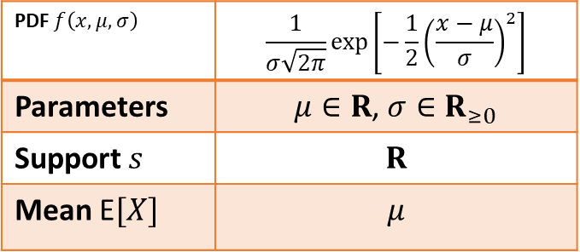
Gaussian / Normal Distribution
Support Type:
Plot(s) of the distribution:
Support Type: scalar single variable $x$. Distribution is continuous.
PDF $f\left(x,μ,σ\right)$ | $$\frac{1}{σ\sqrt{2π}}exp\left[−\frac{1}{2}{\left(\frac{x−μ}{σ}\right)}^{2}\right]$$
Parameters | $μ∈R$, $σ∈R_{≥0}$
Support $s$ | $$R$$
Mean E$[X]$ | $$μ$$
Typical Uses: Univariate Central Limit Theorem. Model adult heights, baby weights, ball-bearing diameters, and random variables that can be thought of as a sum of several independent random variables. Approximate binomial and Poisson distributions.
Resources:
http://www.math.wm.edu/~leemis/chart/UDR/UDR.html

Slide 10
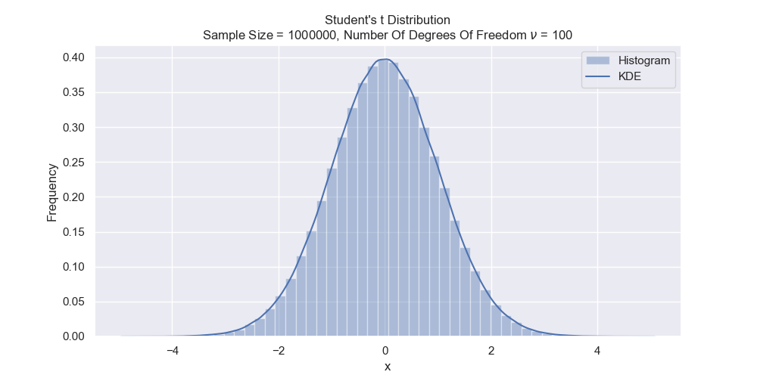

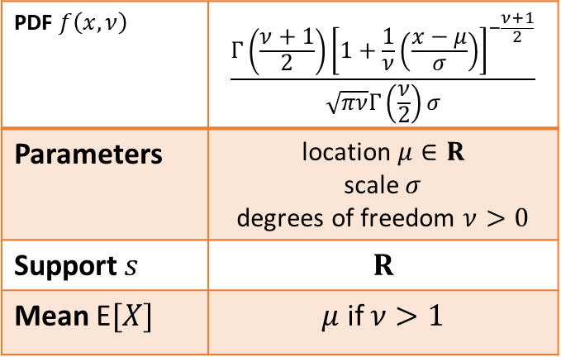
Student’s $t$ Distribution
Support Type:
Plot(s) of the distribution:
Support Type: scalar single variable $x$. Distribution is continuous.
PDF $f\left(x,ν\right)$ | $$\frac{Γ\left(\frac{ν+1}{2}\right){\left[1+\frac{1}{ν}\left(\frac{x−μ}{σ}\right)\right]}^{−\frac{ν+1}{2}}}{\sqrt{πν}Γ\left(\frac{ν}{2}\right)σ}$$
Parameters | location $μ∈R$ scale $σ$ degrees of freedom $ν>0$
Support $s$ | $$R$$
Mean E$[X]$ | $μ$ if $ν>1$
Typical Uses: Hypothesis tests concerning the comparison of (a) a sample mean to a standard, or (b) the difference between two means
Resources:
http://www.math.wm.edu/~leemis/chart/UDR/UDR.html

Slide 11
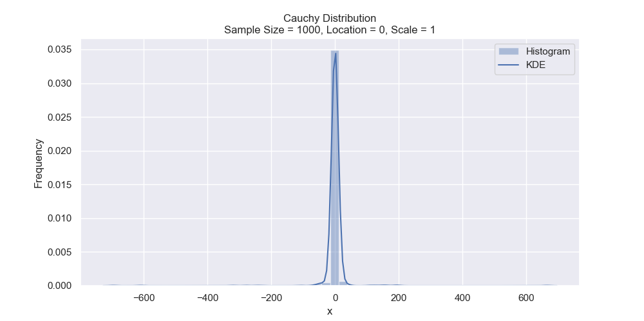
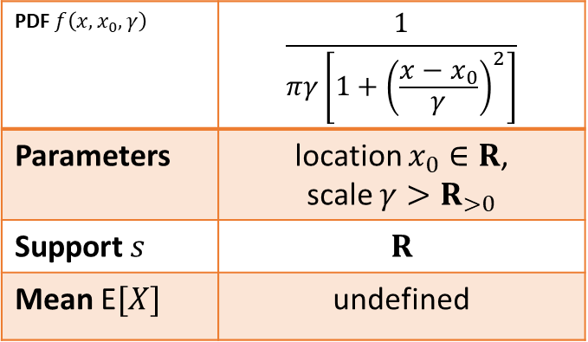
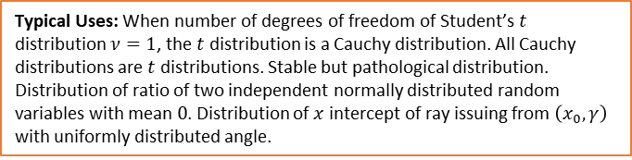
Cauchy Distribution
Support Type:
Plot(s) of the distribution:
Support Type: scalar single variable $x$. Distribution is continuous.
PDF $f\left(x,x_{0},γ\right)$ | $$\frac{1}{πγ\left[1+{\left(\frac{x−x_{0}}{γ}\right)}^{2}\right]}$$
Parameters | location $x_{0}∈R$, scale $γ>R_{>0}$
Support $s$ | $$R$$
Mean E$[X]$ | undefined
Typical Uses: When number of degrees of freedom of Student’s $t$ distribution $ν=1$, the $t$ distribution is a Cauchy distribution. All Cauchy distributions are $t$ distributions. Stable but pathological distribution. Distribution of ratio of two independent normally distributed random variables with mean $0$. Distribution of $x$ intercept of ray issuing from $\left(x_{0}, γ\right)$ with uniformly distributed angle.
Resources:
https://en.wikipedia.org/wiki/Cauchy_distribution

Slide 12
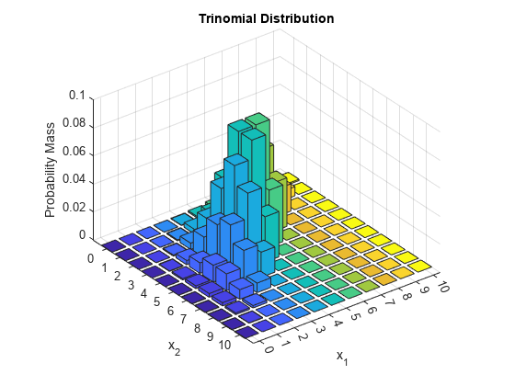
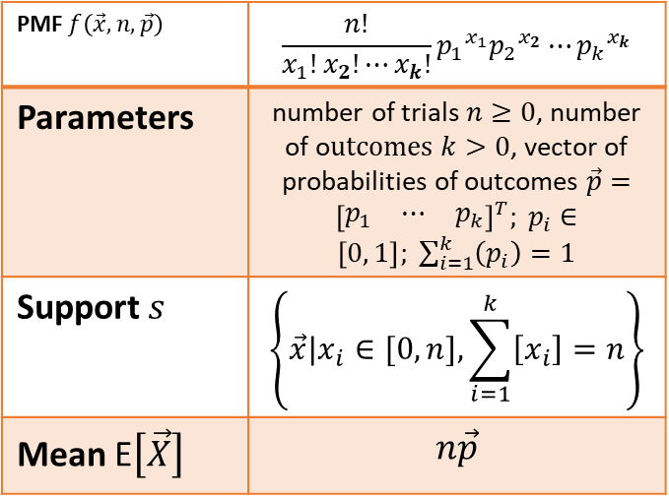
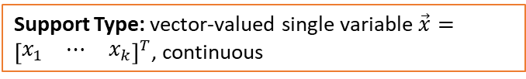
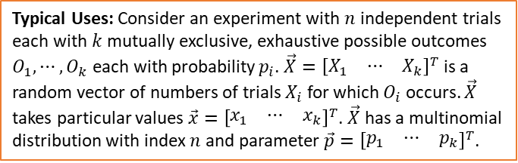
Multinomial Distribution
Support Type:
Support Type: vector-valued single variable $\vec{x}={\left[\begin{matrix}x_{1} & ⋯ & x_{k}\end{matrix}\right]}^{T}$, continuous
Plot(s) of the distribution:
PMF $f\left(\vec{x},n,\vec{p}\right)$ | $$\frac{n!}{x_{1}!x_{2}!⋯x_{k}!}{p_{1}}^{x_{1}}{p_{2}}^{x_{2}}⋯{p_{k}}^{x_{k}}$$
Parameters | number of trials $n≥0$, number of o$utcomes k>0$, vector of probabilities of outcomes $\vec{p}={\left[\begin{matrix}p_{1} & ⋯ & p_{k}\end{matrix}\right]}^{T}; p_{i}∈\left[0, 1\right]; \sum_{i=1}^{k}{\left(p_{i}\right)=1}$
Support $s$ | $$\left\{\vec{x}|x_{i}∈[0,n], \sum_{i=1}^{k}{\left[x_{i}\right]}=n\right\}$$
Mean E$\left[\vec{X}\right]$ | $$n\vec{p}$$
Typical Uses: Consider an experiment with $n$ independent trials each with $k$ mutually exclusive, exhaustive possible outcomes $O_{1},⋯,O_{k}$ each with probability $p_{i}$. $\vec{X}={\left[\begin{matrix}X_{1} & ⋯ & X_{k}\end{matrix}\right]}^{T}$ is a random vector of numbers of trials $X_{i}$ for which $O_{i}$ occurs. $\vec{X}$ takes particular values $\vec{x}={\left[\begin{matrix}x_{1} & ⋯ & x_{k}\end{matrix}\right]}^{T}$. $\vec{X}$ has a multinomial distribution with index $n$ and parameter $\vec{p}={\left[\begin{matrix}p_{1} & ⋯ & p_{k}\end{matrix}\right]}^{T}$.
Resources:
https://online.stat.psu.edu/stat504/lesson/1/1.3

Slide 13
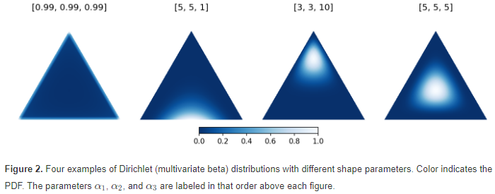
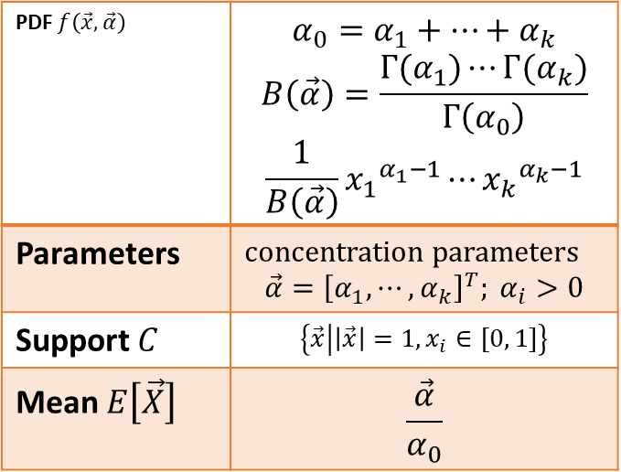
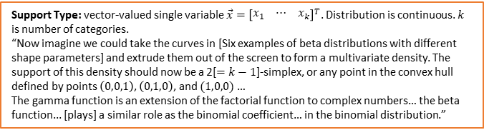
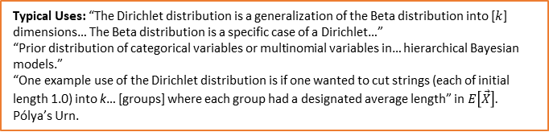
Dirichlet Distribution
Support Type:
Support Type: vector-valued single variable $\vec{x}={\left[\begin{matrix}x_{1} & ⋯ & x_{k}\end{matrix}\right]}^{T}$. Distribution is continuous. $k$ is number of categories.
“Now imagine we could take the curves in [Six examples of beta distributions with different shape parameters] and extrude them out of the screen to form a multivariate density. The support of this density should now be a 2[$=k−1$]-simplex, or any point in the convex hull defined by points $\left(0,0,1\right)$, $\left(0,1,0\right)$, and $(1,0,0)$ …
The gamma function is an extension of the factorial function to complex numbers… the beta function... [plays] a similar role as the binomial coefficient… in the binomial distribution.”
Plot(s) of the distribution:
PDF $f\left(\vec{x},\vec{α}\right)$ | $$α_{0}=α_{1}+⋯+α_{k}$$ $$B\left(\vec{α}\right)=\frac{Γ(α_{1})⋯Γ(α_{k})}{Γ\left(α_{0}\right)}$$ $$\frac{1}{B\left(\vec{α}\right)}{x_{1}}^{α_{1}−1}⋯{x_{k}}^{α_{k}−1}$$
Parameters | concentration parameters $$\vec{α}={\left[α_{1},⋯,α_{k}\right]}^{T}; α_{i}>0$$
Support $C$ | $$\left\{\vec{x}\left|\left|\vec{x}\right|=1, x_{i}∈[0, 1]\right.\right\}$$
Mean $E\left[\vec{X}\right]$ | $$\frac{\vec{α}}{α_{0}}$$
Typical Uses: “The Dirichlet distribution is a generalization of the Beta distribution into [$k$] dimensions… The Beta distribution is a specific case of a Dirichlet…”
“Prior distribution of categorical variables or multinomial variables in… hierarchical Bayesian models.”
“One example use of the Dirichlet distribution is if one wanted to cut strings (each of initial length 1.0) into k… [groups] where each group had a designated average length” in $E\left[\vec{X}\right].$
Pólya’s Urn.
Resources:
https://rpubs.com/JanpuHou/295096
https://gregorygundersen.com/blog/2020/12/24/dirichlet-multinomial/

Slide 14
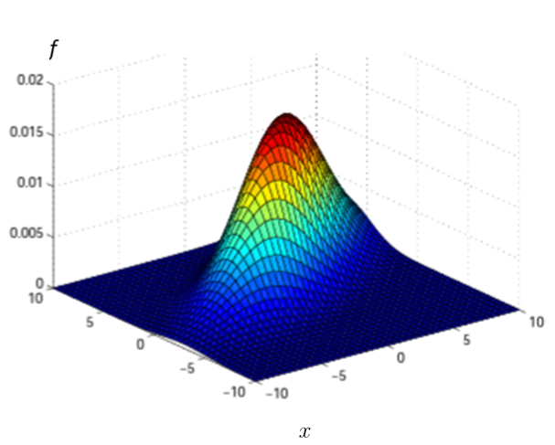
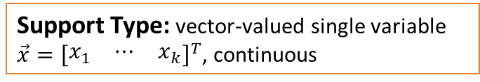
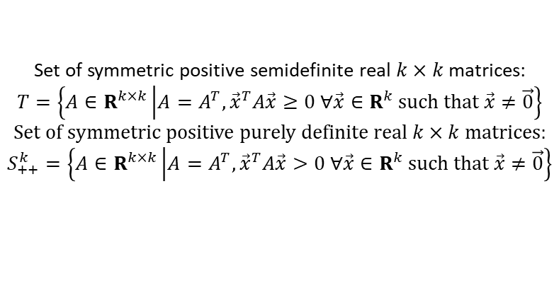

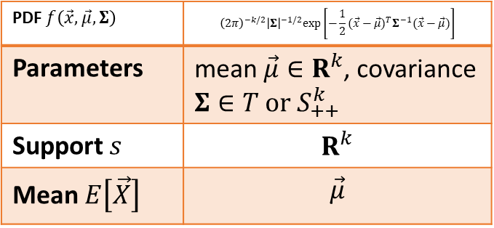
Multivariate Gaussian / Normal Distribution $\left[N_{k}\left(\vec{μ},Σ\right)\right]$
Support Type:
Plot(s) of the distribution:
Support Type: vector-valued single variable $\vec{x}={\left[\begin{matrix}x_{1} & ⋯ & x_{k}\end{matrix}\right]}^{T}$, continuous
PDF $f\left(\vec{x},\vec{μ},Σ\right)$ | $${\left(2π\right)}^{−k/2}{\left|Σ\right|}^{−1/2}exp\left[−\frac{1}{2}{(\vec{x}−\vec{μ})}^{T}Σ^{−1}(\vec{x}−\vec{μ})\right]$$
Parameters | mean $\vec{μ}∈R^{k}$, covariance $Σ∈T or S_{++}^{k}$
Support $s$ | $$R^{k}$$
Mean $E\left[\vec{X}\right]$ | $$\vec{μ}$$
Set of symmetric positive semidefinite real $k×k$ matrices:
$$T=\left\{A∈R^{k×k}\left|A=A^{T}, {\vec{x}}^{T}A\vec{x}≥0 ∀\vec{x}∈R^{k} such that \vec{x}≠\vec{0}\right.\right\}$$
Set of symmetric positive purely definite real $k×k$ matrices:
$$S_{++}^{k}=\left\{A∈R^{k×k}\left|A=A^{T}, {\vec{x}}^{T}A\vec{x}>0 ∀\vec{x}∈R^{k} such that \vec{x}≠\vec{0}\right.\right\}$$
Typical Uses: Multivariate Central Limit Theorem. Model set of correlated real-valued random variables each clustered around a mean value.
Resources:
https://cs229.stanford.edu/section/gaussians.pdf

Slide 15
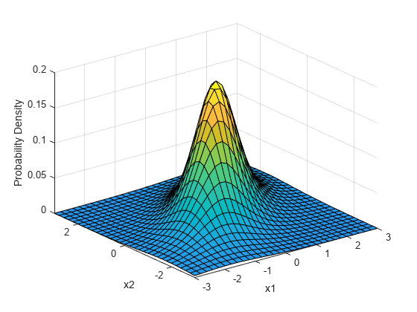
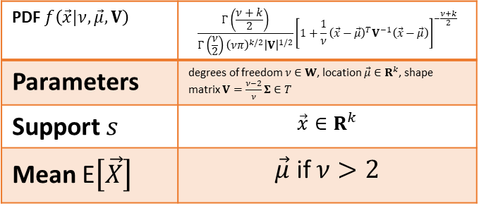
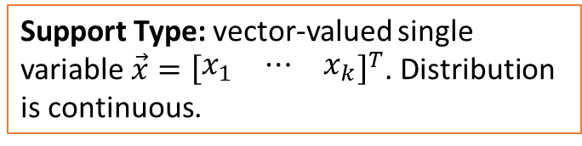

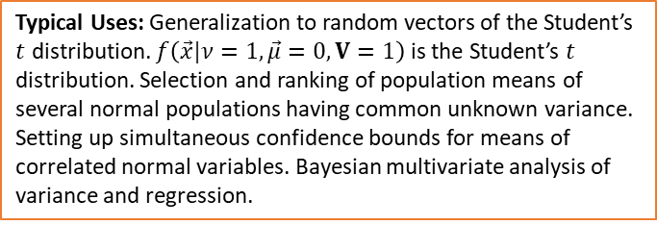
Multivariate t Distribution
Support Type:
Plot(s) of the distribution:
Support Type: vector-valued single variable $\vec{x}={\left[\begin{matrix}x_{1} & ⋯ & x_{k}\end{matrix}\right]}^{T}$. Distribution is continuous.
PDF $f\left(\vec{x}|ν,\vec{μ},V\right)$ | $$\frac{Γ\left(\frac{ν+k}{2}\right)}{Γ\left(\frac{ν}{2}\right){\left(νπ\right)}^{k/2}{\left|V\right|}^{1/2}}{\left[1+\frac{1}{ν}{\left(\vec{x}−\vec{μ}\right)}^{T}V^{−1}\left(\vec{x}−\vec{μ}\right)\right]}^{−\frac{ν+k}{2}}$$
Parameters | degrees of freedom $ν∈W$, location $\vec{μ}∈R^{k}$, shape matrix $V=\frac{ν−2}{ν}Σ∈T$
Support $s$ | $$\vec{x}∈R^{k}$$
Mean E$\left[\vec{X}\right]$ | $\vec{μ}$ if $ν>2$
Typical Uses: Generalization to random vectors of the Student’s $t$ distribution. $f\left(\vec{x}|ν=1,\vec{μ}=0,V=1\right)$ is the Student’s $t$ distribution. Selection and ranking of population means of several normal populations having common unknown variance. Setting up simultaneous confidence bounds for means of correlated normal variables. Bayesian multivariate analysis of variance and regression.
$$d=5$$
Resources:
https://core.ac.uk/download/pdf/81139018.pdf, https://www.mathworks.com/help/stats/multivariate-t-distribution.html, https://en.wikipedia.org/wiki/Multivariate_t-distribution

Slide 16
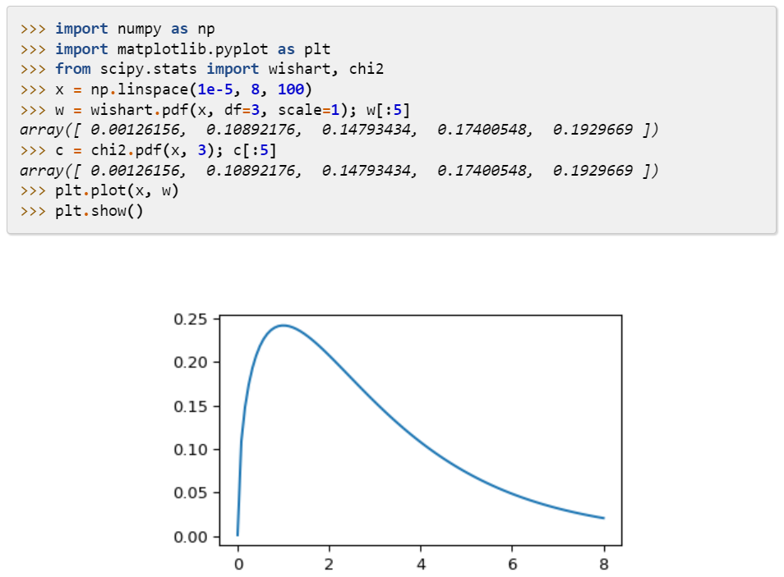
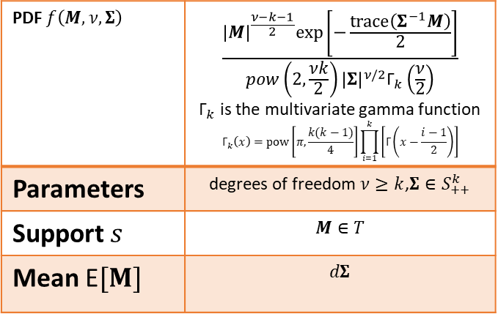
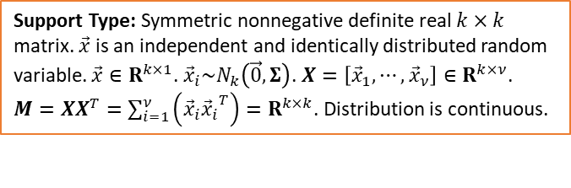
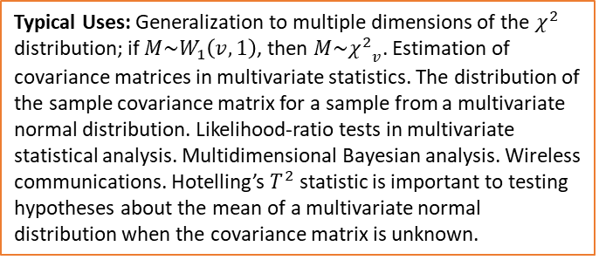
Wishart Distribution
Support Type:
Support Type: Symmetric nonnegative definite real $k×k$ matrix. $\vec{x}$ is an independent and identically distributed random variable. $\vec{x}∈R^{k×1}$. ${\vec{x}}_{i}\sim N_{k}\left(\vec{0},Σ\right)$. $X=\left[{\vec{x}}_{1}, ⋯, {\vec{x}}_{ν}\right]∈R^{k×ν}$. $M=XX^{T}=\sum_{i=1}^{ν}{\left({\vec{x}}_{i}{{\vec{x}}_{i}}^{T}\right)}=R^{k×k}$. Distribution is continuous.
Plot(s) of the distribution:
PDF $f\left(M,ν,Σ\right)$ | $$\frac{{\left|M\right|}^{\frac{ν−k−1}{2}}exp\left[−\frac{trace\left(Σ^{−1}M\right)}{2}\right]}{pow\left(2, \frac{νk}{2}\right){\left|Σ\right|}^{ν/2}{\text{Γ}}_{k}\left(\frac{ν}{2}\right)}$$ ${\text{Γ}}_{k}$ is the multivariate gamma function $${\text{Γ}}_{k}\left(x\right)=pow\left[π, \frac{k(k−1)}{4}\right]\prod_{i=1}^{k}{\left[\text{Γ}\left(x−\frac{i−1}{2}\right)\right]}$$
Parameters | degrees of freedom $ν≥k$,$Σ∈S_{++}^{k}$
Support $s$ | $$M∈T$$
Mean E$[M]$ | $$dΣ$$
Typical Uses: Generalization to multiple dimensions of the $χ^{2}$ distribution; if $M\sim W_{1}\left(v,1\right)$, then $M\sim {χ^{2}}_{v}$. Estimation of covariance matrices in multivariate statistics. The distribution of the sample covariance matrix for a sample from a multivariate normal distribution. Likelihood-ratio tests in multivariate statistical analysis. Multidimensional Bayesian analysis. Wireless communications. Hotelling’s $T^{2}$ statistic is important to testing hypotheses about the mean of a multivariate normal distribution when the covariance matrix is unknown.
Resources:
https://en.wikipedia.org/wiki/Wishart_distribution, https://www.stat.pitt.edu/sungkyu/course/2221Fall13/lec2.pdf, https://rich-d-wilkinson.github.io/MATH3030/7-2-the-wishart-distribution.html

Slide 17
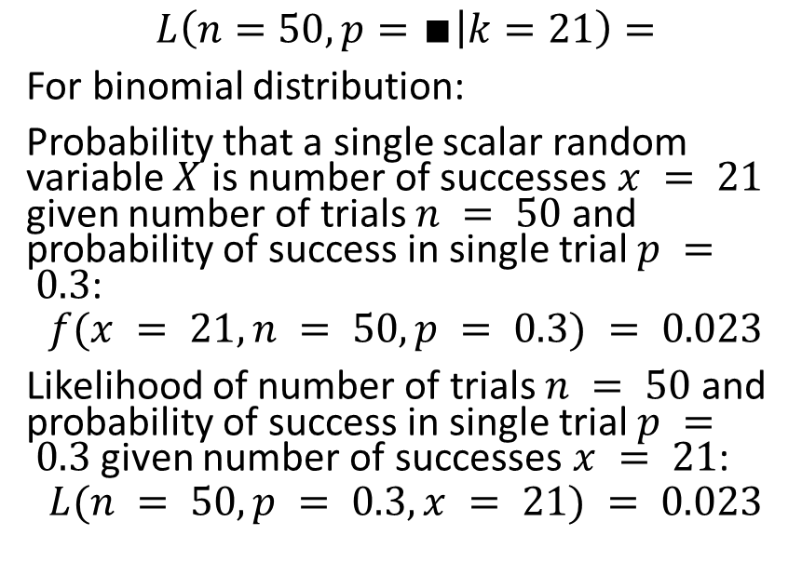
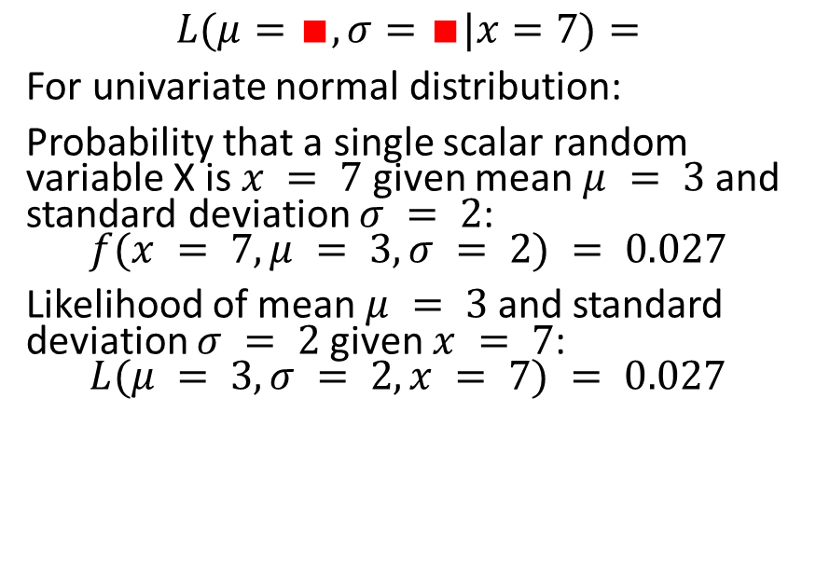
Compute the Likelihoods:
(Use https://www.kaggle.com/billbasener/probability-distributions-and-likelihoods Section 2)
(Choose your own values for the black and red boxes.)
Discrete Binomial Distribution:
Continuous Gaussian Distribution
$$L\left(n=50,p=∎ | k=21\right)=$$
For binomial distribution:
Probability that a single scalar random variable $X$ is number of successes $x = 21$ given number of trials $n = 50$and probability of success in single trial $p = 0.3$:
$$f(x = 21, n = 50, p = 0.3) = 0.023$$
Likelihood of number of trials $n = 50$and probability of success in single trial $p = 0.3$given number of successes $x = 21$:
$$L(n = 50, p = 0.3, x = 21) = 0.023$$
$$L(μ=∎,σ=∎|x=7)=$$
For univariate normal distribution:
Probability that a single scalar random variable X is $x = 7$ given mean $μ = 3$and standard deviation $σ = 2$:
$$f(x = 7, μ = 3, σ = 2) = 0.027$$
Likelihood of mean $μ = 3$and standard deviation $σ = 2$given $x = 7$:
$$L(μ = 3, σ = 2, x = 7) = 0.027$$

