Slide 1
BulletZone
Dexter Richards and Taylor Quinn

Slide 2
Overview
Given a grid from the REST server
Use int array to create a tank game

Slide 3
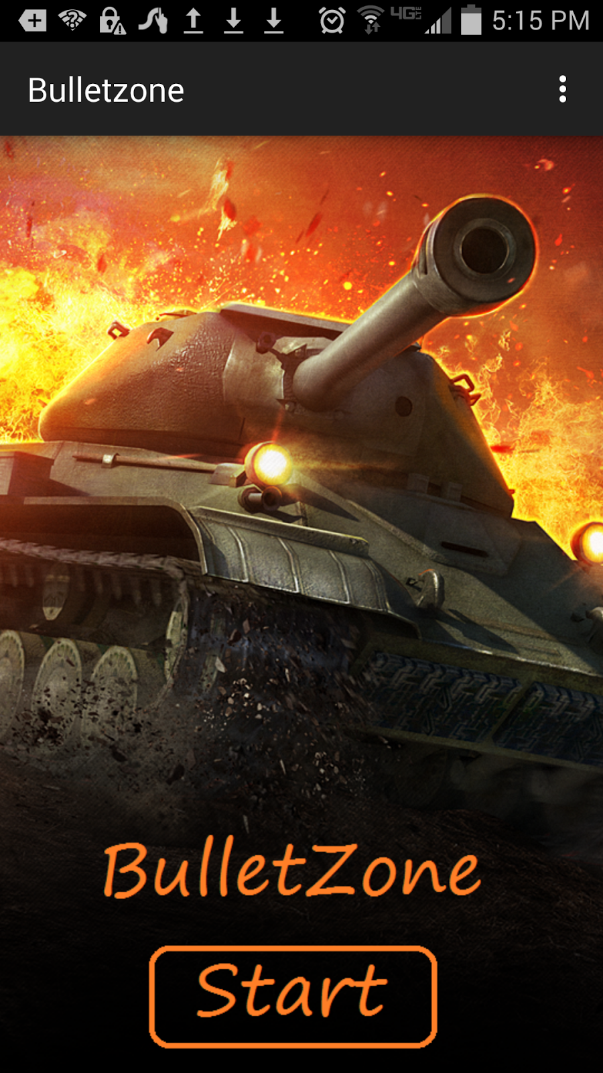
The Main screen
Prompts the user to log in
Flashy?

Slide 4
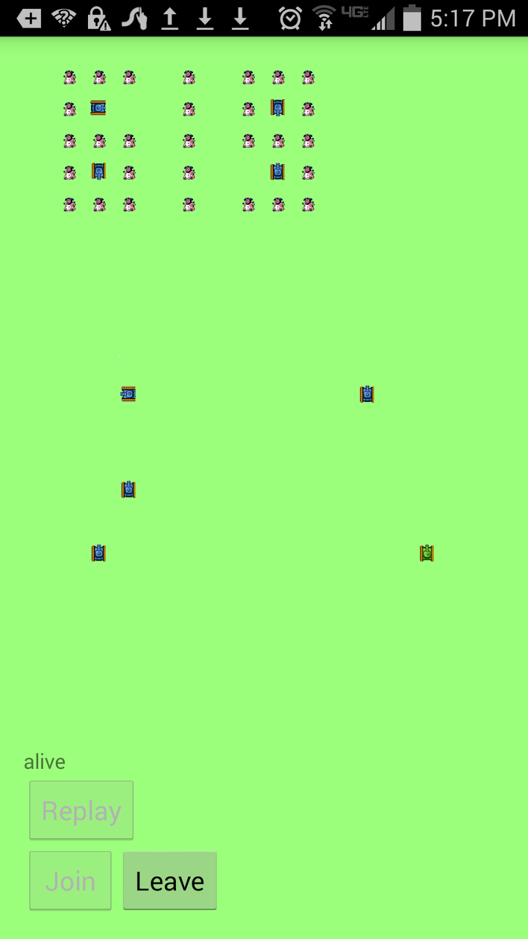
The field
OOP Design
Loose coupling
Tight cohesion

Slide 5
Constraints
Tank can move once in every .5 seconds
Tank can fire once in every .5 seconds.
Only 3 fired bullets can be in the game
Tank can take only one turn per step.
Tank can only move forward or back

Slide 6
Sounds Shakes and Swipes
Begin, Fire, Turn, Move, Dying all have sounds
Shake to fire
Swipe to move or turn
No background music (sadly)

Slide 7
Replays
When the user dies, a red X shows and the option to replay is enabled
The replays are stored in the database as a comma-separated string for each timestamp

Slide 8
