Slide 1
Learning-to-rank
中央大學 陳弘軒
https://www.ncu.edu.tw/~hhchen/

Slide 2
Ranking is everywhere
Search engine
Ranking billions of web pages based on user specified text
Recommender system
Ranking millions of items (e.g., books, movies, music, documents) based on various clues (usually without explict request from users)
Digital assistant
Ranking thousands items and possible actions (e.g., open the navigation app; turn on the battary saving mode) based on voice command and other clues (e.g., day of week, weather, etc.)

Slide 3
Outline
Rule-based ranking
Ranking in search engines
TF-IDF and PageRank
Ranking in recommender systems
View also view, buy also buy
Learning-based ranking
Pointwise
Pairwise
Listwise
Practical issues

Slide 4
Ranking methodologies
Ranking by rules
Define ranking rules by experience
Ranking by ML models
Machines learn the ranking rules based on user logs

Slide 5
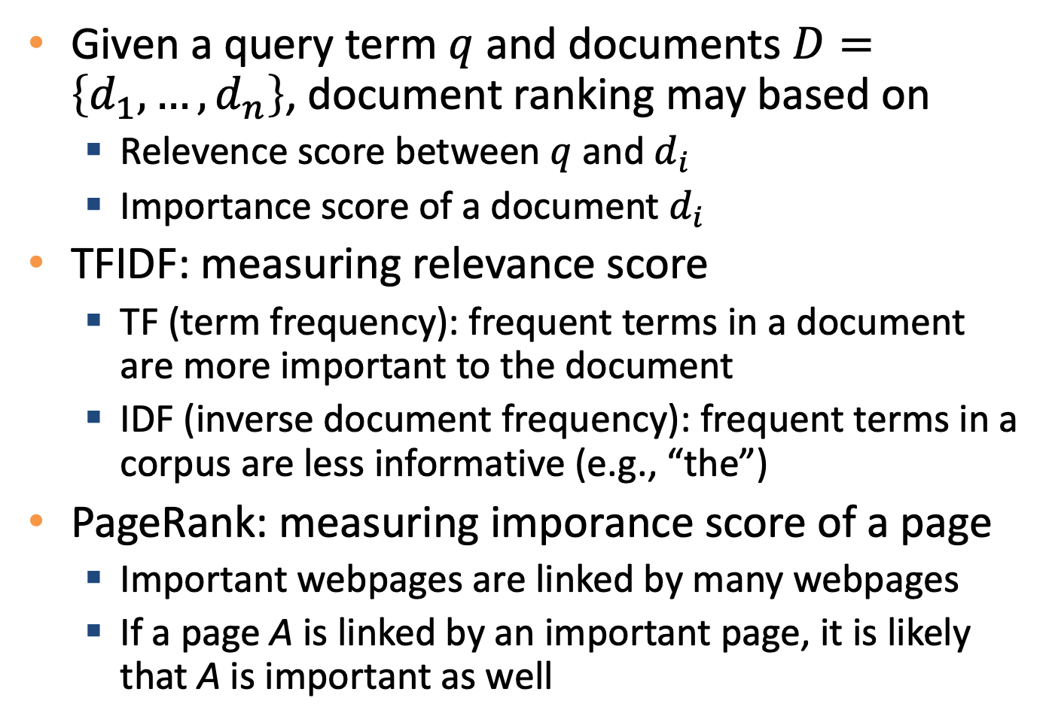
Rule-based ranking strategy for search engines
Given a query term $q$ and documents $D=\left\{d_{1},…,d_{n}\right\}$, document ranking may based on
Relevence score between $q$ and $d_{i}$
Importance score of a document $d_{i}$
TFIDF: measuring relevance score
TF (term frequency): frequent terms in a document are more important to the document
IDF (inverse document frequency): frequent terms in a corpus are less informative (e.g., “the”)
PageRank: measuring imporance score of a page
Important webpages are linked by many webpages
If a page A is linked by an important page, it is likely that A is important as well

Slide 6
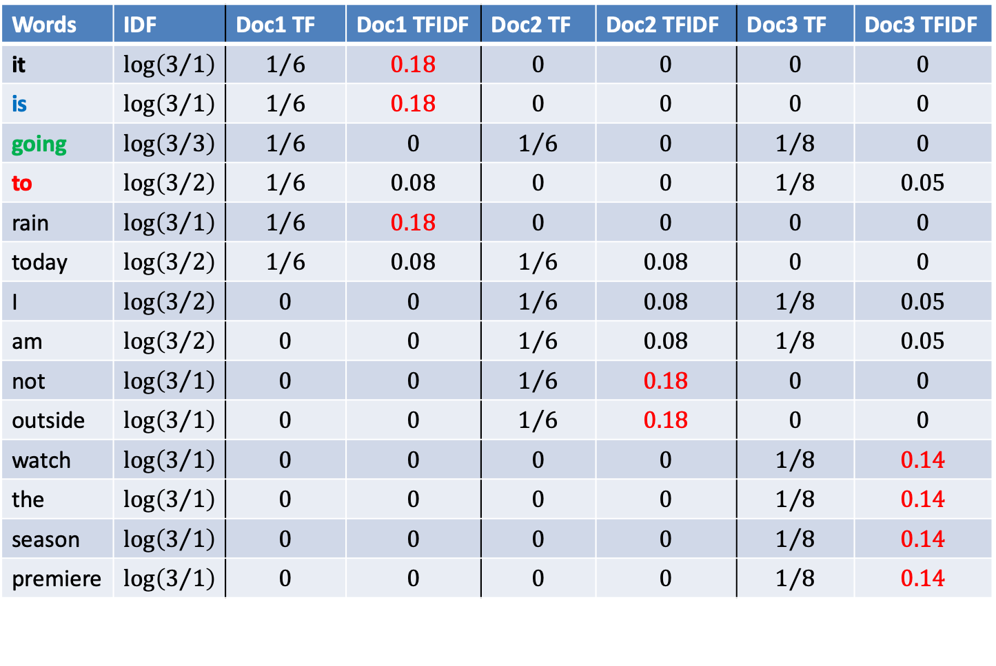
TFIDF example
Doc1: it is going to rain today
Doc2: today I am not going outside
Doc3: I am going to watch the season premiere
Words | IDF | Doc1 TF | Doc1 TFIDF | Doc2 TF | Doc2 TFIDF | Doc3 TF | Doc3 TFIDF
it | $$\log\left(3/1\right)$$ | $$1/6$$ | $$0.18$$ | $$0$$ | $$0$$ | $$0$$ | $$0$$
is | $$\log\left(3/1\right)$$ | $$1/6$$ | $$0.18$$ | $$0$$ | $$0$$ | $$0$$ | $$0$$
going | $$\log\left(3/3\right)$$ | $$1/6$$ | $$0$$ | $$1/6$$ | $$0$$ | $$1/8$$ | $$0$$
to | $$\log\left(3/2\right)$$ | $$1/6$$ | $$0.08$$ | $$0$$ | $$0$$ | $$1/8$$ | $$0.05$$
rain | $$\log\left(3/1\right)$$ | $$1/6$$ | $$0.18$$ | $$0$$ | $$0$$ | $$0$$ | $$0$$
today | $$\log\left(3/2\right)$$ | $$1/6$$ | $$0.08$$ | $$1/6$$ | $$0.08$$ | $$0$$ | $$0$$
I | $$\log\left(3/2\right)$$ | $$0$$ | $$0$$ | $$1/6$$ | $$0.08$$ | $$1/8$$ | $$0.05$$
am | $$\log\left(3/2\right)$$ | $$0$$ | $$0$$ | $$1/6$$ | $$0.08$$ | $$1/8$$ | $$0.05$$
not | $$\log\left(3/1\right)$$ | $$0$$ | $$0$$ | $$1/6$$ | $$0.18$$ | $$0$$ | $$0$$
outside | $$\log\left(3/1\right)$$ | $$0$$ | $$0$$ | $$1/6$$ | $$0.18$$ | $$0$$ | $$0$$
watch | $$\log\left(3/1\right)$$ | $$0$$ | $$0$$ | $$0$$ | $$0$$ | $$1/8$$ | $$0.14$$
the | $$\log\left(3/1\right)$$ | $$0$$ | $$0$$ | $$0$$ | $$0$$ | $$1/8$$ | $$0.14$$
season | $$\log\left(3/1\right)$$ | $$0$$ | $$0$$ | $$0$$ | $$0$$ | $$1/8$$ | $$0.14$$
premiere | $$\log\left(3/1\right)$$ | $$0$$ | $$0$$ | $$0$$ | $$0$$ | $$1/8$$ | $$0.14$$
Source: https://tinyurl.com/2uyykdf5

Slide 7

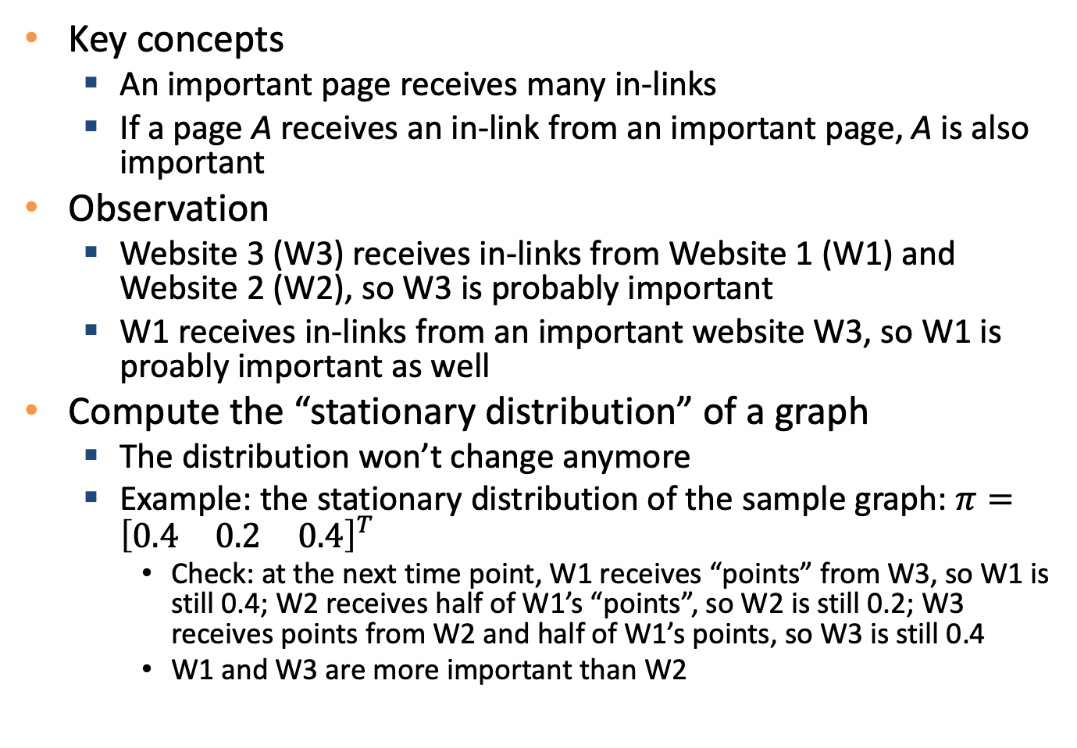


PageRank example
$$2$$
$$1$$
$$3$$
Key concepts
An important page receives many in-links
If a page A receives an in-link from an important page, A is also important
Observation
Website 3 (W3) receives in-links from Website 1 (W1) and Website 2 (W2), so W3 is probably important
W1 receives in-links from an important website W3, so W1 is proably important as well
Compute the “stationary distribution” of a graph
The distribution won’t change anymore
Example: the stationary distribution of the sample graph: $π={\left[\begin{matrix}0.4 & 0.2 & 0.4\end{matrix}\right]}^{T}$
Check: at the next time point, W1 receives “points” from W3, so W1 is still 0.4; W2 receives half of W1’s “points”, so W2 is still 0.2; W3 receives points from W2 and half of W1’s points, so W3 is still 0.4
W1 and W3 are more important than W2

Slide 8
Can we apply the lessons on search engine to other domains?
Design a recommender system recommending 5 items from millions of products for an e-commerce website
Can we use relevance score?
Only partially
Users do not submit text queries continuously
However, we may compare the text similarity between the description of the currently browsing item and other items
What if we want to recommend music/image/…
Music and image have poor text information

Slide 9
Recommendation beyond “text”
Recommendation based on users’ collective behaviors
Simple rules
View also view
Buy also buy
Frequently bought together
ML-based methods
Learning the latent factor (a.k.a., embedding, latent representation) of items
Learning the latent factor (a.k.a., embedding, latent representation) of users
Predict next click/purchase item based on previous views and purchases
Learning-to-rank

Slide 10
Learning to rank, L2R (a.k.a., machine-learned ranking, MLR)

Slide 11
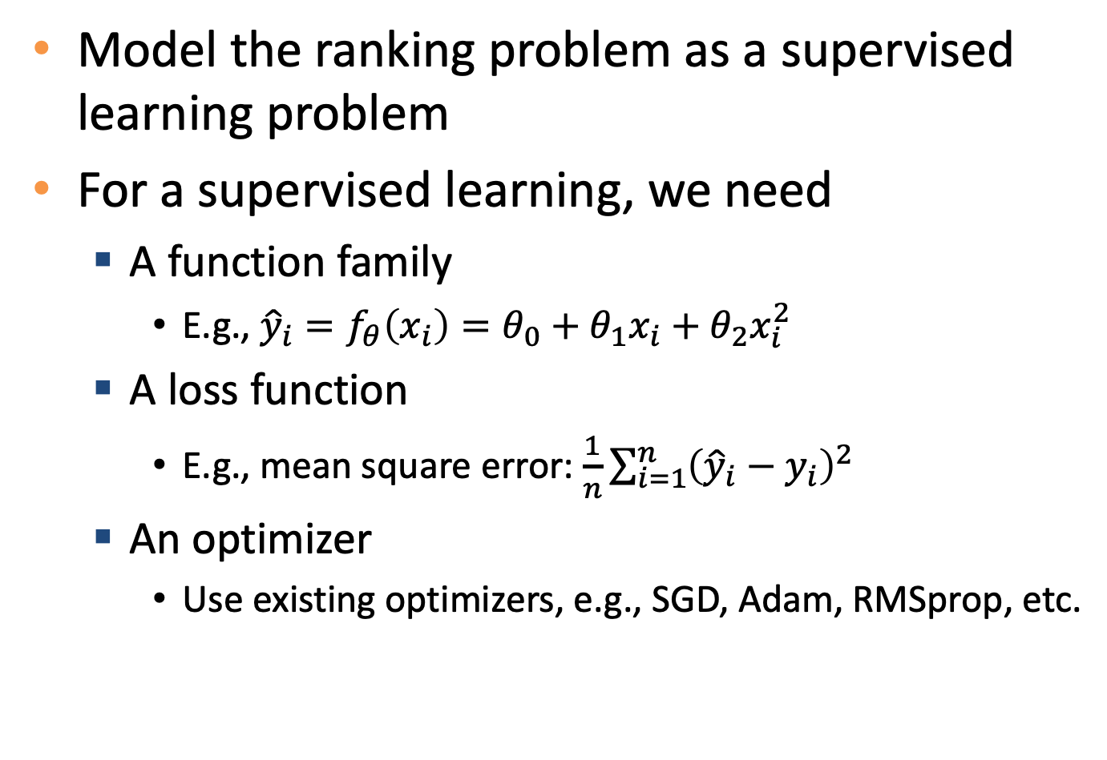
Learning to rank (L2R)
Model the ranking problem as a supervised learning problem
For a supervised learning, we need
A function family
E.g., ${\hat{y}}_{i}=f_{θ}\left(x_{i}\right)=θ_{0}+θ_{1}x_{i}+θ_{2}x_{i}^{2}$
A loss function
E.g., mean square error: $\frac{1}{n}\sum_{i=1}^{n}{{\left({\hat{y}}_{i}−y_{i}\right)}^{2}}$
An optimizer
Use existing optimizers, e.g., SGD, Adam, RMSprop, etc.

Slide 12
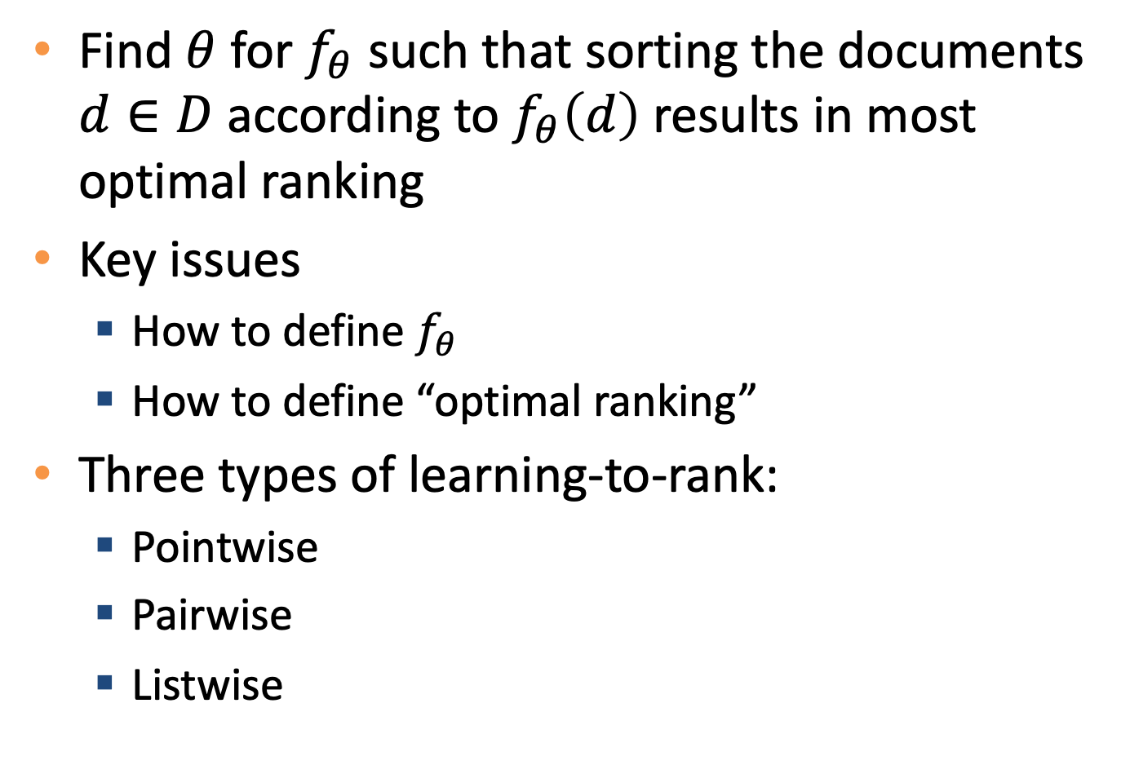
Learning to rank (L2R)
Find $θ$ for $f_{θ}$ such that sorting the documents $d∈D$ according to $f_{θ}\left(d\right)$ results in most optimal ranking
Key issues
How to define $f_{θ}$
How to define “optimal ranking”
Three types of learning-to-rank:
Pointwise
Pairwise
Listwise

Slide 13
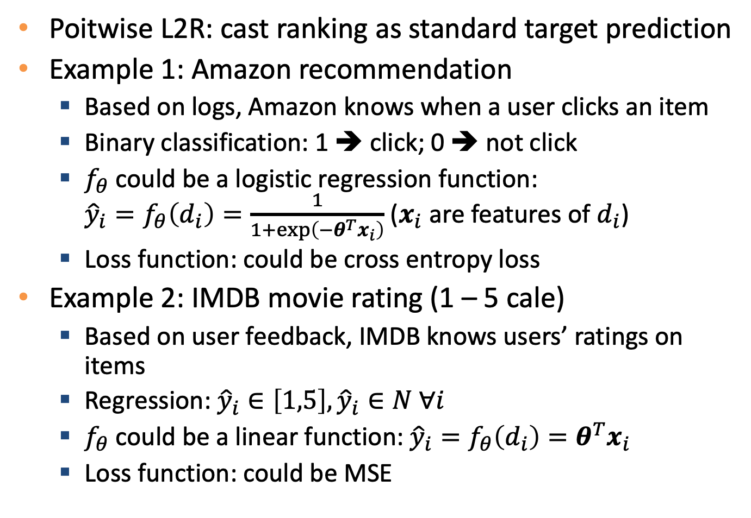
Pointwise methods
Poitwise L2R: cast ranking as standard target prediction
Example 1: Amazon recommendation
Based on logs, Amazon knows when a user clicks an item
Binary classification: 1 ➔ click; 0 ➔ not click
$f_{θ}$ could be a logistic regression function: ${\hat{y}}_{i}=f_{θ}\left(d_{i}\right)=\frac{1}{1+\exp\left(−θ^{T}x_{i}\right)}$ ($x_{i}$ are features of $d_{i}$)
Loss function: could be cross entropy loss
Example 2: IMDB movie rating (1 – 5 cale)
Based on user feedback, IMDB knows users’ ratings on items
Regression: ${\hat{y}}_{i}∈\left[1,5\right],{\hat{y}}_{i}∈N ∀i$
$f_{θ}$ could be a linear function: ${\hat{y}}_{i}=f_{θ}\left(d_{i}\right)=θ^{T}x_{i}$
Loss function: could be MSE

Slide 14
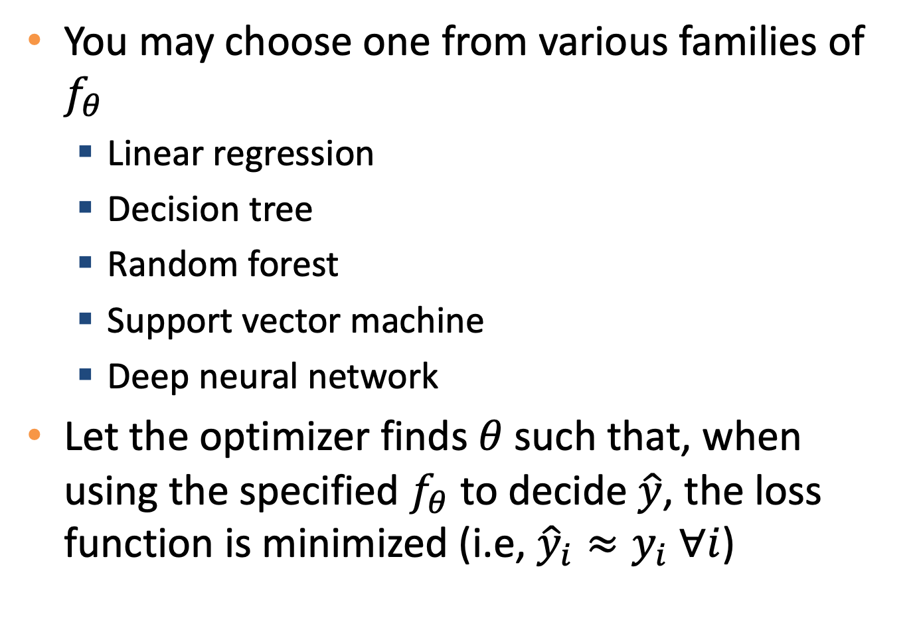

The choice of $f_{θ}$
You may choose one from various families of $f_{θ}$
Linear regression
Decision tree
Random forest
Support vector machine
Deep neural network
Let the optimizer finds $θ$ such that, when using the specified $f_{θ}$ to decide $\hat{y}$, the loss function is minimized (i.e, ${\hat{y}}_{i}≈y_{i} ∀i$)

Slide 15
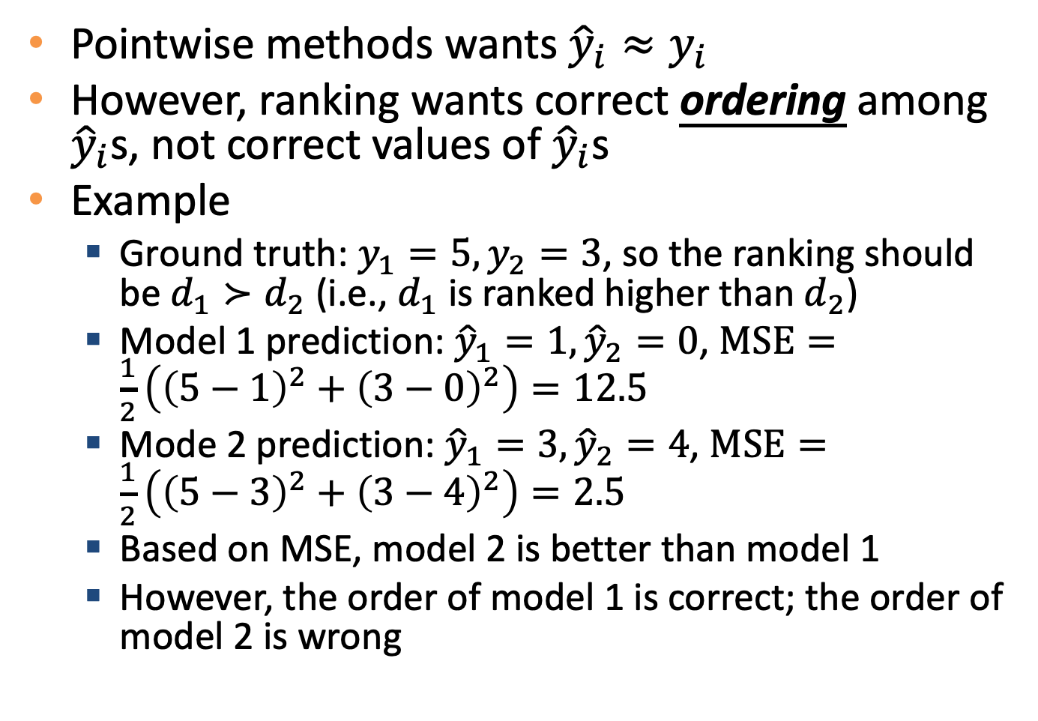
Problem of pointwise methods
Pointwise methods wants ${\hat{y}}_{i}≈y_{i}$
However, ranking wants correct ordering among ${\hat{y}}_{i}$s, not correct values of ${\hat{y}}_{i}$s
Example
Ground truth: $y_{1}=5, y_{2}=3$, so the ranking should be $d_{1}≻d_{2}$ (i.e., $d_{1}$ is ranked higher than $d_{2}$)
Model 1 prediction: ${\hat{y}}_{1}=1, {\hat{y}}_{2}=0$, $MSE=\frac{1}{2}\left({\left(5−1\right)}^{2}+{\left(3−0\right)}^{2}\right)=12.5$
Mode 2 prediction: ${\hat{y}}_{1}=3, {\hat{y}}_{2}=4$, $MSE=\frac{1}{2}\left({\left(5−3\right)}^{2}+{\left(3−4\right)}^{2}\right)=2.5$
Based on MSE, model 2 is better than model 1
However, the order of model 1 is correct; the order of model 2 is wrong

Slide 16
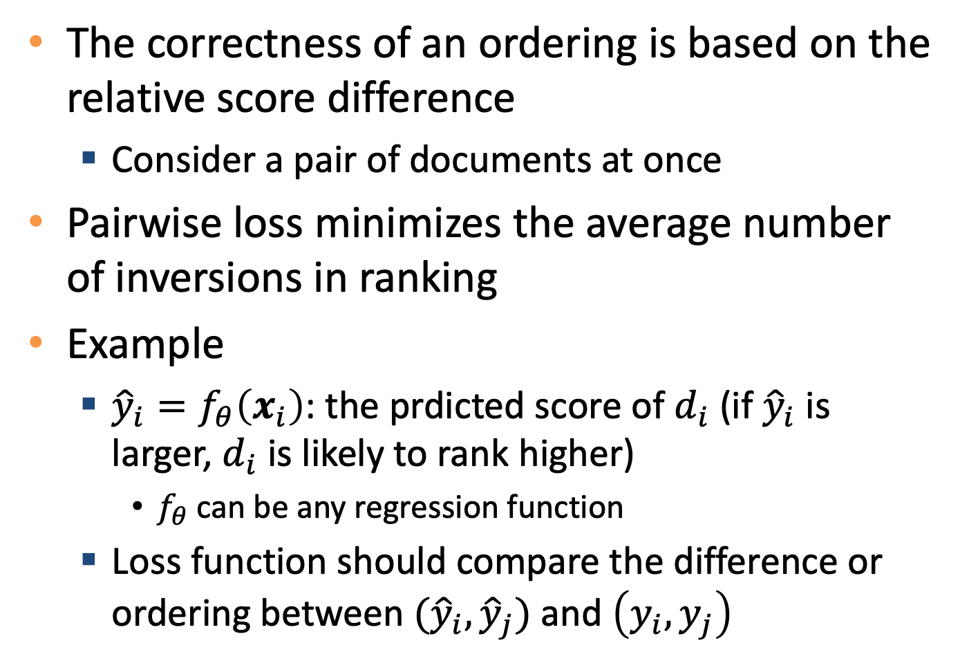
Pairwise methods
The correctness of an ordering is based on the relative score difference
Consider a pair of documents at once
Pairwise loss minimizes the average number of inversions in ranking
Example
${\hat{y}}_{i}=f_{θ}\left(x_{i}\right)$: the prdicted score of $d_{i}$ (if ${\hat{y}}_{i}$ is larger, $d_{i}$ is likely to rank higher)
$f_{θ}$ can be any regression function
Loss function should compare the difference or ordering between ${(\hat{y}}_{i}, {\hat{y}}_{j})$ and $\left(y_{i},y_{j}\right)$

Slide 17
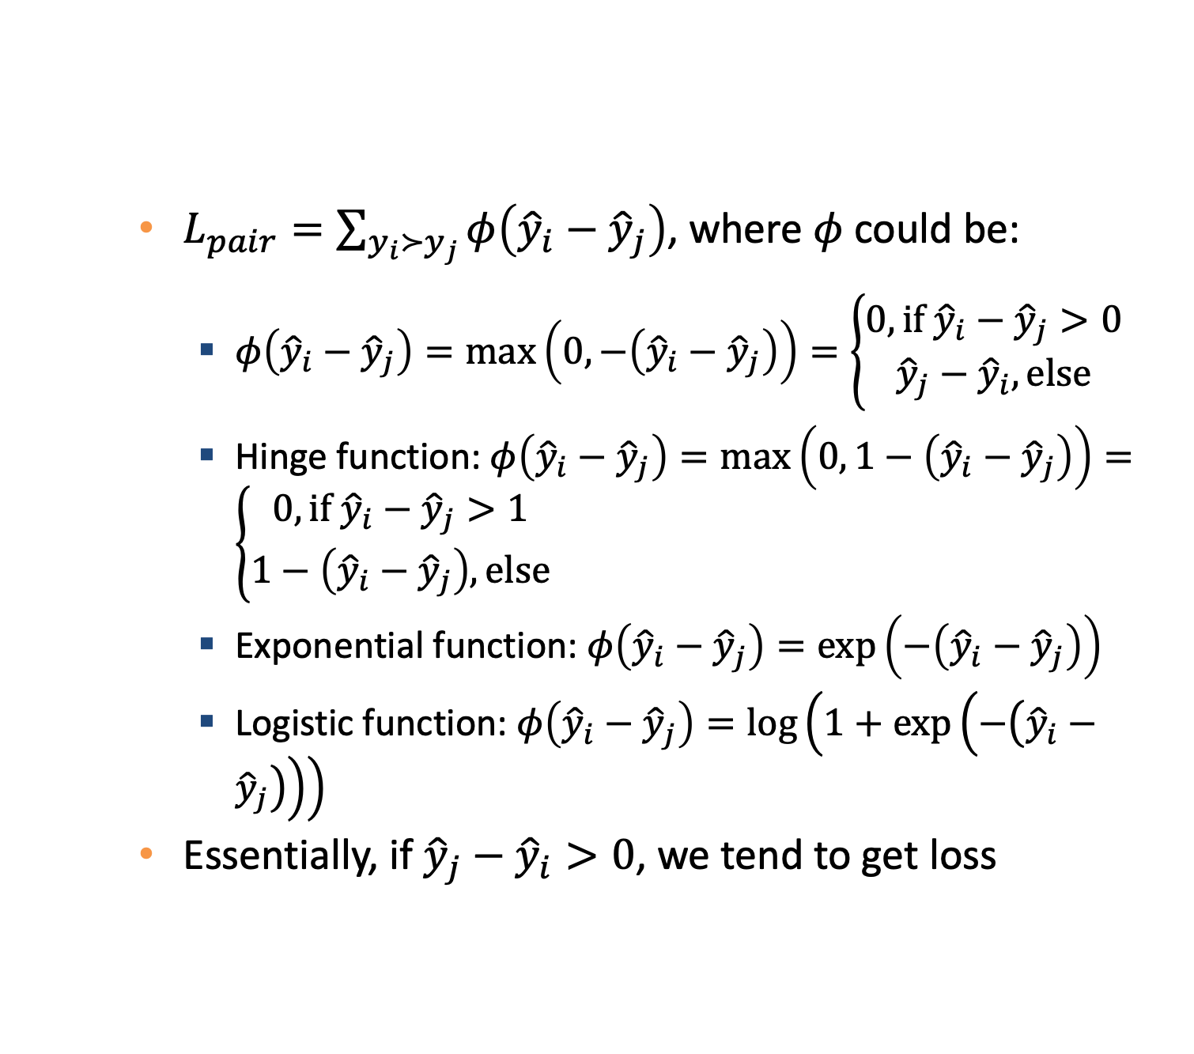
Pairwise method loss function examples
$L_{pair}=\sum_{y_{i}≻y_{j}}{φ\left({\hat{y}}_{i}−{\hat{y}}_{j}\right)}$, where $φ$ could be:
$φ\left({\hat{y}}_{i}−{\hat{y}}_{j}\right)=\max\left(0,−\left({\hat{y}}_{i}−{\hat{y}}_{j}\right)\right)=\left\{\begin{aligned}0, if {\hat{y}}_{i}−{\hat{y}}_{j}>0 \\ {\hat{y}}_{j}−{\hat{y}}_{i}, else\end{aligned}\right.$
Hinge function: $φ\left({\hat{y}}_{i}−{\hat{y}}_{j}\right)=\max\left(0, 1−\left({\hat{y}}_{i}−{\hat{y}}_{j}\right)\right)=\left\{\begin{aligned}0, if {\hat{y}}_{i}−{\hat{y}}_{j}>1 \\ &1−\left({\hat{y}}_{i}−{\hat{y}}_{j}\right), else\end{aligned}\right.$
Exponential function: $φ\left({\hat{y}}_{i}−{\hat{y}}_{j}\right)=\exp\left(−\left({\hat{y}}_{i}−{\hat{y}}_{j}\right)\right)$
Logistic function: $φ\left({\hat{y}}_{i}−{\hat{y}}_{j}\right)=\log\left(1+\exp\left(−\left({\hat{y}}_{i}−{\hat{y}}_{j}\right)\right)\right)$
Essentially, if ${\hat{y}}_{j}−{\hat{y}}_{i}>0$, we tend to get loss

Slide 18
Problem of pairwise methods
Pairwise methods treat each document pair equally important
But in reality, the top-10 returns are more important than the others (e.g., documents ranked in 91st – 100th)
Consequently, pairwise methods may compromise the quality of top-10 to improve the ordering in the tail of top-100

Slide 19
Detour: ranking metrics

Slide 20
Ranking evaluation metrics
Concept: correctly ranking the top returns are more valuable than correctly ranking the others
We usually browse only the first page of a search
Metric for ranking evaluation
Mean Reciprocal Rank (MRR)
Mean Average Precision (MAP)
(Normalized) Discounted Cumulative Gain (DCG, or nDCG)

Slide 21

Mean Reciprocal Rank
Measure the position of the first relevant item
$MRR=\frac{1}{Q}\sum_{i=1}^{Q}{\left(1/{rank_{i}}\right)}$
$Q$: number of queries
$rank_{i}$: the position of the first relevant item for query $i$

Slide 22
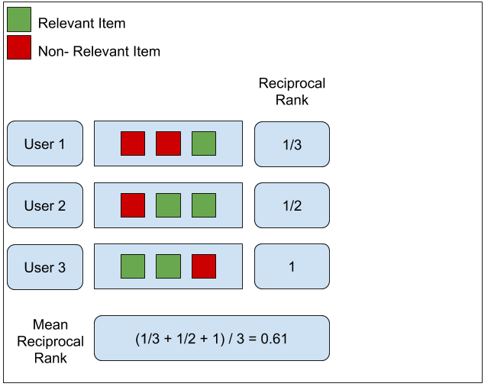
Mean Reciprocal Rank Example
Source: https://medium.com/swlh/rank-aware-recsys-evaluation-metrics-5191bba16832

Slide 23
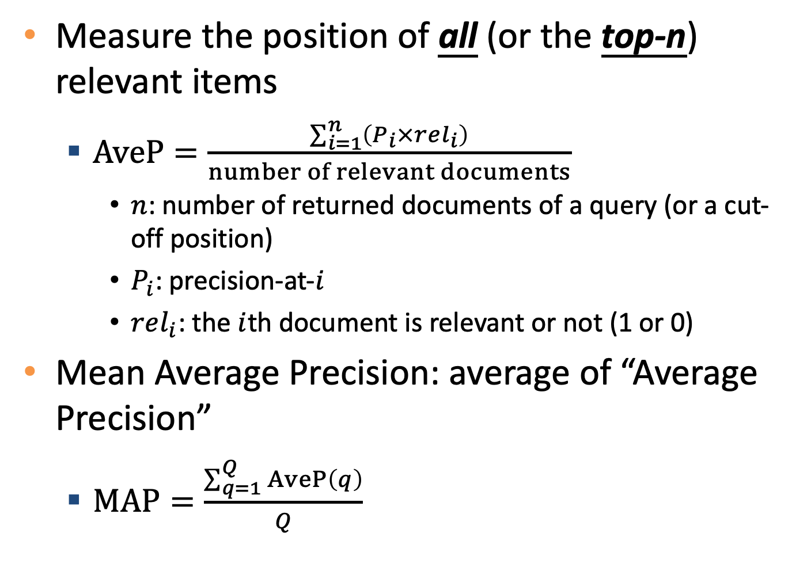
Mean Average Precision
Measure the position of all (or the top-n) relevant items
$AveP=\frac{\sum_{i=1}^{n}{\left(P_{i}×rel_{i}\right)}}{number of relevant documents}$
$n$: number of returned documents of a query (or a cut-off position)
$P_{i}$: precision-at-$i$
$rel_{i}$: the $i$th document is relevant or not (1 or 0)
Mean Average Precision: average of “Average Precision”
$MAP=\frac{\sum_{q=1}^{Q}{AveP\left(q\right)}}{Q}$

Slide 24
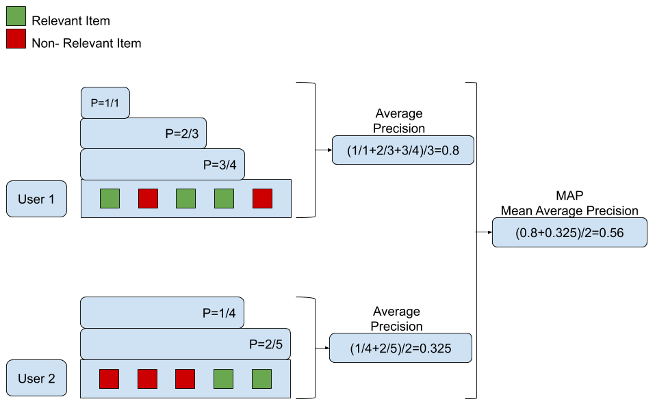
Mean Average Precision Example
Source: https://medium.com/swlh/rank-aware-recsys-evaluation-metrics-5191bba16832

Slide 25
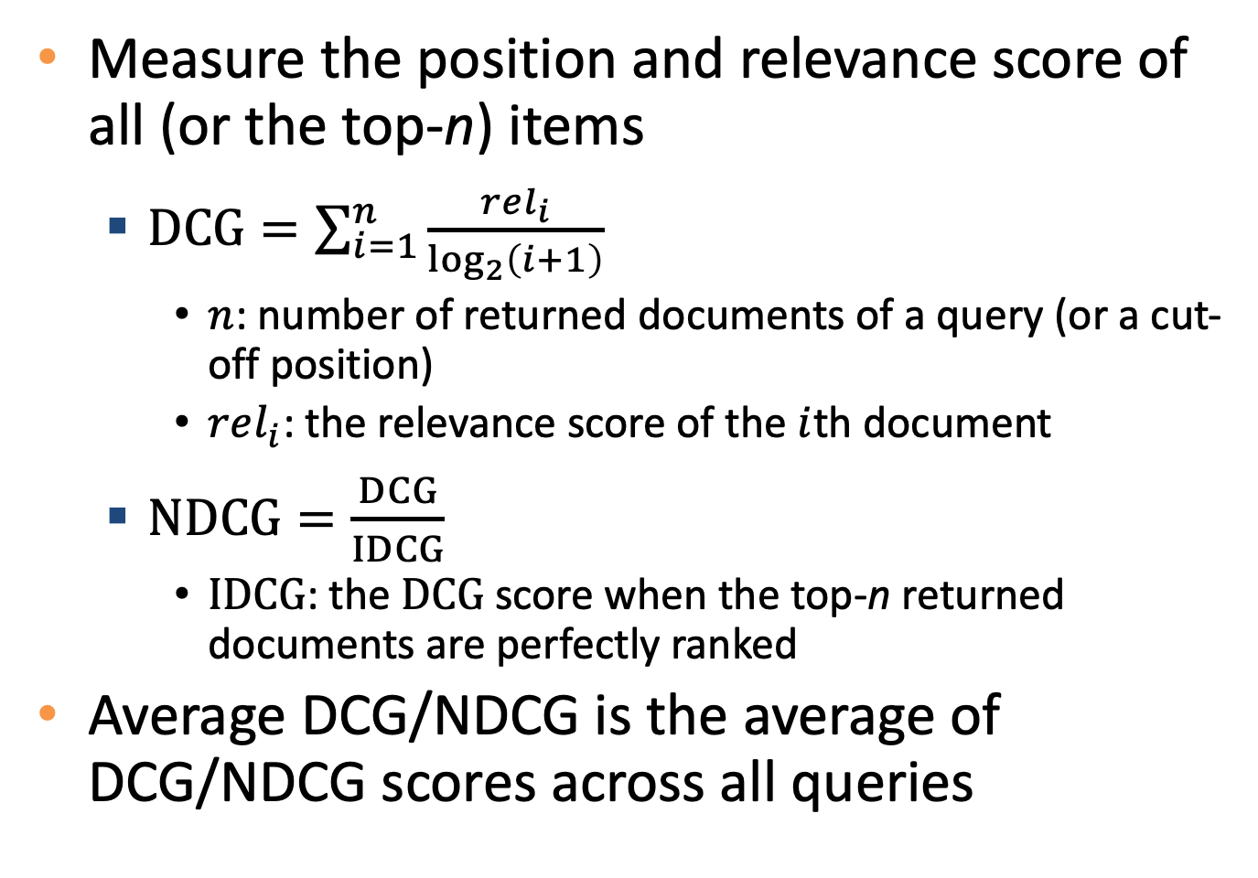
(Normalized) Discounted Cumulative Gain
Measure the position and relevance score of all (or the top-n) items
$DCG=\sum_{i=1}^{n}{\frac{rel_{i}}{\log_{2}\left(i+1\right)}}$
$n$: number of returned documents of a query (or a cut-off position)
$rel_{i}$: the relevance score of the $i$th document
$NDCG=\frac{DCG}{IDCG}$
$IDCG$: the $DCG$ score when the top-n returned documents are perfectly ranked
Average DCG/NDCG is the average of DCG/NDCG scores across all queries

Slide 26
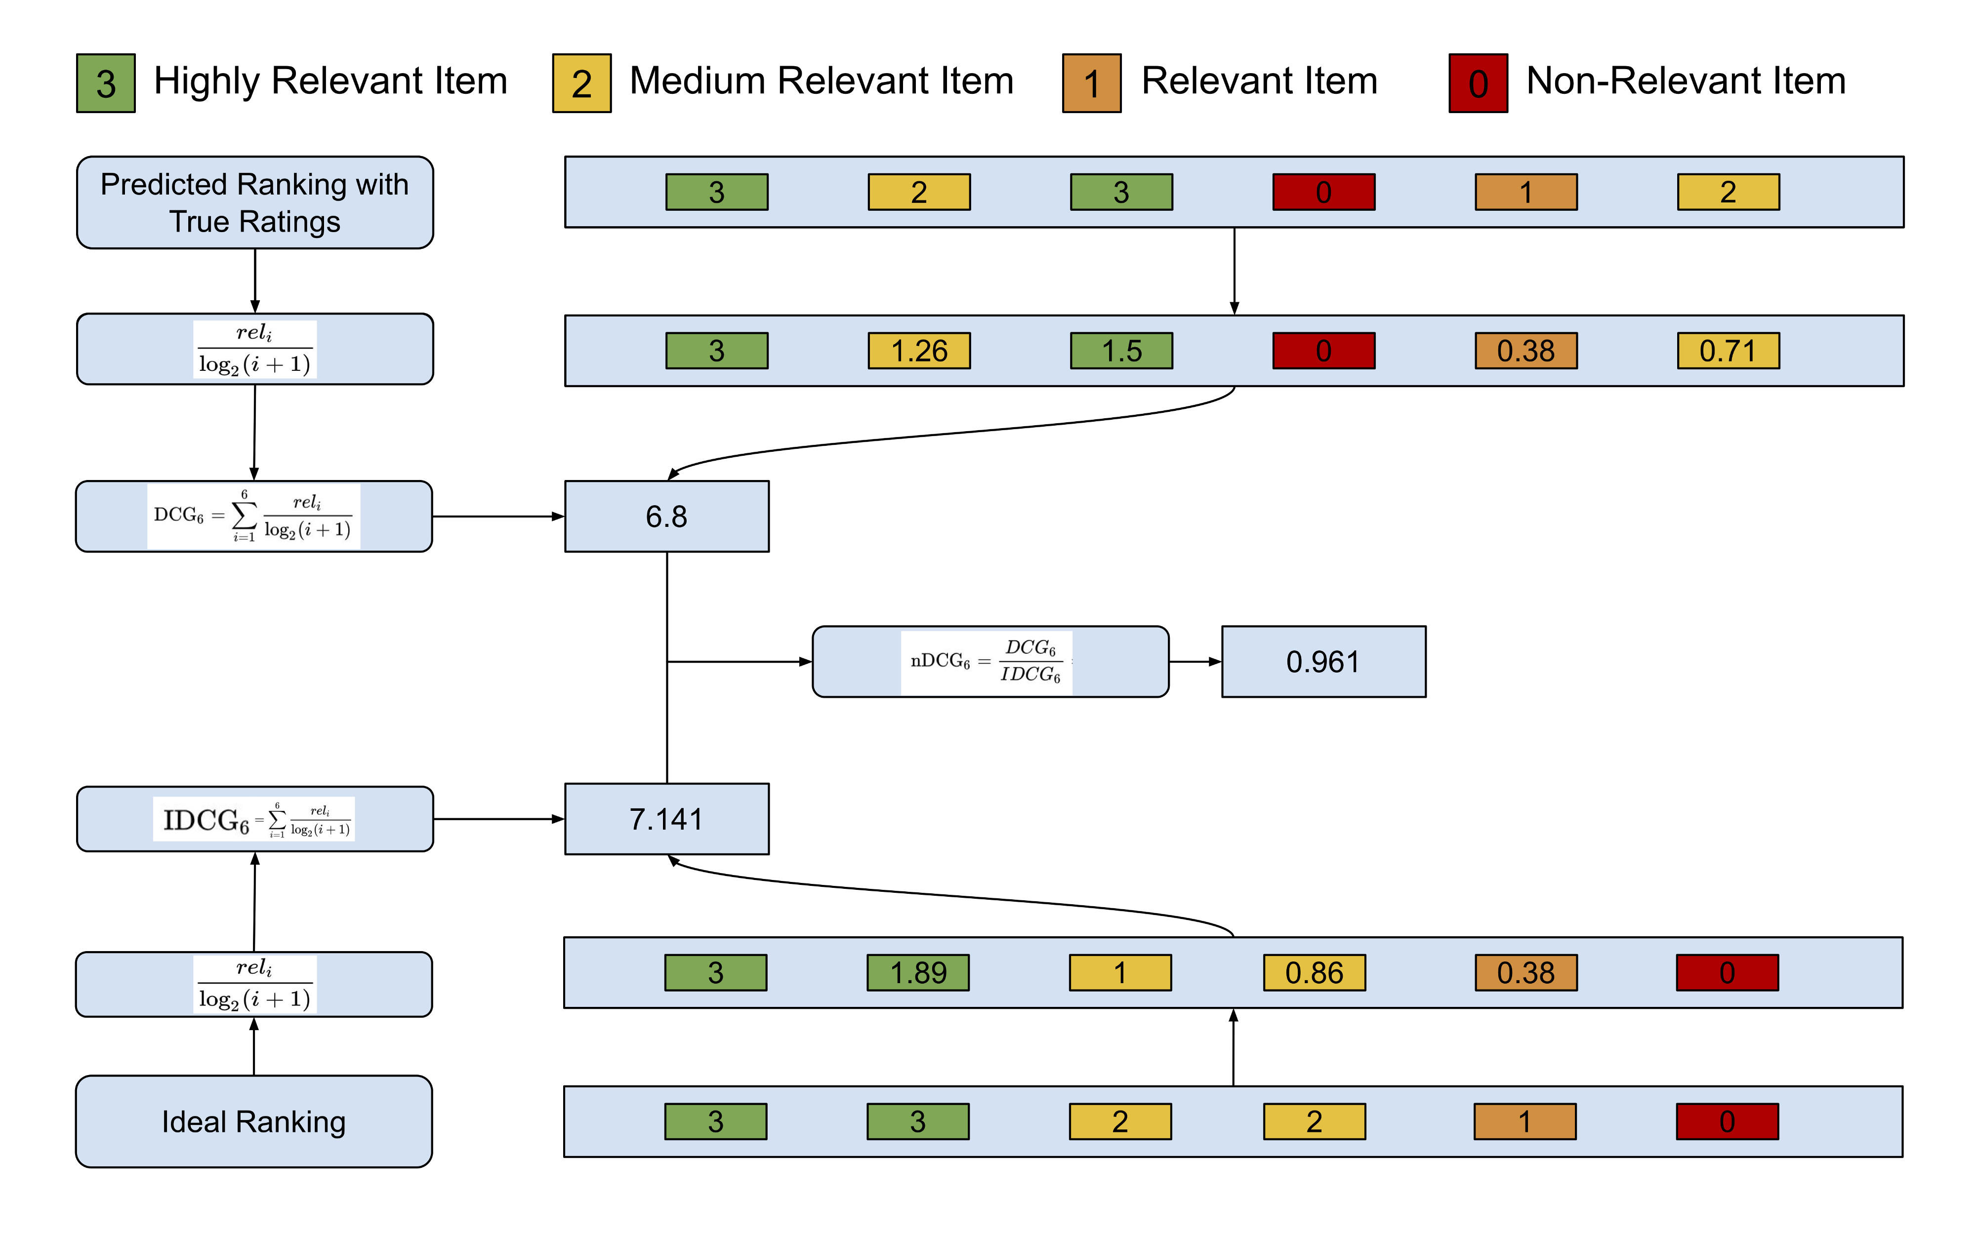
DCG and NDCG example
Source: https://medium.com/swlh/rank-aware-recsys-evaluation-metrics-5191bba16832

Slide 27
Detour ends

Slide 28
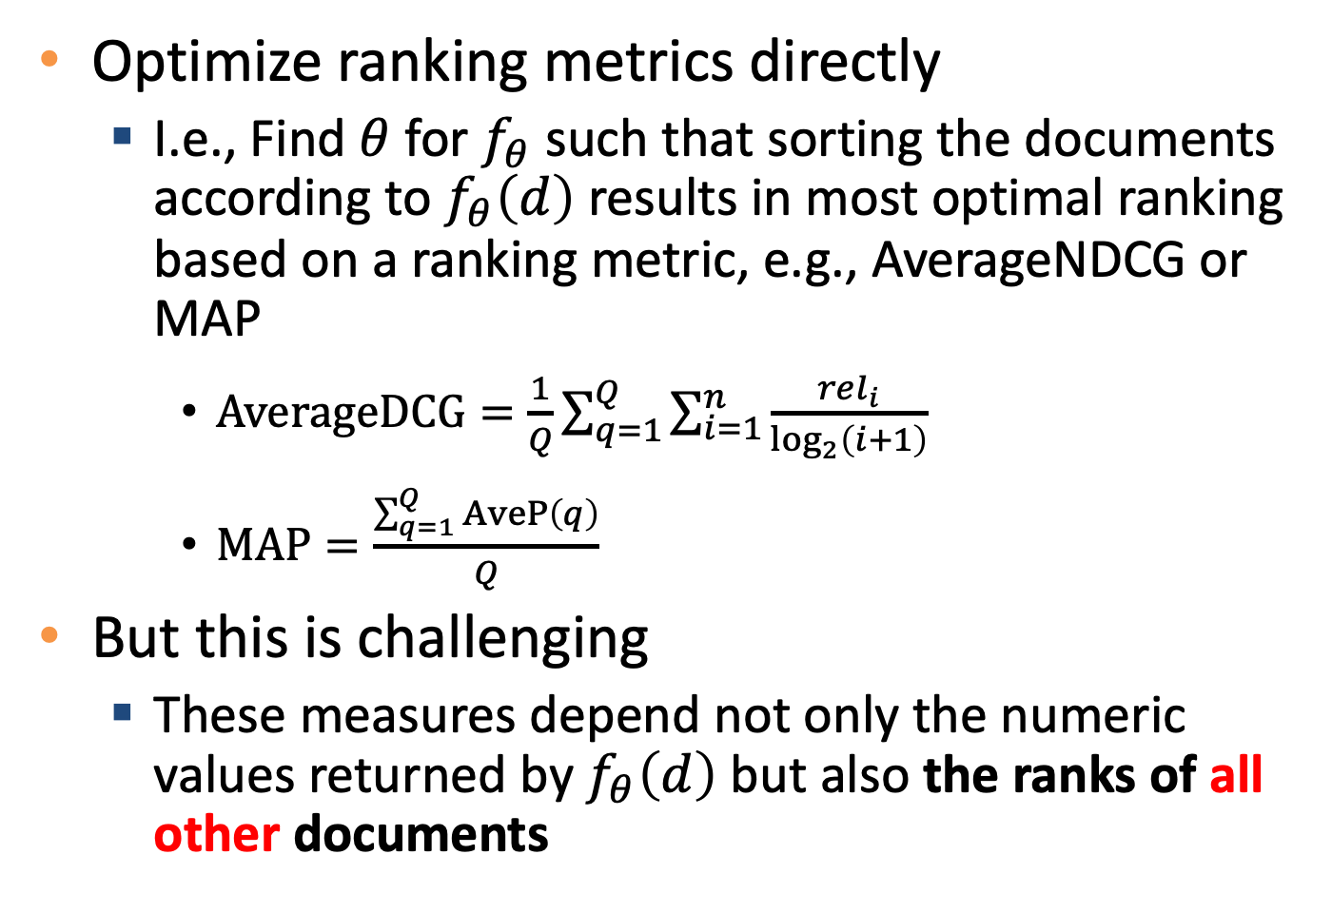
Listwise methods
Optimize ranking metrics directly
I.e., Find $θ$ for $f_{θ}$ such that sorting the documents according to $f_{θ}\left(d\right)$ results in most optimal ranking based on a ranking metric, e.g., AverageNDCG or MAP
$AverageDCG=\frac{1}{Q}\sum_{q=1}^{Q}{\sum_{i=1}^{n}{\frac{rel_{i}}{\log_{2}\left(i+1\right)}}}$
$MAP=\frac{\sum_{q=1}^{Q}{AveP\left(q\right)}}{Q}$
But this is challenging
These measures depend not only the numeric values returned by $f_{θ}\left(d\right)$ but also the ranks of all other documents

Slide 29
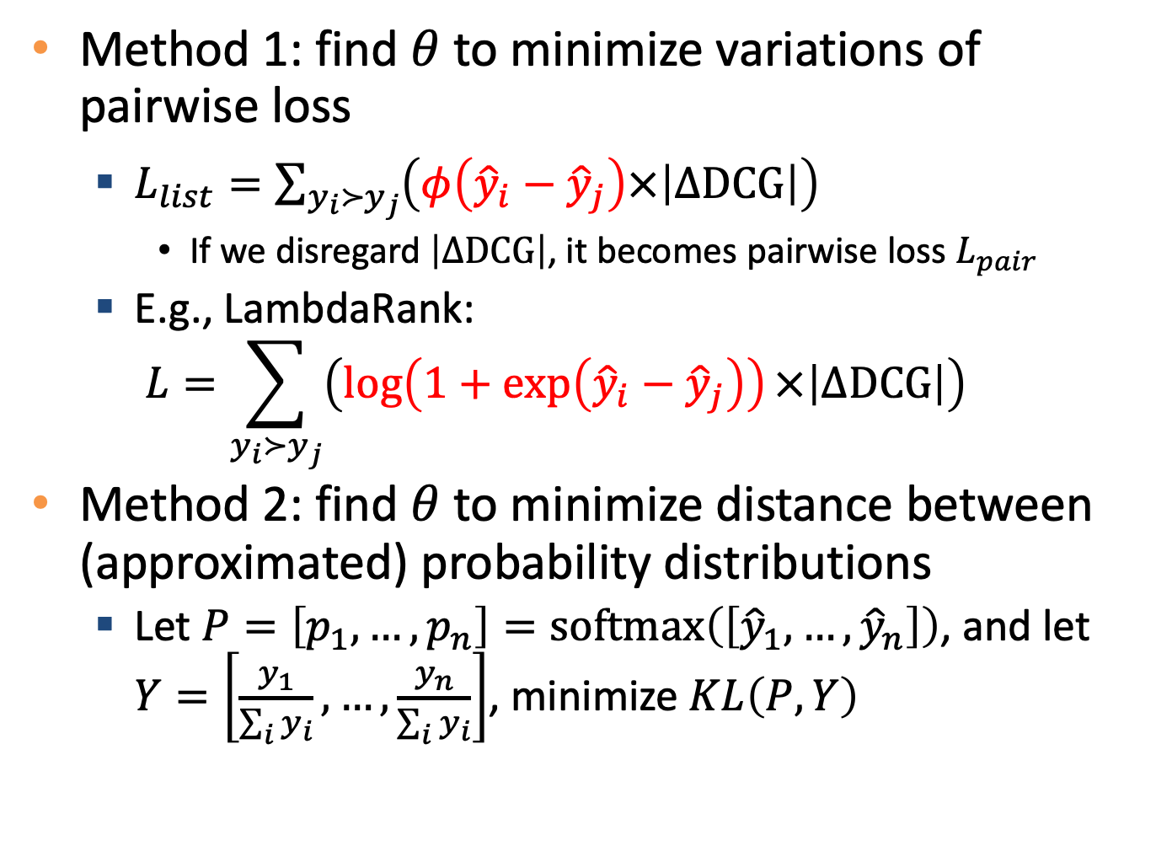
Listwise methods usually require some workaround
Method 1: find $θ$ to minimize variations of pairwise loss
$L_{list}=\sum_{y_{i}≻y_{j}}{\left(φ\left({\hat{y}}_{i}−{\hat{y}}_{j}\right)×\left|ΔDCG\right|\right)}$
If we disregard $\left|ΔDCG\right|$, it becomes pairwise loss $L_{pair}$
E.g., LambdaRank: $L=\sum_{y_{i}≻y_{j}}{\left(\log\left(1+\exp\left({\hat{y}}_{i}−{\hat{y}}_{j}\right)\right)×\left|ΔDCG\right|\right)}$
Method 2: find $θ$ to minimize distance between (approximated) probability distributions
Let $P=\left[p_{1},…,p_{n}\right]=softmax\left(\left[{\hat{y}}_{1},…,{\hat{y}}_{n}\right]\right)$, and let $Y=\left[\frac{y_{1}}{\sum_{i}{y_{i}}},…,\frac{y_{n}}{\sum_{i}{y_{i}}}\right]$, minimize $KL\left(P,Y\right)$

Slide 30
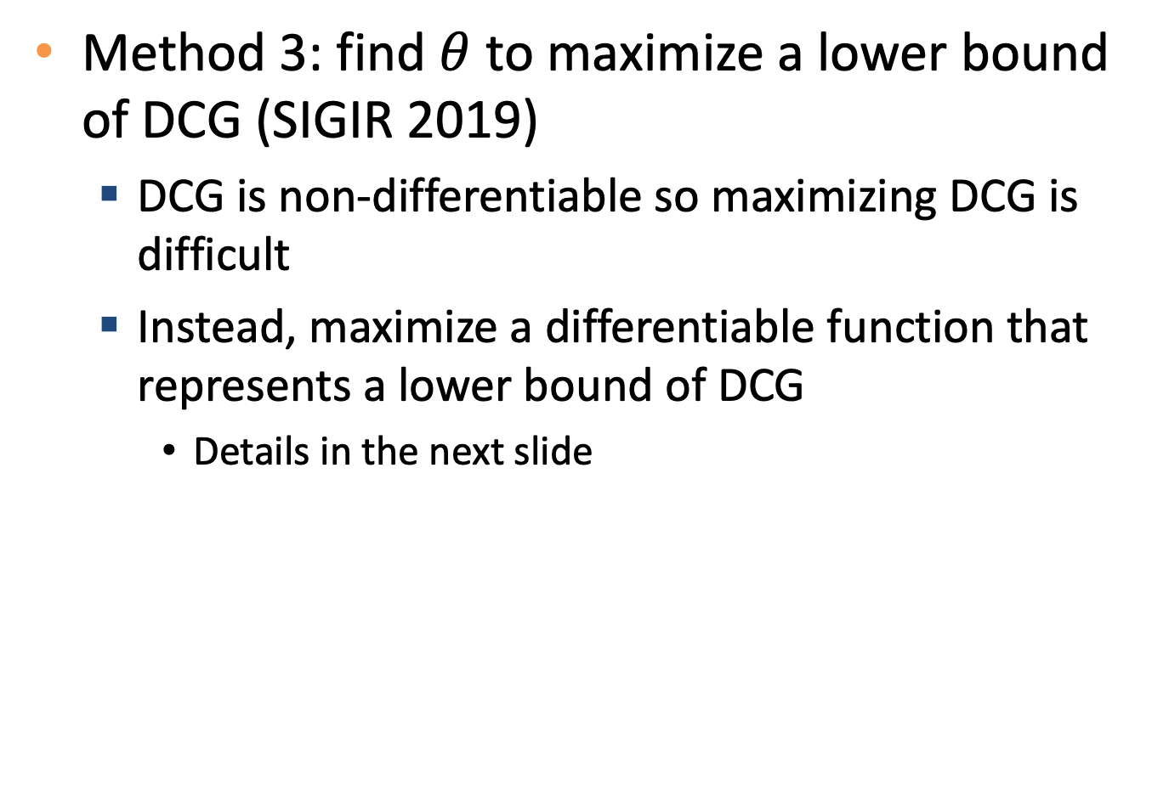
Listwise methods usually require some workaround
Method 3: find $θ$ to maximize a lower bound of DCG (SIGIR 2019)
DCG is non-differentiable so maximizing DCG is difficult
Instead, maximize a differentiable function that represents a lower bound of DCG
Details in the next slide

Slide 31
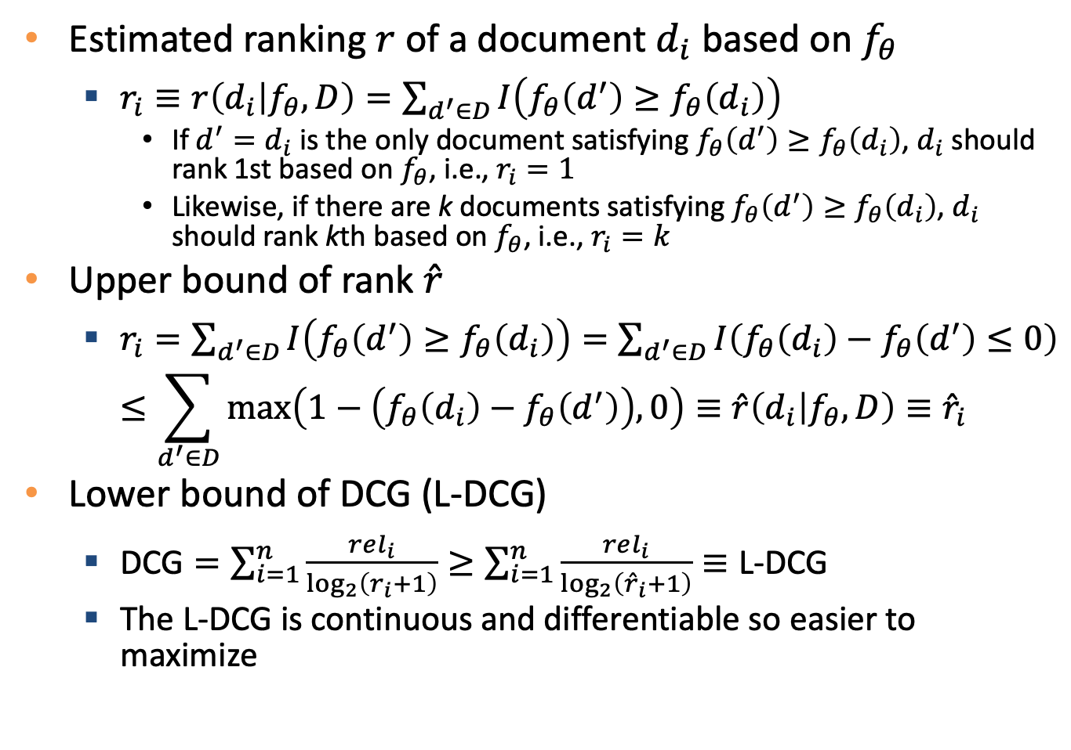
Deriving lower bound of DCG
Estimated ranking $r$ of a document $d_{i}$based on $f_{θ}$
$r_{i}≡r\left(d_{i} | f_{θ},D\right)=\sum_{d^{′}∈D}{I\left(f_{θ}\left(d^{′}\right)≥f_{θ}\left(d_{i}\right)\right)}$
If $d^{′}=d_{i}$ is the only document satisfying $f_{θ}\left(d^{′}\right)≥f_{θ}\left(d_{i}\right)$, $d_{i}$ should rank 1st based on $f_{θ}$, i.e., $r_{i}=1$
Likewise, if there are k documents satisfying $f_{θ}\left(d^{′}\right)≥f_{θ}\left(d_{i}\right)$, $d_{i}$ should rank kth based on $f_{θ}$, i.e., $r_{i}=k$
Upper bound of rank $\hat{r}$
$r_{i}=\sum_{d^{′}∈D}{I\left(f_{θ}\left(d^{′}\right)≥f_{θ}\left(d_{i}\right)\right)}=\sum_{d^{′}∈D}{I\left(f_{θ}\left(d_{i}\right)−f_{θ}\left(d^{′}\right)≤0\right)}$ $≤\sum_{d^{′}∈D}{\max\left(1−\left(f_{θ}\left(d_{i}\right)−f_{θ}\left(d^{′}\right)\right),0\right)}≡\hat{r}\left(d_{i} | f_{θ},D\right)≡{\hat{r}}_{i}$
Lower bound of DCG (L-DCG)
$\text{DCG}=\sum_{i=1}^{n}{\frac{rel_{i}}{\log_{2}\left(r_{i}+1\right)}}≥\sum_{i=1}^{n}{\frac{rel_{i}}{\log_{2}\left({\hat{r}}_{i}+1\right)}}≡\text{L}\text{−}\text{DCG}$
The L-DCG is continuous and differentiable so easier to maximize

Slide 32
How to rank millions of items in real time?
Example: when browsing an item on an EC website, how to find top-5 relevant items out of millions of items?
Online computation
Too slow for real time ranking / recommendation
Offline computation
Possible strategies
TFIDF
Compute top-k similar items for each item in advance
Problem: contextual clues (that may vary over queries) cannot be included
E.g., user’s gender, user’s location, current weather, current date, …

Slide 33
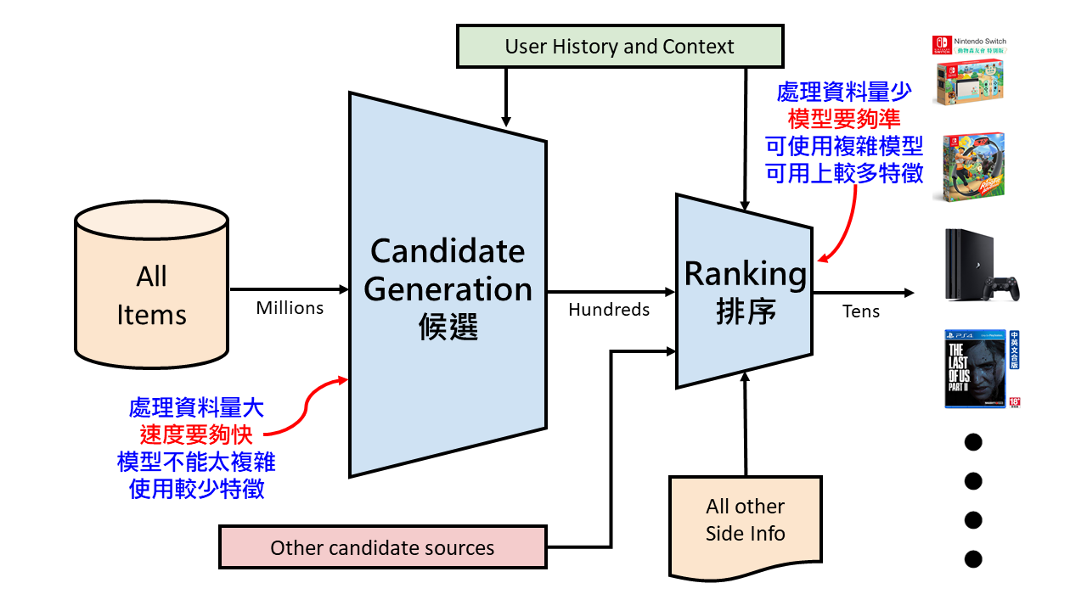
Candidate generation and rank
Source: 楊易哲. “探索深度學習或簡易學習模型在點擊率預測任務中的使用時機” 2020 (中大論文)

Slide 34
Candidate generation and rank
Candidate generation
From millions of items select few (e.g., dozens or hundreds) candidate items
Fast, high recall
Usually preprocessed for fast online query
E.g., TFIDF, KNN
Ranking
Rank candidate items (usually dozens or hundreds)
Could be complex
Online computation, so integrating dynamic contextual clues is possible
E.g., learning-to-rank

Slide 35
Summary
Ranking is an essential topic in various information systems
Rule-based ranking
Relevancy score (e.g., TFIDF)
Importance score (e.g., PageRank)
ML-based ranking (learning to rank)
Pointwise, pairwise, and listwise
Ranking metrics
NDCG, MAP, MRR
Candidate generation and ranking
Issues of ranking and recommendation

Slide 36
Quiz
Explain and compare the following methods
Pointwise ranking
Pairwise ranking
Listwise ranking

