Slide 1
Introduction to Data Science
Hung-Hsuan Chen 陳弘軒
Computer Science and Information Engineering
National Central University
hhchen@ncu.edu.tw
Many slides are obtained from Prof. Shou-De Lin (NTU)

Slide 2
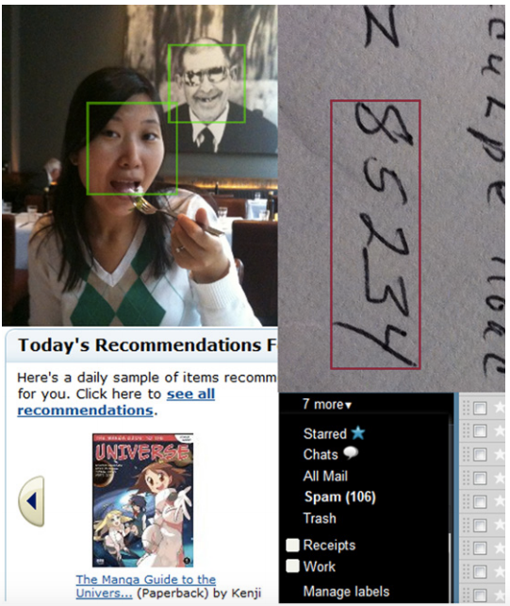
Examples of machine learning today

Slide 3
Traditional algorithm vs data driven algorithm
How to detect a face?
Traditional algorithm
Round shape, with two black circles (eyes), …
Solve a problem based on your knowledge (prior information)
Data driven algorithm
Show many face/non-face photos to the machine, and let the machine identifies their differences
Solve the problem based on the data (and maybe some of the prior knowledge)

Slide 4
Types of Machine Learning
Based on the input-output structure, ML can be categorized as:
Supervised Learning
Unsupervised Learning
Semi-supervised Learning
Reinforcement Learning
We will mostly discuss the first type in this class

Slide 5
Supervised Learning
Given: a set of <input, output> pairs
Goal: given an unseen input, predict the corresponding output
For example:
Input: X-ray photo of chests, output: whether it is cancerous
Input: a sentence, output: whether a sentence is grammatical
Input: some indicators of a company, output: whether it will make profit next year
Two typical types of outputs an ML system generates
Categorical: classification problem
Ordinal outputs: small, medium, large
Non-ordinal outputs: blue, green, orange
Real values: regression problem
There are several other variations

Slide 6
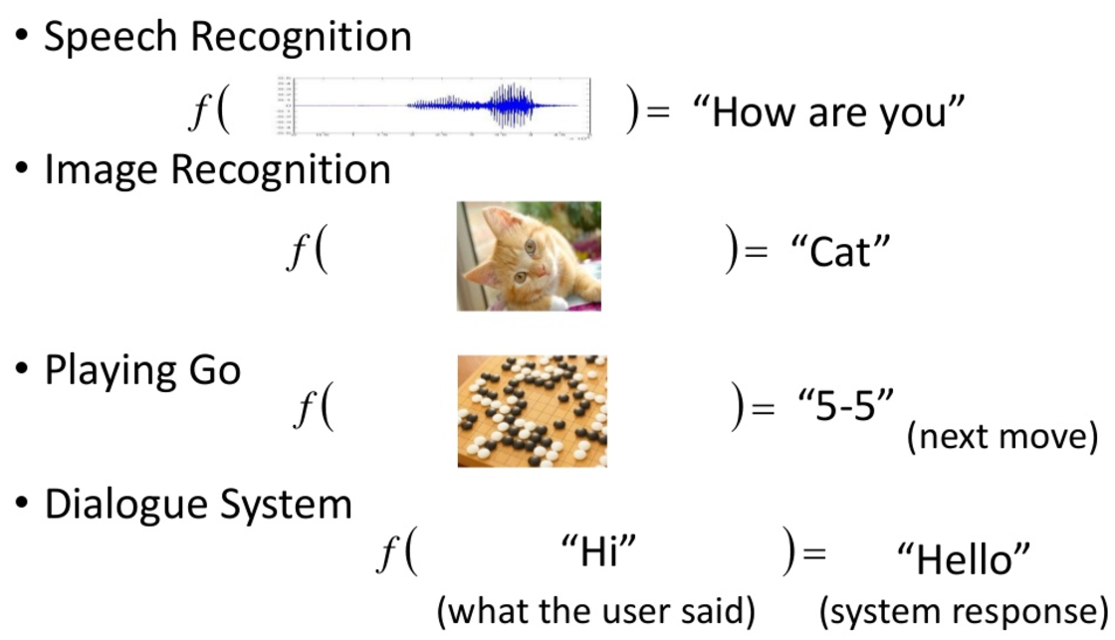
Different types of outputs
Source: Hung-Yi Lee https://www.slideshare.net/tw_dsconf/ss-62245351

Slide 7
Terminology
Training data: a set of data used to discover potentially predictive relationships
Test data: the data that has been specifically identified for use in tests
Features (a.k.a. attributes, independent variables)
We usually use X to represent features
Features are the “input” of a prediction task
Target variable (a.k.a. outputs, dependent variables)
In classification, target variables are also called classes
We usually use y to represent target variables
Targets are the “output” of a prediction task

Slide 8
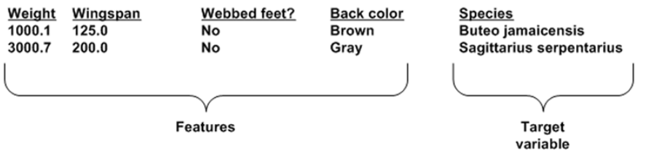
Example

Slide 9
Unsupervised Learning
Learning without teachers (presumably harder than supervised learning)
Learning “what normally happens”
Think of how babies learn their first language (unsupervised) comparing with how people learn their 2nd language (supervised).
Given: a bunch of input X (there is no output y)
Goal: depending on the tasks, for example
Estimate P(X) ➔ then we can find augmax P(X)
Finding Sim(X₁,X₂) ➔ then we can group similar X’s
Finding P(X₂|X₁)➔ we can know whether some items can occur together.

Slide 10
A variety of ML Tasks
Classification
Regression
Clustering
Transfer learning
Multi-label learning
Multi-instance learning
Cost-sensitive leering
Active learning
Semi-supervised learning
Reinforcement learning

Slide 11
Classification (1/2)
It is a supervised learning task that, given a feature vector x, predicts which class in C may be associated with x.
|C|=2 ➔ Binary Classification
|C|>2 ➔ Multi-class Classification
Training and predicting of a binary classification problem:
Training set (Binary Classification)
Feature Vector (x_{i} ∈ R^{d}) | Class
x₁ | +1
x₂ | -1
… | …
x_{n-1} | -1
x_{n} | +1
A new instance
Feature Vector (x_{new} ∈ R^{d}) | Class
x_{new} | ?
(1) Training
(2) Predicting
Classifier f(x)

Slide 12
Classification (2/2)
A classifier can be either linear or non-linear
The geometric view of a linear classifier
-1
+1
w^{T}x + b
w
Famous classification models:
k-nearest neighbor (kNN)
Decision Tree (DT)
Support Vector Machine (SVM)
…

Slide 13
Real example: E-mail spam check
Blocking the junk email and passing the normal email
Training Set
Test Set
mails
(labeled)
mails
(unlabeled)
(1)Training
(2)Testing
Classifier (DT)
If sender =“X” and reciver=“Y” -> label=“spam”
If title_phrase=“ABC” -> label= “not spam”
.
.
.
Output (with class label)
mail
spam

Slide 14
Regression (1/2)
A supervised learning task that, given a feature vector x, predicts the target value y ∈ R.
Training and predicting of a regression problem:
Training set
Feature Vector (x_{i} ∈ R^{d}) | y_{i} ∈ R
x₁ | +0.26
x₂ | -3.94
… | …
x_{n-1} | -1.78
x_{n} | +5.31
A new instance
Feature Vector (x_{new} ∈ R^{d}) | y_{new} ∈ R
x_{new} | ?
(1) Training
(2) Predicting
Regressor f(x)

Slide 15
Regression (2/2)
The geometric view of a linear regression function
Some types of regression: linear regression, support vector regression, …

Slide 16
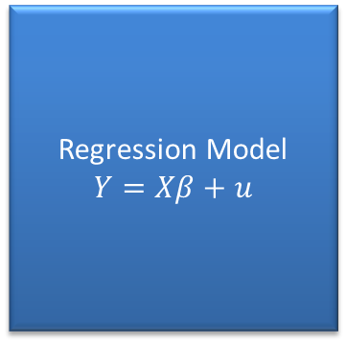
Real Example: Stock price prediction
Predicting the price of stock
Training Set
Test Set
Stock Data
Stock Data
(1) Training
(2)Testing
Regression Model
$$Y=Xβ+u$$
Output (with real value)
Stock
price

Slide 17
Clustering
An unsupervised learning task
Given a finite set of real-valued feature vector S ⊂ R^{d}, discover clusters in S
S
Feature Vector (x_{i} ∈ R^{d})
x₁
x₂
…
x_{n-1}
x_{n}
Clustering Algorithm
K-Means,Hierarchical clustering, DBSCAN, etc

Slide 18
Problem modeling is critical
It is very important to know how to model the problem into a suitable ML task
Incorrect problem modeling leads you to nowhere

Slide 19
An example: click-through rate prediction
Assuming you want to predict quality of an advertisement by estimating its click-ratio (i.e. how likely a person would buy the product after viewing this ad)
Since this click-ratio is a real number between 0 and 1, a natural way is to model it as a regression problem.
However, an experienced machine learning person would suggest decomposing this into a binary classification problem (i.e. 3/8 will be decomposed into 3 positive instances and 5 negative instances)

Slide 20
Overfitting vs underfitting

Slide 21
Quiz
Explain the difference between a supervised and an unsupervised algorithm
Explain the difference between classification and regression
Blocking the junk email and passing the normal email based on the labeled datasets
Supervised or unsupervised?
Predicting the price of stock
Classification or regression?

