Slide 1
K-nearest neighbors classifier (KNN)
Hung-Hsuan Chen 陳弘軒
Computer Science and Information Engineering
National Central University
hhchen@ncu.edu.tw
Slides adapted from Xiaoli Fern (Oregon State), Rong Jin (MSU)

Slide 2
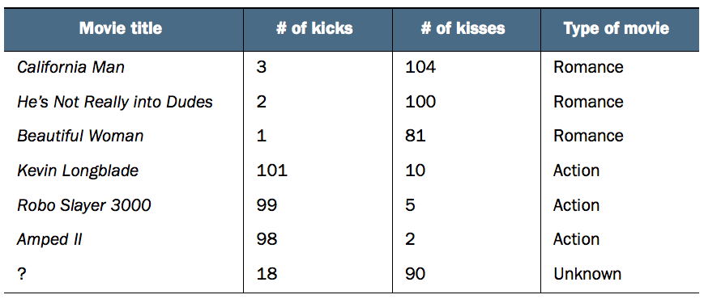
An example of movie type classification

Slide 3
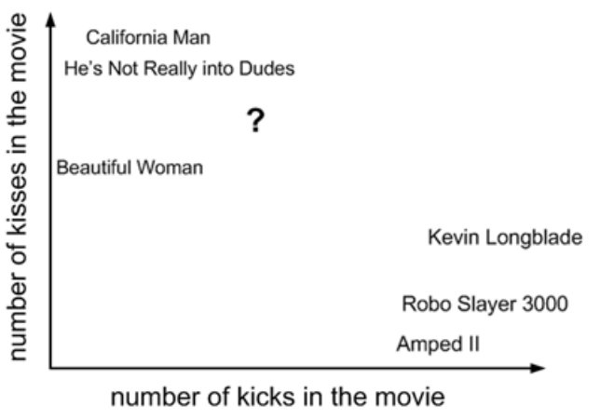
Visualize the data

Slide 4
K-Nearest-Neighbor (kNN) Classifier
(k=1)

Slide 5
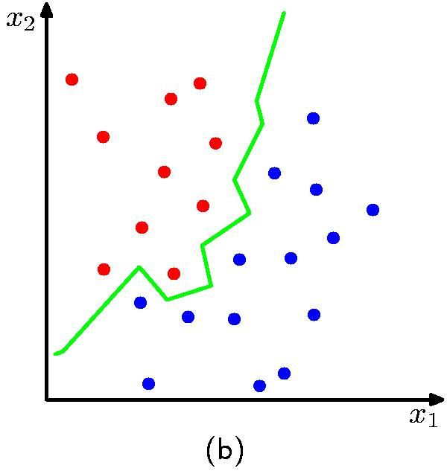
K Nearest Neighbour (kNN) Classifier when k=1
K = 1

Slide 6
K Nearest Neighbour (kNN) Classifier
K is a hyperparameter of the model
(k=4)
(k=1)

Slide 7
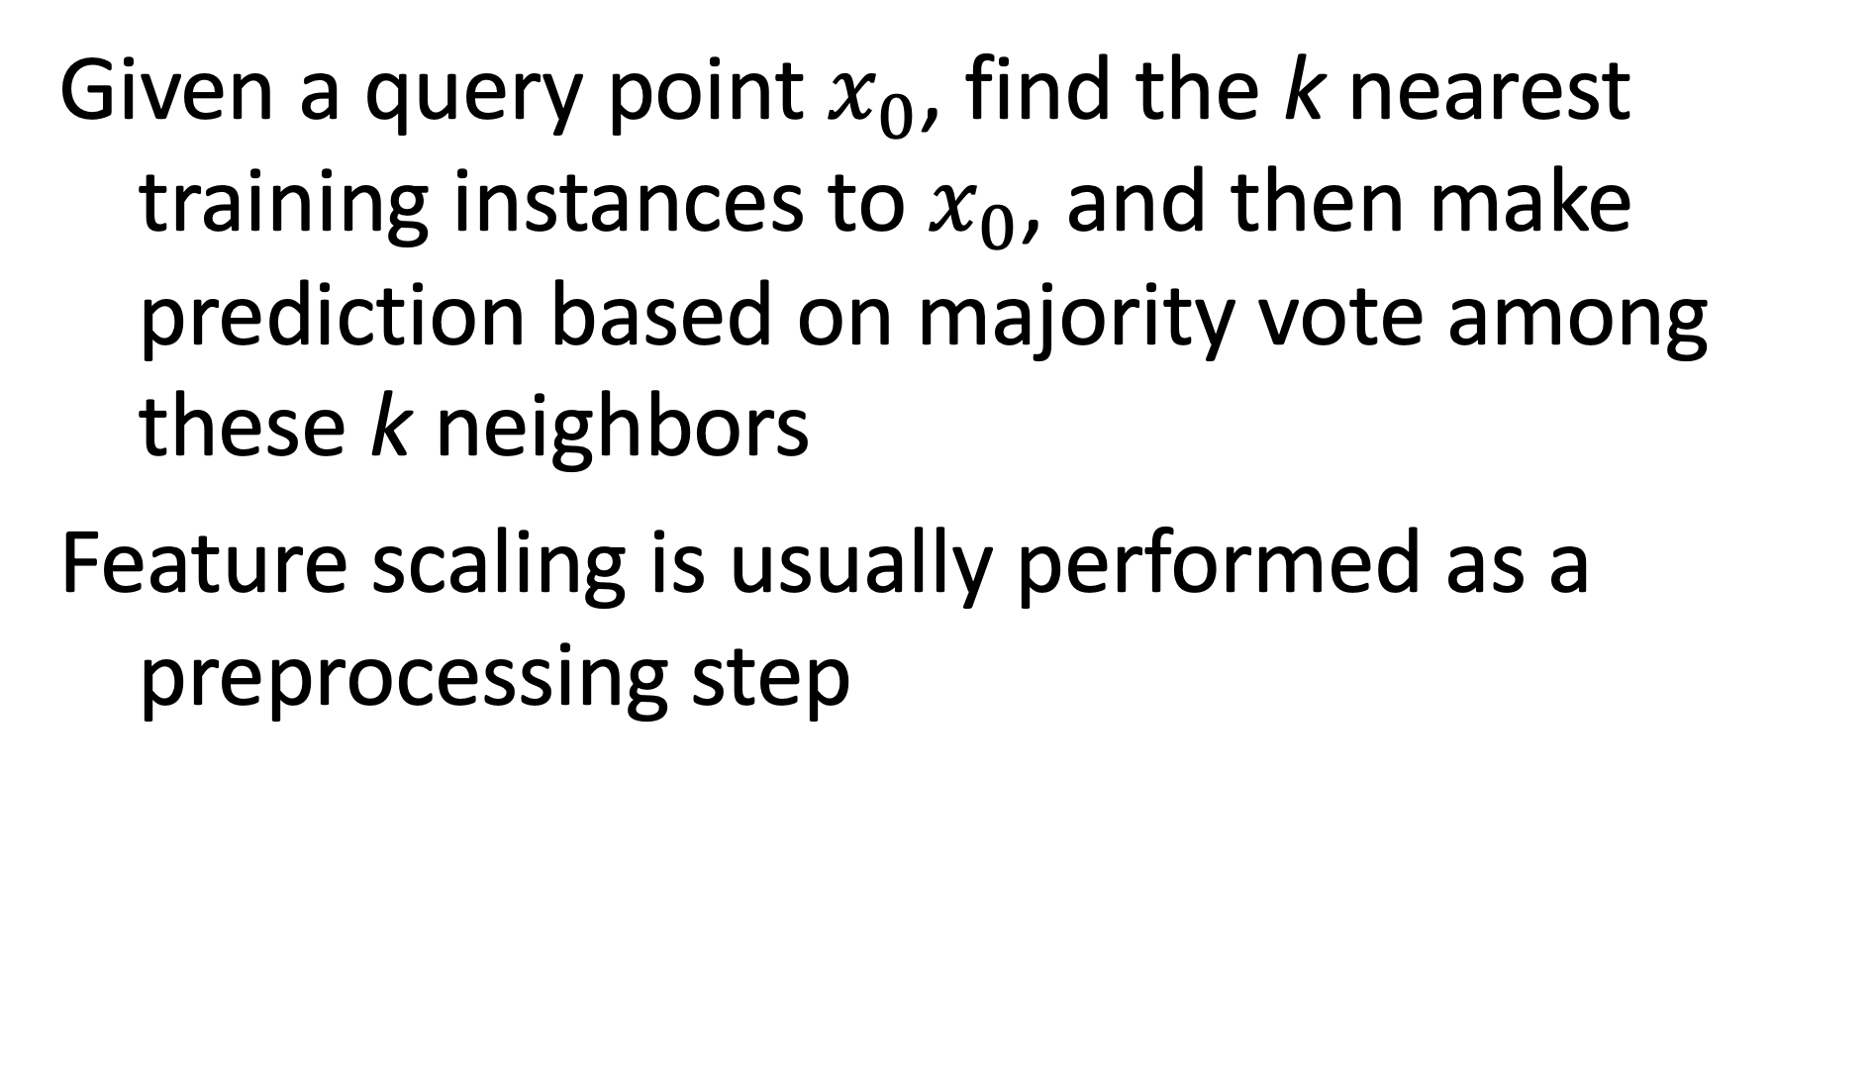
KNN classifier
Given a query point $x_{0}$, find the k nearest training instances to $x_{0}$, and then make prediction based on majority vote among these k neighbors
Feature scaling is usually performed as a preprocessing step

Slide 8
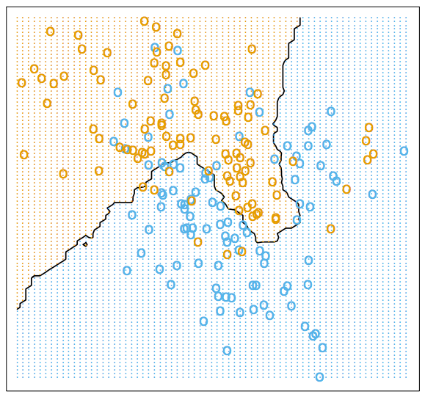
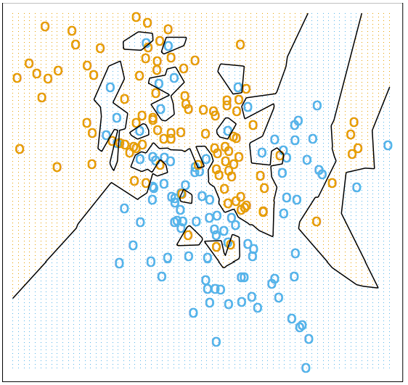
How to select k?
15-nearest neighbors
1-nearest neighbors

Slide 9
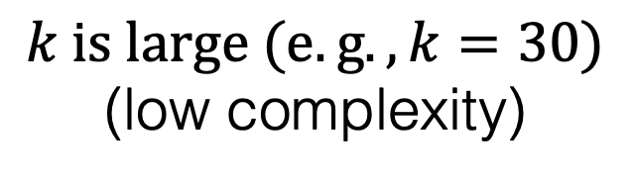
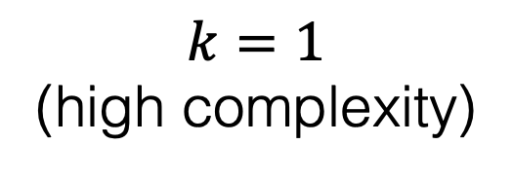
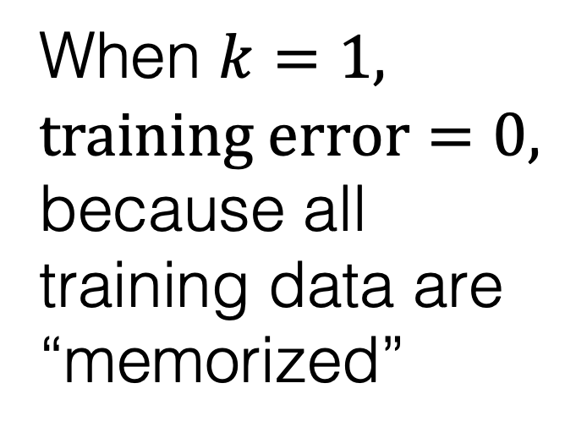
Overfitting vs underfitting of KNN
Error
Test data
When $k=1,$ $training error=0,$ because all training data are “memorized”
Training data
$$k=1$$
(high complexity)
$$k is large (e.g.,k=30)$$
(low complexity)

Slide 10
Why feature scaling?

Slide 11
Popular feature preprocessing methods
Normalized to N(0, 1)
Scale to [o, 1]
Scale to [-1, 1]

Slide 12
Quiz
How to select k?
What if k is an even number?
What if k equals 1?
What if k equals the number of the training instances?
How fast for model training/testing?

Slide 13
Quiz
How to accelerate testing time?
E.g., by designing a special data structure and algorithm? By approximation?
Although this may increase the training time
This could be a research project!
How to measure “distance”?
Euclidean distance, Cosine distance, etc.
Can we apply knn when some features are categorical?
Can we use KNN to do regression?

Slide 14
Quiz
Training data: (X=height, y=gender)
Given a new student’s height, explain how to predict the student’s gender by kNN (k=3)?
Explain overfitting and underfitting
When using KNN with a very small k, will the model tend to overfit or underfit?

