Slide 1
K-means clustering
Hung-Hsuan Chen 陳弘軒
Computer Science and Information Engineering
National Central University
hhchen@ncu.edu.tw
Slides adapted from David Sontag (NYU), Andrew W. Moore (CMU), Elise Arnaud (INRIA)

Slide 2
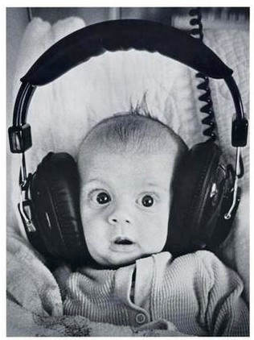
Clustering
Clustering:
Unsupervised learning
Requires data, but no labels
Detect patterns e.g. in
Group emails or search results
Customer shopping patterns
Regions of images
Useful when don’t know what you’re looking for
But: can get gibberish

Slide 3



Clustering
Basic idea: group together similar instances
Example: 2D point patterns

Slide 4


Clustering
Basic idea: group together similar instances
Example: 2D point patterns

Slide 5




Clustering
Basic idea: group together similar instances
Example: 2D point patterns
What could “similar” mean?
One option: small Euclidean distance (squared)
Clustering results are crucially dependent on the measure of similarity (or distance) between the “points” to be clustered

Slide 6
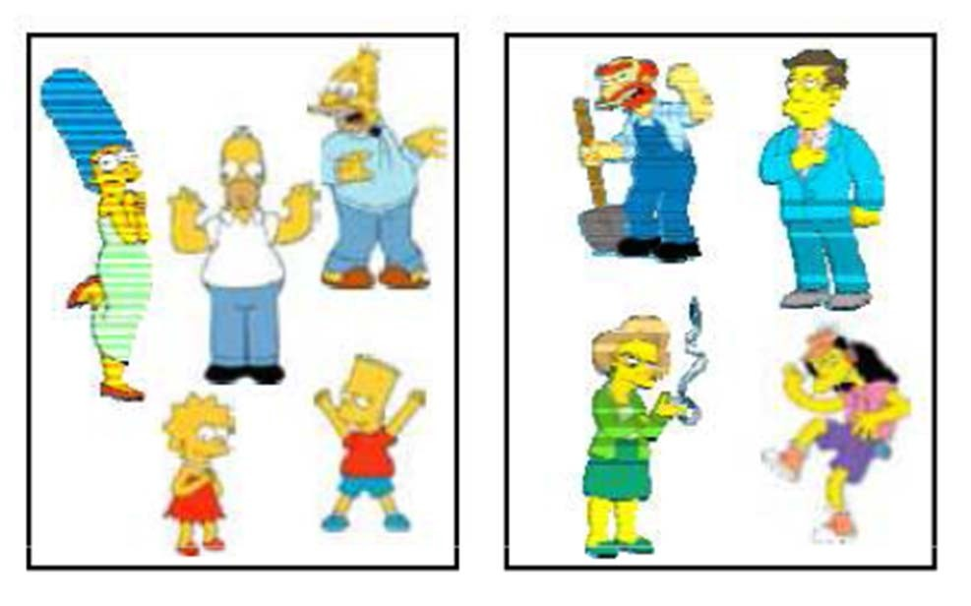
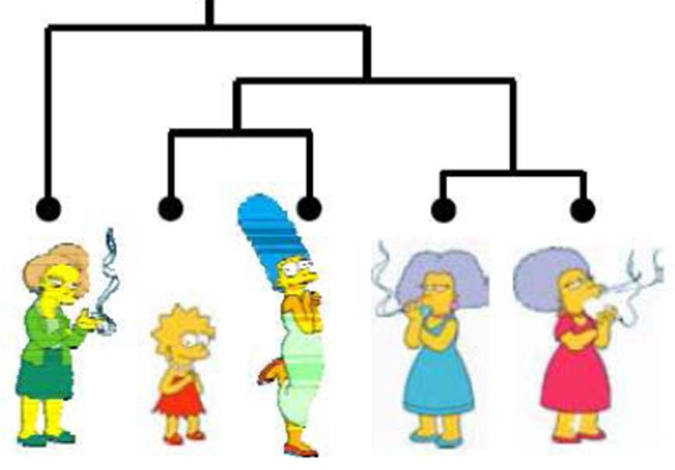
Clustering algorithms
Partition algorithm (Flat)
K-means
Mixture Gaussian
Spectral clustering
Hierarchical algorithm
Bottom up – agglomerative
Top down -- divisive

Slide 7
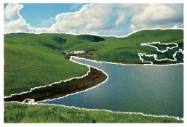
Clustering examples
Image segmentation
Goal: Break up the image into meaningful or perceptually similar regions
[Slide from James Hayes]

Slide 8
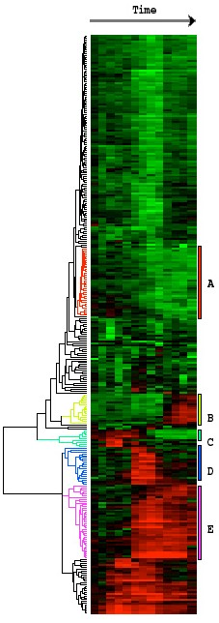
Clustering examples
Clustering gene expression data
Eisen et al, PNAS 1998

Slide 9
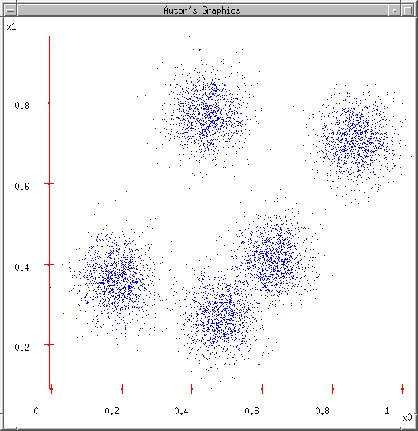
K-means
Ask user how many clusters they’d like. (e.g. k=5)

Slide 10
K-means
Ask user how many clusters they’d like. (e.g. k=5)
Randomly guess k cluster Center locations

Slide 11
K-means
Ask user how many clusters they’d like. (e.g. k=5)
Randomly guess k cluster Center locations
Each datapoint finds out which Center it’s closest to. (Thus each Center “owns” a set of datapoints)

Slide 12
K-means
Ask user how many clusters they’d like. (e.g. k=5)
Randomly guess k cluster Center locations
Each datapoint finds out which Center it’s closest to.
Each Center finds the centroid of the points it owns

Slide 13
K-means
Ask user how many clusters they’d like. (e.g. k=5)
Randomly guess k cluster Center locations
Each datapoint finds out which Center it’s closest to.
Each Center finds the centroid of the points it owns…
…and jumps there
…Repeat until terminated!

Slide 14
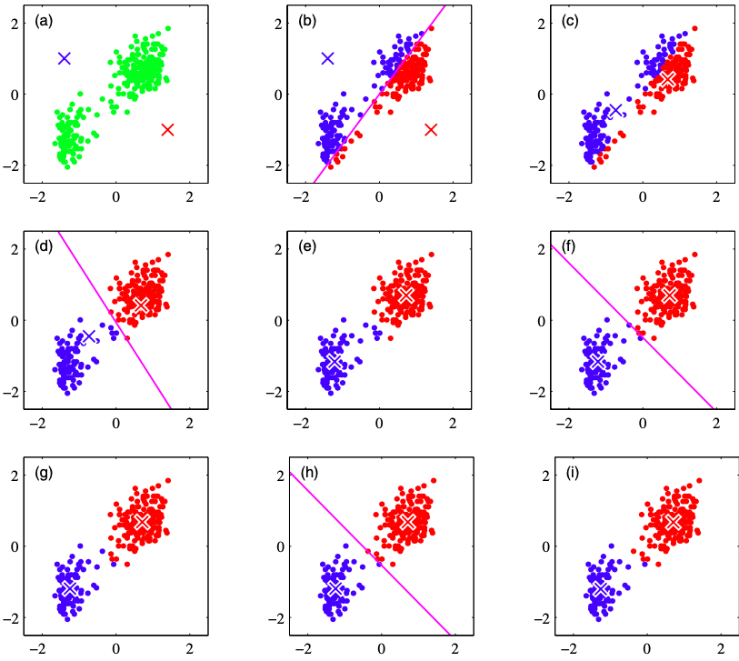
K-means example

Slide 15
K-means is guaranteed to converge
We ignore the proof here
However, given different initializations, the converged results could be different

Slide 16
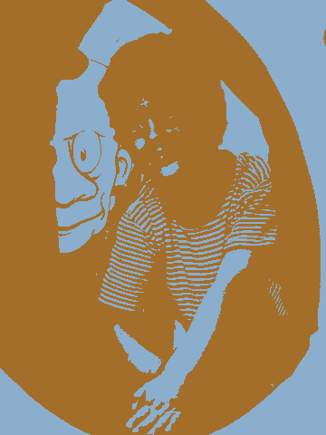
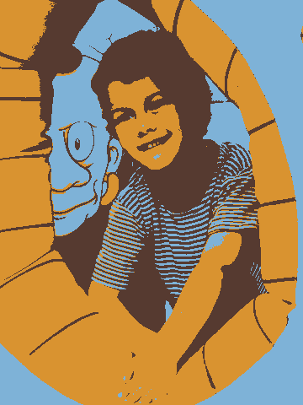
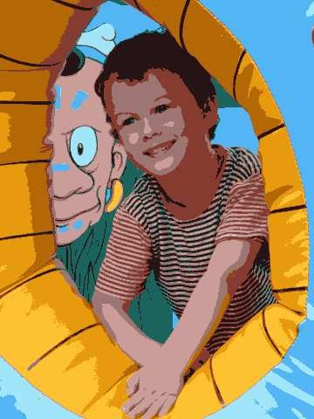
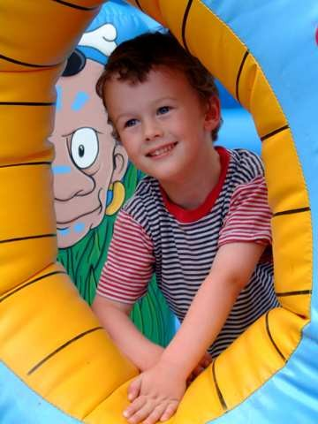
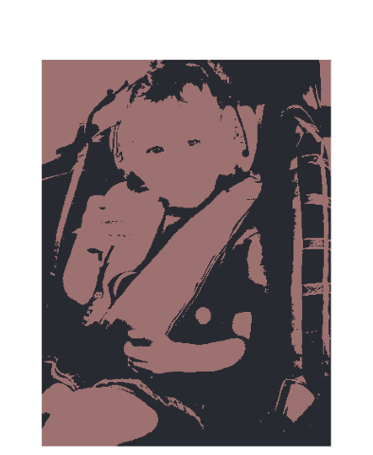
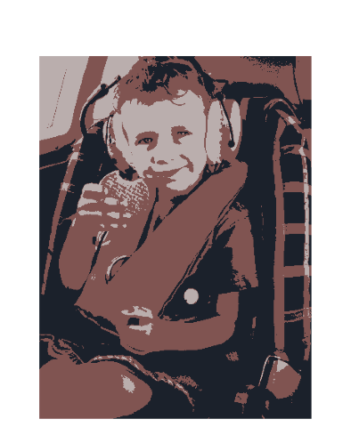
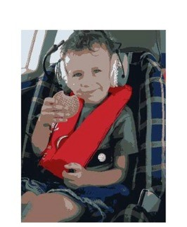
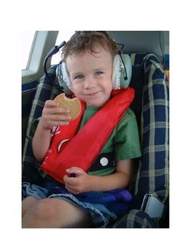
Example: K-Means for Segmentation
K =2
K =3 K = 10
Original image
K=2
Goal of Segmentation is
Original
to partition an image into regions each of which has reasonably homogenous visual appearance.

Slide 17
Example: K-Means for Segmentation
K =2
K =3
K=10
K=2
K=3
K = 10
Original image
Original

Slide 18
Example: K-Means for Segmentation
K =2
K =3
K = 10
Original image
K=2
K=3
K=10
Original
Size: 4% of original
8%
17%

Slide 19
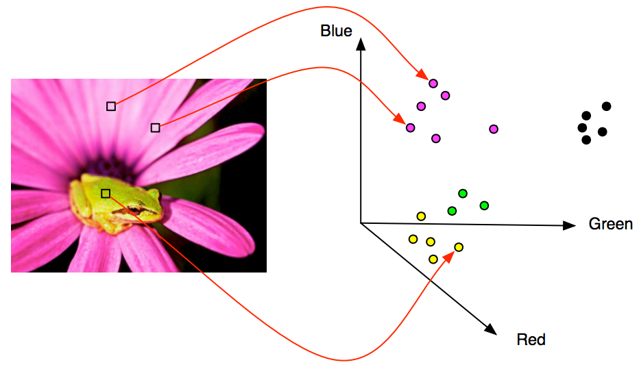
K-Means for Segmentation

Slide 20
Initialization
K-means algorithm is a heuristic
Requires initial means
It does matter what you pick!
What can go wrong?
Various schemes for preventing this kind of thing: variance-based split / merge, initialization heuristics

Slide 21
Example of K-Means Getting Stuck
Ideally

Slide 22
Example of K-Means Getting Stuck
A local optimum:
Would be better to have one cluster here
and two clusters here…

Slide 23









K-means not able to properly cluster

Slide 24








Changing the features can help
R
θ

Slide 25
Quiz
What is the difference between k-means and KNN?
Given a set of students with their heights, weights, and genders, you are asked to build a model to predict the gender of a new student
Which one is more appropriate? KNN or k-means?

