Slide 1
Distance measures
Reproduced from Jeffrey D. Ullman at Stanford

Slide 2
Axioms of a Distance Measure
d is a distance measure if it is a function from pairs of points to real numbers such that:
d(x,y) > 0.
d(x,y) = 0 iff x = y.
d(x,y) = d(y,x).
In fact, there are some asymmetric distance measures, so this constraint is not always required
d(x,y) < d(x,z) + d(z,y) (triangle inequality ).

Slide 3
Euclidean Distance
d(x,y) = square root of the sum of the squares of the differences between x and y in each dimension.
The most common notion of “distance.”
A.k.a., L₂ norm

Slide 4
Manhattan Distance
d(x,y) = sum of the differences in each dimension.
Distance if you had to travel along coordinates only.
A.k.a., L₁ norm

Slide 5
Examples of Euclidean Distance and Manhattan Distance
b = (9,8)
L₂-norm:
dist(x,y) =
√(4²+3²)
= 5
5
3
L₁-norm:
dist(x,y) =
4+3 = 7
4
a = (5,5)

Slide 6
Other norms
L∞ norm : d(x,y) = the maximum of the differences between x and y in any dimension.
Note: the maximum is the limit as n goes to ∞ of the L_{n} norm: what you get by taking the n ^{th} power of the differences, summing and taking the n ^{th} root.

Slide 7
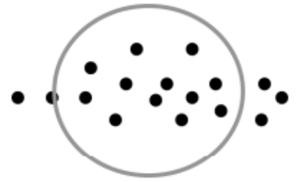
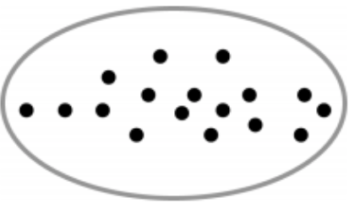
Mahalanobis distance
A lot of times, data points do not form a circle shape
We probably need to consider the variability of each dimension

Slide 8

Mahalanobis distance
$d\left(x,y\right)=\sqrt{\sum_{i=1}^{d}{\frac{{\left(x_{i}−y_{i}\right)}^{2}}{s_{i}^{2}}}}$
Take into account the variation of each dimension

Slide 9
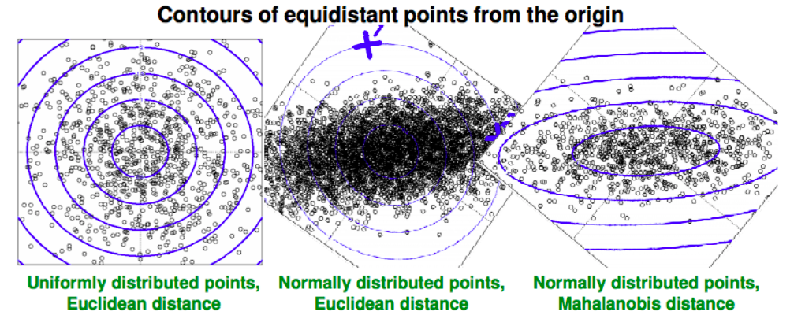
Euclidean vs Mahalanobis distance
Source: J. Leskovec, A. Rajaraman, J. Ullman: Mining of Massive Datasets

Slide 10
Distances beyond L_{k} norms
Jaccard distance for sets = 1 minus Jaccard similarity.
Cosine distance = angle between vectors from the origin to the points in question.
Edit distance = number of inserts and deletes to change one string into another.
Hamming Distance = number of positions in which bit vectors differ.

Slide 11
Jaccard Distance for Sets (Bit-Vectors)
Example: p₁ = {a,c,d,e}; p₂ = {a,d,e}.
Size of intersection = 3; size of union = 4, Jaccard similarity (not distance) = 3/4.
d(x,y) = 1 – (Jaccard similarity) = 1/4.

Slide 12
Why J.D. Is a Distance Measure
d(x,x) = 0 because x∩x = x∪x.
d(x,y) = d(y,x) because union and intersection are symmetric.
d(x,y) > 0 because |x∩y| < |x∪y|.
d(x,y) < d(x,z) + d(z,y) trickier – ignore the proof here

Slide 13
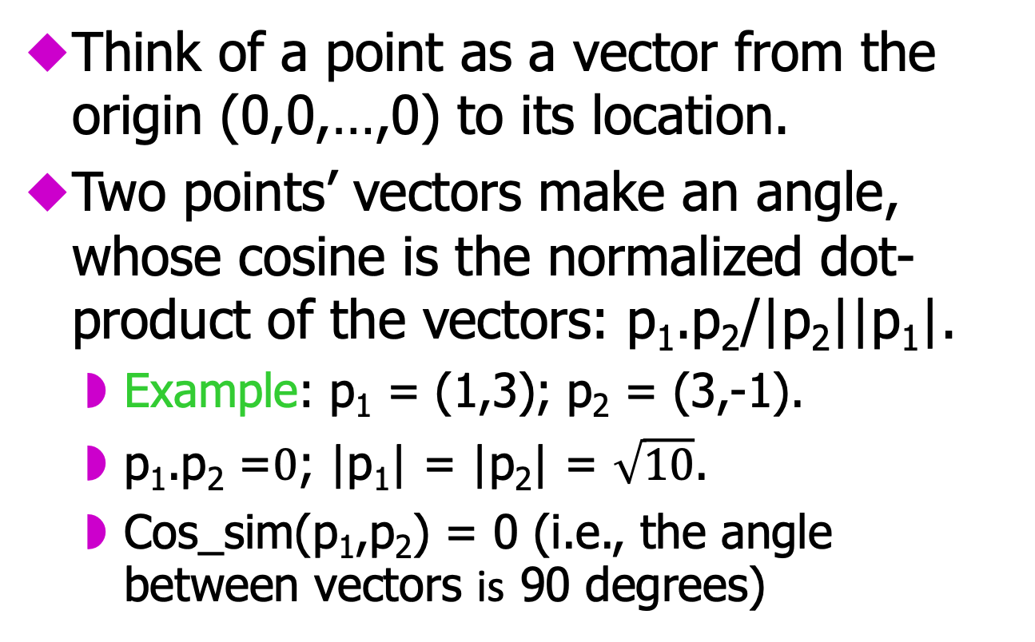
Cosine Distance and Similarity
Think of a point as a vector from the origin (0,0,…,0) to its location.
Two points’ vectors make an angle, whose cosine is the normalized dot-product of the vectors: p₁.p₂/|p₂||p₁|.
Example: p₁ = (1,3); p₂ = (3,-1).
p₁.p₂ =$0$; |p₁| = |p₂| = $\sqrt{10}$.
Cos_sim(p₁,p₂) = 0 (i.e., the angle between vectors is 90 degrees)

Slide 14
Cosine-Measure Diagram
p₁
θ
p₁.p₂
p₂
|p₂|
d (p₁, p₂) =1-cos_sim(P₁, P₂)

Slide 15
Why C.D. Is a Distance Measure
d(x,x) = 0 because cos_sim(x,x) = 1.
d(x,y) = d(y,x) by symmetry.
d(x,y) > 0 because cos_sim(x,y) is between -1 and 1
Triangle inequality: physical reasoning. If I rotate an angle from x to z and then from z to y, I can’t rotate less than from x to y.

Slide 16
Edit Distance
The edit distance of two strings is the number of inserts and deletes of characters needed to turn one into the other. Equivalently:
d(x,y) = |x| + |y| - 2|LCS(x,y)|.
LCS = longest common subsequence = any longest string obtained both by deleting from x and deleting from y.

Slide 17
Example: LCS
x = abcde ; y = bcduve.
Turn x into y by deleting a, then inserting u and v after d.
Edit distance = 3.
Or, LCS(x,y) = bcde.
Note: |x| + |y| - 2|LCS(x,y)| = 5 + 6 –2*4 = 3 = edit distance.

Slide 18
Why Edit Distance Is a Distance Measure
d(x,x) = 0 because 0 edits suffice.
d(x,y) = d(y,x) because insert/delete are inverses of each other.
d(x,y) > 0: no notion of negative edits.
Triangle inequality: changing x to z and then to y is one way to change x to y.

Slide 19
Variant Edit Distances
Allow insert, delete, and mutate.
Change one character into another.
Minimum number of inserts, deletes, and mutates also forms a distance measure.
Ditto for any set of operations on strings.
Example: substring reversal OK for DNA sequences

Slide 20
Hamming Distance
Hamming distance is the number of positions in which bit-vectors differ.
Example: p₁ = 10101; p₂ = 10011.
d(p₁, p₂) = 2 because the bit-vectors differ in the 3rd and 4th positions.

Slide 21
Why Hamming Distance Is a Distance Measure
d(x,x) = 0 since no positions differ.
d(x,y) = d(y,x) by symmetry of “different from.”
d(x,y) > 0 since strings cannot differ in a negative number of positions.
Triangle inequality: changing x to z and then to y is one way to change x to y.

Slide 22
Other distance measures
Distance between two distributions
KL-divergence (a well-known asymmetric distance measure)
Number of steps to move a king (in a chess game) from (x1, y1) to (x2, y2),
A king can move to any of it’s neighboring square
A.k.a., infinity norm, or Chebyshev distance
Distance = max(|x1-x2|, |y1-y2|)

Slide 23
Quiz
Given an example in which Euclidean distance may be inapplicable or inappropriate
How to define the distance between two sets (e.g., A=[1,2,3], B=[2,3,4], C=[5,6,7], S(A,B)=? S(A,C)=?)
Doc1 has 100 word “w1” and 300 word “w2”; doc2 has 10 word “w1” and 30 word “w2”, doc3 has 101 word ”w1” and 200 word “w2”
Which doc is more similar to doc1?

