Slide 1
Information measurement and entropy
Hung-Hsuan Chen

Slide 2
Claude E. Shannon
1916 – 2001
Master’s thesis: a symbolic analysis of relay and switching circuits (1937)
PhD thesis: an algebra for theoretical genetics
The foundation of practical digital circuit design
Howard Gardner called Shannon's thesis "possibly the most important, and also the most noted, master's thesis of the (20th) century."
“A Mathematical Theory of Communication” (1948) -- Shannon developed information entropy as a measure for the uncertainty in a message
This essentially invents the field of information theory

Slide 3
How to measure “information”?
If we observe the occurrence of an event E with probability p, how much information we get?
I(p) = ?
Note that measure we use p (not E) as the input parameter
Essentially, given two events E₁ and E₂, if their occurrence chance are both p, observing E₁ and observing E₂ reveal the same amount of information

Slide 4
The desired properties of the information measure
We want the information measure I(p) to have the following properties
I(p) ≥ 0
If p=1, we get no information from the occurrence of the event ➔ I(p) = 0
If two independent events E (with probability p) and F (with probability q) occur, the information we get from observing both events is the sum of the two information ➔ I(p * q) = I(p) + I(q)
The information measure should be a continuous and monotonic function of the probability
Observing a more likely events gives us fewer information
Shannon discovered a proper function to meet the above properties:
I(p) = log(1/p) = -log(p)

Slide 5
Logarithm with different bases
log₂: binary information unit ➔ bit
log₃: trinary information unit ➔ trit
log_{e}: natural information unit ➔ nat
Unless otherwise mentioned, we often use base 2
If you see log(p), typically we mean log₂(p)

Slide 6
Examples
If you draw a card at random from a standard N=52-card deck and get a spade-A, how much information you get?
p = 1/52, I(p) = log₂(52/1) = 5.7
If the card is a heart, how much information you get?
p = 1/4, I(p) = log₂(4/1) = 2

Slide 7
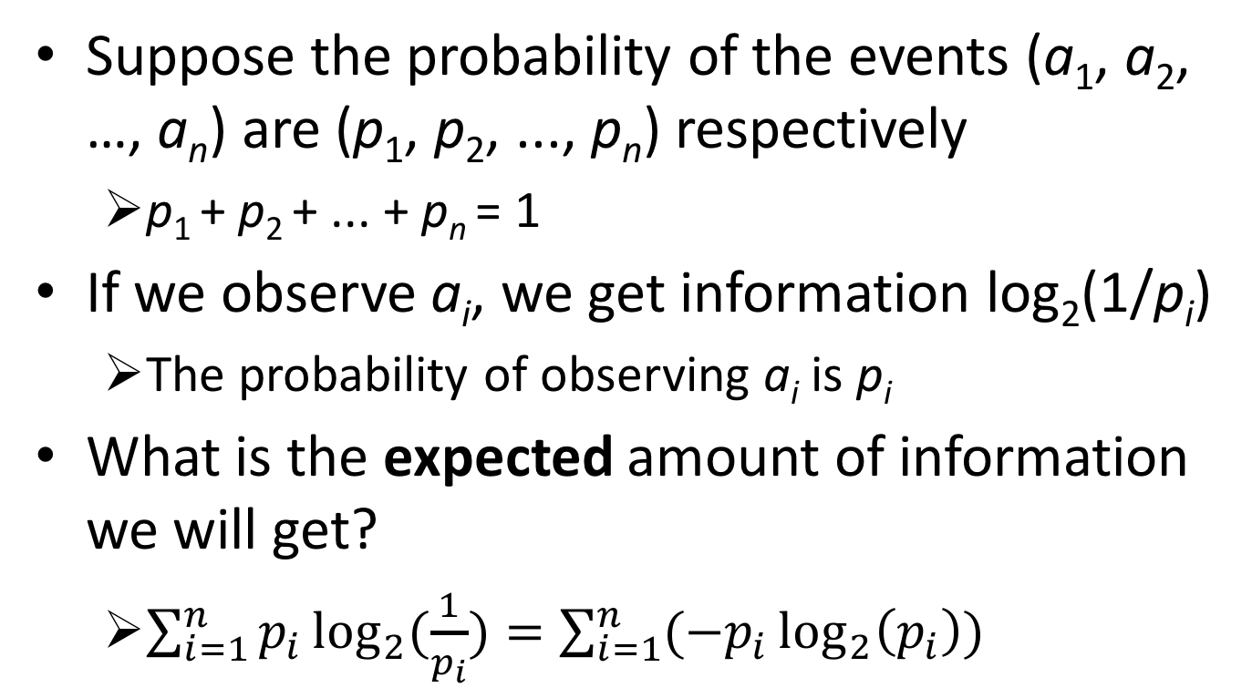
Entropy as the expected amount of information
Suppose the probability of the events (a₁, a₂, …, a_{n}) are (p₁, p₂, ..., p_{n}) respectively
p₁ + p₂ + ... + p_{n} = 1
If we observe a_{i}, we get information log₂(1/p_{i})
The probability of observing a_{i} is p_{i}
What is the expected amount of information we will get?
$\sum_{i=1}^{n}{p_{i}\log_{2}{(\frac{1}{p_{i}})}}=\sum_{i=1}^{n}{({−p}_{i}\log_{2}\left(p_{i}\right))}$

Slide 8
Entropy as a measurement of uncertainty
Example
Predicting the tossing result of a fair coin is harder (uncertainty is high)
Predicting the tossing result of an unfair coin is easier (uncertainty is low)
Uniform distribution ➔ every outcome is equally likely ➔ hard to predict ➔ high uncertainty ➔ high entropy
Gaussian distribution with small variance ➔ certain outcomes are more likely ➔ easier to predict ➔ low uncertainty ➔ low entropy

Slide 9
The range of entropy
Max: log₂(n)
n: the number of possible outcomes
If n=2, the max entropy is 1
Max occurs when all the probabilities are the same
p₁ = p₂ = p₃ = … = p_{n} = 1/n
Min: 0
Min occurs when one of the probabilities is 1 and the rests are 0’s
p_{i}=1; for all j≠i, p_{j}=0

Slide 10
Shannon game
Guess a short paragraph “character by character”
The expected value of the log of the number of guesses is the entropy of the paragraph
The following examples are listed in the book “The most human human” by Brian Christian (Chinese translation: 人性較量)

Slide 11
U N D E R N E A T H _ T H E _ B L U E _
22 1 1 1 1 1 1 1 1 1 1 2 1 1 1 5 6 5 1 2
C U S I O N _ I N _ T H E _ L I V I N G _
2 7 11 5 1 1 1 2 6 5 2 1 1 1 1 1 1 1 1 1 1
R O O M _ I S _ A _ H A N D F U L _ O F _
1 1 1 1 1 1 1 1 1 1 19 3 1 2 13 5 1 1 1 1 1
C H A N G E _ A N D _ T H E _ R E M O T E _
1 21 1 1 2 1 1 1 1 1 1 6 1 1 1 4 2 9 5 1 1 1
C O N T R O L
1 1 1 1 1 1 1
# of times to correctly guess the character
Information entropy is highly imbalanced
Some are easy to guess (low entropy)
Some requires much effort (high entropy)

Slide 12
E V E N _ T H O U G H _ Y O U _ D O N T _
K N O W _ H O W _ T O _ F L Y _ Y O U _
M I G H T _ B E _ A B L E _ T O _ L I F T _
Y O U R _ S H O E _ L O N G _ E N O U G H _
F O R _ T H E _ C A T _ T O _ M O V E _ O U T _
F R O M _ U N D E R _ Y O U R _ F O O T
Brian reported “Y”, “C”, and “M” are the ones with highest entropy (most guesses)
It seems that “you”, “cat”, and “move” are the essence of the paragraph

Slide 13
Search function and Shannon game
When using search engines, we tend to pick the less common words (high entropy)
Because we know that common words lead you to less relevant pages
When search for a certain paragraph in a large document, we tend to search for the “special words”
Because we know the common words may appear in many paragraphs

Slide 14
Summary
Information entropy provides a possible way to measure the “information” based on uncertainty
A highly certain event provides little information
We may use information entropy to help build a decision tree classifier
We want after a split, each child node is “pure” (less uncertain)
i.e., the information entropy is low

Slide 15
Quiz
Calculate the entropy of the following cases
(O,O,X,X)
½ log₂(2) + ½ log₂(2) = 1
(O,O,O,O)
0
(O,O,X,X,A,A,B,B)
Max entropy ➔ log₂(4) = 2
Or, based on the definition: ¼ log₂(4) + ¼ log₂(4) + ¼ log₂(4) + ¼ log₂(4) = log₂(4) = 2

