Slide 1
Decision tree classifier
Hung-Hsuan Chen 陳弘軒
Computer Science and Information Engineering
National Central University
hhchen@ncu.edu.tw
Many slides are taken from Jiawei Han at UIUC

Slide 2
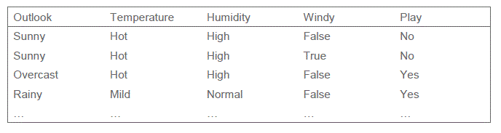
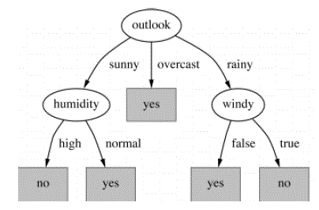
Decision Tree (1/2)
Training set
y_{i}: +1:Yes, -1: No
feature vector (x_{i})
Learned decision tree
[Note]
Only one feature will be involved at a node

Slide 3
Decision Tree (2/2)
Example:
(A test instance)
Outlook | Temperature | Humidity | Windy | Play
Rainy | Hot | High | True | ?
Ans: no

Slide 4
How to generate a classification tree?

Slide 5
Algorithm for Decision Tree Induction
Basic algorithm (a greedy algorithm)
Tree is constructed in a top-down recursive divide-and-conquer manner.
Attributes are categorical.
(if an attribute is a continuous number, it needs to be discretized in advance.) E.g.
At start, all the training examples are at the root.
Examples are partitioned recursively based on selected attributes.
0 ~ 20
61 ~ 80
0 <= age <= 100
21 ~ 40
81 ~ 100
41 ~ 60

Slide 6
Algorithm for Decision Tree Induction
Basic algorithm (a greedy algorithm)
Test attributes are selected on the basis of a heuristic or statistical measure (e.g., information gain): maximizing an information gain measure, i.e., favoring the partitioning which makes the majority of examples belong to a single class.
better

Slide 7
Expected Information (Entropy)
Expected information (entropy) needed to classify a tuple in D:
(p_{i}: probability that a tuple in D belongs to class C_{i}, m: number of classes)
Notes:
I : the expected information needed to classify a given sample
E (entropy) : expected information based on the partitioning into subsets by A

Slide 8
Expected Information (Entropy)
Information needed (after using A to split D into v partitions) to classify D:
Split on Attribute A
Split on Attribute B
Notes:
I : the expected information needed to classify a given sample
E (entropy) : expected information based on the partitioning into subsets by A

Slide 9
Algorithm for Decision Tree Induction
Basic algorithm (a greedy algorithm)
Test attributes are selected on the basis of a heuristic or statistical measure (e.g., information gain): maximizing an information gain measure, i.e., favoring the partitioning which makes the majority of examples belong to a single class.
Examples of conditions for stopping partitioning:
All samples for a given node belong to the same class
There are no remaining attributes for further partitioning – majority voting is employed for classifying the leaf
There are no samples left

Slide 10
Primary Issues in Tree Construction (1/2)
Split criterion: Goodness function
Used to select the attribute to be split at a tree node during the tree generation phase
Different algorithms may use different goodness functions:
Information gain (used in ID3)
Gain ratio (used in C4.5)
Gini index (used in CART)

Slide 11
Primary Issues in Tree Construction (2/2)
Branching scheme:
Determining the tree branch to which a sample belongs
Binary vs. k-ary splitting
When to stop the further splitting of a node? e.g. impurity measure
Labeling rule: a node is labeled as the class to which most samples at the node belongs.
Income: high
Income: medium
Income: low

Slide 12
How to Use a Tree?
Directly
Test the attribute value of unknown sample against the tree.
A path is traced from root to a leaf which holds the label.
Indirectly
Decision tree is converted to classification rules.
One rule is created for each path from the root to a leaf.
IF-THEN might be easier for humans to understand .

Slide 13
Expected Information (Entropy)
Entropy is a measurement of uncertainty (or randomness, untidiness)
Entropy H(X) of a coin flip
X: the probability of getting a head
If the coin is fair, then entropy of the next flip is maximized
This is the situation of maximum uncertainty, since it is most difficult to predict the outcome
If the coin is unfair, there is less uncertainty
One side is more likely to come up than the other
Extreme case: a double-headed or a double-tailed coin
There is no uncertainty
The entropy is zero

Slide 14
Attribute Selection Measure: Information Gain (ID3)
Select the attribute with the highest information gain
To minimize # of tests needed to classify a given tuple
Let p_{i} be the probability that an arbitrary tuple in D belongs to class C_{i}; p_{i} is estimated by |C_{i, D}|/|D|
Expected information (entropy) needed to classify a tuple in D:
Information needed (after using A to split D into v partitions) to classify D:
Information gained by branching on attribute A
We’d like to maximize Gain(A), i.e., to minimize Info_{A}(D), the information still required to finish classifying the tuples
Notes:
I : the expected information needed to classify a given sample
E (entropy) : expected information based on the partitioning into subsets by A

Slide 15
Decision Tree Induction: An Example
Training data set: Buys_computer
Resulting tree:

Slide 16
Attribute Selection: Information Gain
Class P: buys_computer = “yes”
Class N: buys_computer = “no”

Slide 17
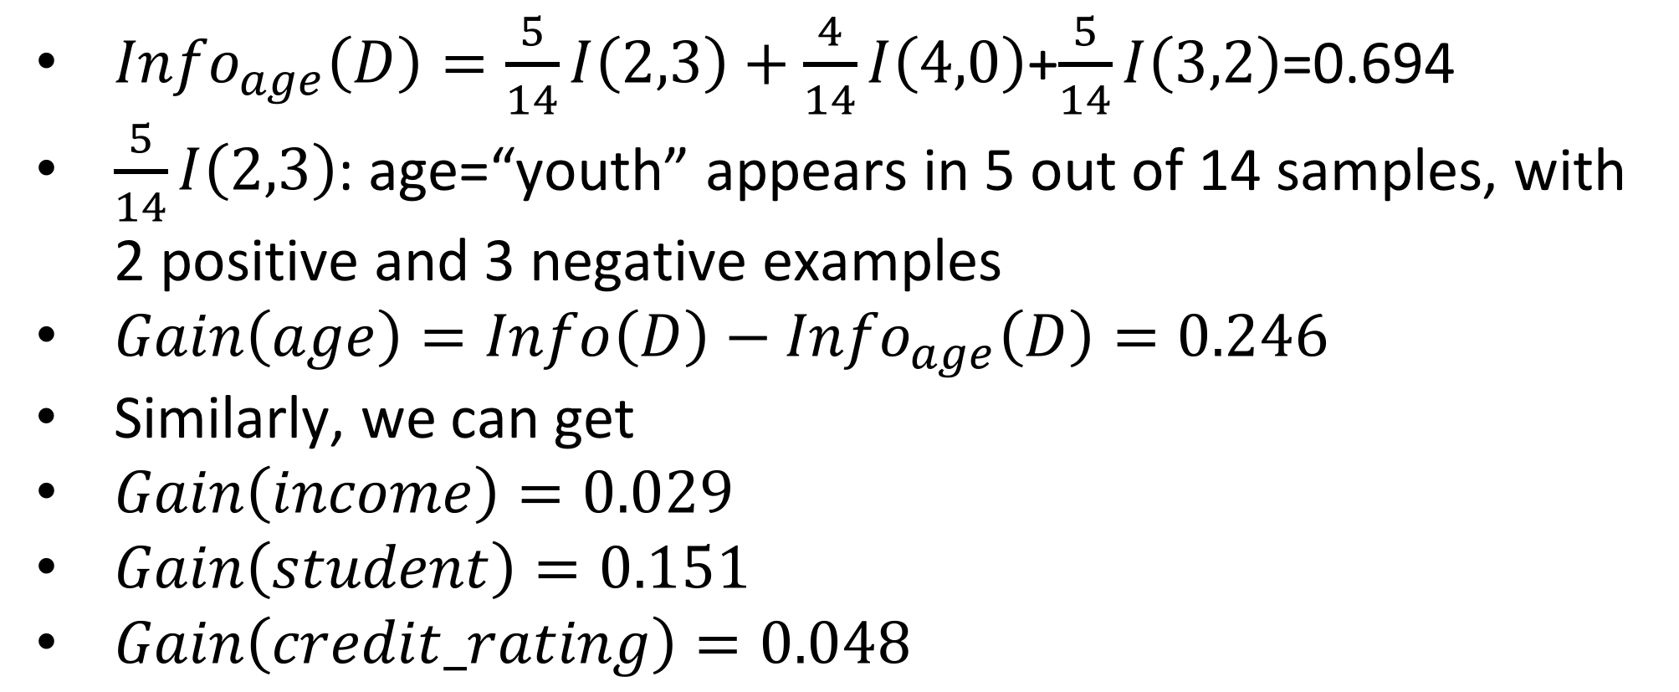
Attribute Selection: Information Gain
Class P: buys_computer = “yes”
Class N: buys_computer = “no”
${Info}_{age}\left(D\right)=\frac{5}{14}I\left(2,3\right)+\frac{4}{14}I\left(4,0\right)$+$\frac{5}{14}I\left(3,2\right)$=0.694
$\frac{5}{14}I\left(2,3\right)$: age=“youth” appears in 5 out of 14 samples, with 2 positive and 3 negative examples
$Gain\left(age\right)=Info\left(D\right)−{Info}_{age}\left(D\right)=0.246$
Similarly, we can get
$Gain\left(income\right)=0.029$
$Gain\left(student\right)=0.151$
$Gain\left(credit_rating\right)=0.048$

Slide 19
Quiz
Which of the following has a higher entropy?
(O,O,X,X) vs (O,O,X,X,X) vs (O,O,O)
Which attribute (A or B) will be selected by a decision tree classifier based on information gain?
Split on Attribute A
Split on Attribute B

Slide 20
Gain Ratio for Attribute Selection (C4.5)
Information gain measure is biased towards attributes with a large number of values
E.g., unique pID -> split on pID results in large number of partitions, each containing just one tuple => each partition is pure => information required to classify this partition would be Info_{pID}(D)=0, i.e., the information gain is maximal!!
C4.5 (a successor of ID3) uses gain ratio to overcome the problem (normalization to information gain)
GainRatio(A) = Gain(A)/SplitInfo(A)
The attribute with the maximum gain ratio is selected as the splitting attribute

Slide 21
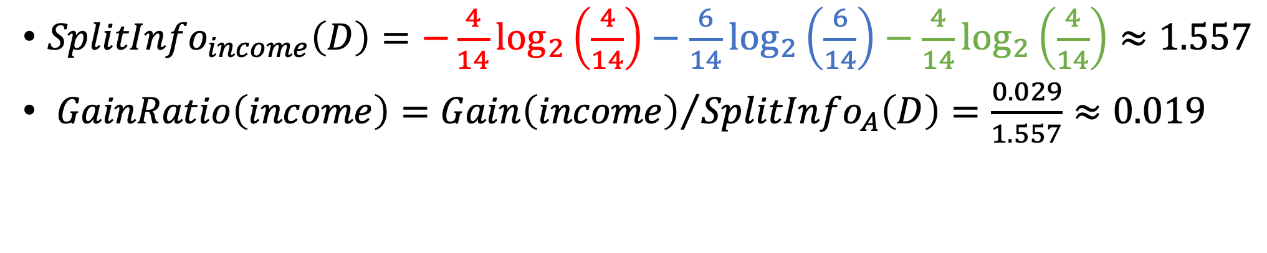
Example of Gain Ratio
# income=high: 4
# income=medium: 6
# income=low: 4
${SplitInfo}_{income}\left(D\right)=−\frac{4}{14}\log_{2}\left(\frac{4}{14}\right)−\frac{6}{14}\log_{2}\left(\frac{6}{14}\right)−$ $\frac{4}{14}\log_{2}\left(\frac{4}{14}\right)≈1.557$
$GainRatio\left(income\right)={Gain\left(income\right)}/{SplitInfo_{A}\left(D\right)}=\frac{0.029}{1.557}≈0.019$

Slide 22
Quiz
Given students’ ID, height, weight, and gender as the training data, you are asked to build a decision tree classifier to predict a student’s gender based on her/his ID, height, and weight
Which attribute (ID, height, or weight) is likely to be selected first if you use information gain as the attribute selection method?

Slide 23
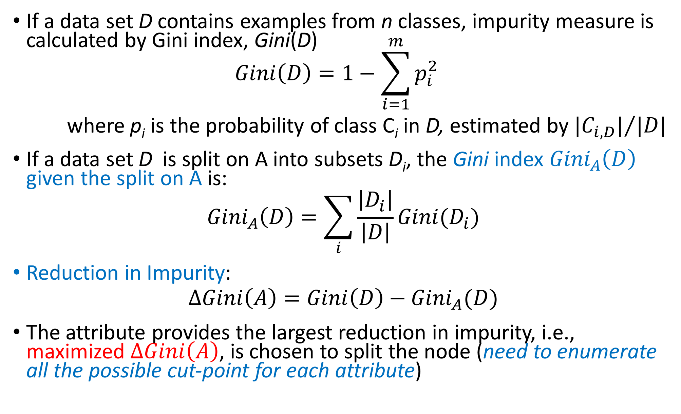
Gini Index (CART, IBM IntelligentMiner)
If a data set D contains examples from n classes, impurity measure is calculated by Gini index, Gini(D) $Gini\left(D\right)=1−\sum_{i=1}^{m}{p_{i}^{2}}$
where p_{i} is the probability of class C_{i} in D, estimated by ${{|C}_{i,D}|}/{|D|}$
If a data set D is split on A into subsets D_{i}, the Gini index ${Gini}_{A}\left(D\right)$ given the split on A is:
$${Gini}_{A}\left(D\right)=\sum_{i}{\frac{\left|D_{i}\right|}{\left|D\right|}Gini(D_{i})}$$
Reduction in Impurity:
$$∆Gini\left(A\right)=Gini\left(D\right)−{Gini}_{A}(D)$$
The attribute provides the largest reduction in impurity, i.e., maximized $∆Gini\left(A\right)$, is chosen to split the node (need to enumerate all the possible cut-point for each attribute)

Slide 24
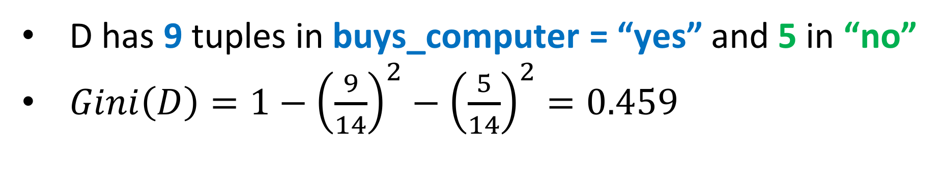
Example of Gini index
D has 9 tuples in buys_computer = “yes” and 5 in “no”
$Gini\left(D\right)=1−{\left(\frac{9}{14}\right)}^{2}−{\left(\frac{5}{14}\right)}^{2}=0.459$

Slide 25
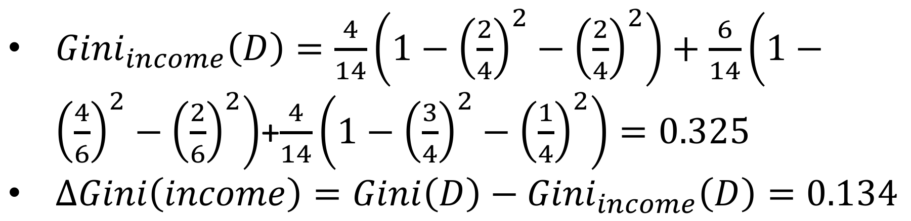
Example of Gini index
When income = “high”
2 “yes” and 2 “no”
When income = “medium”
4 “yes” and 2 “no”
When income = “low”
3 “yes” and 1 “no”
${Gini}_{income}\left(D\right)=\frac{4}{14}\left(1−{\left(\frac{2}{4}\right)}^{2}−{\left(\frac{2}{4}\right)}^{2}\right)+\frac{6}{14}\left(1−{\left(\frac{4}{6}\right)}^{2}−{\left(\frac{2}{6}\right)}^{2}\right)$+$\frac{4}{14}\left(1−{\left(\frac{3}{4}\right)}^{2}−{\left(\frac{1}{4}\right)}^{2}\right)=0.325$
$ΔGini\left(income\right)=Gini\left(D\right)−{Gini}_{income}\left(D\right)=0.134$

Slide 26
Quiz
Can we apply Decision Tree Classifier on the datasets with only numerical attributes?

Slide 27
Computing Information-Gain for Continuous-Valued Attributes
Let attribute A be a continuous-valued attribute
Must determine the best split point for A
Sort the value A in increasing order
Typically, the midpoint between each pair of adjacent values is considered as a possible split point
(a_{i}+a_{i+1})/2 is the midpoint between the values of a_{i} and a_{i+1}
The point with the minimum expected information requirement for A is selected as the split-point for A
Split:
D1 is the set of tuples in D satisfying A ≤ split-point, and D2 is the set of tuples in D satisfying A > split-point

Slide 28

Example of Information-Gain for Continuous-Valued Attributes
Sort the continuous-valued attributes
Determine the classifier’s changing points
E.g., (48-60) and (80-90) in the above example
Take the mid-points of the changing points as the candidates for discretization
E.g., (48+60)/2, (80+90)/2
Use “54” to split
If Temperature <= 54 ➔ No; Else ➔ Yes
Gain(T=54) = Info(D) – Info_{T=54}(D) = 1 – 0.811 = 0.189
Use “85” to split
If Temperature <= 85 ➔ Yes; Else ➔ No
Gain(T=85) = Info(D) – Info_{T=85}(D) = 1 – 0.696 = 0.304

Slide 29
Comparing Attribute Selection Measures
The three measures, in general, return good results but
Information gain:
biased towards multivalued attributes
Gain ratio:
tends to prefer unbalanced splits in which one partition is much smaller than the others
Gini index:
biased to multivalued attributes
Usually faster than information gain (because information gain requires logarithm computation)

Slide 30
Many Attribute Selection Measures
Which attribute selection measure is the best?
Most give good results, none is significantly superior than others

Slide 31
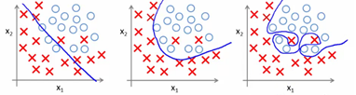
Overfitting and Tree Pruning
Overfitting: An induced tree may overfit the training data
Too many branches, some may reflect anomalies due to noise or outliers
Poor accuracy for unseen samples, i.e., lose the ability of generalization
underfitting overfitting

Slide 32
Overfitting and Tree Pruning
Perfect decision tree performs 100% accuracy on the training data
Assuming that in the training data if two instances have the same feature sets then they must have the same label
Prevent overfitting
Pre-prune the tree
Stop before a tree is fully grown
E.g., limit the tree height; stop when the number of instances in a node is small; when misclassification rate is low enough
The method is short-sighted
A seemly worthless early split may be followed by a very good split
Post-prune the tree
Grow a perfect tree and prune the nodes from bottom up
R_{α}(T) = R(T) + α⋅|f(T)|
Training error
# leaves

Slide 33

Post-pruning considerations
Goal: cut a large portion of a tree, but only increase few error rate
The two requests are usually against each other
We may define the goodness of a cut by
$α\left(t_{i}\right)=\frac{\# error after cut−\# error before cut}{\# leaves been cut−1}$

Slide 34


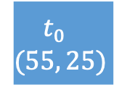
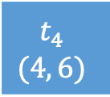
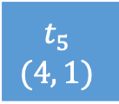
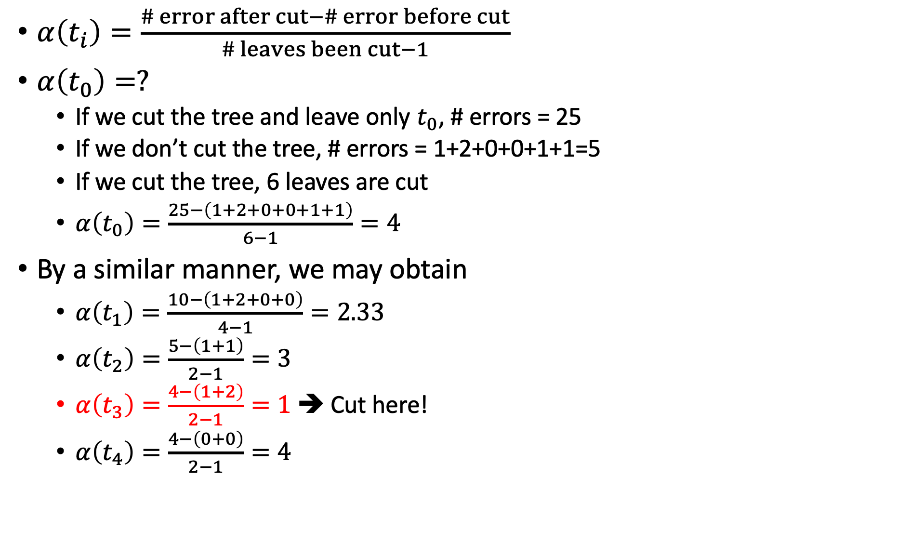

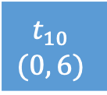
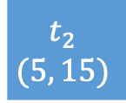
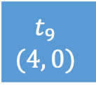
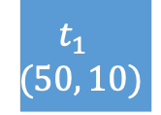
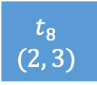
Example
$α\left(t_{i}\right)=\frac{\# error after cut−\# error before cut}{\# leaves been cut−1}$
$α\left(t_{0}\right)=?$
If we cut the tree and leave only $t_{0}$, # errors = 25
If we don’t cut the tree, # errors = 1+2+0+0+1+1=5
If we cut the tree, 6 leaves are cut
$α\left(t_{0}\right)=\frac{25−\left(1+2+0+0+1+1\right)}{6−1}=4$
By a similar manner, we may obtain
$α\left(t_{1}\right)=\frac{10−\left(1+2+0+0\right)}{4−1}=2.33$
$α\left(t_{2}\right)=\frac{5−\left(1+1\right)}{2−1}=3$
$α\left(t_{3}\right)=\frac{4−\left(1+2\right)}{2−1}=1$ ➔ Cut here!
$α\left(t_{4}\right)=\frac{4−\left(0+0\right)}{2−1}=4$
$$t_{0} \\ (55, 25)$$
$$t_{1} \\ (50, 10)$$
$$t_{2} \\ (5, 15)$$
$$t_{3} \\ (46, 4)$$
$$t_{4} \\ (4, 6)$$
$$t_{5} \\ (4, 1)$$
$$t_{6} \\ (1, 14)$$
$$t_{7} \\ (44, 1)$$
$$t_{8} \\ (2, 3)$$
$$t_{9} \\ (4, 0)$$
$$t_{10} \\ (0, 6)$$

Slide 35
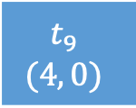
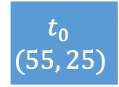
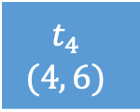

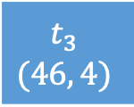

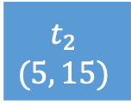
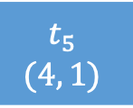
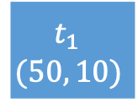
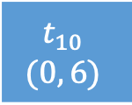
Example
$α\left(t_{0}\right)=\frac{25−\left(4+0+0+1+1\right)}{5−1}=4.75$
$α\left(t_{1}\right)=\frac{10−\left(4+0+0\right)}{3−1}=3$ ➔ Cut here!
$α\left(t_{2}\right)=\frac{5−\left(1+1\right)}{2−1}=3$
$α\left(t_{4}\right)=\frac{4−\left(0+0\right)}{2−1}=4$
$$t_{0} \\ (55, 25)$$
$$t_{1} \\ (50, 10)$$
$$t_{2} \\ (5, 15)$$
$$t_{3} \\ (46, 4)$$
$$t_{4} \\ (4, 6)$$
$$t_{5} \\ (4, 1)$$
$$t_{6} \\ (1, 14)$$
$$t_{9} \\ (4, 0)$$
$$t_{10} \\ (0, 6)$$

Slide 36
Classification tree is constructed in a ”greedy” manner
Greedy: pick a feature to split the data best on the current information
This may lead to a local optimal

Slide 37
Example
A | B | C | label
1 | 0 | 1 | 1
0 | 1 | 0 | 1
0 | 1 | 1 | 1
0 | 0 | 0 | 0
1 | 1 | 1 | 0
…
We build an imaginary dataset as follows
The dataset has three binary features A, B, and C
The label is constructed by A xor B
C is set to label for 80% of the time and the inverse of the label for 20% of the time
On average, Info_{A}(D) = 1
When A=1, 50% of the labels are 1 and 50% of the labels are 0
When A=0, 50% of the labels are 1 and 50% of the labels are 0
Similarly, Info_{B}(D) = 1
On average, Info_{C}(D) = 0.722
When C=1, 80% of the labels are 1; 20% of the labels are 0
When C=0, 80% of the labels are 0; 20% of the labels are 1
In the case, we will choose feature C as the feature to split data
However, an oracle should first select one feature from A or from B, and select the other feature as the second feature

Slide 38
Which one is better?
C
A
0
1
0
1
A
A
B
B
0
1
0
1
0
1
0
1
B
B
B
B
0
1
1
0
0
1
0
1
0
1
0
1
0
1
1
0
0
1
1
0
Occam's razor
Among competing hypotheses, the one with the fewest assumptions should be selected.

Slide 39
Why not try all possible attribute splitting sequences?
The best tree requires to test all possible sequences
Very large search space
If the training data have d binary features, consider one path from root to one leaf:
d possible roots
d-1 possible level-1 nodes
d-2 possible level-2 nodes
…
This is just one path from root to one leaf, there are d different leaves
If there are numerical attributes, the number of trees is even larger
Why?

Slide 40
An example of testing all trees vs decision trees
Suppose we want to predict whether an individual has a certain disease based on 4 binary features: gender (male/female), height (tall/short), weight (fat/thin), age (young/old)
Decision tree: need to test approximately 4 + 3*2 + 2*4 =18 splits
4: root split test 4 features
3*2: each level-1 node test 3 features; 2 level-1 nodes
2*4: each level-1 node test 2 features; 4 level-1 nodes
List all tress: need to test approximately 4 * 3*2 * 2*4 = 192
4: root split test 4 features
3*2: each level-1 node test 3 features; 2 level-1 nodes
2*4: each level-1 node test 2 features; 4 level-1 nodes

Slide 41
Regression tree
A brief review of classification tree
Select a feature A and a cut-point v to split the original dataset D into sub-groups such that the labels in each sub-group are as pure as possible
Repeat the above step
Regression tree
Select a feature A and a cut-point v to split the original dataset D into sub-groups such that the target values in each group is as pure as possible
There could be multiple ways to define “purity”
Possible choices: RSS (residual sum of squares), max-min, variance
Repeat the above step

Slide 42
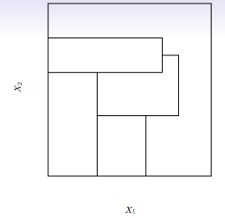
Quiz
You are asked to build a decision tree classifier based on two features x1 and x2. How to partition the space into the following figure?

Slide 43
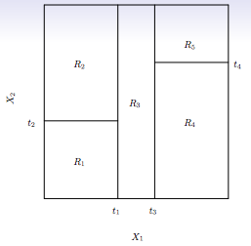
Quiz
You are asked to build a decision tree classifier based on two features x1 and x2. How to separate the space into the following figure?

Slide 44
Quiz
True or false: if decision tree T2 a pruned tree of tree T1, then T1 is less likely to overfit the training data
Consider the following training data
What is the entropy of the training examples?
What is the information gain of f2 relative to these training examples?
f1 | f2 | Target
T | T | 1
T | F | 1
T | T | 0
F | F | 1
F | T | 0
F | F | 0

Slide 45
Random forest
A random forest is a meta estimator that fits numerous decision tree classifiers on various sub-samples of the dataset
Each tree can use only part of the available features
A common practice is using sqrt(n_features)
Sub-sampling the training data for each tree
A common practice: the sub-sample size is always the same as the original input sample size, but the samples are drawn with replacement
The prediction is based on the majority voting of all the generated decision trees
Prevent overfitting
Usually yield higher test accuracy
Highly parallelizable during training and testing
One of the best predictor in many applications and competitions

Slide 46
Summary
Decision tree generates a set of classification/regression rules based on the training data
“Interpretable” prediction

