Slide 1
Matrix differentiation
Hung-Hsuan Chen

Slide 2
What is matrix differentiation
A specialized notation for doing multivariable differentiation, especially over spaces of matrices

Slide 3
Notations
x (lower case) ➔ a scalar
x (lower case, bold face) ➔ a column vector
x = (x₁, x₂, …, x_{n})^{T}
X (upper case, bold face) ➔ a matrix
X = (x_{ij}) = (x₁^{T}, x₂^{T}, ..., x_{n}^{T})

Slide 4
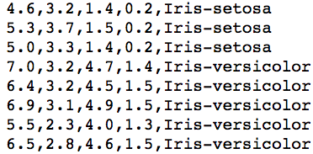
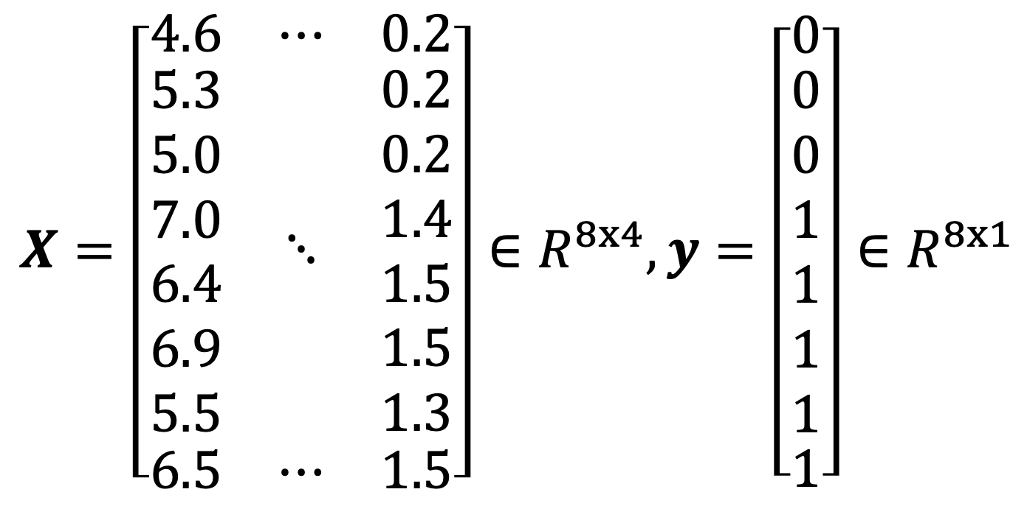
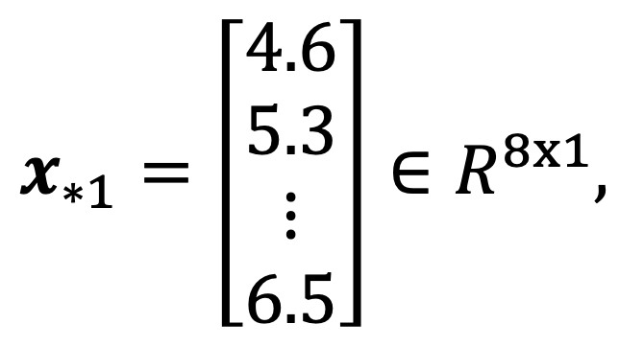
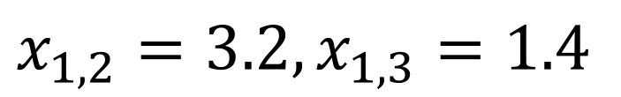
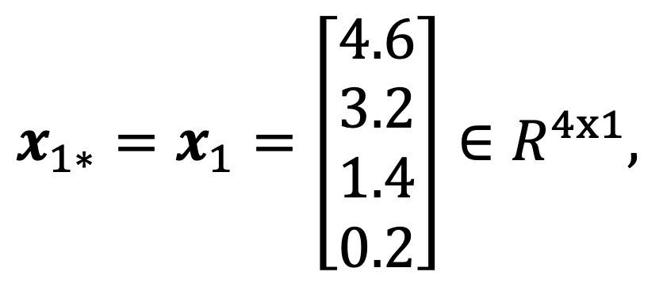
Example
$$X=\left[\begin{matrix}4.6 & ⋯ & 0.2 \\ \begin{aligned}5.3 \\ 5.0 \\ 7.0 \\ 6.4 \\ 6.9 \\ 5.5\end{aligned} & ⋱ & \begin{aligned}0.2 \\ 0.2 \\ 1.4 \\ 1.5 \\ 1.5 \\ 1.3\end{aligned} \\ 6.5 & ⋯ & 1.5\end{matrix}\right]∈R^{8x4}, y=\left[\begin{matrix}0 \\ \begin{aligned}0 \\ 0 \\ 1 \\ 1 \\ 1 \\ 1\end{aligned} \\ 1\end{matrix}\right]∈R^{8x1}$$
$$x_{1,2}=3.2, x_{1,3}=1.4$$
$$x_{1∗}=x_{1}=\left[\begin{aligned}4.6 \\ 3.2 \\ 1.4 \\ 0.2\end{aligned}\right]∈R^{4x1},$$
$$x_{∗1}=\left[\begin{aligned}4.6 \\ 5.3 \\ ⋮ \\ 6.5\end{aligned}\right]∈R^{8x1},$$

Slide 5
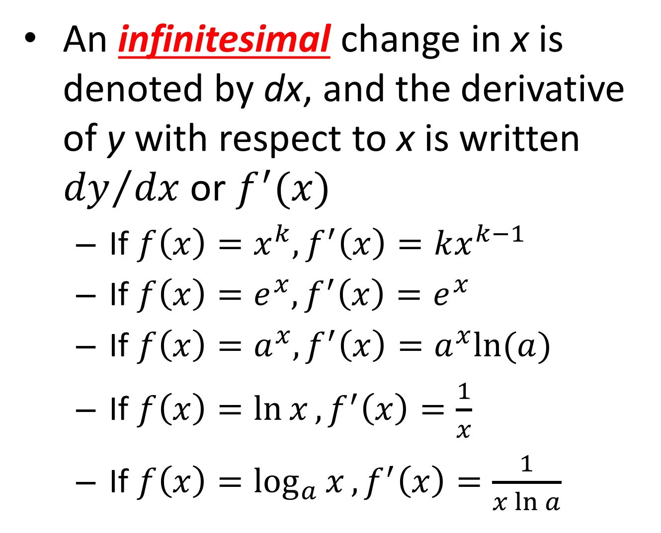
Derivative (scalar)
An infinitesimal change in x is denoted by dx, and the derivative of y with respect to x is written ${dy}/{dx}$ or $f^{′}(x)$
If $f\left(x\right)=x^{k}, f^{′}\left(x\right)=kx^{k−1}$
If $f\left(x\right)=e^{x}, f^{′}\left(x\right)=e^{x}$
If $f\left(x\right)=a^{x}, f^{′}\left(x\right)=a^{x}ln⁡(a)$
If $f\left(x\right)=\ln{x}, f^{′}\left(x\right)=\frac{1}{x}$
If $f\left(x\right)=\log_{a}{x}, f^{′}\left(x\right)=\frac{1}{x\ln{a}}$

Slide 6
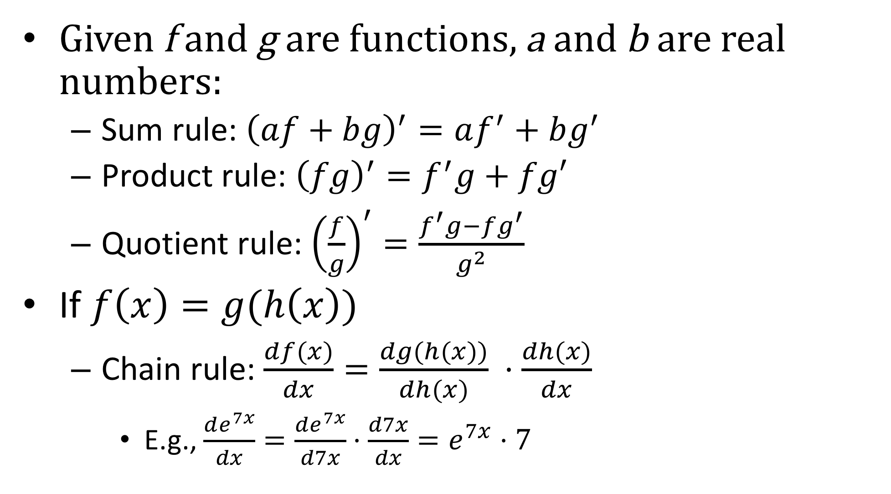
Combined function and chain rule
Given f and g are functions, a and b are real numbers:
Sum rule: ${\left(af+bg\right)}^{′}=af^{′}+bg^{′}$
Product rule: ${\left(fg\right)}^{′}=f^{′}g+fg′$
Quotient rule: ${\left(\frac{f}{g}\right)}^{′}=\frac{f^{′}g−fg^{′}}{g^{2}}$
If $f\left(x\right)=g(h\left(x\right))$
Chain rule: $\frac{df(x)}{dx}=\frac{dg(h(x))}{dh(x)} ⋅\frac{dh(x)}{dx}$
E.g., $\frac{de^{7x}}{dx}=\frac{de^{7x}}{d7x}⋅\frac{d7x}{dx}=e^{7x}⋅7$

Slide 7
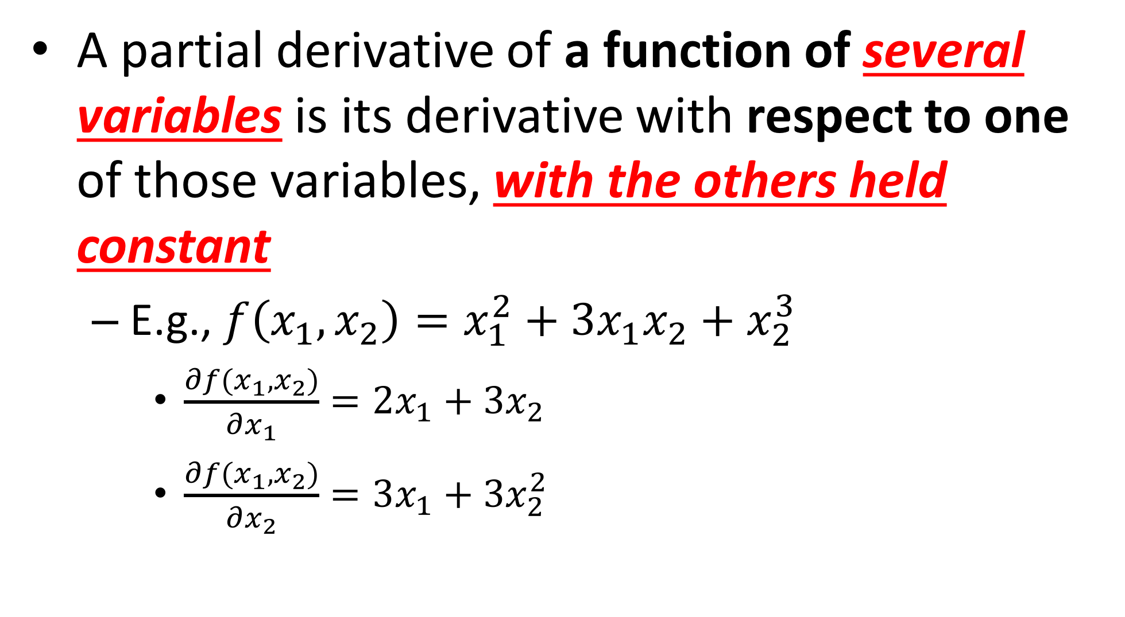
Partial derivative (scalar)
A partial derivative of a function of several variables is its derivative with respect to one of those variables, with the others held constant
E.g., $f\left(x_{1},x_{2}\right)=x_{1}^{2}+3x_{1}x_{2}+x_{2}^{3}$
$\frac{∂f(x_{1},x_{2})}{∂x_{1}}=2x_{1}+3x_{2}$
$\frac{∂f(x_{1},x_{2})}{∂x_{2}}=3x_{1}+3x_{2}^{2}$

Slide 8
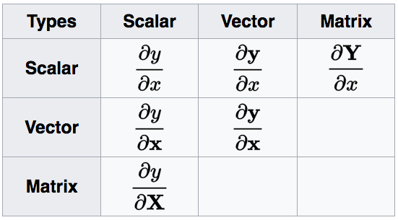
Types of matrix derivatives
The three types of derivatives that have not been considered are not as widely considered and a notation is not widely agreed upon

Slide 9
Layout conventions
There are mainly two types of layout conventions in matrix calculus
Numerator Layout Notation
Denominator Layout Notation
Most books and papers don’t state which convention they use
Even worse, sometimes the two conventions are mixed in the equations
This confuses the beginners
We will mostly follow the Numerator Layout Notation unless otherwise mentioned

Slide 10
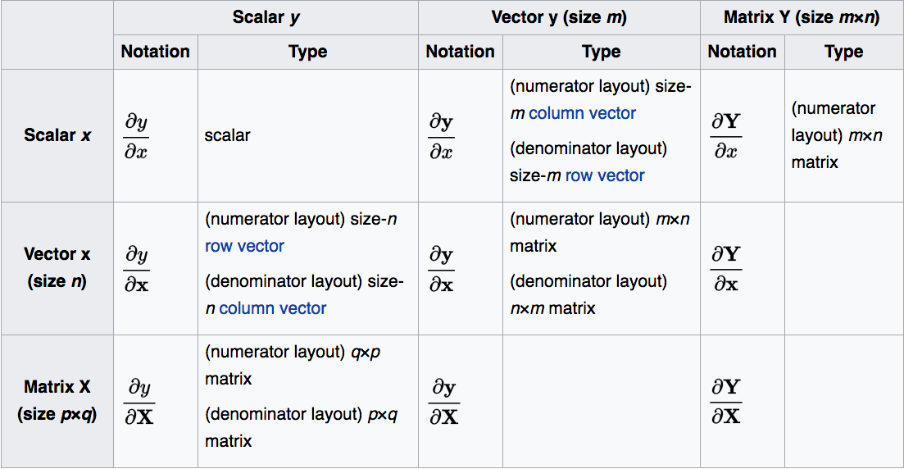
Types of matrix derivatives of different layout conventions

Slide 11

Derivative by scalar
$\frac{∂y}{∂x}$
$\frac{∂y}{∂x}=\left[\begin{aligned}\frac{∂y_{1}}{∂x} \\ ⋮ \\ \frac{∂y_{m}}{∂x}\end{aligned}\right]$
$\frac{∂Y}{∂x}=\left[\begin{matrix}\frac{∂y_{11}}{∂x} & ⋯ & \frac{∂y_{1n}}{∂x} \\ ⋮ & ⋱ & ⋮ \\ \frac{∂y_{m1}}{∂x} & ⋯ & \frac{∂y_{mn}}{∂x}\end{matrix}\right]$

Slide 12

Derivative by vector
$\frac{∂y}{∂x}=\left[\begin{matrix}\frac{∂y}{ ∂x_{1}} & … & \frac{∂y}{ ∂x_{n}}\end{matrix}\right]$
$\frac{∂y}{∂x}=\left[\begin{matrix}\frac{∂y_{1}}{∂x_{1}} & ⋯ & \frac{∂y_{1}}{∂x_{n}} \\ ⋮ & ⋱ & ⋮ \\ \frac{∂y_{m}}{∂x_{1}} & ⋯ & \frac{∂y_{m}}{∂x_{n}}\end{matrix}\right]$

Slide 13

Derivative by matrix
$\frac{∂y}{∂X}=\left[\begin{matrix}\frac{∂y}{∂x_{11}} & ⋯ & \frac{∂y}{∂x_{m1}} \\ ⋮ & ⋱ & ⋮ \\ \frac{∂y}{∂x_{1n}} & ⋯ & \frac{∂y}{∂x_{mn}}\end{matrix}\right]$

Slide 14
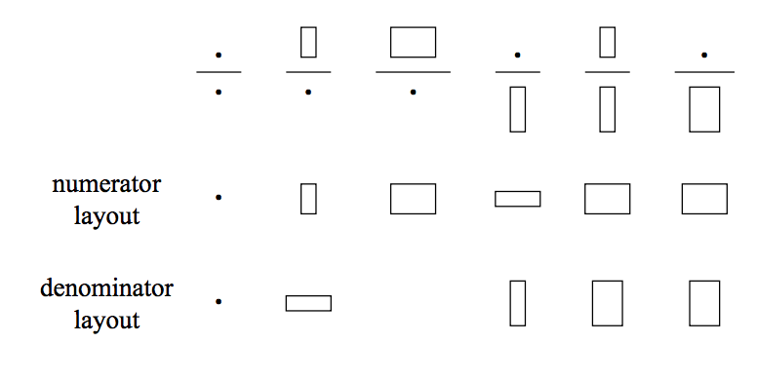
Pictorial representation

Slide 15
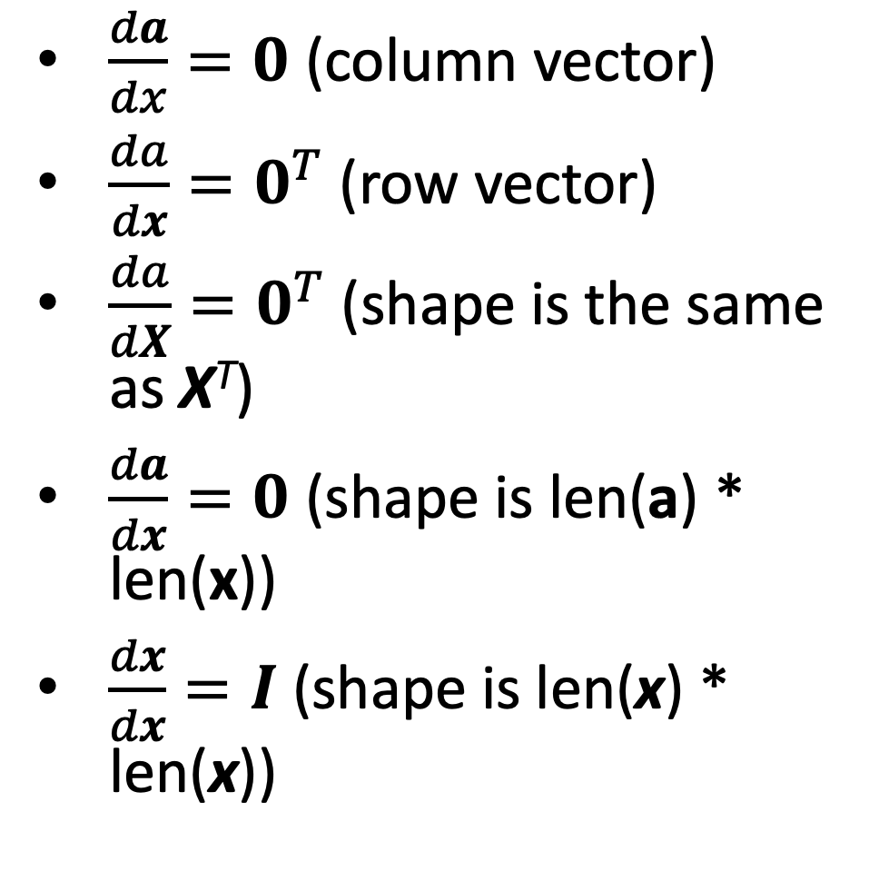
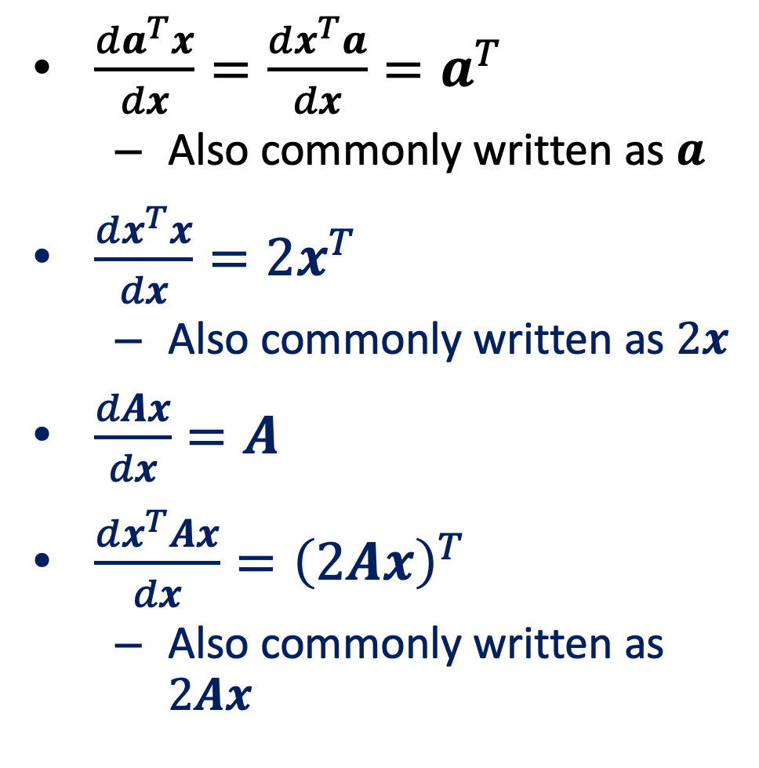
Commonly used derivatives
Scalar a, vector a, and matrix A are not functions of x, x, and X
$\frac{da}{dx}=0$ (column vector)
$\frac{da}{dx}=0^{T}$ (row vector)
$\frac{da}{dX}=0^{T}$ (shape is the same as X^{T})
$\frac{da}{dx}=0$ (shape is len(a) * len(x))
$\frac{dx}{dx}=I$ (shape is len(x) * len(x))
$\frac{da^{T}x}{dx}=\frac{dx^{T}a}{dx}=a^{T}$
Also commonly written as $a$
$\frac{dx^{T}x}{dx}=2x^{T}$
Also commonly written as $2x$
$\frac{dAx}{dx}=A$
$\frac{dx^{T}Ax}{dx}={\left(2Ax\right)}^{T}$
Also commonly written as $2Ax$

Slide 16

Exercise
$\frac{d{\left(x^{T}a\right)}^{2}}{dx}=?$
$\frac{d{\left(x^{T}a\right)}^{2}}{dx}=\frac{d{\left(x^{T}a\right)}^{2}}{d(x^{T}a)}⋅\frac{d\left(x^{T}a\right)}{dx}=\left(2x^{T}a\right)a^{T}$

Slide 17
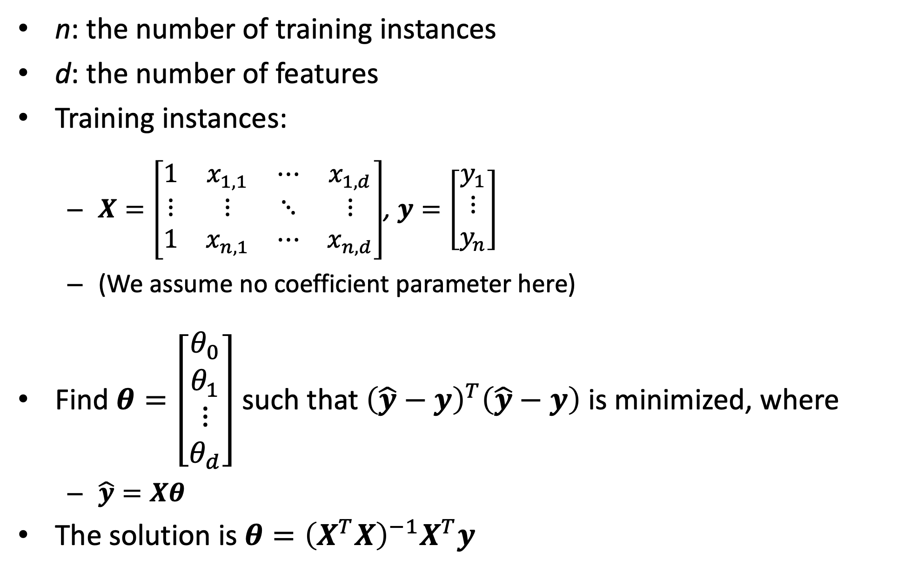
Multiple linear regression
n: the number of training instances
d: the number of features
Training instances:
$X=\left[\begin{matrix}1 & x_{1,1} & ⋯ & x_{1,d} \\ ⋮ & ⋮ & ⋱ & ⋮ \\ 1 & x_{n,1} & ⋯ & x_{n,d}\end{matrix}\right]$, $y=\left[\begin{matrix}y_{1} \\ ⋮ \\ y_{n}\end{matrix}\right]$
(We assume no coefficient parameter here)
Find $θ=\left[\begin{matrix}\begin{aligned}θ_{0} \\ θ_{1}\end{aligned} \\ ⋮ \\ θ_{d}\end{matrix}\right]$ such that ${\left(\hat{y}−y\right)}^{T}\left(\hat{y}−y\right)$ is minimized, where
$\hat{y}=Xθ$
The solution is $θ={\left(X^{T}X\right)}^{−1}X^{T}y$

Slide 18
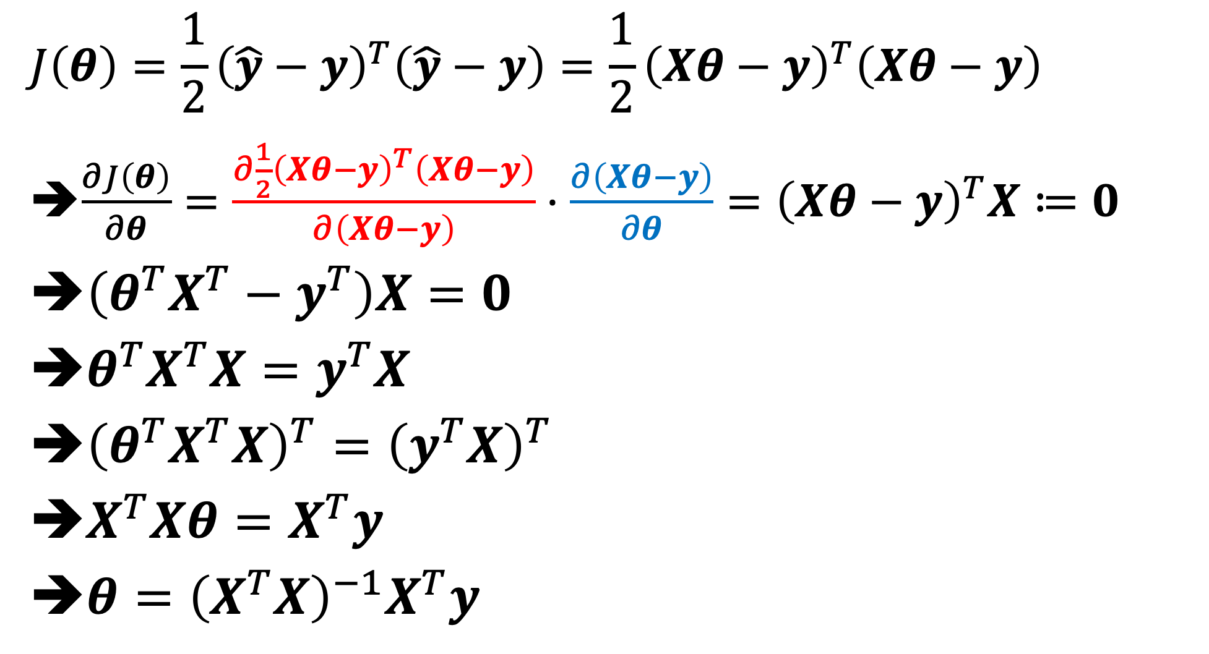


Solving $θ$
$$J\left(θ\right)=\frac{1}{2}{\left(\hat{y}−y\right)}^{T}\left(\hat{y}−y\right)=\frac{1}{2}{\left(Xθ−y\right)}^{T}\left(Xθ−y\right)$$
$\frac{∂J\left(θ\right)}{∂θ}=\frac{∂\frac{1}{2}{\left(Xθ−y\right)}^{T}\left(Xθ−y\right)}{∂\left(Xθ−y\right)}⋅\frac{∂\left(Xθ−y\right)}{∂θ}={\left(Xθ−y\right)}^{T}X≔0$
$\left(θ^{T}X^{T}−y^{T}\right)X=0$
$θ^{T}X^{T}X=y^{T}X$
${\left(θ^{T}X^{T}X\right)}^{T}={\left(y^{T}X\right)}^{T}$
$X^{T}Xθ=X^{T}y$
$θ={\left(X^{T}X\right)}^{−1}X^{T}y$
Note:
$\frac{dx^{T}x}{dx}=2x^{T}$
$\frac{dAx}{dx}=A$

Slide 19
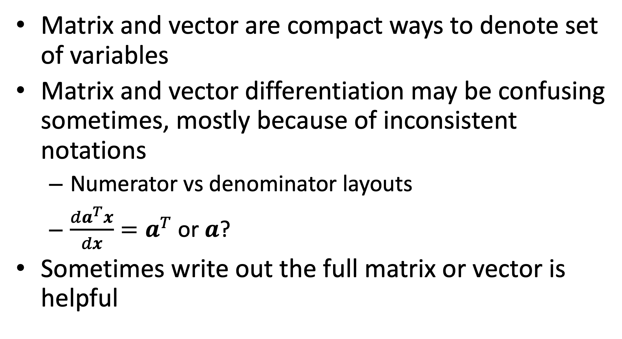
Summary
Matrix and vector are compact ways to denote set of variables
Matrix and vector differentiation may be confusing sometimes, mostly because of inconsistent notations
Numerator vs denominator layouts
$\frac{da^{T}x}{dx}=a^{T}$ or $a$?
Sometimes write out the full matrix or vector is helpful

Slide 20
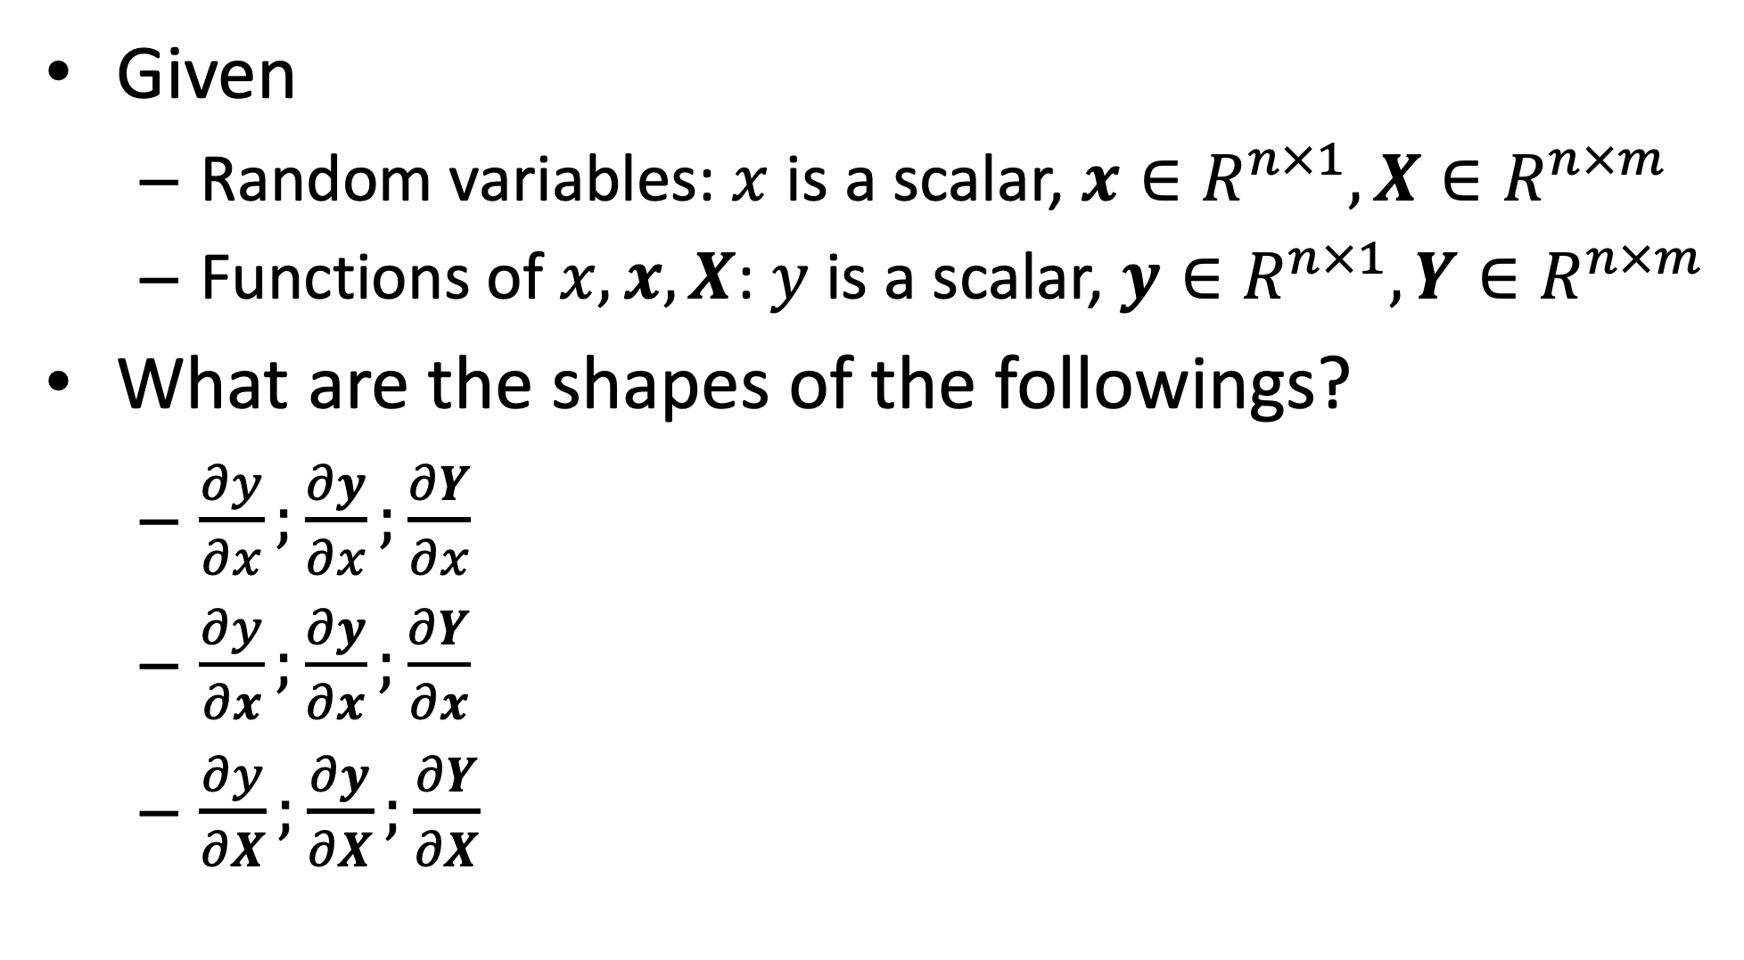
Quiz
Given
Random variables: $x$ is a scalar, $x∈R^{n×1},X∈R^{n×m}$
Functions of $x, x, X$: $y$ is a scalar, $y∈R^{n×1},Y∈R^{n×m}$
What are the shapes of the followings?
$\frac{∂y}{∂x};\frac{∂y}{∂x};\frac{∂Y}{∂x}$
$\frac{∂y}{∂x};\frac{∂y}{∂x};\frac{∂Y}{∂x}$
$\frac{∂y}{∂X};\frac{∂y}{∂X};\frac{∂Y}{∂X}$

