Slide 1
Python Tutorial
This tutorial is very simple.
If you want to learn more about python, please Google by yourself.

Slide 2
Outline
Version
Download and Install
Built-in Data Types
IDE or editor
Package

Slide 3
Version
Python 3.0 was released in 2008.
Its newest version 3.10, which was released in 2021
https://docs.python.org/3/whatsnew/

Slide 4
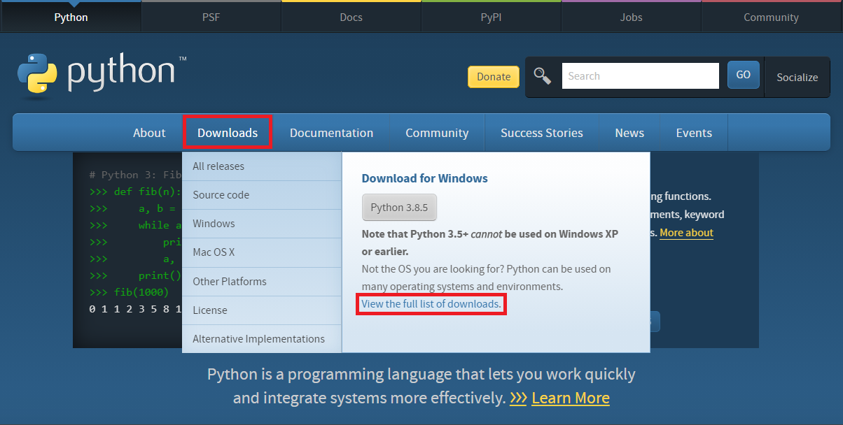
Download – Step 1.
https://www.python.org/

Slide 5
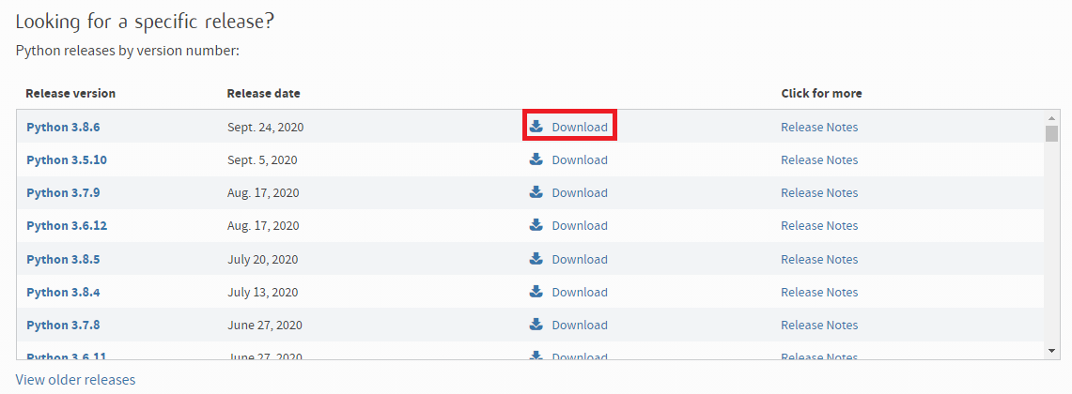
Download – Step 2.

Slide 6
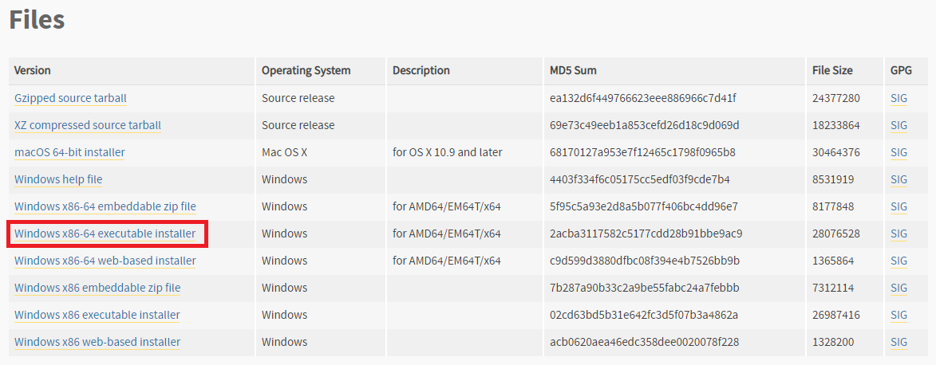
Download – Step 3. Roll to the bottom of web
If you use Windows 64 bit, we recommend this installer.

Slide 7
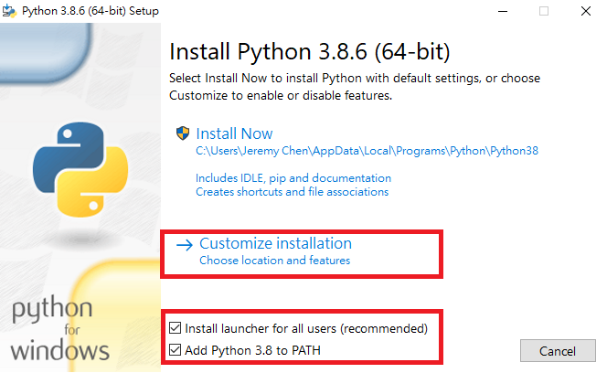
Install
We recommend choosing customize installation
Install launcher for all user
Add Python 3.8 to PATH

Slide 8
IDE or Editor
VS code
You can install the Python extension.
Jupyter notebook
Anaconda
Anaconda is the standard platform for Python data science, it include many tools, e.g. Jupyter notebook, spyder

Slide 9
Built-in Data Types
Python has the following data types built-in by default, in these categories:
Text Type : str
Numeric Types : int, float, complex
Sequence Types: list, tuple, range
Mapping Type : dict
Set Types : set, frozenset
Boolean Type : bool
Binary Types : bytes, bytearray, memoryview
https://www.w3schools.com/python/python_datatypes.asp

Slide 10
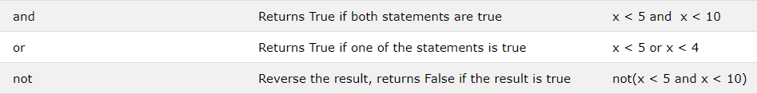
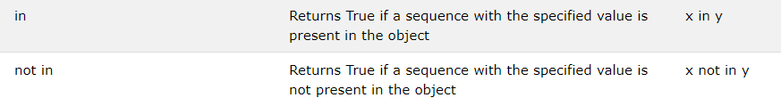
Operators
Python operators were like most of the programming language
Apart from a few operators
https://www.w3schools.com/python/python_operators.asp
Notes:
* Asterisk
/ slash
() parentheses

Slide 11
Python Package for Data analysis
Numpy
support for large, multi-dimensional arrays and matrices, along with a large collection of high-level mathematical functions to operate on these arrays
Scipy
used for scientific computing and technical computing
Scikit-learn
Simple and efficient tools for data mining and data analysis
Pandas
providing high-performance, easy-to-use data structures and data analysis tool
Matplotlib
Python 2D plotting library

Slide 12
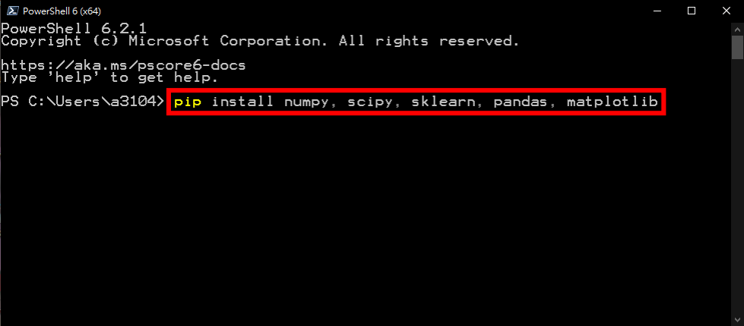
Install package
Use command line to install python package.
Remember to run as administrator.

Slide 13
Learning Resources
Python Tutorial
https://www.w3schools.com/python/default.asp
Numpy
https://docs.scipy.org/doc/numpy/user/quickstart.html
Scikit-learn
https://scikit-learn.org/stable/
Pandas
https://pandas.pydata.org/docs/user_guide/10min.html

Slide 14
The end
Thank you for your attention.

