Slide 1
Review quizzes
What is L2-norm?
What is L1-norm?
What are cosine similarity and cosine distance?
What is entropy?
What is the main difference between information gain and gain ratio?

Slide 2
Two different gini-indices
Decision tree
$Gini\left(D\right)=1−\sum_{i=1}^{m}{p_{i}^{2}}$
Income inequality
Gini-index = A/(A+B)

Slide 3
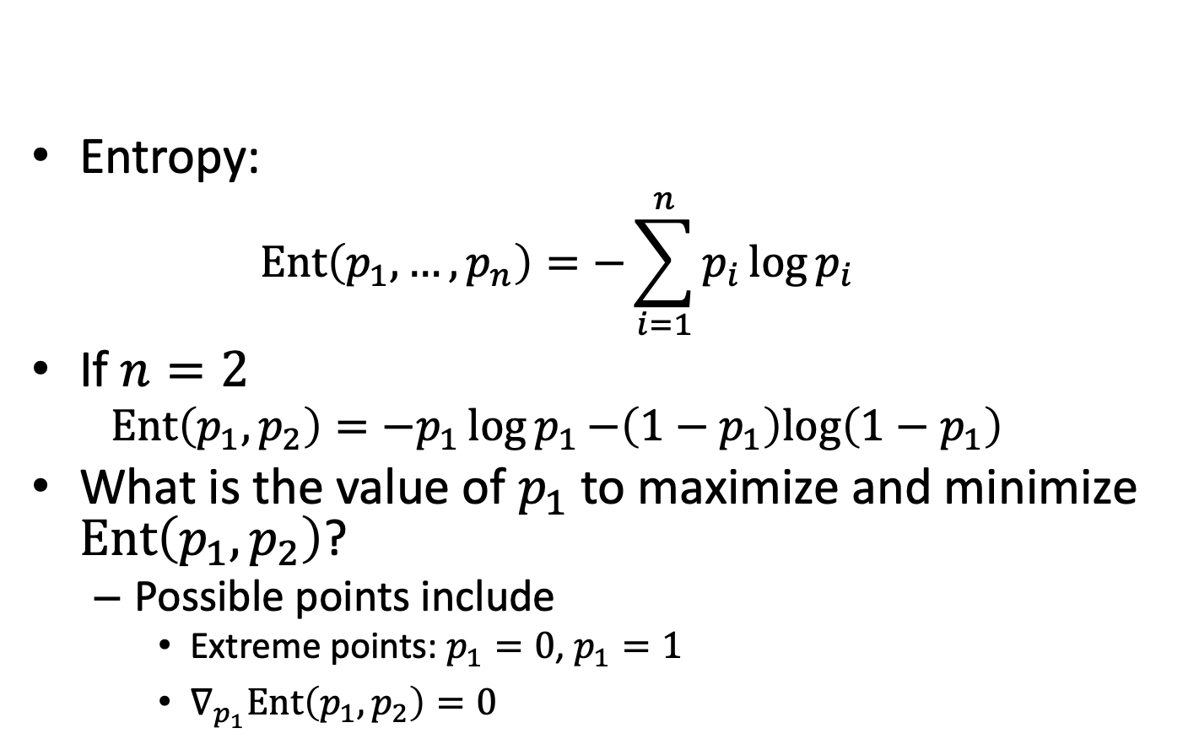
When $p_{i}$’s give maximum entropy and minimum entropy? (1/3)
Entropy:
$$Ent\left(p_{1},…,p_{n}\right)=−\sum_{i=1}^{n}{p_{i}\log{p_{i}}}$$
If $n=2$
$$Ent\left(p_{1},p_{2}\right)=−p_{1}\log{p_{1}−\left(1−p_{1}\right)log\left(1−p_{1}\right)}$$
What is the value of $p_{1}$ to maximize and minimize $Ent\left(p_{1},p_{2}\right)$?
Possible points include
Extreme points: $p_{1}=0$, $p_{1}=1$
$∇_{p_{1}}Ent\left(p_{1},p_{2}\right)=0$

Slide 4
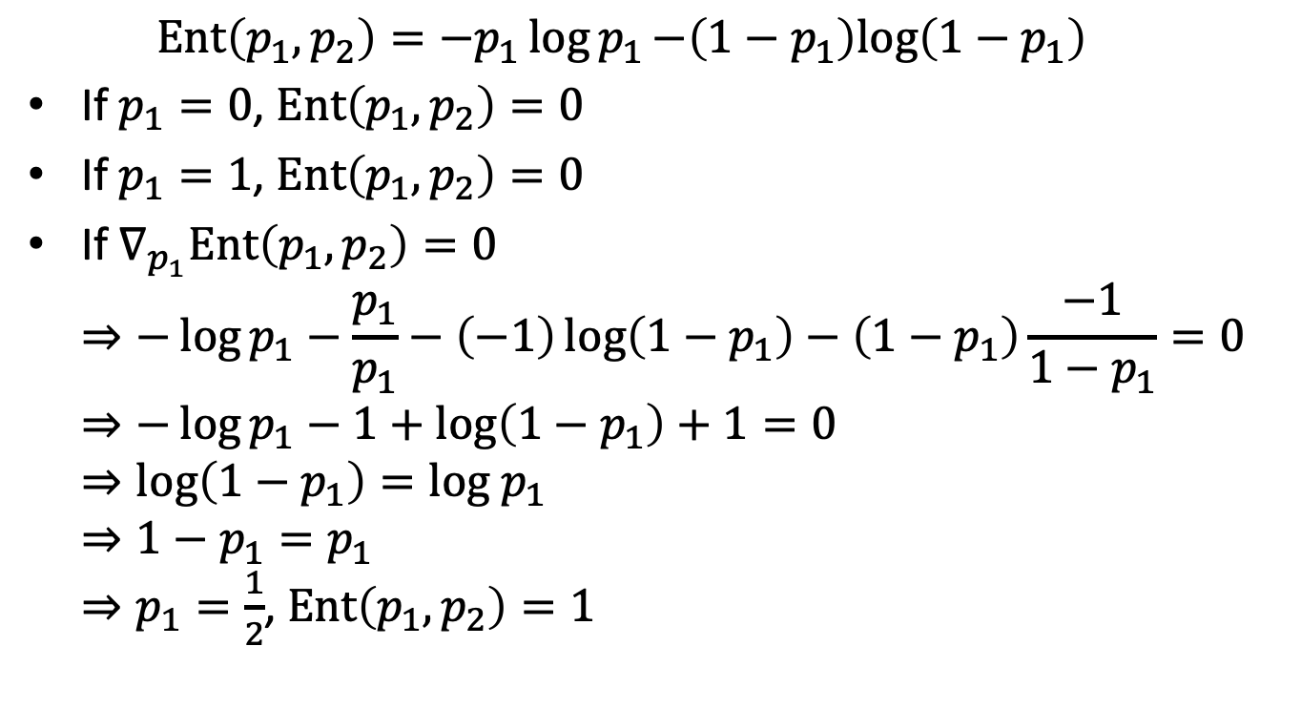
When $p_{i}$’s give maximum entropy and minimum entropy? (2/3)
$$Ent\left(p_{1},p_{2}\right)=−p_{1}\log{p_{1}−\left(1−p_{1}\right)log\left(1−p_{1}\right)}$$
If $p_{1}=0$, $Ent\left(p_{1},p_{2}\right)=0$
If $p_{1}=1$, $Ent\left(p_{1},p_{2}\right)=0$
If $∇_{p_{1}}Ent\left(p_{1},p_{2}\right)=0$ $⇒−\log{p_{1}}−\frac{p_{1}}{p_{1}}−\left(−1\right)\log\left(1−p_{1}\right)−\left(1−p_{1}\right)\frac{−1}{1−p_{1}}=0$ $⇒−\log{p_{1}}−1+\log\left(1−p_{1}\right)+1=0$ $⇒\log\left(1−p_{1}\right)=log p_{1}$ $⇒1−p_{1}=p_{1}$ $⇒p_{1}=\frac{1}{2}$, $Ent\left(p_{1},p_{2}\right)=1$

Slide 5
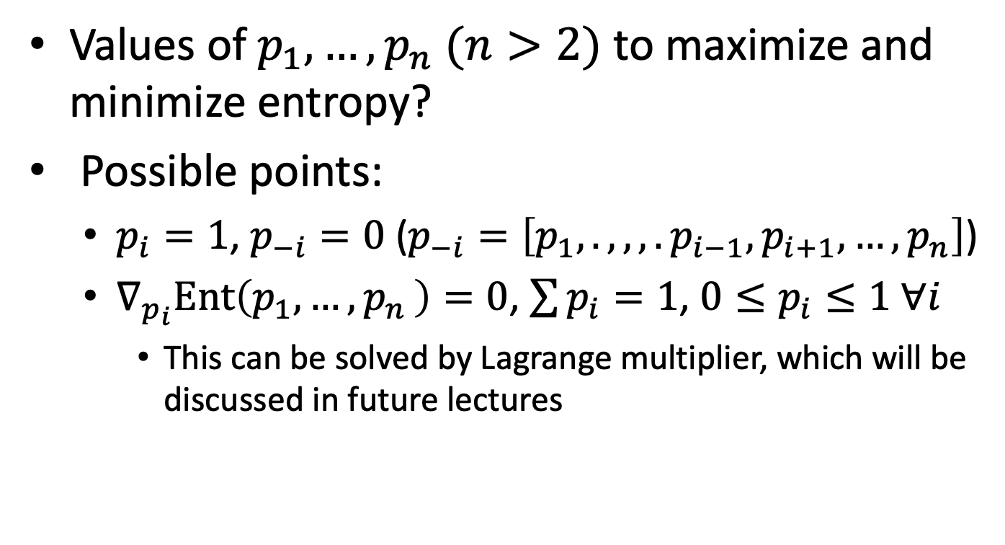
When $p_{i}$’s give maximum entropy and minimum entropy? (3/3)
Values of $p_{1},…,p_{n} (n>2)$ to maximize and minimize entropy?
Possible points:
$p_{i}=1$, $p_{−i}=0$ ($p_{−i}=\left[p_{1},.,,,.p_{i−1},p_{i+1},…,p_{n}\right]$)
$∇_{p_{i}}Ent\left(p_{1},{…,p}_{n}\right)=0$, $\sum{p_{i}}=1$, ${0≤p}_{i}≤1 ∀i$
This can be solved by Lagrange multiplier, which will be discussed in future lectures

Slide 6
Exercise 2
Requirement
Coding (90%)
Implement a decision tree classifier and tree pruning using Python.
You **cannot** use existing decision tree libraries (e.g., sklearn.tree.DecisionTreeClassifier)
Use your classifier to predict the given dataset
A brief discussion of the results. (10%)
Please submit your code and report to new ee-class
Due date: 10/25 23:59:59 (the midnight between Monday and Tuesday)

