Slide 1
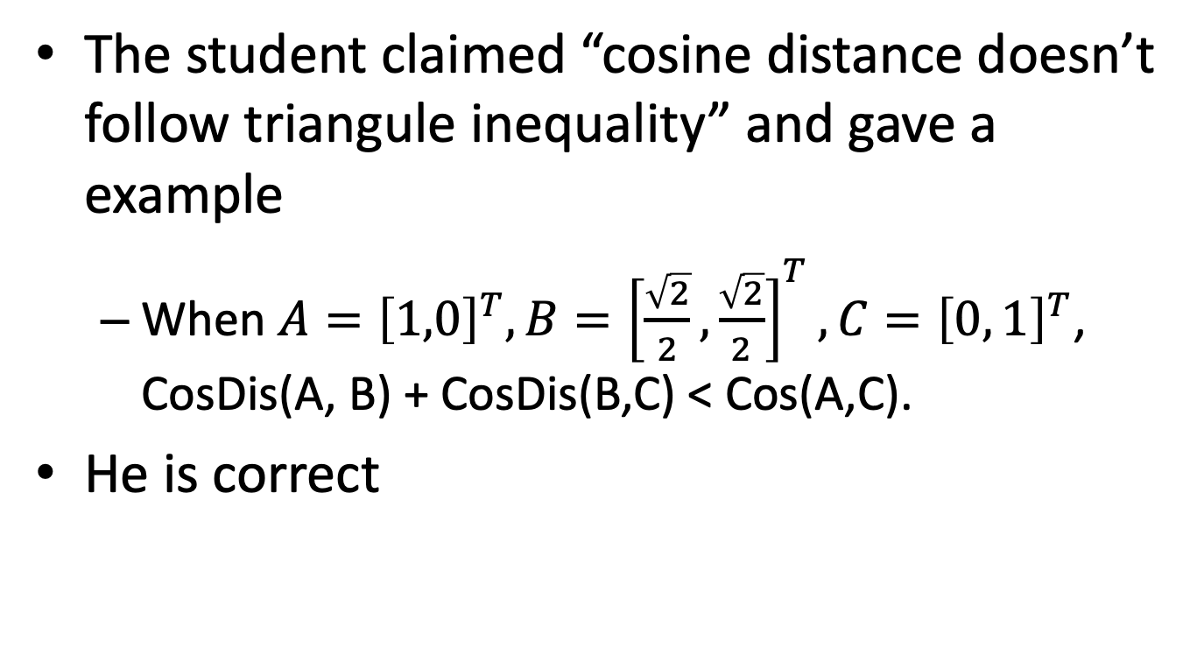
A question from a student (朱訓威)
The student claimed “cosine distance doesn’t follow triangule inequality” and gave a example
When $A={\left[1,0\right]}^{T},B={\left[\frac{\sqrt{2}}{2},\frac{\sqrt{2}}{2}\right]}^{T}, C={\left[0, 1\right]}^{T}$, CosDis(A, B) + CosDis(B,C) < Cos(A,C).
He is correct

Slide 2
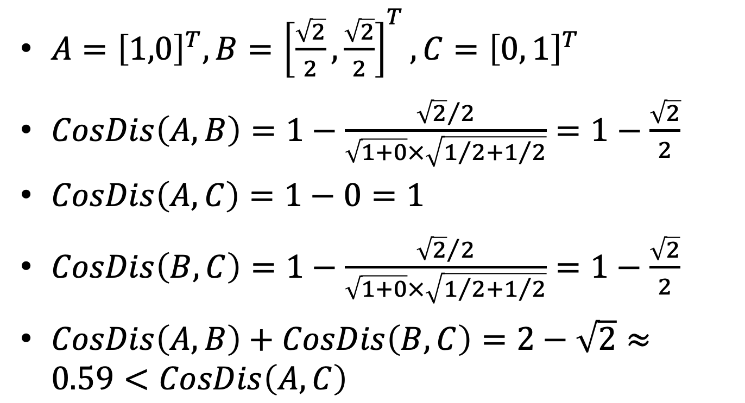
$A={\left[1,0\right]}^{T},B={\left[\frac{\sqrt{2}}{2},\frac{\sqrt{2}}{2}\right]}^{T}, C={\left[0, 1\right]}^{T}$
$CosDis\left(A,B\right)=1−\frac{{\sqrt{2}}/2}{\sqrt{1+0}×\sqrt{1/2+1/2}}=1−\frac{\sqrt{2}}{2}$
$CosDis\left(A,C\right)=1−0=1$
$CosDis\left(B,C\right)=1−\frac{{\sqrt{2}}/2}{\sqrt{1+0}×\sqrt{1/2+1/2}}=1−\frac{\sqrt{2}}{2}$
$CosDis\left(A,B\right)+CosDis\left(B,C\right)=2−\sqrt{2}≈0.59<CosDis\left(A,C\right)$

Slide 3
Two different gini-indices
Decision tree
$Gini\left(D\right)=1−\sum_{i=1}^{m}{p_{i}^{2}}$
Income inequality
Gini-index = A/(A+B)

Slide 4
Review quizzes
What is “entropy” in decision tree classifier?
Explain random forest algorithm

